Slide 1
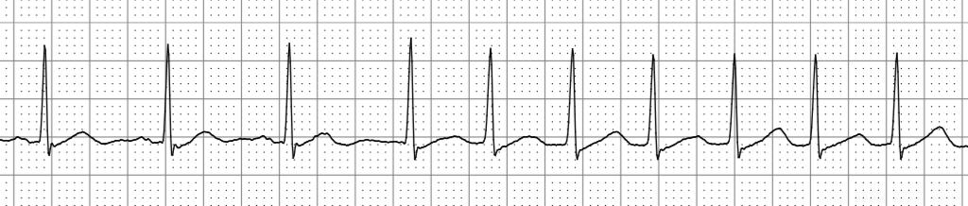

Associations of demographic, clinical and cardiac MRI characteristics with supraventricular ectopy: the Multi-Ethnic Study of Atherosclerosis

Slide 2
Writing group:
Susan R. Heckbert
Paul N. Jensen
Colleen Sitlani
Thomas R. Austin
James S. Floyd
Elsayed Z. Soliman
Nona Sotoodehnia
Richard A. Kronmal
Joao A.C. Lima
Bharath Ambale Venkatesh

Slide 3
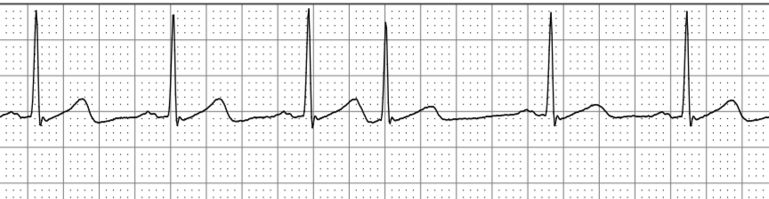
Supraventricular ectopy
Premature atrial contractions (PACs)
Runs of supraventricular tachycardia (SVT)
Notes:
Supraventricular ectopy (SVE)includes both PACs and runs of SVT; these are quantified on Zio Patch as total PAC count and total count of runs of SVT, during the monitored period

Slide 4
Supraventricular ectopy
Common
Increased prevalence with age
Generally considered benign
BUT
Associated with AF, stroke, and death in
  Patients with implanted pacemakers
  Patients with recent cryptogenic stroke/TIA
  Population based cohort studies
Notes:
CHS and Copenhagen Heart Study

Slide 5
Atrial fibrillation
Established risk factors for AF
  advanced age
  male sex / taller height
  hypertension
  diabetes / obesity
  white race/ethnicity, relative to
    African American
    Hispanic
    Asian
    Yet AA have greater prevalence of hypertension & diabetes and higher stroke incidence
Notes:
CHS and Copenhagen Heart Study

Slide 6
Background
Frequent SVE and AF may both be manifestations of underlying atrial pathophysiology
Frequent SVE, like AF, may be a clinically relevant predictor of stroke risk
Long-term monitoring needed to quantify SVE
Little is known about SVE in race/ethnic groups other than whites
Little information about cardiac structure and function in relation to SVE

Slide 7
Research questions
How are demographic and clinical characteristics at Exam 5 related to the extent of SVE on long-term monitoring 6 years later (Exam 6)?
How are L atrial and ventricular structure and function, measured by Exam 5 MRI, related to extent of SVE about 6 years later (Exam 6)?

Slide 8
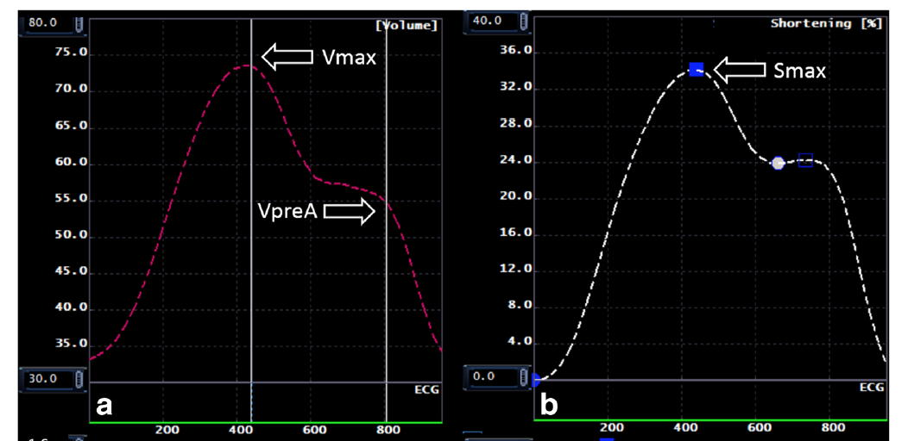
L atrial volume and longitudinal strain
LA maximum volume, LA minimum volume
LA peak longitudinal strain
LA total EF, passive EF, active EF
LV mass, LV end diastolic volume
Zareian. J CV Magn Res 2015;17:52
Notes:
by Multimodality Tissue Tracking; this figure shows LA volume and longitudinal strain over time during one cardiac cycle
Y axis is % wall shortening for longitudinal strain

Slide 9
Outcome: PACs
Use data from two monitors if available; from one monitor otherwise
Measured as cumulative PAC count during monitoring
  Calculated average PACs/hour

Slide 10
Statistical analysis
Analysis of count data: generalized linear models, Poisson distribution, robust standard errors clustered by person to account for repeated measures, offset to account for variable monitoring duration
Notes:
Narrowed the sample at e5 to a reference sample: those with no prior hx of AF, MI, or HF, with no htn and no diabetes and with BMI between18.5-30
Develop equation, separately for men and women, that expresses how LA and LV volumes and LV mass are related to body size.

Slide 11
Statistical analysis
Analysis of e5 cardiac MRI characteristics
  LA max and min volumes, LV end-diast volume, LV mass
  Use of conventional indices for LV mass and volume do not fully remove their correlation with weight and height
  Allometric approach
    In a reference sample at e5: no htn, IFG, DM, obesity, AF, MI, HF
    Regress log(LA max volume) on log(height), log(weight), and sex
    Yields a LA max volume indexed for height, weight, and sex
    Indexed LA max volume of 110 is an LA volume 10% greater than predicted for height, weight, and sex
Bluemke JACC 2008;25:2148; Brumback Int J Cardiovasc Imaging 2010;26:459
Notes:
Defined a reference sample among those with MRI at e5: those with no htn, no diabetes, no IFG, and with BMI between 18.5-30 and no prior hx of AF, MI, or HF. Develop regression models, by regressing log of each MRI measure on log(height), log(weight) and sex. Yields the body-size adjusted MRI measure. So if the LA max volume index is 110, that would be interpreted as an LA volume 10% greater than predicted for weight, height, and sex e.

Slide 12
Results: Study population
MESA participants with Exam 6 rhythm monitoring
  N=1,324 as of January 2018
  Excluded if <2 days analyzable rhythm (n=27)
  Excluded if any AF/flutter on the monitor (n=86)
  N= 1,211 included in analysis
For analysis of cardiac MRI characteristics
  Had cardiac MRI at Exam 5
  N=1,033
Notes:
Of total in Jan 2018 dataset, 128 (10.5%) with prior hx of AF (dx or self-report); 244 (20.1%) in high risk groups (top 3 deciles of estimated risk), 839 (69.3%) remainder

Slide 13
Monitoring and participant characteristics
N= 1,211 participants included
  42% wore two patches
  median wear time per patch = 13.9 (IQR 12.9-14.0) days
  median analyzable time per patch = 13.7 (IQR 12.2 – 14.0) days
  Race/ethnicity:
    white 41%
    Chinese 14%
    AA 24%
    Hispanic 21%
  6% with history of clinically-recognized AF but no AF on patch

Slide 14
Average PACs/hr

Slide 15
Distribution of Average PACs/hr (n=1,211)
Only 1 participant had zero PACs
Notes:
Right histogram zooms in on the leftmost part of the distribution, where most of the ppts are. Red bars show where we set the cutpoints for the four categories of PACs/hour, for descriptive table (next slide)

Slide 16
Demographic & Clinical Characteristics by Average PACs/hr
 | <1 PAC/hr n = 249 | 1– 9.9 PAC/hr n = 561 | 10 – 49.9 PAC/hr n = 257 | ≥ 50 PAC/hr n = 144
Age at e6, yr | 69 (7) | 73 (8) | 77 (8) | 77 (8)
Male, % | 39 | 48 | 52 | 63
Race/Ethnicity, % White Chinese AA Hispanic | 27 20 27 27 | 45 14 21 20 | 45 13 21 21 | 48 6 35 11
BMI, kg/m² | 29 (5) | 28 (5) | 28 (6) | 29 (5)
Diabetes, % | 18 | 17 | 16 | 21
Current smoking, % | 9 | 8 | 4 | 8
Treated HTN, % | 43 | 46 | 57 | 54
Systolic BP, mmHg | 118 (17) | 120 (19) | 124 (22) | 125 (20)
e5 NT-proBNP, pg/ml | 65 (89) | 98 (136) | 136 (135) | 143 (241)
History clinical AF, % | 2 | 4 | 8 | 14
eGFR (mL/min/1.73 m²) | 87 (19) | 82 (20) | 79 (21) | 81 (18)
Notes:
NOTE THAT ALL CHARACS EXC AGE COME FROM EXAM 5.

Slide 17
Multivariable association of demographic characteristics with PACs/hr
 | IRR | 95% CI
Age, per 10 yr | 1.57 | 1.33 - 1.86
Male vs. female | 1.60 | 1.15 - 2.22
Race/ethnicity White Chinese African American Hispanic | Reference 0.66 1.32 0.68 | 0.36 - 1.20 0.91 - 1.92 0.41 - 1.15
Greater age and male sex are associated with more PACs/hr; results were similar for AAs and whites
Notes:
IRR of 1.60 (for male vs female) means male sex was associated on average with a 60% greater count of PACs/hr.

Slide 18
Multivariable associations with PAC count
 | IRR* | 95% CI
Age, per 10 yr | 1.56 | 1.27 - 1.90
Male vs. female | 1.62 | 1.16 - 2.27
Race/ethnicity (white=ref) Chinese African American Hispanic | 0.65 1.13 0.60 | 0.34 - 12.5 0.76 - 1.67 0.35 - 1.03
BMI, per 5 kg/m² | 1.12 | 0.95 - 1.33
Diabetes | 1.07 | 0.68 - 1.68
Current smoking | 1.53 | 0.79 - 2.97
Treated hypertension | 0.85 | 0.62 - 1.17
Systolic BP, per 10 mmHg | 1.15 | 1.04 - 1.26
e5 NT-proBNP, per 150 pg/ml | 1.02 | 0.91 - 1.15
History of AF | 1.70 | 1.01 - 2.87
eGFR, per 20 (mL/min/1.73 m²) | 1.11 | 0.98 - 1.26

Slide 19
e5 Cardiac MRI Measures by e6 Average PACs/hr
 | <1 PAC/hr n = 187 | 1– 9.9 PAC/hr n = 449 | 10 – 49.9 PAC/hr n = 206 | ≥ 50 PAC/hr n = 107
LA max volume (ml) | 59 (17) | 62 (21) | 66 (20) | 68 (20)
LA min volume (ml) | 25 (10) | 27 (13) | 31 (13) | 34 (14)
LA strain (%) | 35 (13) | 34 (14) | 32 (14) | 30 (14)
LA total EF (%) | 59 (9) | 58 (10) | 54 (11) | 51 (11)
LA passive EF (%) | 27 (8) | 25 (8) | 23 (8) | 21 (7)
LA active EF (%) | 44 (10) | 44 (11) | 41 (11) | 40 (10)
LV mass (g) | 115 (26) | 122 (35) | 125 (34) | 134 (37)
LV volume (ml) | 114 (26) | 121 (30) | 122 (33) | 124 (28)

Slide 20
Adjusted associations of MRI characteristics with PACs/hr
each line is a separate model
 | Model 1
 | IRR | 95% CI
LA max volume,*per 25% | 1.15 | 0.99 - 1.35
LA min volume,*per 25% | 1.10 | 1.01 - 1.19
LA max longitudinal strain (%) | 0.85 | 0.73 - 0.99
LA total EF, per 10% | 0.80 | 0.66 - 0.99
LA passive EF, per 10% | 0.83 | 0.62 - 1.11
LA active EF, per 10% | 0.84 | 0.69 - 1.02
LV mass,* per 25% | 1.35 | 1.01 - 1.82
LV volume,* per 25% | 0.97 | 0.74 - 1.27
* indexed on height and weight, by sex
Model 1: adj for age and race
Notes:
For indexed measures, 25% is approx. one SD. For LA EFs, 10% is approx. one SD

Slide 21
Additional analyses
Exclude top 5% of PACs/hour
  Associations with age and sex unchanged
  Associations with SBP and history of AF attenuated
  Associations with MRI LA volumes and function attenuated
Examine associations of MRI measures in people with very high PAC count compared with “typical” PAC count
For continuous predictor variables, examine nonlinear associations with PAC count
Examine runs of SVT

Slide 22
Summary of findings
Unlike AF prevalence and incidence, PACs/hr similar in AA and white ppts
Older age, male sex associated with more PACs/hr
When examined across the entire distribution of PACs/hr --
  SBP and history of AF associated with more PACs/hr
  Large LA, impaired LA function, high LV mass tend to be associated with more PACs/hr
  Likely these associations are driven by findings in ppts with very high PAC counts

Slide 23
Conclusions
PAC count from long-term recording may be a useful noninvasive measure of left atrial myopathy
Whether PAC count associated with risk of developing AF, stroke, cognitive decline requires more study

Slide 24
Thanks to PIs, FC staff, MESA participants!

