Slide 1
Ancillary Study Update: MESA Memory
Timothy Hughes, MPH, PhD

Slide 2
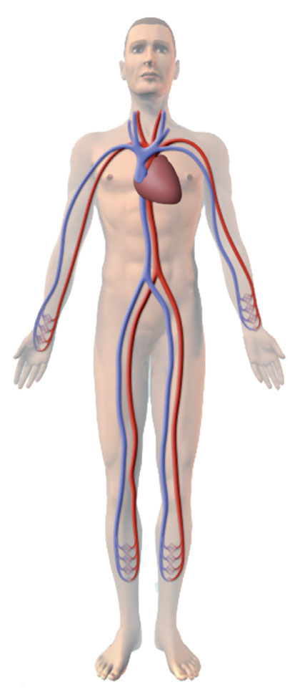
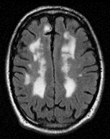
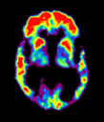
MESA Memory (n=540, WFU only)
Goal - Determine how (micro- vs. macro-) vascular risk factors relate to dementia pathology and AD risk.
Repeated Cognition
CASI, DSC and DS
UDS v3 (used by all NIH-funded AD Centers)
Physical exam by clinician
Cognitive adjudication (normal, MCI, dementia subtypes)
Repeated Brain MRI
β-amyloid PET imaging
Optional LP substudy (n=200, 40%)
Funded: R01 AG054069 (Hughes) P30 AG049638 (Craft)
Exams 1-6
Exam 6
Exam 7
Cog
MRI
PET
Cog
MRI
2016 2017 2018 2019 2020 2021

Slide 3
Recruitment Waves / Study Flow
MESA Memory Only (completed by May 2018?)
*
Overlap AFib (completed by Jan 2019)
Phase 1
Cognitive Adjudication
Phase 2
Cognitive Adjudication
*

Slide 4
Progress in Exam 6
Table. MESA Memory – Completion of Components
Consented Exam 6 | Cognitive Testing (UDS) |  | Brain MRI |  | Aβ-PET |  | Optional LP
 | n | % | n | % | n | % | n | %
AFIB (n=250) | 180 | 72%
Completed | 4 | 1% | 2 | 50% | -- |  | 1 | 50%
Memory (n=300) | 146 | 49%
Completed | 146 | 100% | 110 | 75% | 74 | 50% | 8 | 47%
Total / Target | 328 | 60% | 111 | 21% | 74 | 14% | 9 | 5%
Total Consented | 326 | 99% | 299 | 91% | 300 | 92% | 18 | 22%
*Target sample size (n=540); optional LP (n=200) consent rate
‘Impaired’ at initial adjudication (36%) includes:
MCI 18 (12%)
Dementia 4 (3%)
Other 4 (3%)

Slide 5
Anticipated Completion Dates
MESA-Memory Procedures | Exam 6 2016-2018 | Exam 7 2019-2021
Enrollment & Consenting | 05/2018 | 12/2020
Cognitive Assessment (in-person) CASI, DSC, DS UDS-3 | 12/2018 | 12/2020
Brain MRI (volume, blood flow) | 12/2018 | 12/2020
β-amyloid PET Imaging | 12/2020

Slide 6
Challenges
Slow recruitment at WFU, supplement with:
Memory visit extension
Direct recruitment
Separate in-home exam
Image processing
Retinal architecture Exams 1 and 5 (site-PI Wong)
Vascular Neurology Reads (by WF Neuroradiology)
Infarcts, lacunae, microinfarcts, microbleeds, etc.

Slide 7
Antecedent
Cardiovascular Dysfunction
Neuroimaging Abnormalities
Age-Related Dementia
Small Vessel Disease
Vascular
Cognitive Impairment
Microvascular
β-Amyloid Pathology
Mixed
Dementia
Macrovascular
Neuro-degeneration
Alzheimer’s
Disease
MESA Study
MESA Memory Study

Slide 8
3 Funded AD-Related Grants
AFib Study
Atrial Fibrillation and Cerebral and Cardiac Structure Study. (PI Heckbert, R01HL127659)
Epigenetics of AD
Cell-Specific Genomic Features of Alzheimer’s Disease Progression. (PI Ding, R01AG054474)
MESA Memory
Macrovascular and Microvascular Contributions to Alzheimer's Disease. (PI Hughes, R01AG054069)

