Slide 1
MESA Individual Response to Vitamin D (INVITe) Trial
Ian H. de Boer, MD, MS
Bryan Kestenbaum, MD, MS
Principal Investigators

Slide 2
The association of serum 25(OH)D with CHD events varies by race
25(OH)D
(ng/mL)
No. events | 167 | 27 | 94 | 73
Robinson-Cohen et al, JAMA 2013

Slide 3
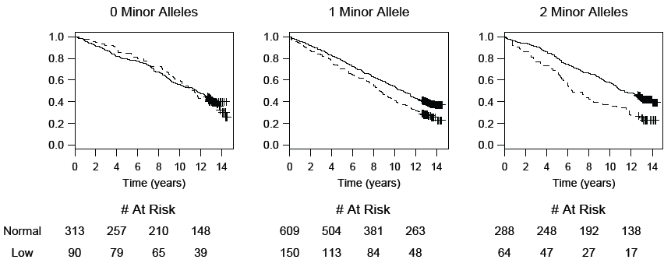
Vitamin D receptor SNP modifies association of 25(OH)D with events
Levin G et al, JAMA 2012

Slide 4
INVITe study design
16 weeks
Information:
Newsletter
Pre-Screen
Exam 6
Placebo
Exam 6a
Results reported:
Treatment assignment, calcium, 25(OH)D
Vitamin D 2000 IU
Vitamin D 2000 IU
Vitamin D 2000 IU
Assess
Eligibility
Consent
Randomize
Dispense med
BP/vitals
Blood draw
Urine
Collect study medication

Slide 5
Developments in the field
New GWAS:
Parathyroid hormone
25(OH)D – expanded, multiethnic
Extension of results:
Gene-treatment interaction in Polyp Prevention Study
Mendelian randomization studies
Large clinical trials wrapping up:
VITAL – results this fall
D-Health Trial – fully enrolled

Slide 6
Enrollment to date
Total eligible
N=2891
Exam 6 before INVITE start
N=610
Exam 6 after INVITE start
N=1145
Exam 6 pending
N=1136
N=340
N=1053
N=5
Screened
N=1398
Ineligible
N=540 (39%)
Refused screen
N=441 (32%)
Eligible
N=417 (30%)
Pending (4)
Vit D >1000 IU/d (N=373)
Elevated serum Ca (N=16)
Kidney stone (N=21)
Hyperparathyroid (N=6)
Consented
N=407
Pending (10)
Drug dispensed
N=397

Slide 7
Evaluating recruiting barriers
Recruiting barrier | Reason for barrier | Plans to address barrier
Pool of potential participants smaller than expected | Exam 6 non-attendance | Expand to: MESA Air UCLA
Enrollment proportion lower than expected | High prevalence of vitamin D supplementation | Temporary dose reduction

Slide 8
Temporary dose reduction
Eligible
N=357
Approached
N=305
Not willing
N=244 (80%)
Willing
N=61 (20%)
Pending permission
Started dose reduction
N=48
Drug dispensed
N=18

Slide 9
MESA Air expansion
Site | Active | Within 50 miles of FC | 80% response rate | Expected Eligible (30%)
Wake | 42 | 42 | 34 | 10
Columbia | 230 | 213 | 170 | 51
Hopkins | 44 | 39 | 31 | 9
NWU | 144 | 137 | 110 | 33
UCLA | 165 | 154 | 123 | 37
Total | 625 | 585 | 468 | 140
Cell contents are numbers of participants

Slide 10
Results?
Reporting to participants:
Serum 25(OH)D and calcium (baseline & end)
Treatment assignment (analysts masked)
DSMB report March 2018:
Total AE, N=38
Organ: 17 gastrointestinal
Relation: 17 unrelated, 21 possibly
Study drug discontinuation: 13
Severe AE: 3 (breast CA, GIB, kidney stone)

Slide 11
Strategies to address sample size
Enroll as well as possible
Tiered analytic strategy
Focus on candidate gene approach
Inform/focus candidates using emerging data
Consider GWAS more exploratory
Replication and combined analyses
Much activity and many likely partners in the field

Slide 12
Vitamin D receptor SNP modifies effect of vitamin D3 supplements
Genotype rs7968585 | Effect of vitamin D3 supplements with incident polyps |  |  | Association of low 25(OH)D with polyps
 | No vitamin D N (%) events | Vitamin D N (%) events | HR (95% CI) | HR (95% CI)
AA | 32 (14%) | 11 (5%) | 0.4 (0.2-0.7) | 0.3 (0.1-1.2)
AG | 31 (7%) | 43 (10%) | 1.4 (0.9-2.2) | 1.9 (0.9-4.4)
GG | 17 (9%) | 27 (13%) | 1.4 (0.9-2.4) | 1.8 (1.0-3.3)
P-interaction |  |  | 0.001 | 0.01
Post-hoc analysis of the Vitamin D/calcium Polyp Prevention Study (Caucasian, N=1702)
Barry EL et al, JAMA Oncology 2017

