Slide 1

Epigenomics Studies
in MESA Exam 6
Yongmgei Liu, MD, PhD, FAHA
Duke University School of Medicine

Slide 2
Prospective/longitudinal Epigenetic Studies
Built upon MESA epigenomics study, a cross-sectional study, funded at Exam 5
  ~2800 participants
  WFU, JHU, Columbia, UMN
Goals: to identify genomic features (DNA methylation and mRNA expression) in monocytes that predict:
  Initiation and progression of atherosclerosis (R01 HL135009)
  Incident T2DM (R01 DK103531)
  Cognitive decline & incident AD (R01 AG054474 )
Notes:
R01 HL135009
R01 AG054474
R01 DK103531

Slide 3
Alterations of a cellular cholesterol metabolism network mediate side effects of stains on increased diabetes risk

Slide 4
Statin Use Increases T2DM Risk
Table 1. Meta-analyses of randomized controlled trials.
Literature | Participants | Age (years) | Duration of follow-up (years) | Adjusted odds ratio (95% CI) | Comments
Sattar et al. 13 trials, statin vs. placebo | 91,140 | Means: 55.0–76.0 | Mean: 4.0 | 1.09 (1.02–1.17) | Highest risk in older patients; unrelated to % low-density lipoprotein cholesterol reduction
Preiss et al. 5 trials, more- vs. less intensive statin | 32,752 | Means: 58.0–64.0 | Mean: 4.9 | 1.12 (1.04–1.22) | Odds ratio for incident cardiovascular disease 0.84 (95% confidence interval 0.75–0.94)
Navarese et al. 17 trials, various statins and doses | 113,394 | Means: 55.0–65.0 | 2.0–6.0 | Pravastatin 40 mg vs. placebo: 1.07 (0.89–1.30) Atorvastatin 80 mg vs. placebo: 1.15 (0.90–1.50) Rosuvastatin 20 mg vs. placebo: 1.25 (0.82–1.90) | Odds ratio unrelated to % low-density lipoprotein cholesterol reduction
(Adapted from Ganda OP, F1000Research, 2016)

Slide 5
Statin Use Increases T2DM Risk
Table 2. Population-based observational studies.
Literature | Participant | Age (years) | Duration of floow-up (years) | Adjusted odds ratio (95% CI) | Comments
Culver et al. Women’s Health Initiative (WHI) | 153,840 | Mean: 63.2 Range: 50–79 | 3 | 1.48 (1.38–1.59) | Only 7.4% were on atorvastatin, none on rosuvastatin Hazard ratio identical with or without cardiovascular disease at baseline
Cederberg et al. METSIM (Finnish men) | 8749 | Range: 43–73 | 5.9 | 1.46 (1.11–1.74) | Risk dose dependent for atorvastatin and simvastatin
Castro et al. Olmsted county, MNMETSIM (Finnish men) | 18,071 | Range: 43–73 | 6 | Normoglycemic: 1.19 (1.05–1.35) Impaired fasting glucose: 1.24 (1.11–1.38) | Mortality reduced in both groups on statin
Corrao et al. Lombardy, Italy | 115,709 | Mean: 62.0 | 6.4 | 1.12 to 1.32 per statin adherence
Ko et al. Ontario, Canada | 17,080 | Mean: 78.0 Range: 65–78 | 5 | Incidence rates for intensive vs. moderate statin: 13.6 vs. 13.0% (non-significant) | Mortality and acute coronary syndrome rates lower with intensive statin: 44.8 vs. 46.5% (p=0.044)
Macedo et al. UK practice databaseMacedo et al. | 2,016,094 | Range: 30–85 | 5.4 | 1.57 (1.55–1.60) | Hazard ratio increased to 3.63 (95% confidence interval 2.44–5.38) by 15–20 years
Carter et al. Ontario, Canada | 471,250 | Median: 73.0 | 0.5-1.0 | Dose dependent compared to pravastatin | Atorvastatin, rosuvastatin, simvastatin > pravastatin
(Adapted from Ganda OP, F1000Research, 2016)

Slide 6
Figure 1. Study design
A
Exam 3 (N=1269)
344 statin users
857 non-users
68 missing data
0
Exclude 317 prevalent T2DM cases
or missing data
5
Exam 5 (N=1269)
Exam 5 (N=952)
101 T2DM cases
851 controls
Statin-associated expression differences
in trancriptomic analysis
Timeline
Monocytes
(N=1269)
CD4+ T Cells
(N=604)
Exclude 290 prevalent T2DM,
288 loss to follow-up
12
Exam 6 (N=691)
319 Euglycemia
305 prediabetes
67 T2DM
Year
Cross-sectional
study
Retrospective
Study
(Mediation analysis)
Prospective
study

Slide 7
Methods
At MESA Exam 5 (2010-11), transcriptomic profiling
  Monocytes:14,620 transcripts
  CD4 + T cells: 16,062 transcripts
ADA classification at both Exam 5 &6:
  Prediabetes: fasting glucose 5.6-6.9 mmol/L (100-125 mg/dL), or HbA1C 5.7-6.4%
  T2DM: fasting glucose ≥ 7.0 mmol/L (≥ 126 mg/dL), HbA1C ≥ 6.5%, or use of hypoglycemic medication,
Covariate adjustment: known T2DM risk factors: age, sex, ethnicities, education, BMI, cigarettes, and physical activity, LDL, and HTN
FDR used for multiple comparison correction

Slide 8
Table 1. Statin-associated mRNA expression difference in monocytes and CD4+ T cells (cross-sectional analysis at Exam 5)
 |  |  | Monocyte (n=1261) |  |  |  |  | CD+4 T Cell (n=604)
Function | Gene | PROBE_ID | Fold difference | 95% CI | p value | FDR |  | Fold difference | 95% CI | p value |  | FDR
Cholesterol efflux | ABCA1 | ILMN_1766054 | 0.76 | 0.73-0.79 | 6.61E-34 | 9.40E-30 |  | 0.82 | 0.78-0.87 | 5.32E-11 |  | 3.87E-07
 | ABCG1 | ILMN_1794782 | 0.74 | 0.70-0.78 | 3.39E-28 | 2.41E-24 |  | 0.86 | 0.83-0.90 | 7.70E-14 |  | 1.12E-09
Cholesterol uptake | MYLIP | ILMN_1656111 | 0.93 | 0.91-0.95 | 6.15E-11 | 2.19E-07 |  | 0.95 | 0.92-0.97 | 2.20E-06 |  | 8.00E-03
 | LDLR | ILMN_2053415 | 1.12 | 1.08-1.16 | 1.22E-10 | 3.47E-07 |  | 1.09 | 1.05-1.13 | 1.13E-05 |  | 3.29E-02
Fatty acid synthesis | FADS1 | ILMN_1670134 | 1.08 | 1.05-1.11 | 6.84E-09 | 1.39E-05 |  | 1.04 | 0.99-1.09 | 1.08E-01 |  | 8.48E-01
 | SCD | ILMN_1689329 | 1.13 | 1.08-1.18 | 1.33E-07 | 2.36E-04 |  | 1.01 | 0.97-1.06 | 5.54E-01 |  | 9.08E-01
Cholesterol synthesis | FDFT1 | ILMN_2144088 | 1.05 | 1.03-1.06 | 2.96E-10 | 7.03E-07 |  | 0.99 | 0.97-1.02 | 7.12E-01 |  | 9.28E-01
 | SC4MOL | ILMN_1689842 | 1.08 | 1.05-1.11 | 3.38E-07 | 5.35E-04 |  | 1.02 | 0.99-1.05 | 2.41E-01 |  | 8.69E-01
 | SQLE | ILMN_2041293 | 1.08 | 1.05-1.12 | 1.63E-06 | 2.10E-03 |  | 1.06 | 1.02-1.09 | 5.46E-04 |  | 6.29E-01
 | CYP51A1 | ILMN_1664718 | 1.06 | 1.03-1.09 | 1.71E-05 | 1.62E-02 |  | 1 | 0.97-1.03 | 9.28E-01 |  | 9.42E-01
 | HMGCS1 | ILMN_1797728 | 1.02 | 1.01-1.04 | 7.03E-03 | 6.00E-01 |  | 1 | 0.99-1.02 | 5.65E-01 |  | 9.10E-01
Transcription factor* | NR1H3 | ILMN_1814022 | 0.94 | 0.91-0.97 | 1.60E-05 | 1.62E-02 |  | 0.97 | 0.94-1.00 | 5.45E-02 |  | 8.48E-01
 | SREBF2** | ENSG00000198911 | 1.07 | 1.02-1.12 | 2.67E-03 | 8.67E-01
* Encode master transcription factors, LXRa and SREBP2, that regulate the expression of cellular cholesterol metabolism genes for the maintenance of cholesterol homeostasis . ** Expression of SREBF2 (Ensemble gene ID: ENSG00000198911) was only detectable by mRNA-sequencing; presented data come from a subset of 372 monocyte samples

Slide 9
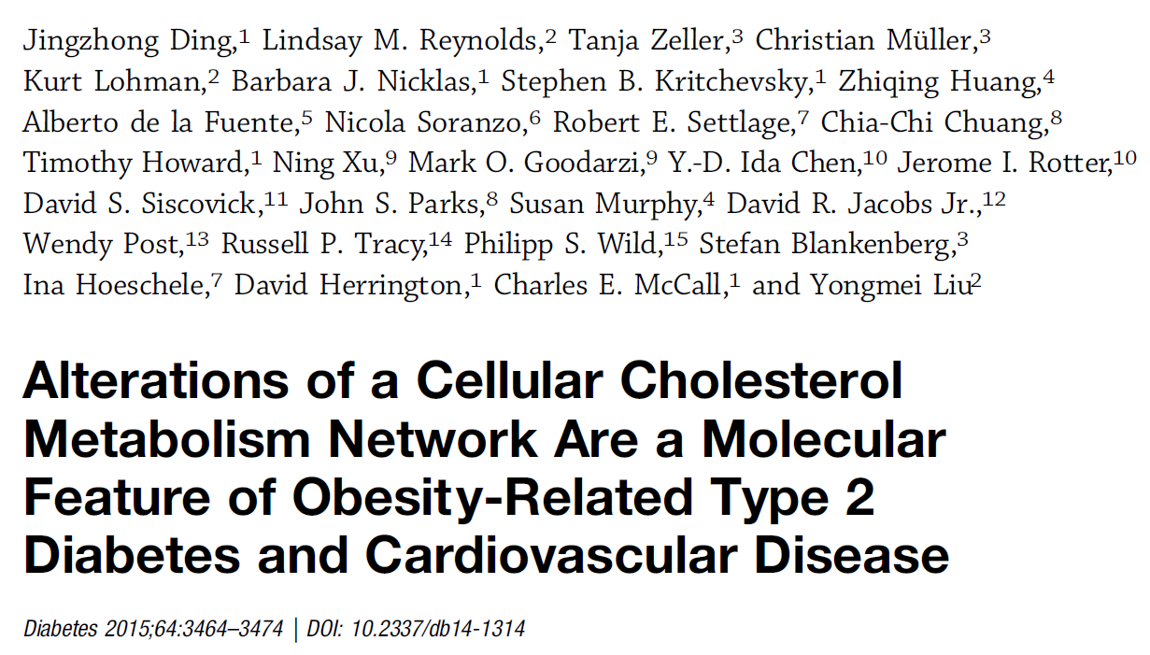
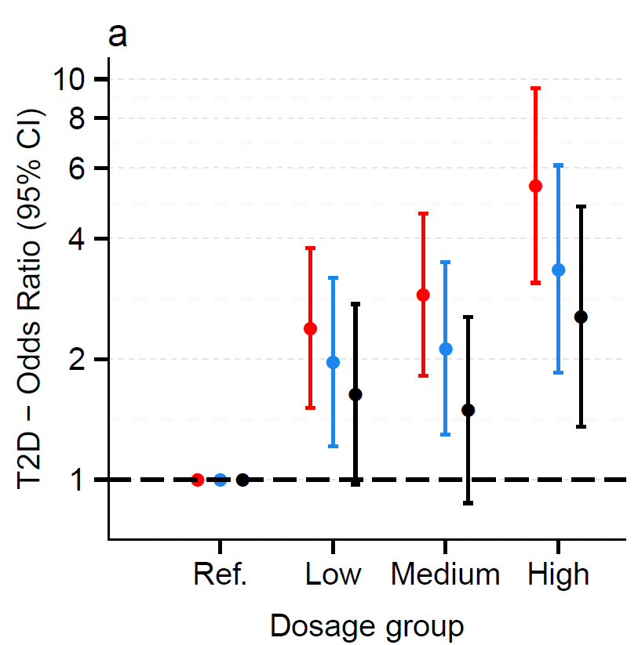
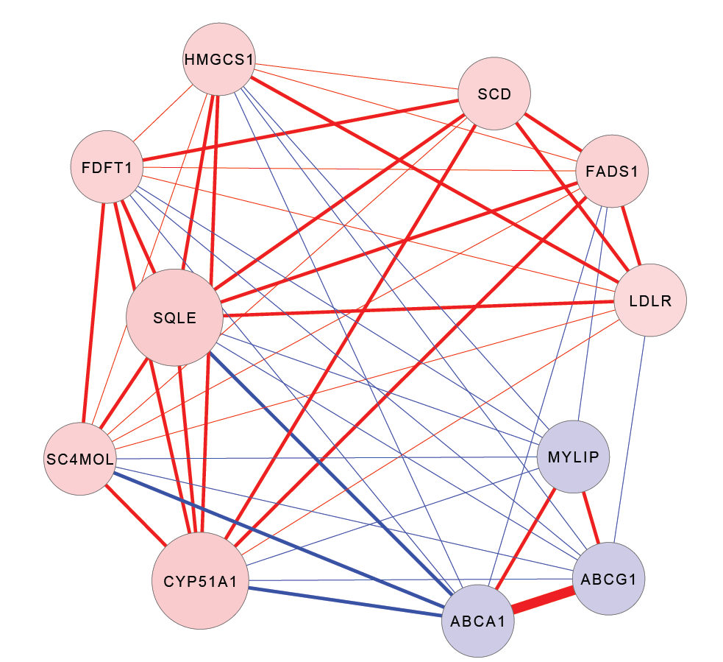
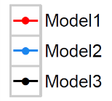
Cross-sectional Association
of Co-expressed Cholesterol Metabolism Transcriptional Network (CMTN) genes
with T2DM
A. Correlations between co-expressed CMTN genes. Correlation coefficients between genes (absolute correlations range 0.3 – 0.7) are indicated by line thickness and color (positive = red, negative = blue).
B. Odds of T2DM increase as intracellular cholesterol accumulation risk score increases.
Fatty acid synthesis
Cholesterol synthesis
Cholesterol uptake
Cholesterol efflux

Slide 10
Figure 1. Study design
A
0
Exam 3 (N=1269)
344 statin users
857 non-users
68 missing data
Exclude 317 prevalent T2DM cases
or missing data
Exam 3 (N=952)
201 Statin users
751 non-users
5
Exam 5 (N=1269)
Exam 5 (N=952)
101 T2DM cases
851 controls
Timeline
Statin-associated expression differences
in trancriptomic analysis
Monocytes
(N=1269)
CD4+ T Cells
(N=604)
12
Year
Retrospective Study
(Mediation analysis)

Slide 11
Table 2. Characteristics of 952 MESA participants free of T2DM at exam 3
Variable | Statin user (n=201) | Non-users (n=751) | p value
Age, mean (SD) | 66 (8) | 61.94 (9) | 1.13E-08
Female | 98 (49%) | 392 (52%) | 4.31E-01
African American | 27 (13 %) | 156 (20%) | 4.52E-05
Hispanic | 46 (23%) | 250 (33%)
Caucasian | 128 (64%) | 345 (46%)
Former Smoker | 99 (49 %) | 337 (45%) | 3.15E-01
Current smokers | 20 (10 %) | 102 (13%)
BMI, kg/m² | 29 (5) | 29 (5) | 3.74E-02
LDL, mg/dL | 95 (28) | 118 (29) | 1.88E-22
HDL, mg/dL | 50 (13) | 52 (15) | 3.97E-01
Hypertension | 114 (57%) | 265 (36%) | 9.60E-08
Prediabetes | 40 (20%) | 132 (18%) | 5.23E-01
CVD | 33 (17%) | 82 (11%) | 4.24E-02
The total effect of statin use on T2DM risk :
Adjusted OR: 1.73 (95% CI: 1.01-2.96; p=0.045).

Slide 12
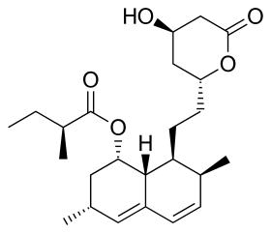
Figure 2. Mediation analysis of CMTN key members mediating statin effects on T2DM risk
Direct effect after accounting for ABCA1: OR: 1.34 (95% CI, 0.78-2.32)
Mediator
Indirect effect via ABCA1: OR: 1.29 (1.1-1.5)
46% explained via ABCA1
0.80 (0.76-0.85)
ABCA1
0.63 (0.50-0.79)
1.06 (1.01-1.11)
LDLR
1.07 (0.85-1.35)
1.05 (1.0-1.10)
SQLE
1.20 (0.95-1.51)
Incidence of T2DM
at Exam 5
Statin use at Exam 3
LDLR
0.78 (0.41-1.15)
ABCA1
1.35 (1.08-1.70)
PC1_{CMTN}
17% explained via PC1_{CMTN}
Indirect effect via PC1_{CMTN}: OR: 1.09 (1.0-1.20)
Direct effect after accounting for PC1_{CMTN} : OR: 1.55 (95% CI, 0.91-2.66)

Slide 13
Figure 1. Study design
A
0
5
Exam 5 (N=1269)
Exclude 290 prevalent T2DM,
288 loss to follow-up
Exam 5 (N=691)
Statin-associated expression differences
in trancriptomic analysis
295 Euglycemia
388 Prediabetes
Timeline
Monocytes
(N=1269)
CD4+ T Cells
(N=604)
12
Exam 6
220 Euglycemia
68 prediabetes
7 T2DM
Exam 6
97 Euglycemia
231 prediabetes
60 T2DM
Year
Prospective
study

Slide 14
Figure 3. Association of expression of CMTN key members with progression to prediabetes/T2DM and reversion to euglycemia
 |  | N | Incident cases (%) |  | Adjusted Odds Ratio (95%)
Progression to Prediabetes/T2DM
 | 295 Euglycemia |  |  | 75 (25%)
ABCA1 |  |  |  |  | 0.78 (0.58-1.04)
LDLR |  |  |  |  | 1.19 (0.89-1.58)
SQLE |  |  |  |  | 1.47 (1.08-2.00)
PC1_{CMTN} |  |  |  |  | 1.37 (1.02-1.83)
Reversion to Euglycemia
 | 388 Prediabetes |  |  | 97 (25%)
ABCA1 |  |  |  |  | 1.18 (0.92-1.51)
LDLR |  |  |  |  | 0.78 (0.59-1.02)
SQLE |  |  |  |  | 1.05 (0.80-1.36)
PC1_{CMTN} |  |  |  |  | 0.73 (0.56-0.95)
p value
0.09
0.23
0.01
0.03
0.20
0.07
0.74
0.02
0.5
1
1.5
2
Odds ratio (95% CI) per 1 SD increase

Slide 15
Figure 1. Study design
A
0
5
Exam 5 (N=1269)
Exclude 290 prevalent T2DM,
288 loss to follow-up
Exam 5 (N=691)
Statin-associated expression differences
in trancriptomic analysis
295 Euglycemia
388 Prediabetes
Timeline
Monocytes
(N=1269)
CD4+ T Cells
(N=604)
12
Exam 6
97 Euglycemia
+
231 prediabetes
Exam 6
220 Euglycemia
68 prediabetes
7 T2DM
Exam 6
97 Euglycemia
231 prediabetes
60 T2DM
Year
Vs.
60 T2DM
Prospective
study

Slide 16
Figure 4. Statin effects on the expression of CMTN genes and intracellular cholesterol levels
4a) Human monocytic THP-1 cells
4b) Human monocytic THP-1 cells
P=0.001
P=<0.001
P=0.007
P=0.01
P=<0.001
4c) PBMCs and pancreatic islets in mice
4d) PBMCs in mice
P=0.002
P=0.007
P=0.45
P=0.005
P=0.38
P=0.002
P=0.01
P=0.009
P=0.49

Slide 17
Conceptual Model
Cholesterol Efflux
Cholesterol uptake
LDLR
ABCA1
ABCG1
Cellular Cholesterol
CMTN
Chol Efflux
(ABCA1/G1)
T2DM
SREBP2
LXRα
Chol Uptake
(LDLR etc.)
Statin
Chol Synthesis
(SQLE etc.)

Slide 18
Beta cell-specific Abca1 KO mice
Islet Cholesterol
Insulin secretion
Glucose tolerance
(Brunham LR et al., Nat Med., 2007)

Slide 19
Abca1/g1 double KO mice
Islet Cholesterol
Insulin secretion
Glucose tolerance
Fasting glucose
(Kruit JK et al., Diabetes., 2012)

Slide 20
Functional ABCA1 variant decreases cholesterol efflux
and increasesT2DM risk
R230C
(Qian H et al., Cell, 2017)
(Acuna-Alonzo V et al., Human Mol Genet., 2010)
(Villarreal-Molina MT et al., Diabetes, 2008)

Slide 21
Conclusion
Identified the altered expression of cholesterol metabolism transcriptional network (CMTN) genes is associated with statin use in monocytes and T cells collected in MESA
Further establish a new role for statins in altering CMTN and increasing intracellular cholesterol levels in vitro and in vivo experiments
Discover the altered expression of CMTN genes is associated with increased risk of incident prediabetes/T2DM
  suggests a causal role of intracellular cholesterol accumulation in the pathogenesis of T2DM
Reveal intracellular cholesterol accumulation as a novel mechanism linking statin treatment and T2DM risk.

Slide 22
Carotid Ultrasounds
at Exam 6 by Field Centers
 | Participants Scanned
3-WF | 199
4-COL | 404
5-JHU | 266
6-MN | 359
ALL | 1228

Slide 23
Plaque Progression
 |  | Plaque score change from Exam 5 to 6
Adjscore5 | -1 | 0 | 1 | 2 | 3 | 4 | 5 | 6 | 7 | 8 | Sum
0 | 0 | 229 | 109 | 51 | 14 | 4 | 3 | 0 | 0 | 0 | 410
1+ | 1 | 262 | 276 | 150 | 59 | 22 | 7 | 2 | 1 | 1 | 781
Sum | 1 | 491 | 385 | 201 | 73 | 26 | 10 | 2 | 1 | 1 | 1191
Percent (%) |  | 41 | 32 | 17 | 6 | 2 | 1
Notes:
, 181 individuals develop a new plaque but 1 also lost a plaque
we did logistic regression for new plaque or not (ie, score increase or not).

Slide 24
Association of CVD Risk factors at Exam 5 with Plaque Progression
 |  | Logistic regression |  |  | Multinomial logistic regression |  |  |  |  | Logistic regression
 |  | 1+ vs. 0 |  |  | 1 vs. 0 |  | 2+ vs. 0 |  |  | 2+ vs. 0/1
Model Term |  | beta | pvalue |  | beta | pvalue | beta | pvalue |  | beta | pvalue
Age |  | 0.02 | 7.32e-03 |  | 0.03 | 5.90e-03 | 0.02 | 9.89e-02 |  | 0.01 | 5.94e-01
Female |  | -0.36 | 1.09e-02 |  | -0.16 | 3.11e-01 | -0.63 | 3.54e-04 |  | -0.56 | 5.07e-04
African American |  | -0.28 | 9.64e-02 |  | -0.06 | 7.39e-01 | -0.56 | 6.91e-03 |  | -0.53 | 4.50e-03
Hispanic |  | -0.29 | 8.74e-02 |  | -0.17 | 3.71e-01 | -0.45 | 4.01e-02 |  | -0.38 | 6.26e-02
WFU |  | 0.09 | 6.78e-01 |  | -0.00 | 9.87e-01 | 0.19 | 4.26e-01 |  | 0.20 | 3.57e-01
COL |  | -0.33 | 7.65e-02 |  | -0.21 | 3.11e-01 | -0.46 | 4.31e-02 |  | -0.37 | 7.60e-02
UMN |  | -0.25 | 2.00e-01 |  | -0.05 | 8.04e-01 | -0.48 | 4.32e-02 |  | -0.45 | 3.34e-02
Former smoker |  | 0.01 | 9.49e-01 |  | -0.03 | 8.52e-01 | 0.06 | 7.03e-01 |  | 0.08 | 6.12e-01
Current smoker |  | 0.59 | 2.42e-02 |  | 0.33 | 2.81e-01 | 0.87 | 3.76e-03 |  | 0.72 | 5.67e-03
BMI |  | -0.01 | 2.76e-01 |  | 0.00 | 9.91e-01 | -0.04 | 3.68e-02 |  | -0.04 | 2.28e-02
LDL |  | 0.00 | 3.28e-02 |  | 0.00 | 7.03e-01 | 0.01 | 4.59e-04 |  | 0.01 | 2.15e-04
Prediabetes |  | 0.04 | 7.53e-01 |  | -0.02 | 8.79e-01 | 0.15 | 4.15e-01 |  | 0.16 | 3.35e-01
Diabetes |  | 0.34 | 7.82e-02 |  | -0.01 | 9.79e-01 | 0.78 | 1.03e-03 |  | 0.78 | 2.59e-04
SBP |  | 0.01 | 2.30e-03 |  | 0.01 | 1.18e-01 | 0.02 | 1.33e-04 |  | 0.02 | 4.11e-04
DBP |  | -0.02 | 3.00e-02 |  | -0.02 | 1.40e-01 | -0.03 | 2.22e-02 |  | -0.02 | 6.63e-02
Statin user |  | -0.12 | 3.97e-01 |  | -0.11 | 5.12e-01 | -0.13 | 4.67e-01 |  | -0.08 | 6.18e-01
BP med |  | 0.03 | 8.13e-01 |  | -0.03 | 8.24e-01 | 0.12 | 4.89e-01 |  | 0.13 | 3.82e-01

Slide 25
Plaque Progression
500
500
400
400
300
300
Count
Count
200
200
100
100
0
0
-1
0
1
2
3
4
5
6
7
8
chngpqscore5to6
0.0
0.5
1.0
1.5
2.0
log(chngpqscore5to6 + 1)

Slide 26
Association of CVD Risk factors at Exam 5 with Plaque Progression
 |  | Linear regression Log (change +1)
Model Term |  | beta | pvalue
Age |  | 0.00 | 5.78e-02
Female |  | -0.13 | 2.41e-04
African American |  | -0.11 | 7.81e-03
Hispanic |  | -0.09 | 3.09e-02
WFU |  | 0.05 | 2.75e-01
COL |  | -0.09 | 4.36e-02
UMN |  | -0.09 | 4.87e-02
Former smoker |  | -0.00 | 9.45e-01
Current smoker |  | 0.18 | 2.33e-03
BMI |  | -0.01 | 3.49e-02
LDL |  | 0.00 | 3.97e-03
Pre Diabetes |  | 0.00 | 9.21e-01
Diabetes |  | 0.13 | 4.35e-03
SBP |  | 0.00 | 5.07e-05
DBP |  | -0.01 | 1.08e-02
Statin user |  | -0.05 | 1.27e-01
BP med |  | 0.03 | 3.22e-01

Slide 27
Acknowledgements
Wake Forest School of Medicine: Jingzhong Ding, Gregory Burke
Johns Hopkins University: Wendy Post
University of Minnesota: David Jacobs
Columbia University: Steven Shea
University of Vermont: Russ Tracy
University of Washington: Bruce M. Psaty, Joel Kaufman
New York Academy of Medicine: David Siscovick
University of Virginia: Stephen S. Rich
University of Wisconsin : James H. Stein
Virginia Tech: Ina Hoeschele
MESA: all participants, investigators, and staff
Funding:
  R01 HL135009
  R01 AG054474
  R01 DK103531
Notes:
This work can’t be done without teams of support from different institutions, and MESA participants and funding agents.
Thank you for your attention; I’ll take your quesitons

