Slide 1
The Relationship of Cigarette Smoking and Incident Heart Failure: Results from the Multi-Ethnic Study of Atherosclerosis
Mahmoud Al Rifai, Megan Watson, Zeina Dardari, Sina Kianoush, Michael E. Hall, Andrew P. DeFilippis, Rachel J. Keith, Emelia J. Benjamin, Carlos J. Rodriguez, Aruni Bhatnagar, Joao A. Lima, Javed Butler, Michael J. Blaha

Slide 2
Background
Approximately 6.5 M Americans have HF (2011-2014).
The prevalence of HF is expected to increase 46% from 2012-2030.
The economic burden of HF is significant and is projected to be $70 B in 2030.

Slide 3
Background
Cigarette smoking is associated with a 60% higher risk of HF.
Inflammation and atherosclerosis may predispose to HFpEF and HFrEF respectively.
Cigarette smoking is associated with markers of inflammation and subclinical atherosclerosis.

Slide 4
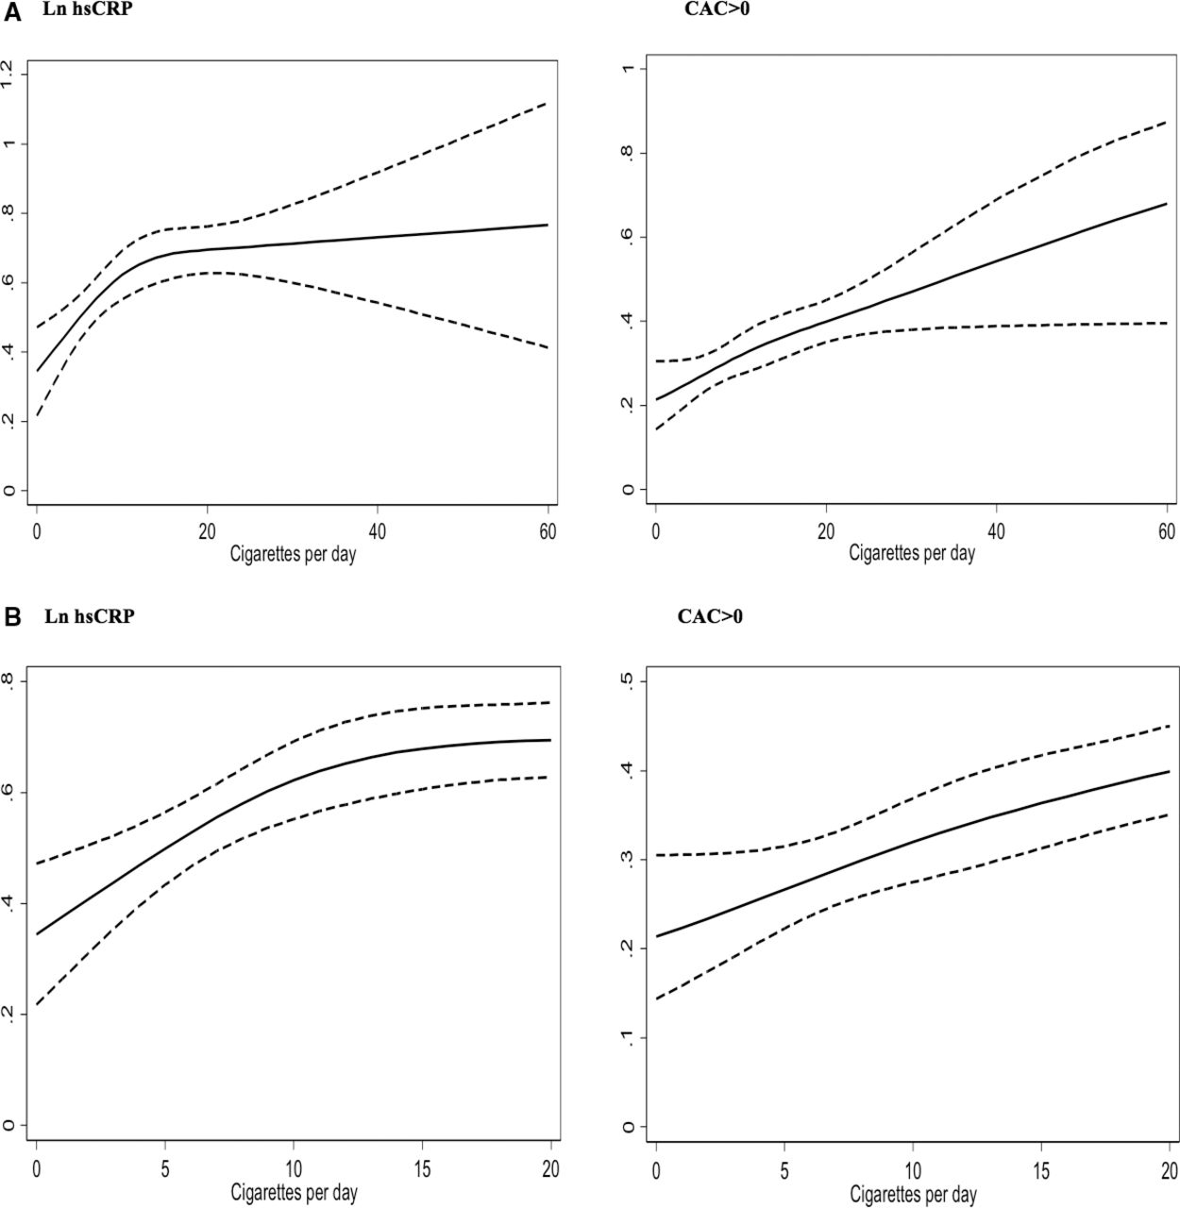
A, Dose‐response restricted cubic spline graphs for the association of mean log‐transformed high‐sensitivity C‐reactive protein (ln hsCRP) levels and coronary artery calcium (CAC) >0 with smoking intensity.
Sina Kianoush et al. J Am Heart Assoc 2017;6:e005088
© 2017 Sina Kianoush et al.
Notes:
A, Dose‐response restricted cubic spline graphs for the association of mean log‐transformed high‐sensitivity C‐reactive protein (ln hs‐CRP) levels and coronary artery calcium (CAC) >0 with smoking intensity. B, Graphs restricted to smoking ≤20 cigarettes per day.

Slide 5
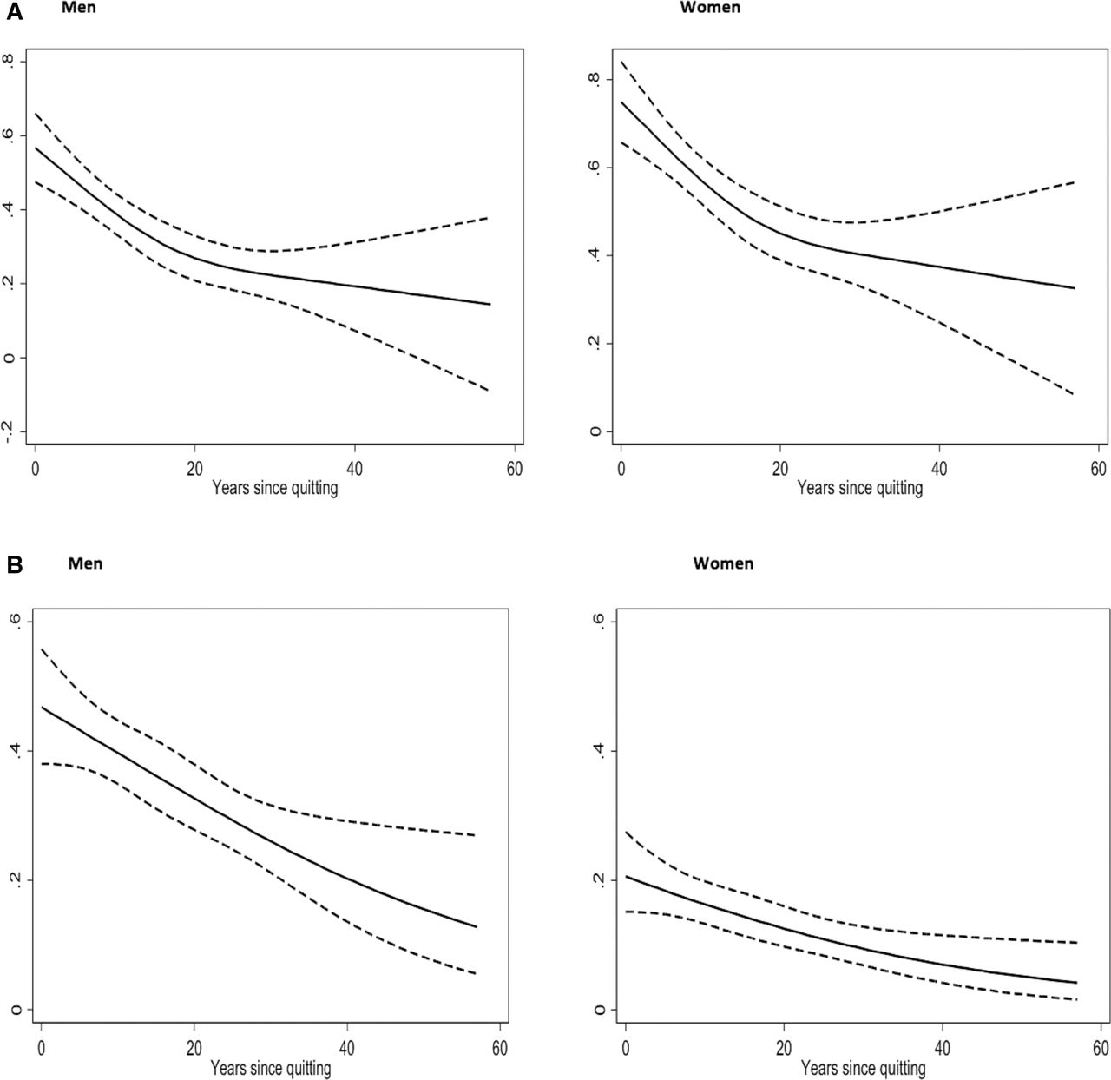
Age‐ and sex‐adjusted associations of (A) log‐transformed high‐sensitivity C‐reactive protein and (B) coronary artery calcium (CAC) >0 with years since quitting smoking among former smokers in men and women.
Ln hsCRP
CAC >0
Sina Kianoush et al. J Am Heart Assoc 2017;6:e005088
© 2017 Sina Kianoush et al.
Notes:
Age‐ and sex‐adjusted associations of (A) log‐transformed high‐sensitivity C‐reactive protein and (B) coronary artery calcium (CAC) >0 with years since quitting smoking among former smokers in men and women.

Slide 6
Study Aim
Evaluate the association between cigarette smoking and HF stratified by EF.

Slide 7
Methods
Cigarette Smoking
Self-reported status
Status reclassified by cotinine
Intensity
Burden
Time since quitting smoking

Slide 8
Methods
Heart Failure
NT-proBNP
Adjudicated HF cases
Total cases
HFrEF (EF ≤40%)
HFpEF (EF ≥50%)
Notes:
EF was available in 195 participants

Slide 9
Methods
Covariates
Age, sex, race/ethnicity
Education, BMI, SBP, antihypertensive medication, LDL-C, HDL-C, lipid-lowering medication, DM, moderate-vigorous physical activity, Mediterranean diet, salt intake, alcohol use

Slide 10
Methods
Multivariable linear regression models examined the association between smoking and log-transformed NT-proBNP.
Multivariable Cox regression models examined the association between smoking and incident HF.
Multivariable competing risk analysis examined the association between smoking, HFrEF, and HFpEF.

Slide 11
Results
Baseline characteristics of study cohort by cigarette smoking status
 | Study Cohort (N=6792) | Never Smokers (N=3418) | Former Smokers (N=2487) | Current Smokers (N=887) | p-value
Current alcohol use | 3749 (55) | 1596 (47) | 1551 (63) | 602 (68) | <0.001
Moderate-vigorous physical activity (mins/week) | 1080 (1515) | 1050 (1480) | 1080 (1440) | 1233 (1890) | 0.005
Mediterranean Diet score | 5 (3) | 5 (3) | 5 (3) | 4 (3) | <0.001
Frequent addition of salt | 2513 (40) | 1071 (33) | 1035 (45) | 407 (51) | <0.001
LDL-C (mg/dL) | 117 (31) | 118 (31) | 116 (31) | 116 (33) | 0.04
HDL-C (mg/dL) | 51 (15) | 52 (15) | 51 (15) | 48 (14) | <0.001
DM | 857 (13) | 425 (12) | 321 (13) | 111 (13) | 0.87
BMI (kg/m²) | 28.3 (5.5) | 28.1 (5.5) | 28.8 (5.5) | 28.0 (5.3) | <0.001
SBP (mm Hg) | 127 (21) | 127 (22) | 127 (21) | 124 (22) | <0.001
Age (years) | 62 (10) | 62 (11) | 63 (10) | 58 (9) | <0.001
Male | 3203 (47) | 1297 (38) | 1439 (58) | 467 (53) | <0.001
Race/Ethnicity |  |  |  |  | <0.001
White | 2615 (39) | 1157 (34) | 1157 (47) | 301 (34)
Chinese- American | 802 (12) | 604 (18) | 153 (6) | 45 (5)
Black | 1879 (28) | 850 (25) | 691 (28) | 338 (38)
Hispanic | 1496 (22) | 807 (24) | 486 (20) | 203 (23)
Continuous variables summarized as mean (SD) or median (interquartile range) and compared using ANOVA or Kruksal-Wallis test.
Categorical variables summarized as count (percentage) and compared using chi-square test.
Notes:
Over a median 12.2 years of follow up, there were 279 cases of incident HF. The incidence rate of HFrEF was 2.15 cases per 1000 person-years and that of HFpEF was 1.86 per 1000 person-years.

Slide 12
Results
Beta coefficients (95% Confidence Interval) for the association of smoking and NT-proBNP
 | Model 1 | Model 2
 | Smoking Intensity (Cigarettes/Day)
1-9 | 1 (ref) | 1 (ref)
10-20 | 0.05 (-0.14,0.25) | 0.08 (-0.11,0.27)
>20 | 0.15 (-0.13,0.43) | 0.17 (-0.11,0.46)
p-value for trend | 0.22 | 0.39
 | Time Since Quitting (Quit Years)
Tertile 1: <16 | 1 (ref) | 1 (ref)
Tertile 2: 16-28 | -0.07 (-0.18,0.03) | -0.09 (-0.20,0.02)
Tertile 3: >29 | -0.09 (-0.20,0.02) | -0.110 (-0.223,-0.003)
p-value for trend | 0.11 | 0.06
 | Smoking Status
Never | 1 (ref) | 1 (ref)
Former | 0.01 (-0.05,0.06) | 0.003 (-0.057,0.063)
Current | 0.07 (-0.01,0.15) | 0.05 (-0.04,0.13)
 | Smoking Burden (Pack Years)
Tertile 1: <8 | 1 (ref) | 1 (ref)
Tertile 2: 8-25 | -0.07 (-0.16, 0.03) | -0.07 (-0.16, 0.03)
Tertile 3: >26 | 0.02 (-0.07, 0.12) | 0.06 (-0.04, 0.15)
p-value for trend | 0.65 | 0.27
Model 1: Age, sex, race/ethnicity
Model 2: Age, sex, race/ethnicity, education, BMI, SBP, antihypertensive medication, LDL-C, HDL-C, lipid-lowering medication, DM, moderate-vigorous physical activity, Mediterranean diet, salt intake, alcohol use

Slide 13
Results
Hazard Ratios (95% Confidence Interval) for the association of smoking and HF
 | HF |  | HFrEF |  | HFpEF
 | Model 1 | Model 2 | Model 1 | Model 2 | Model 1 | Model 2
 | Smoking Status
Never | 1 (ref) | 1 (ref) | 1 (ref) | 1 (ref) | 1 (ref) | 1 (ref)
Former | 1.18 (0.91, 1.53) | 1.17 (0.88, 1.56) | 1.02 (0.64, 1.61) | 1.05 (0.62, 1.79) | 1.56 (0.97, 2.50) | 1.36 (0.81, 2.27)
Current | 1.73 (1.19, 2.52) | 2.05 (1.36, 3.09) | 2.21 (1.26, 3.88) | 2.58 (1.27, 5.25) | 1.97 (0.95, 4.07) | 2.51 (1.15, 5.49)
 | Smoking Burden (Pack Years)
Tertile 1: <8 | 1 (ref) | 1 (ref) | 1 (ref) | 1 (ref) | 1 (ref) | 1 (ref)
Tertile 2: 8-25 | 1.05 (0.70, 1.57) | 1.00 (0.64, 1.55) | 0.85 (0.44, 1.66) | 0.89 (0.42, 1.90) | 0.96 (0.46, 2.00) | 0.87 (0.40, 1.90)
Tertile 3: >26 | 1.21 (0.83, 1.79) | 1.16 (0.76, 1.77) | 0.86 (0.44, 1.68) | 0.99 (0.46, 2.16) | 1.13 (0.58, 2.23) | 0.98 (0.47, 2.03)
p-value for trend | 0.33 | 0.48 | 0.67 | 1.00 | 0.71 | 0.96
 | Time Since Quitting (Quit Years)
Tertile 1: <16 | 1 (ref) | 1 (ref) | 1 (ref) | 1 (ref) | 1 (ref) | 1 (ref)
Tertile 2: 16-28 | 0.89 (0.57,1.41) | 0.76 (0.46,1.25) | 1.07 (0.43,2.69) | 1.02 (0.33,3.12) | 0.77 (0.34,1.75) | 0.61 (0.25,1.48)
Tertile 3: >29 | 0.62 (0.39,0.97) | 0.66 (0.41,1.06) | 0.93 (0.37,2.30) | 0.95 (0.31,2.94) | 0.68 (0.32,1.46) | 0.77 (0.34,1.71)
p-value for trend | 0.03 | 0.09 | 0.85 | 0.93 | 0.33 | 0.58
Smoking intensity analysis underpowered
Model 1: Age, sex, race/ethnicity
Model 2: Age, sex, race/ethnicity, education, BMI, SBP, antihypertensive medication, LDL-C, HDL-C, lipid-lowering medication, DM, moderate-vigorous physical activity, Mediterranean diet, salt intake, alcohol use

Slide 14
Results
Sensitivity Analyses
Smoking status reclassified by cotinine
Adjustment for CAC and hsCRP
Adjustment for interim CHD
Competing risk of non-CV mortality
HFmrEF

Slide 15
Discussion
Time since quitting smoking is inversely associated with NT-proBNP.
Current smoking is associated with higher risk of HF, including HFrEF and HFpEF.
No “dose-response” association between smoking exposure and HF.
Smoking and HFrEF vs. HFpEF.
Al Rifai et al. Atherosclerosis 2017

Slide 16
Discussion
Limitations
Change in smoking status
Exposure misclassification
Selection bias
Residual confounding

Slide 17
THANK YOU

