Slide 1
MESA Memory / AD Update
Tim Hughes, PhD

Slide 2
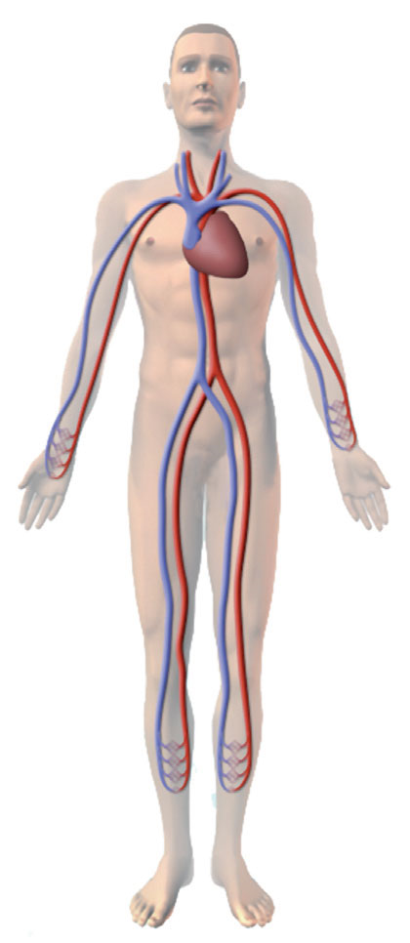
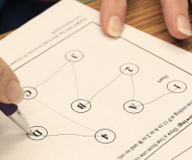
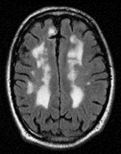
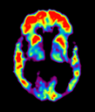
MESA Memory (Single site, WFU only)
Goal - Determine how microvascular vs. macrovascular risk factors relate to dementia pathology and AD risk.
Repeated Cognition
CASI, DSC and DS
UDS v3
Cognitive adjudication
Physical exam by clinician
Repeated Brain MRI
β-amyloid PET imaging
Optional LP substudy (40%)
R01 AG054069 (Hughes) P30 AG049638 (Craft)
Exams 1-6
Exam 6
Follow-up
Cog
MRI
PET
Cog
MRI
2016 2017 2018 2019 2020 2021

Slide 3
Progress in Exam 6
Exam 6 | Cognitive Testing (UDS) |  | Brain MRI |  | Aβ PET |  | Optional LP
 | n | % | n | % | n | % | n | %
AFIB | 197
Completed | 116 | 59% | 101 | 55% | 10 | 6% | 1 | 50%
Memory | 187
Completed | 187 | 100% | 129 | 82% | 98 | 62% | 8 | 47%
Total completed of eligible | 303 | 80% | 230 | 65% | 108 | 30% | 9 | 40%
Consent Rate | 383 385 | 99% | 355 383 | 93% | 355 383 | 93% | 23 86 | 28%
*Target sample size (n=540); optional LP (n=200)
383 / 540 = 70% of recruitment goals

Slide 4
Completion Dates
MESA-Memory Procedures | Exam 6 2016-2018 | Follow-up 2019-2021
Enrollment & Consenting | 05/18 | 06/19 - 05/21
Cognitive Assessment (in-person) CASI, DSC, DS UDS-3 | 05/19 | 06/19 - 05/21
Brain MRI (volume, blood flow) | 05/19 | 06/19 - 05/21
β-amyloid PET Imaging | 05/21

Slide 5
Preliminary Results
Exam 6 CASI Q
Cognitive decline (all sites)
Adjudication results
Vascular risk factors and:
Cognitive Decline
Neuroimaging
MESA Memory

Slide 6
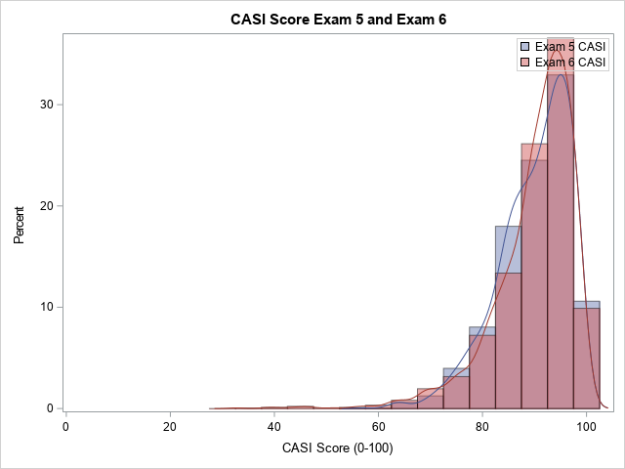
Exam 6 Cognitive Data
Repeated CASI, DSC, DS
Exam 5 = 4591
Exam 6 = 2042
QC, valid data, n = 1840
‘valid5’ and ‘valid6’
Not missing >3 items
Exam 6 Collection by:
MESA Afib (all sites)
MESA Memory (WFU)
MESA Epigenetics (JHU)

Slide 7
Individual Change in CASI

Slide 8
Decline in CASI by Race/Ethnicity All Sites (n=1840 preliminary)
CASI Change
1.0
0.0
White Chinese African Hispanic
American
n=796
-1.0
n=194
-2.0
n=527
-3.0
n=323
Updated from AAIC 2018, Chicago
Notes:
Adjusted for change_casi = age, education, race, casisum5c
race1c chg_CASI LSMEAN 95% Confidence Limits
1 0.584798 -0.434643 1.604238
2 -0.206836 -1.419665 1.005993
3 -1.668428 -2.738124 -0.598731
4 -2.278785 -3.390404 -1.167166

Slide 9
Cognitive Adjudication – ongoing - 1 (WFU and JHU)
MESA + UDS v3 Cognitive Battery
Test | Average Time (min)
WRAT-IV/V/AMNART | 2
AVLT | 10
Benson Figure Copy | 2
Number Span | 5
Digit Symbol Coding | 3
Category Fluency (Animals/Veg) | 3
Benson Figure Delayed | 2
TMT | 5
GDS | 1
AVLT Delayed & Recognition | 5
Craft Story - Immediate | 5
MoCA | 5
CASI | 10
Craft Story - Delayed | 2
FCSRT | 15
Total | 75 (60 – 90 min)
MESA tests
UDS-3 cognitive battery
Proxy information
Clinician Interview
Adjudication of cognitive subtype
MESA tests
MESA Memory (only)

Slide 10
Cognitive Adjudication – ongoing - 2 (WFU and JHU)
Diagnosis | Substudy
 | Afib | Memory | Epigenetics
NC | 51 (61%) | 125 (82%) | 282 (88%)
MCI | 29 (35%) | 21 (14%) | 36 (11%)
Dementia | 5 (6%) | 7 (5%) | 3 (1%)
‘Cannot Classify’ | 3/19/3 | 3/7/13
Cannot Classify = Missing / No Phase II / ‘other’

Slide 11
Cognitive Adjudication – ongoing - 3 (WFU)
UDS-3 cognitive battery
Proxy information
Clinician Interview
Adjudication of cognitive subtype
TBD – biomarker confirmation

Slide 12
CAIDE
Education
Obesity
Physical Inactivity
APOE-4
Framingham Risk Score
Age
Gender
Cholesterol
BP
Atherosclerotic
(subASCVD)
Smoking
BP Meds
HDL
CAC
ABI
cIMT
Diabetes
Family Hx Heart
Lipid Meds
PCE
CVD Events
FRS
Atherosclerotic - PCE
CAIDE
Dementia
Midlife
Late-life

Slide 13
Vascular Risk Factors and Change in CASI All Sites (n=1647 preliminary)
Baseline Risk (Exam 1; 2000-02) | Change CASI (n=1647) |  |  |  |  | race interaction
 |  |  | beta | (SE) | p-value
CAIDE |  |  | -0.57 | 0.17 | <0.001 | 0.109
FRS |  |  | -0.78 | 0.18 | <0.001 | 0.529
ASCVD-PCE |  |  | -1.26 | 0.21 | <0.001 | 0.635
subASCVD |  |  | -0.44 | 0.10 | 0.021 | 0.324
*All models include race/ethnicity and components of CAIDE (age, educational level, hypertension, hypercholesterolemia, obesity, APOE ε4 and physical inactivity) as needed.
Similar, but weaker associations with Exam 5 CVD scores
Presented at AAIC 2018, Chicago

Slide 14
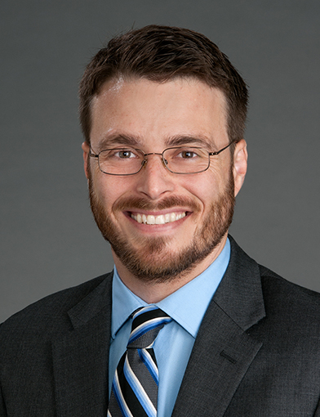
Preliminary Neuroimaging
Amyloid (PiB) PET
White Matter
Hyperintensities (WMH)
3T MRI (2016-2019, 2019-2021)
Amyloid PET (‘PiB’, 2017-2021)
Cortical Thickness on MRI
Accepted for presentation at AAIC 2019, Los Angeles

Slide 15
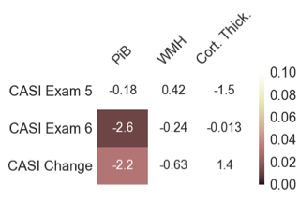
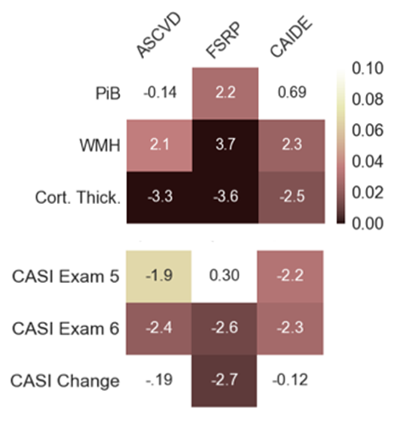
Vascular Risk Factors, Multimodal Neuroimaging Biomarkers, and Cognitive Decline
Amyloid deposition is most strongly related to cognitive decline
Table 3. Vascular Risk Factors and Neuroimaging
 | PiB PET | WMH volume | Cort. Thick.
CAIDEª | t= 0.7, p=0.50 | t= 2.3, p=0.02 | t= -2.5, p=0.02
FSRP^{b} | t= 2.2, p=0.03 | t= 3.7, p<0.01 | t= -3.6, p<0.01
ASCVD-PCE^{c} | t= -0.1, p=0.82 | t= 2.1, p=0.04 | t= -3.3, p<0.01
ª adjusted for race
^{b} Revised - adjusted for sex, education, race, and APOE-ε4 carriage
^{c} adjusted for education and APOE-ε4 carriage
Analysis of first 91 participants with amyloid-PET
to be presented at AAIC 2019, Los Angeles

Slide 16
Next Steps for MESA Memory
Wrapping up ‘baseline’ assessments (Cog and MRI)
Align follow-up with MESA-MIND Protocol
MRI processing
Ongoing at UPenn
Vascular Neurology Reads: infarcts, lacunae, microinfarcts, microbleeds, etc.
Relate subclinical CVD measures to brain health

Slide 17
Acknowledgements
Wake Forest ADRC
Suzanne Craft
Sam Lockhart
Kathleen Hayden
Steve Rapp
Bonnie Sachs
Chris Whitlow
Youngkyoo Jung
WFU MESA FC
Greg Burke
Alain Bertoni
Cathy Nunn
Katy Melius
Eric Fischer
MESA FC staff
MESA Steering and AS Committees
UPenn MRI Processing
Nick Bryan
Ilya Nasrallah
Lisa Desiderio
Funding
P30 AG049638 (Craft)
R01 AG054069 (Hughes) R01 AG058969 (Hughes)
Participants

