Slide 1
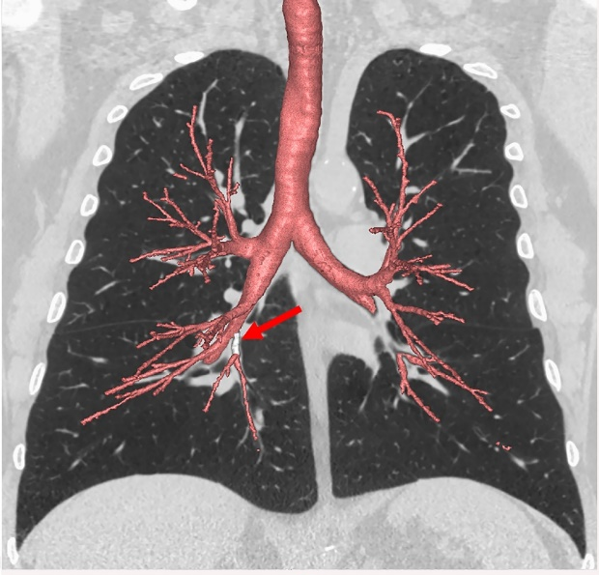

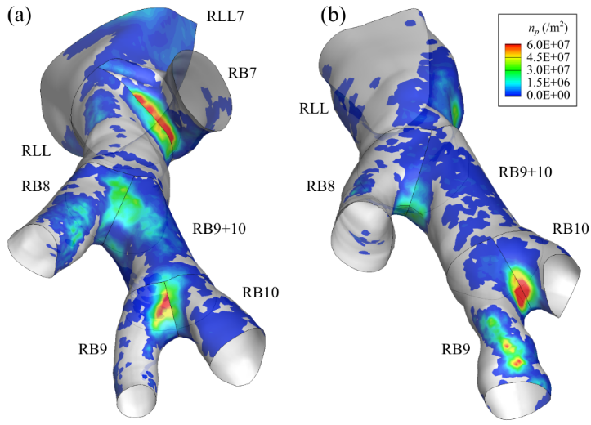
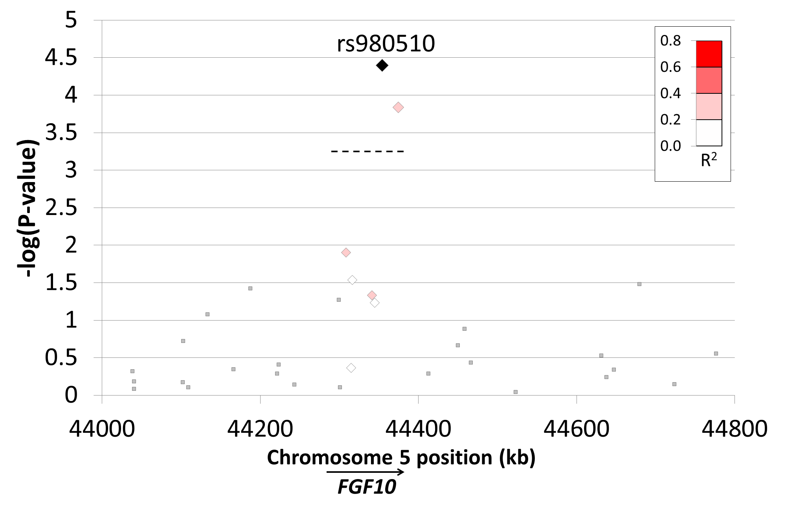
MESA Lung Non-Smokers
Aim 1 Variant airway anatomy predicts COPD, respiratory symptoms, and lung function decline among non-smokers
Aim 2 Variant airway anatomy modifies particulate matter deposition in computational fluid dynamic (CFD) model of participant specific airway geometry
Aim 3 GWAS will discover genetic variants underlying variant airway anatomy
FGF10

Slide 2
MESA Lung Non-Smokers
Aim 1 Primary data collection completion (Q1 of Y3)
Aim 2 CFD analyses commence (Y3)
Aim 3 DNA extraction complete (n=1,417), genotyping (Y3)
4 publications Proc Nat Acad Sci, Thorax, Ann ATS
5 accepted abstracts
4 active paper proposals MESA, MESA Genetics, TOPMed

Slide 3
MESA Lung III/Non-Smokers: Recruitment
Completed to date
Exam 6 | Completed | Target | Completed/Target
MESA | 3,082 | 3,998 | 77%
MESA Lung III/NS
Any CT or spirometry | 2,602 | 2,650 | 98%
Contrast CT protocol | 681 | 1,000 | 68%
Non-contrast CT protocol | 1,412 | 1,650 | 86%
Spirometry | 2,410 | 2,650 | 91%
Lung questionnaire | 2,406 | 2,650 | 91%
As of March 25, 2018
Notes:
Sources to achieve target:
Consented, eligible but procedure not completed (WF, CU, NWU, UCLU):
Contrast CT 242
Non contrast CT 183
Spirometry 179
Visit not performed (WF, CU, NWU, UCLU):
WF 319
CU 176
NWU 126
UCLA 175
Consented, eligible, but not done:
SPIRO:
WF 47
CU 21
NWU 80
UCLA 31
Contrast CT
WF 49
CU 29
NWU 16
UCLA 148
Non contrast CT
WF 56
CU 29
NWU 51
UCLA 47

Slide 4
MESA Lung III/Non-Smokers
Completed to date
Exam 6 | Completed | Target | Completed/Target
MESA | 3,082 | 3,998 | 77%
MESA Lung III/NS
Contrast CT protocol | 681 | 1,000 | 68%
Non-contrast CT protocol | 1,412 | 1,650 | 86%
Spirometry | 2,410 | 2,650 | 91%
Lung questionnaire | 2,406 | 2,650 | 91%
As of March 25, 2018
Notes:
Sources to achieve target:
Consented, eligible but procedure not completed (WF, CU, NWU, UCLU):
Contrast CT 242
Non contrast CT 183
Spirometry 179
Visit not performed (WF, CU, NWU, UCLU):
WF 319
CU 176
NWU 126
UCLA 175
Consented, eligible, but not done:
SPIRO:
WF 47
CU 21
NWU 80
UCLA 31
Contrast CT
WF 49
CU 29
NWU 16
UCLA 148
Non contrast CT
WF 56
CU 29
NWU 51
UCLA 47

Slide 5
MESA Lung III/Non-Smokers
Achieving target*
Exam 6 | Visit initiated, consented, eligible, but not done
Site | WF | CU | NWU | UCLA | Total
Contrast CT protocol | 49 | 29 | 16 | 148 | 242
Non-contrast CT protocol | 56 | 29 | 51 | 47 | 183
Spirometry | 47 | 21 | 80 | 31 | 179
Exam 6 | Visit not initiated but expected
Site | WF | CU | NWU | UCLA | Total
No. | 319 | 176 | 126 | 175 | 796
*Big thanks to JHU and MINN for meeting/exceeding MESA Lung III/NS targets!
As of March 25, 2018
Notes:
Sources to achieve target:
Consented, eligible but procedure not completed (WF, CU, NWU, UCLU):
Contrast CT 242
Non contrast CT 183
Spirometry 179
Visit not performed (WF, CU, NWU, UCLU):
WF 319
CU 176
NWU 126
UCLA 175
Consented, eligible, but not done:
SPIRO:
WF 47
CU 21
NWU 80
UCLA 31
Contrast CT
WF 49
CU 29
NWU 16
UCLA 148
Non contrast CT
WF 56
CU 29
NWU 51
UCLA 47

Slide 6
MESA Lung III/Non-Smokers
Good quality, but need more post-bronchodilator
A
B
Spirometry | Completed | Selected, consented and eligible | %
Pre-BD | 2,410 | 2,622 | 92
Post-BD | 356 | 645 | 55
Spirometry quality grade
C
D
F
E6
Start
As of March 25, 2018
Notes:
Sources to achieve target:
Consented, eligible but procedure not completed (WF, CU, NWU, UCLU):
Contrast CT 242
Non contrast CT 183
Spirometry 179
Visit not performed (WF, CU, NWU, UCLU):
WF 319
CU 176
NWU 126
UCLA 175
Consented, eligible, but not done:
SPIRO:
WF 47
CU 21
NWU 80
UCLA 31
Contrast CT
WF 49
CU 29
NWU 16
UCLA 148
Non contrast CT
WF 56
CU 29
NWU 51
UCLA 47

