Slide 1
MESA PET
MESA Steering Committee Meeting
March 27-28, 2019
Bethesda, MD
Steven Shea, MD, MS
Disclosures: None
Conflicts: None
Funding: R01HL127637

Slide 2
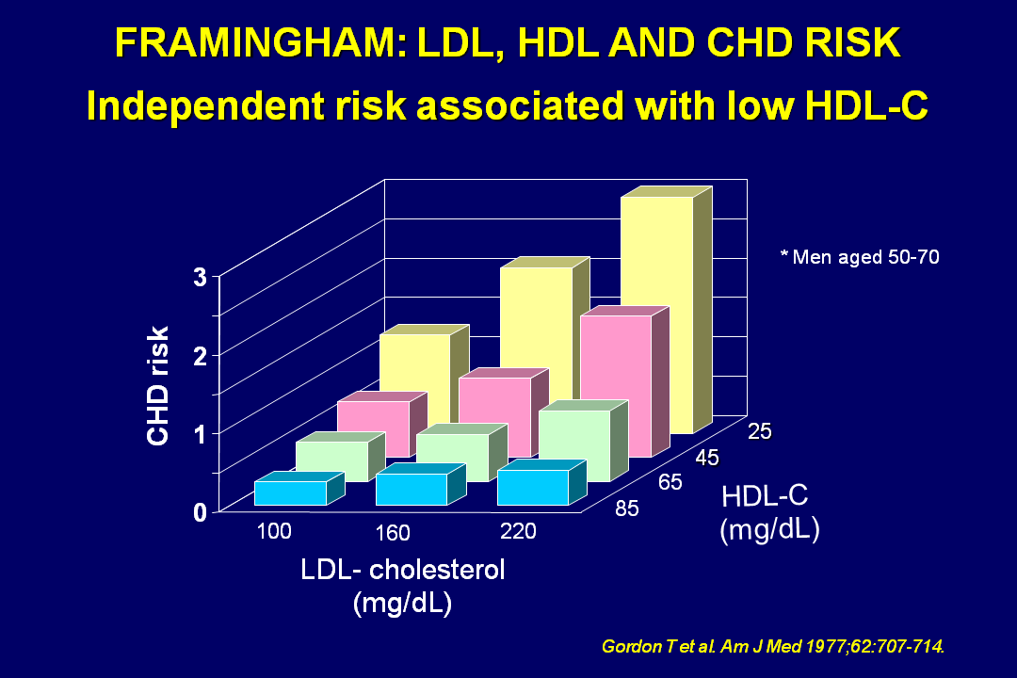

Slide 3
Paramsothy P,….Heckbert S. JACC 2010;56:1034-1041.

Slide 4
HDL-Mediated Reverse Cholesterol Transport and Efflux of Cholesterol from Macrophage Foam Cells in Plaque
Rader DJ, Tall AR. Nat Med 2012;18:1344-1346.

Slide 5
Khera AV, et al. New Engl J Med 2011;364:127-135.
Cholesterol efflux capacity of HDL inversely related to coronary atheroma burden at coronary angiography
Rohatgi A, et al. New Engl J Med 2014;371:2382-2393 -- longitudinal data from Dallas Heart study
Saleheen D, et al. Lancet Diabetes Endocrin 2015;3:507-513 – case control data from Epic-Norfolk Study
Cholesterol efflux capacity of HDL inversely related to CHD incidence
Relationship found after adjustment for serum HDL level.
Conflicting or inconsistent findings: JUPITER Study (Khera AV, et al. Circulation 2017;135:2494-2504) and Li XM, et al. ATVB 2013;33:1696-1705.
Possible explanations: sample size, study design, assay for efflux.
Khera AV, et al. New Engl J Med 2011;364:127-135.
Cholesterol efflux capacity inversely related to carotid IMT in 203 healthy White individuals

Slide 6
HDL-Mediated Cholesterol Efflux and Plaque Inflammation in MESA
Aim 1. To test the hypothesis that HDL-mediated cholesterol mass efflux using subjects’ HDL from MESA Exam 1 samples assayed in THP-1 macrophages is inversely associated with
(a) incidence of CVD (n=453 cases and 453 age- and sex-matched controls), and (b) progression of carotid plaque by ultrasound (n=450 cases, n=450 controls), after adjustment for standard CVD risk factors.
Aim 2. To test the hypothesis that HDL-mediated cholesterol mass efflux using subjects’ HDL assayed in THP-1 macrophages is inversely associated with
FDG uptake in carotid plaque and with carotid plaque volume, using blood samples and PET-MRI data to be collected at MESA Exam 6 (n=350 subjects)
Other MRI-derived variables, including plaque wall area, plaque wall thickness, plaque eccentricity, normalized [plaque] wall index, and plaque composition (presence or absence of a lipid rich necrotic core, calcification or intra-plaque hemorrhage) will be examined as secondary outcomes.

Slide 7
Arterioscler Thromb Vasc Biol 2019;39:89-96.

Slide 9
Cohort 1
Cases: incident CVD exams 1-5 (N=465)
Controls: age (5 years) and sex-matched; at least as much event-free time as cases (N=465)
Cohort 2
Cases: carotid plaque progression exams 1-5 →N=1923 → random sample based on age and
sex-match to controls (N=407 cases and N=407 controls)
plaque¹ defined as a discreet, focal wall thickening >1.5 cmr focal thickening >50% greater than the surrounding intima-media thickening.
plaque score (range 0-12) defined as number of plaques in internal, bifurcation, and common segments of both carotid arteries.
plaque progression² defined as an increase in plaque score (almost always due to appearance of new plaque).
1. Stein JH et al. J Am Soc Echocariogr 2008;21:93-111.
2. Tattersall MC et al. Stroke 2014;45:3257-3262.

Slide 10
Statistical Methods: conditional logistic regression (conditioned on matching factors)
Model 1: adjusted for age, sex, race/ethnicity, study site, BMI
Model 2: additionally adjusted for diabetes, current smoking, SBP, TC, HDL
Model 3: additionally adjusted for pack-years, alcohol use, intentional exercise, Med Diet score¹
1. Abiemo EE et al. Br J Nutr 2013:109:1490-1497.

Slide 11
Cholesterol Mass Efflux Capacity (CMEC)
1. Yvan-Charvet L, et al. Arterioscler Thromb Vasc Biol 2010;30:1430-1438.

Slide 15
Results
Cohort 1
Cohort 2

Slide 16
Cohort 1 only

Slide 17
Results
Cohort 1
Cohort 2

Slide 18
Supplemental Table VII: Dose response analysis of the association between CMEC and plaque progression.
Possible values for plaque progression were integers ranging from 0 to 10 (based on a plaque score ranging from 0 to 12). Progression=0 are the controls and are not included in the dose response analysis. Groups were defined as follows: 1=1; 2=2; 3-10 =3; >3 the groups were sparse and therefore considered as one category.
 | Cholesterol Mass Efflux Capacity CMEC)
Amount of Plaque Progression | Mean ± SD | P value
All Cases of Plaque Progression | 2.8 ± 1.8 (n=407) | 0.162
1 | 3.2 ± 1.9 (n=169)
2 | 2.8 ± 1.8 (n=98)
>3 | 3.1 ± 2.0 (n=140)

Slide 19
Supplementary Table III. Conditional Logistic Regression Models for Plaque Progression for Model 2 with all Covariates
 | Plaque Progression (N=814; Events=407)
 | OR (95% CI) | p
Age (yrs) | 1.01 [0.93,1.10] | 0.783
Race
Caucasian | ref
Chinese | 0.28 [0.15,0.50] | <0.001
African American | 0.52 [0.33,0.82] | 0.005
Hispanic | 0.74 [0.47,1.17] | 0.197
BMI | 0.99 [0.96,1.02] | 0.568
MESA Field Center
Wake Forest | ref
Columbia | 1.47 [0.82,2.65] | 0.193
Johns Hopkins | 1.40 [0.77,2.57] | 0.270
Minnesota | 2.21 [1.17,4.18] | 0.014
Northwestern | 1.53 [0.85,2.74] | 0.153
UCLA | 2.01 [1.05,3.83] | 0.034
Diabetes
Normal | Ref
IFG | 1.12 [0.72,1.73] | 0.616
Untreated Diabetes | 3.58 [0.89,14.40] | 0.072
Treated Diabetes | 2.08 [1.11,3.88] | 0.022
Current Smoker | 2.50 [1.47,4.26] | 0.001
Total Cholesterol | 1.01 [1.00,1.01] | 0.026
HDL Cholesterol | 0.99 [0.97,1.00] | 0.017
Statin Use | 1.01 [0.63,1.61] | 0.979
Hypertension Medication | 0.96 [0.66,1.39] | 0.818
Systolic BP | 1.02 [1.01,1.02] | 0.001
Efflux Mass (mg/dL) (per SD=1.9) | 1.20 [1.02,1.42] | 0.030

Slide 20
Limitations
Small number of strokes (N=28) in Cohort 2 and inability to assess relationship to plaque or plaque progression.
  Gepner AD, et al. Circ Cardiovasc Imaging 2015;8:e002262.
    Plaque but not IMT predicts incident stroke or TIA in MESA
Limitations of the efflux assay

Slide 21
Summary
HDL-mediated cholesterol efflux was inversely associated with risk of CHD but not stroke (cohort 1).
HDL-mediated cholesterol efflux was positively associated with plaque progression but without dose response relationship suggesting that this finding is of minimal or unclear significance.

Slide 22
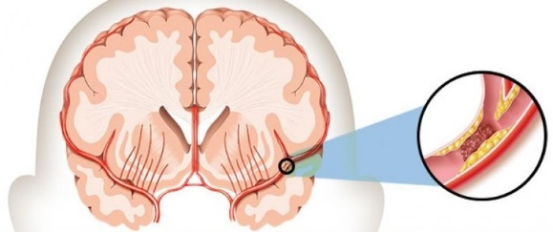
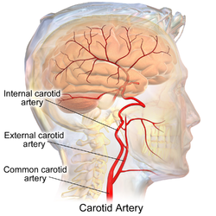

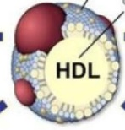

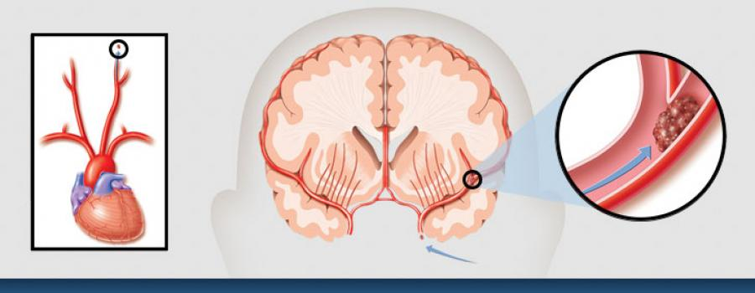
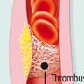
Graphical Abstract
ØStroke
CMEC
cholesterol
Cohort 1
⬇CVD
CMEC
n=465 cases
n=465 controls
MESA: 10years follow-up
⬇CHD
CVD: cardiovascular diseases; CHD: coronary heart diseases; CMEC: HDL-mediated mass cholesterol efflux

Slide 24
Supplementary Table IV. Conditional Logistic Regression Models for Incident Hard CVD for Model 2 with all Covariates
 | Incident Hard CVD (N=930; Events=465)
 | OR (95% CI) | p
Age (yrs) | 1.19 [1.11,1.29] | <0.001
Race
Caucasian | ref
Chinese | 0.65 [0.37,1.13] | 0.126
African American | 0.93 [0.61,1.41] | 0.735
Hispanic | 0.91 [0.58,1.43] | 0.696
BMI | 1.02 [0.99,1.06] | 0.144
MESA Field Center
Wake Forest | ref
Columbia | 0.90 [0.51,1.59] | 0.714
John’s Hopkins | 0.75 [0.44,1.27] | 0.285
Minnesota | 1.37 [0.76,2.46] | 0.296
Northwestern | 0.69 [0.39,1.21] | 0.192
UCLA | 0.79 [0.44,1.40] | 0.418
Diabetes
Normal | Ref
IFG | 1.05 [0.70,1.59] | 0.800
Untreated Diabetes | 0.83 [0.38,1.81] | 0.644
Treated Diabetes | 2.35 [1.48,3.73] | <0.001
Current Smoker | 1.72 [1.12,2.63] | 0.013
Total Cholesterol | 1.00 [1.00,1.01] | 0.211
HDL Cholesterol | 0.99 [0.98,1.01] | 0.319
Statin Use | 0.86 [0.58,1.28] | 0.459
Hypertension Medication | 1.34 [0.97,1.86] | 0.080
Systolic BP | 1.01 [1.01,1.02] | <0.001
Efflux Mass (mg/dL) (per SD=1.9) | 0.80 [0.68,0.94] | 0.006

