Slide 1
MESA Atrial Fibrillation Study
Atrial fibrillation burden, vascular disease of the brain and cardiac MRI in MESA
All 6 field centers
PI: Susan Heckbert
N=1350 participants for brain MRI
12-21 months after Exam 6 visit

Slide 2
Primary aims
  1) Association of AF and AF burden on extended cardiac monitoring with brain structure & function on MRI
  2) Association of cardiac structure and function with AF and AF burden
Exam 5 Exam 6 12-21 mos after Ex 6 follow-up
Cardiac MRI
NT-proBNP
ECG monitoring
Cognitive function Qs
Physical function Q
Blood draw
Brain MRI
Physical function Q
CV events ascertainment

Slide 3
MRI Recruitment
Penn MRI Reading Center, PI: Nick Bryan
MRI site visit training completed by 2/15/18
To date, 19 brain MRI participant scans received:
  John Hopkins: 8 scans (1st participant scan: 3/1/18)
  Columbia: 5 scans (start date: 3/8/18)
  U Minnesota: 5 scans (start date: 3/12/18)
  Wake Forest: 1 scan (start date: 3/3/18)
Pending sites:
  Northwestern: 3DASL sequence (pending MTA)
  UCLA: fMRI software/participant scheduling preparation
Notes:
CC will tell them who is up for a scheduling call & target dates
IRB: Col & Minn have approval; UCLA & WF have this mod in IRB queue; JHU will go in soon; need update from NW

Slide 4
MESA Brain MRI protocol
Outcome measure | Scanning Procedure | Time min:sec
(Localizer) | 3D Gradient Echo | 0:25
Structural/morphology | 3D T1 | 4:26
Structural/morphology | 3D FLAIR | 4:20
Structural/morphology | 3D T2 | 4:08
Cerebral blood flow | 2D Arterial Spin Labeling | 5:32
White matter integrity | Diffusion Tensor Imaging | 4:37
Functional connectivity | BOLD fMRI Resting State | 4:06
Vascular reactivity | BOLD fMRI Breath Hold | 3:36
Cerebral microbleeds | Susceptibility Weighted Imaging | 4:35
 | TOTAL | 35:20

Slide 5
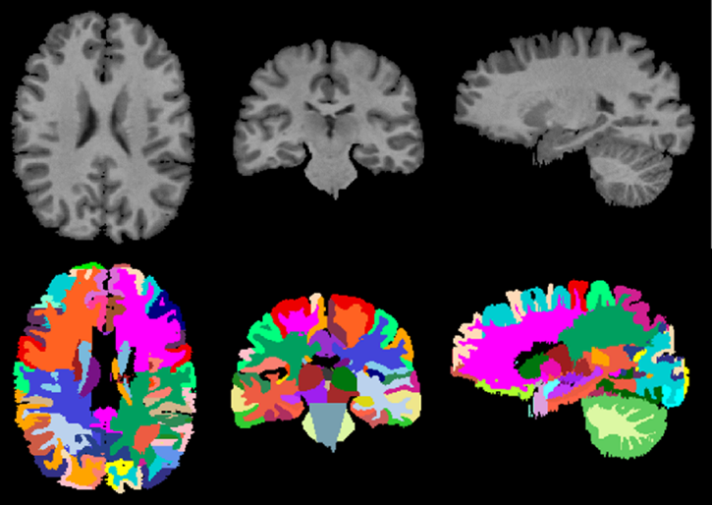
Brain MRI Variables
Total Brain Volume (TBV) and ROI volumes: calculated from T1, T2
White Matter Lesion (WML): Volume of lesions in each (ROI); calculated from T1, T2, FLAIR
Fractional Anisotropy (FA) and Mean Diffusivity (MD): Measures of white matter integrity, calculated from DTI
Cerebral Microbleeds (CMB): Calculated from SWI
Cerebral Blood Flow (CBF): Mean CBF value; calculated from ASL
Vascular reactivity (VR); calculated from breathhold fMRI
Functional Connectivity (FC): calculated from resting state fMRI

Slide 6
MESA Brain MRI
Structural: T1, T2, FLAIR (1 x 1 x 1 mm)
Diffusion tensor imaging: Fractional anisotropy (FA) and mean diffusivity (MD)
Cerebral blood flow (CBF): Arterial spin label (ASL) method
Vascular reactivity (VR): breath hold BOLD fMRI
Functional connectivity: resting state BOLD fMRI
Susceptibility weighted imaging: microbleeds

Slide 7
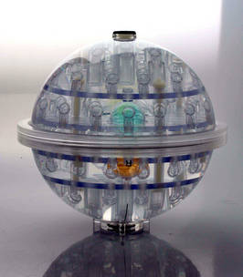
MRI Certification: Site visit/preparation
Phantom Test scans: Scanner performance
  Baseline measurement prior to study start-up and quarterly thereafter
Volunteer Test scan: MRI protocol implementation
  Image quality assessment for MRI processing/analysis
MRI scan data transfer:
  ACRIN/TRIAD installation
Study data entry/completion process
ADNI and fBIRN phantoms

Slide 8
MRI Scanner Performance
Phantom Q/C
Will monitor scanner stability and comparability
Quarterly schedule for each MESA MRI site
Q/A metrics can be used to match analysis strategies between sites, or…
To model site-dependent differences

Slide 9
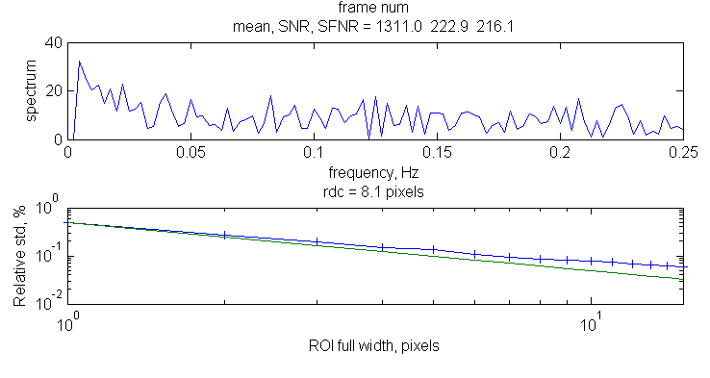
fBIRN Phantom Analysis
Analysis done “in house”
fBIRN distributed software (Matlab)
7 metrics related to scanner temporal stability
  Signal-to-Fluctuation Noise Ratio (SfNR)
  Radius of DeCorrelation (RDC)
  Mean Signal
  Drift
  SNR
  …
* SfNR and RDC metrics will be primary markers

Slide 10
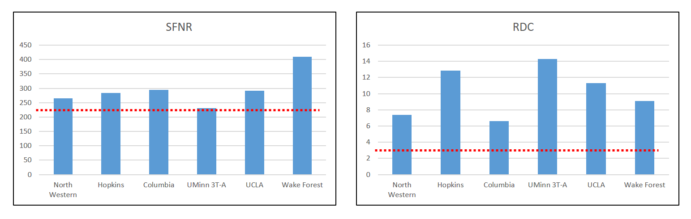
QC: fBIRN Phantom
Baseline Scanner Measurements
Sites must be ABOVE red dotted line to pass
All MESA MRI sites passed!

Slide 11
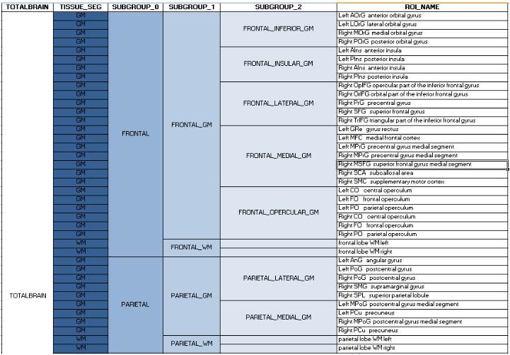
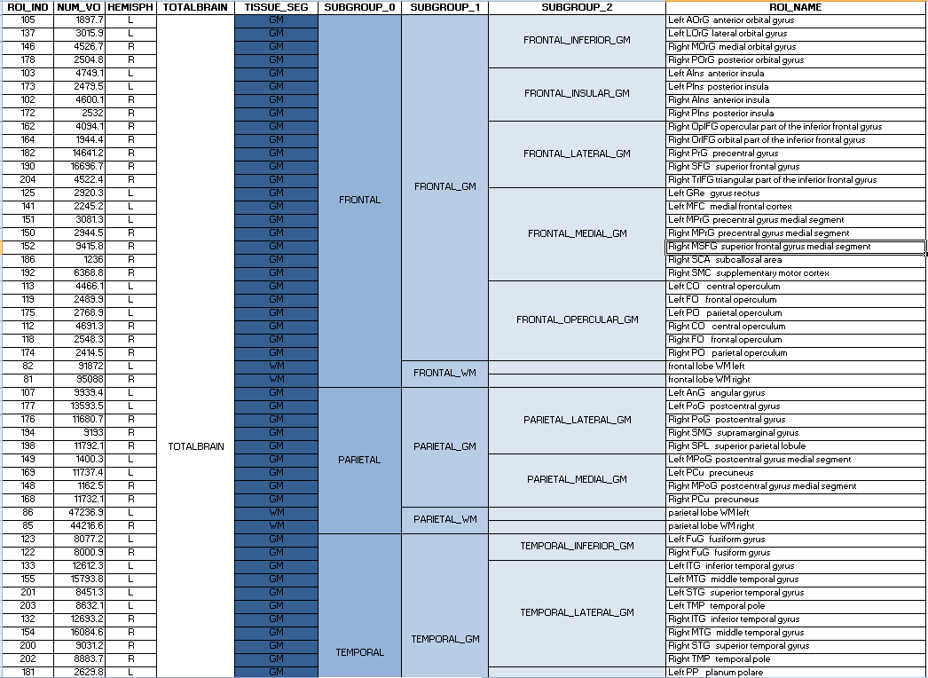
ROI hierarchy:
Volumes are reported for single ROIs (finest parcellation), as well as for derived ROIs, i.e. larger anatomic regions obtained by combining single ROIs.
11
Notes:
11

Slide 12
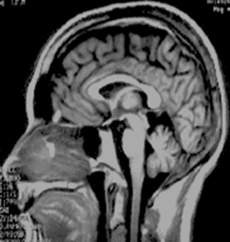
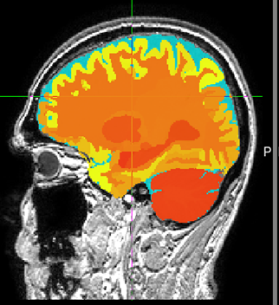
QC: Pilot MRI scans: volumes
(Traveling Volunteer scanned at all MESA MRI sites)
Site | Scan Date | ICV | TBV | GM volume | WM volume
UCLA | 2/8/18 | 1075163.841 | 1045687.675 | 586696.6248 | 458991.0507
Wake Forest | 1/8/18 | 1075967.789 | 1046612.74 | 583619.1177 | 462993.6218
John Hopkins | 1/9/18 | 1077363.968 | 1048042.297 | 588531.4941 | 459510.8032
Northwestern | 11/30/17 | 1071580.887 | 1042470.932 | 583142.2806 | 459328.6514
Columbia | 2/15/18 | 1082768.44 | 1053701.401 | 595344.5435 | 458356.8573
U Minnesota | 12/18/17 | 1075690.269 | 1046325.684 | 588465.6906 | 457859.993
Mean (SD%) |  | 1076422 (0.34%) | 1047140 (0.35%) | 587633 (0.75%) | 459506 (0.39%)

Slide 13
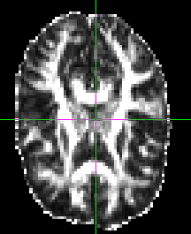
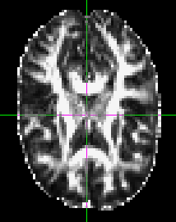
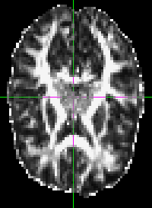
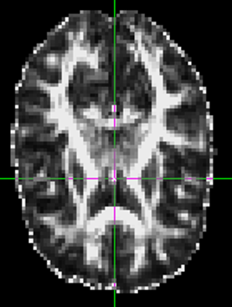
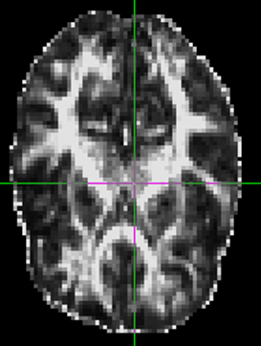
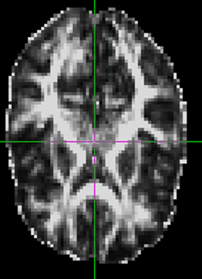
QC: Pilot MRI Scans: DTI
Site | Scan Date | Mean FA in WM | MD in WM
UCLA | 2/8/18 | 0.269725 | 0.002771729
Wake Forest | 1/8/18 | 0.259814 | 0.002883639
John Hopkins | 1/9/18 | 0.265915 | 0.002775033
Northwestern | 11/30/17 | 0.265491 | 0.002806493
Columbia | 2/15/18 | 0.26729 | 0.002745863
U Minnesota | 12/18/17 | 0.26508 | 0.002806648
Mean (SD%) |  | 0.266 (1.2%) | 0.00280 (1.7%)
FA MAPS
UCLA Columbia John Hopkins
UMINN Northwestern Wake Forest

Slide 14
Pilot MRI Scans (DTI)
DTI: FA
Site | Scan Date | ICV | TBV | GM | WM
UCLA | 2/8/18 | 0.209184413 | 0.206491909 | 0.156096619 | 0.266827508
Wake Forest | 1/8/18 | 0.206522321 | 0.204026398 | 0.161503787 | 0.254215148
John Hopkins | 1/9/18 | 0.206729003 | 0.204026739 | 0.153684217 | 0.264396665
Northwestern | 11/30/17 | 0.207900976 | 0.204956677 | 0.156035144 | 0.263161269
Columbia | 2/15/18 | 0.208721583 | 0.205771977 | 0.156803205 | 0.265708331
U Minnesota | 12/18/17 | 0.205138894 | 0.202402616 | 0.152325273 | 0.262833829
DTI: TR
Site | Scan Date | ICV | TBV | GM | WM
UCLA | 2/8/18 | 0.002970186 | 0.002935102 | 0.00307156 | 0.002771729
Wake Forest | 1/8/18 | 0.003091307 | 0.003053052 | 0.003196588 | 0.002883639
John Hopkins | 1/9/18 | 0.002973276 | 0.002939521 | 0.003076688 | 0.002775033
Northwestern | 11/30/17 | 0.002988594 | 0.002955456 | 0.00308066 | 0.002806493
Columbia | 2/15/18 | 0.002933921 | 0.002901846 | 0.003029287 | 0.002745863
U Minnesota | 12/18/17 | 0.002999855 | 0.002965305 | 0.003096779 | 0.002806648

Slide 15
MESA Center Concerns/Questions?
Participant completion timeline
FC personnel status
MRI participant concerns
  Scheduling
  MRI location
  Parking/Transportation
Other?

