Slide 1
Myocardial Infarction As A Clinical Endpoint In Research—What are we really talking about?
Andrew DeFilippis, MD, MSc
Khurram Nasir, MD, MPH, MSc
Michael J. Blaha, MD, MPH
MESA Ancillary Study
Approval 8/15/2018

Slide 2
MESA Case 1

Slide 3
MESA Case 1

Slide 4
MESA Case 1
99th percentile = 0.034

Slide 5
MESA Case 1: Diagnosis
Acute MI?
Preventable with aspirin and statin?

Slide 6
MESA Case 2

Slide 7
MESA Case 2

Slide 8
MESA Case 2

Slide 9
MESA Case 2: Diagnosis
Acute MI?
Preventable with aspirin and statin?

Slide 10
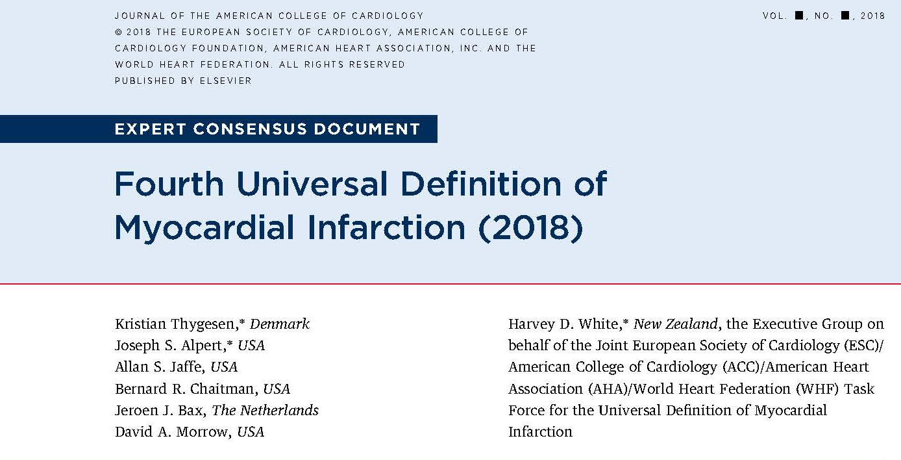
Defining Myocardial Infarction

Slide 11
Terminology
Myocardial Injury: The UDMI defines myocardial injury based on elevation in cTn concentration, with at least one value >99th percentile upper reference limit derived from a normal reference population.
Myocardial Ischemia: Inadequate oxygen supply to the myocardium
Myocardial Infarction (MI): Myocardial injury secondary to ischemia

Slide 12
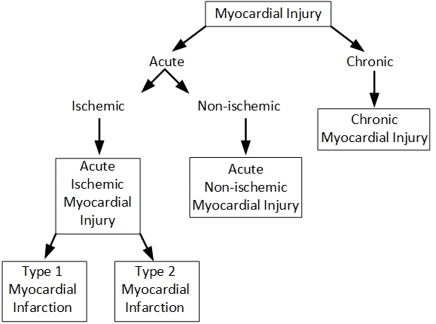
Myocardial injury taxonomy

Slide 13
Types of Myocardial Injury and MI
Classification | Definition
Acute Myocardial Infarction (MI) | Clinical evidence of acute myocardial injury as evident from detection of a rise and/or fall of cTn values with at least one value above the 99th percentile URL and at least one of the following symptoms of myocardial ischemia: Symptoms of acute myocardial ischemia New ischemic ECG changes Development of pathological Q waves Imaging evidence of new loss of viable myocardium or new regional wall motion abnormality in a pattern consistent with an ischemic etiology Identification of a coronary thrombus by angiography or autopsy (not for type 2 MI)
Type 1 MI | MI caused by atherothrombotic coronary artery disease and usually precipitated by atherosclerotic plaque disruption (rupture or erosion)
Type 2 MI | MI caused by a mismatch between oxygen supply and demand by a pathophysiological mechanism other than coronary atherothrombosis (Type 1 MI)
Type 3 MI | Cardiac death, with symptoms suggestive of myocardial ischemia accompanied by presumed new ischemic ECG changes or ventricular fibrillation, but death occurs before blood samples for biomarkers can be obtained, or before increases in cardiac biomarkers can be identified, or MI is detected by autopsy examination
Type 4a MI | Elevation of cTn values more than five times the 99th percentile URL, ≤ 48 hours after the index percutaneous coronary intervention procedure, in patients with normal baseline values. In patients with elevated pre-procedure cTn in whom the cTn level are stable (<20% variation) or falling, the post procedure cTn must rise by >20%. However, the absolute post-procedural value must still be at least five times the 99th percentile URL. In addition, one of the following is required: Coronary imaginig consistent with a procedural flow-limiting complication such as coronary dissection, occlusion of a major epicardial artery or a side branch occlusion/thrombus, disruption of collateral flow, or distal embolization. New ischemic ECG changes Development of pathological Q waves Imaging evidence of new loss of viable myocardium or new regional wall motion abnormality in a pattern consistent with an ischemic etiology
Type 4b MI | MI secondary to stent/scaffold thrombosis documented by angiography or autopsy
Type 4c MI | MI secondary to a focal or diffuse restenosis, or a complex lesion associated with a rise and/or fall of cTn values above the 99th percentile URL, applying the same criteria utilized for type 1 MI
Type 5 MI | Elevation of cTn values > 10 times the 99th percentile URL, ≤ 48 hours after the index coronary artery bypass grafting, in patients with normal baseline cTn values. In patients with elevated pre-procedure cTn in whom cTn levels are stable (<20% variation) or falling, the post-procedure cTn must rise by > 20%. However, the absolute post procedural value still must be > 10 times the 99th percentile URL. In addition, one of the following elements is required: Development of new pathological Q waves Angiographic documented new graft occlusion or new native coronary artery occlusion Imaging evidence of new loss of viable myocardium or new regional wall motion abnormality in a pattern consistent with an ischemic etiology
Silent/Unrecognized MI | Any one of the following criteria meets the diagnosis for prior or silent/unrecognized MI: Abnormal Q waves with or without symptoms in the absence of nonischemic causes Imaging evidence of loss of viable myocardium in a pattern consistent with ischemic etiology Patho-anatomical findings of a prior MI
Acute Non-Ischemic Myocardial Injury | Acute myocardial injury (rise and/or fall in biomarkers [cTn]) in the absence of a primary ischemic cause (i.e. absence of MI).
Chronic Myocardial Injury | Chronic myocardial injury (cTn >99th percentile URL without an acute change)
Notes:
Accurate atherosclerotic cardiovascular disease (ASCVD) risk assessment is essential to effectively balance the risks and benefits of therapy in primary prevention.

Slide 14
Types of Myocardial Injury and MI
Classification | Definition
Acute Myocardial Infarction (MI) | Clinical evidence of acute myocardial injury as evident from detection of a rise and/or fall of cTn values with at least one value above the 99th percentile URL and at least one of the following symptoms of myocardial ischemia: Symptoms of acute myocardial ischemia New ischemic ECG changes Development of pathological Q waves Imaging evidence of new loss of viable myocardium or new regional wall motion abnormality in a pattern consistent with an ischemic etiology Identification of a coronary thrombus by angiography or autopsy (not for type 2 MI)
Type 1 MI | MI caused by atherothrombotic coronary artery disease and usually precipitated by atherosclerotic plaque disruption (rupture or erosion)
Type 2 MI | MI caused by a mismatch between oxygen supply and demand by a pathophysiological mechanism other than coronary atherothrombosis (Type 1 MI)
Acute Non-Ischemic Myocardial Injury | Acute myocardial injury (rise and/or fall in biomarkers [cTn]) in the absence of a primary ischemic cause (i.e. absence of MI).
Chronic Myocardial Injury | Chronic myocardial injury (cTn >99th percentile URL without an acute change)

Slide 15
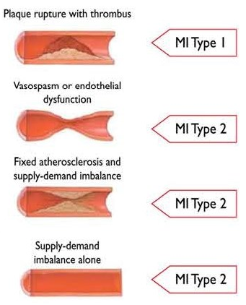
Myocardial Infarction
Non-Ischemic Myocardial Injury
e.g., tachyarrhythmia
Myocarditis
Chemotherapy
Acidosis
e.g., hypoxemia

Slide 16
Prevalence of Type 1 MI, Type 2 MI and Non-ischemic Myocardial Injury
3762 unselected consecutive hospitalized patients with cTn measured at the request of their physicians.
  42% had one or more elevated values
  31% had adjudicated diagnosis of MI
  69% were adjudicated acute or chronic myocardial injury
Most studies find the overwhelming majority of MI’s are equally split between Type 1 and Type 2
Sarkisian L. Am J Med 2016;129:506-14

Slide 17
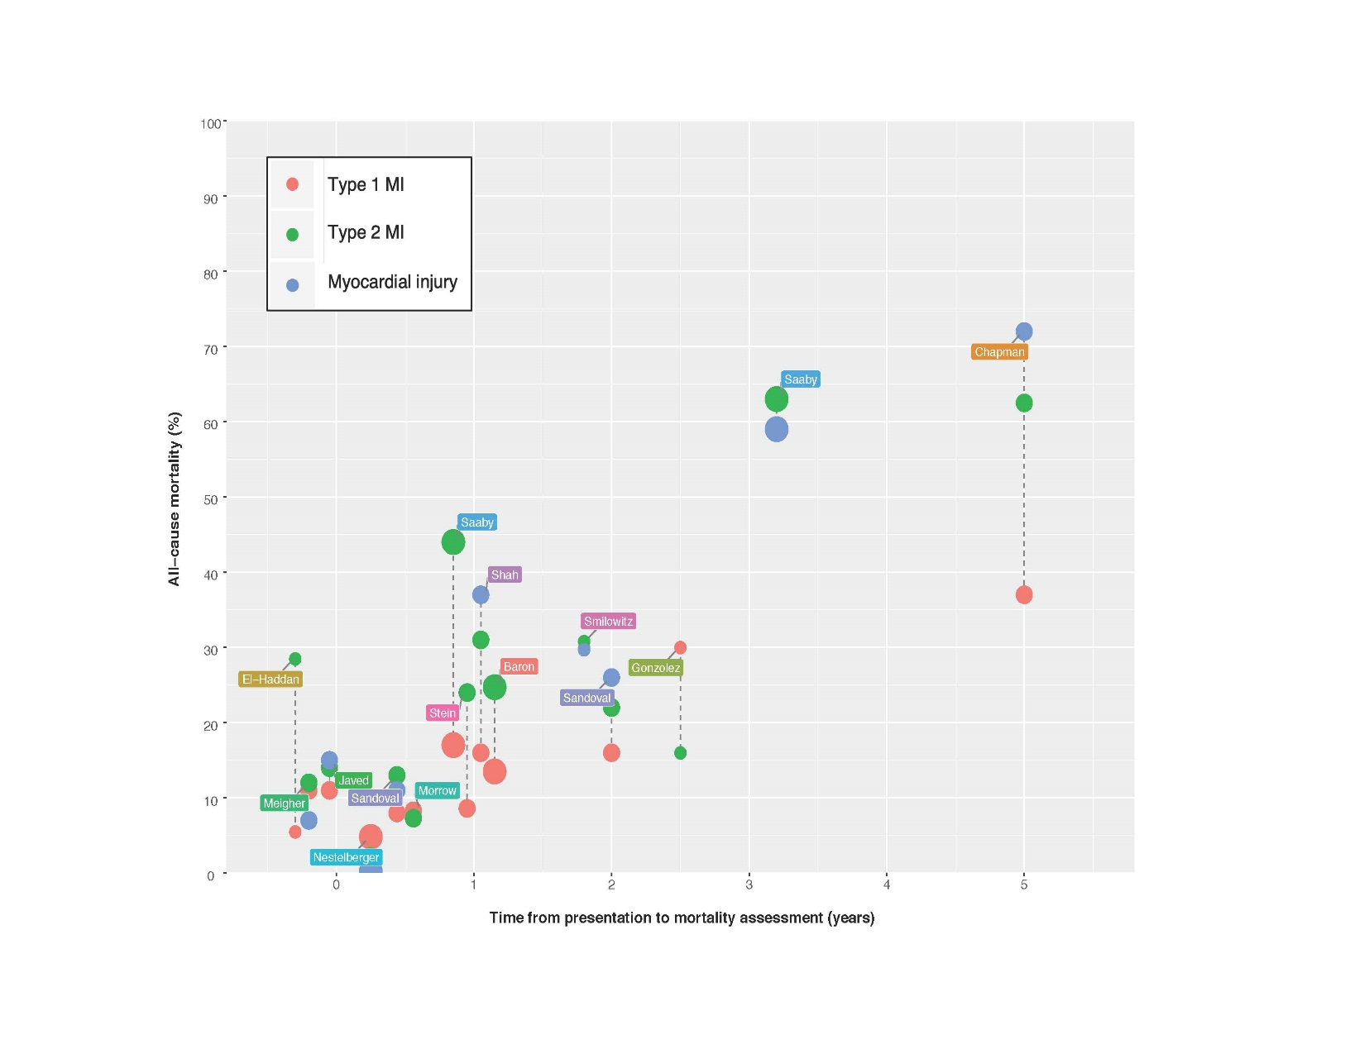
Are Type 2 MI’s and Non-ischemic Myocardial Injury Events Dangerous

Slide 18
MI Size Then and Now
Diagnosis of NSTEMI increases 28 – 195% with utilization of cTn assays introduced in the 1990s as compared CK-MB.
cTn assays introduced in the 2000s increase the diagnosis of acute MI by ~ 50%.
Moratorium on the diagnosis of unstable angina.
Kontos MC. Am Heart J 2003;146:446-52
Mills NL. BMJ 2012;344:e1533.
Braunwald E. Circulation 2013;127:2452-7

Slide 19
The Problem
Despite the greater prevalence, mortality and distinct pathobiology, no prospective cohorts have identified type 2 MI or non-ischemic myocardial injury as defined by international consensus.
  A fundamental understanding of the epidemiology of myocardial injury events, including the risk factors for all AMI sub-types and non-ischemic myocardial injury events, is needed to advance the prediction, prevention, and treatment of these leading causes of death.

Slide 20
The Solution
Adjudicating all clinical events of suspected myocardial injury in MESA as AMI Type 1-5, acute non-ischemic myocardial injury, or chronic non-ischemic myocardial injury, as defined by the Fourth Universal Definition of Myocardial infarction.
  This will result in the first and only NIH/NHLBI prospective cohort with sub classification of one of the most common medical findings and leading causes of death, AMI and non-ischemic myocardial injury.

Slide 21
Hypothesis and Aims
The incidence of, and the risk factors for, etiological distinct types of AMI (type 1 and 2) will differ significantly.
Aim 1: Determine the incidence of all acute MI sub-types (type 1-5) over 14 years of follow-up to understand the changing epidemiology of myocardial injury.
Aim 2: Compare the size and strength of association between traditional atherosclerotic cardiovascular risk factors with individual acute MI sub-types.
Aim 3: Compare the size and strength of association between novel risk factors including burden and features of atherosclerosis, inflammation, and reporters of thrombogenicity with type of acute MI and myocardial injury events.

Slide 22

MESA Cohort
18,975 individual events have been identified, investigated and evaluated for appropriateness for full evaluation by the physician adjudication committee.
4,865 underwent full physician adjudication committee evaluation.

Slide 23
Adequacy of Records
36 randomly selected cases (3 adjudicated as AMI & 3 adjudicated as not AMI from 6 sites)
Data | Availability N (%)
 | All | Adjudicated as AMI (n=18) | Adjudicated as not-AMI (n=18)
Pages of medical records per case (mean) | 35 | 35 | 39 (excluding 2 cases of out of hosp death)
H&P, Consult, Discharge Summary or Death Certificate | 36 (100%) | 18 (100%) | 18 (100%)
ECG report | 31* | 18 | 13*
ECG Image | 27* | 17** | 10*
cTn | 32* | 18 | 14*
> 1 cTn value | 24 | 16*** | 8*
*ECG / ECG report / cTn not available in three cases secondary death before ECG obtained
**no image for a case of an 82 year old with colitis, brady code, sig ICU stay and then died
***single cTn value in a participant with inferior STEMI treated with percutaneous coronary intervention and a participant with delirium tremors and non-sustained ventricular tachycardia

Slide 24
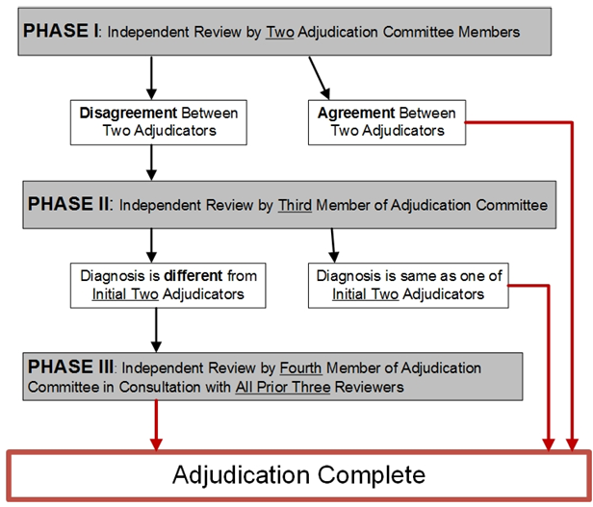
Adjudication Process Schematic

Slide 25
Thank you for attention
Suggestions?

Slide 26
Collaborative MESA Effort
Data Coordinating Center
  Robyn L McClelland, PhD
  John B Pearce
  Craig Johnson
Field Centers
  Wendy Post, MD, MS
  Sonia
Adjudication Committee
  Aaron Folsom, MD, MPH

Slide 27
Data Coordinating Center
CC will assist with development of protocol and criteria for what records will be reviewed.
CC will handle selection of clinical event investigations
CC will arrange for transfer of associated medical records with appropriate tracking and verification that protocols ensuring ppt privacy and data security
CC will work with AS investigators / reviewers to ensure adjudication process is efficient, collects desired information, and meets MESA standards
CC will implement QC strategies and analyses to ensure quality data are produced.
CC will integrate resulting MI adjudication data into MESA clinical events datasets and will establish clear documentation of the processes.
CC will manage distribution of resulting data to MESA Investigators (includes managing necessary agreements, authorizations, and transfers).
5-10 high profile manuscripts are proposed requiring support from MESA P&P Review Committees.
CC will collaborate in the statistical analysis of several papers.
100 or more additional publications may make use of these data going forward (it is thought that virtually every manuscript that makes use of CHD clinical events data will make use of these data).
Notes:
27
Paraphrasing

Slide 28
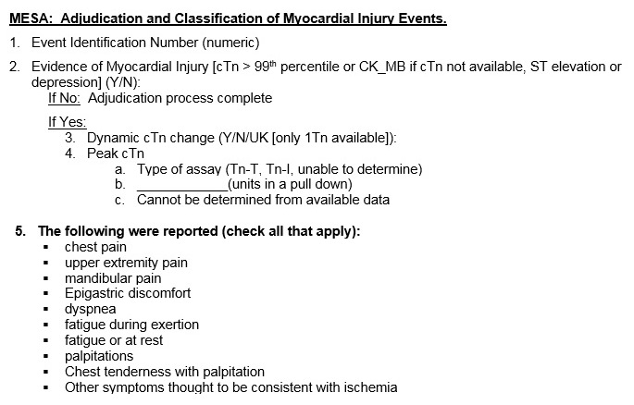
Case Adjudication

Slide 29
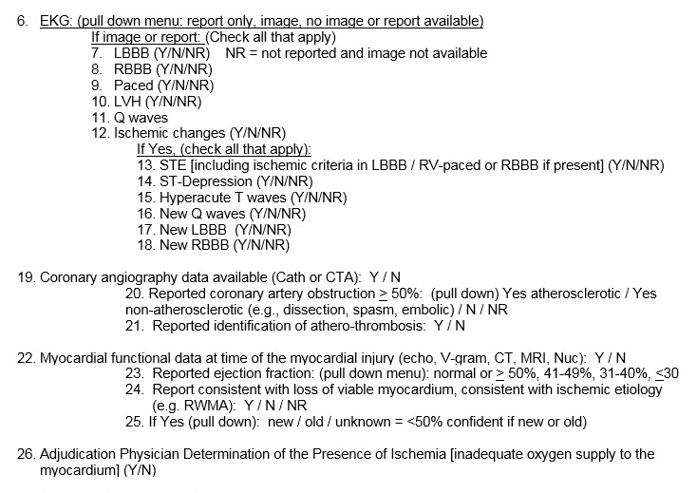
Case Adjudication

Slide 30
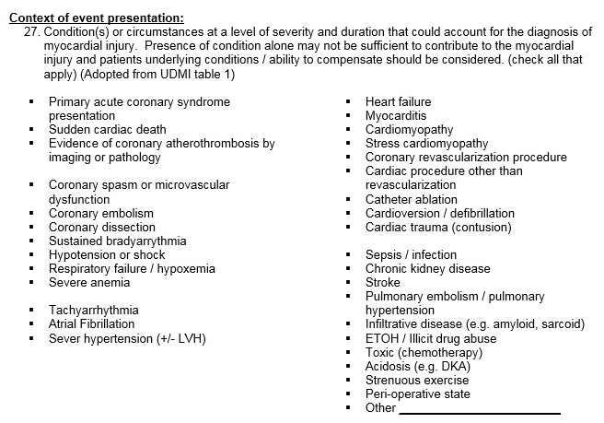
Case Adjudication

Slide 31
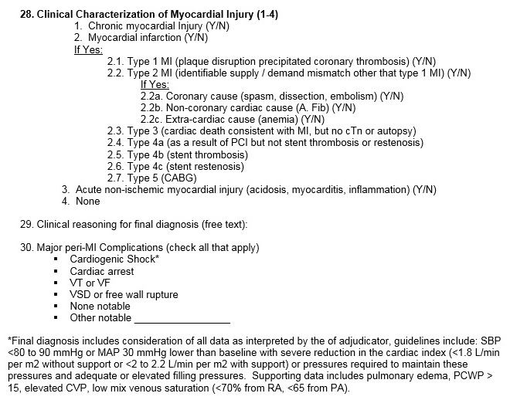
Case Adjudication

Slide 32
Adjudication
https://redcap.louisville.edu/redcap/surveys/?s=X3XLECRXXT
Notes:
32
Paraphrasing

Slide 33
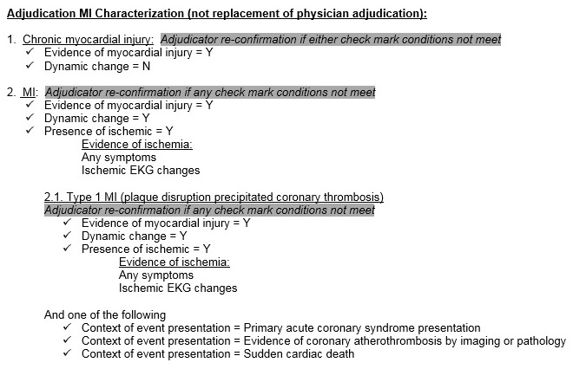
Adjudication MI Characterization
(not replacement of physician adjudication):

Slide 34
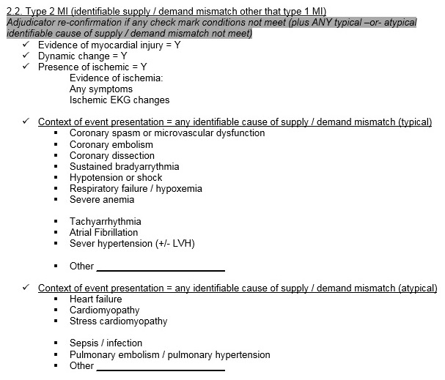
Adjudication MI Characterization
(not replacement of physician adjudication):

Slide 35
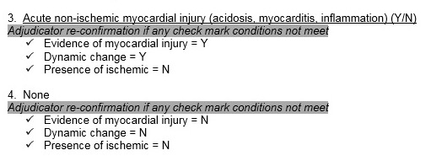
Adjudication MI Characterization
(not replacement of physician adjudication):

Slide 36
Common Clinical Scenarios of MI Types and Non-ischemic Myocardial injury
Type 1 MI | MI caused by atherosclerotic plaque disruption (rupture or erosion) resulting in coronary thrombosis. Features on coronary angiography that are consistent with coronary thrombosis include: spherical, ovoid, or irregular filling defect; abrupt vessel cutoff; intraluminal staining; and any coronary filling defect (PMID: 28150291).
Type 2 MI | MI caused by a mismatch between oxygen supply and demand by a pathophysiological mechanism other than coronary atherothrombosis (Type 1 MI) sustained and sever enough to cause ischemia (inadequate oxygen supply to the myocardium) Coronary causes: spasm, embolism, dissection, microvascular disease Cardiac (non-coronary): significant tachy or brady arrhythmias sustained and relatively sever enough to be responsible for ischemia sever aortic stenosis / acute valve disease Extra-cardiac: anemia, thyroid storm, sever hypertension, hypoxemia, seizure resulting in hypoxemia and/or hypotension
Acute Non-Ischemic Myocardial Injury | Direct and acute myocardial toxicity / insult Acidosis Sepsis in the absence or type 2 MI from sustained profound hypotension or tachyarrhythmia Post-op state in the absence of type 2 MI from sustained profound hypotension or tachyarrhythmia Myocarditis / inflammation Heart failure in the absence of type 1 or type 2 MI Stress cardiomyopathy in the absence of a cause consistent with type 2 MI (coronary spasm) Direct catecholamine toxicity: intracranial bleed, stress cardiomyopathy Cardiac contusion from trauma, ablation, CDV
Chronic Myocardial Injury | Renal failure Infiltrative cardiomyopathy (amyloid, sarcoid, hemochromatosis) Heart failure Prostration / failure to thrive LVH

Slide 37
Default position for common clinical scenarios
Sepsis
No evidence of ischemia → acute non-ischemic myocardial injury secondary to direct myocardial insult (acidosis, inflammation).
Evidence of sustained or profound supply demand mismatch (hypoxemia, hypotension, tachycardia) → supportive of type 2 MI diagnosis
Evidence of ischemia (ECG, new RWMA, symptoms)→ type 2 MI
Post-operative state
No evidence of ischemia → acute non-ischemic myocardial injury secondary to to direct myocardial insult (anesthetic agents).
Evidence of sustained or profound supply demand mismatch (hypoxemia, hypotension, tachycardia, blood loss) → supportive of type 2 MI diagnosis
Evidence of ischemia (ECG, new RWMA, symptoms)→ type 2 MI

Slide 38
Default position for common clinical scenarios
Heart failure
No evidence of ischemia → acute non-ischemic myocardial injury secondary transmural pressure, wall stretch resulting in myocyte apoptosis and autophagy, direct myocyte inflammatory, or neurohormonal toxicity.
Evidence of atherothrombosis → type 1 MI
Evidence of sustained or profound supply demand mismatch (hypoxemia, hypotension, tachycardia) → supportive of type 2 MI diagnosis
Evidence of ischemia (ECG, new RWMA, symptoms)→ type 2 MI
Stress cardiomyopathy
No evidence of ischemia → acute non-ischemic myocardial injury secondary to direct catecholamine myocardial toxicity.
Evidence of sustained or profound vasospasm → supportive of type 2 MI diagnosis

Slide 39
Default position for common clinical scenarios
Hypertensive emergency
No evidence of ischemia → acute non-ischemic myocardial injury secondary to transmural pressure, wall stretch resulting in myocyte apoptosis and autophagy.
Evidence of sustained or profound supply demand mismatch (hypoxemia, sustained hypertension) → supportive of type 2 MI diagnosis
Evidence of ischemia (ECG, new RWMA, symptoms)→ type 2 MI
A.Fib / tachyarrhythmia
Evidence of sustained or profound tachycardia with respect to underlying substrate (LVH, obstructive CAD lower threshold for supply demand / mismatch) → supportive of type 2 MI diagnosis
Evidence of ischemia (significant ST depression (not all ST depression is ischemic), new RWMA, symptoms)→ type 2 MI
No evidence of ischemia → acute non-ischemic myocardial injury secondary inflammatory state that resulted in or from the A. Fib.

Slide 40
Default position for common clinical scenarios
Anemia
Evidence of sustained or profound anemia with respect to underlying substrate (LVH, obstructive CAD, tachycardia lower threshold for supply demand / mismatch) → supportive of type 2 MI diagnosis
Evidence of ischemia (ECG, new RWMA, symptoms)→ type 2 MI
No evidence of ischemia → acute non-ischemic myocardial injury secondary inflammatory state that resulted in or from the anemia.
Toxicity / Chemotherapy / Cocaine
No evidence of ischemia → acute non-ischemic myocardial injury secondary to direct toxicity induced by drug
Evidence of sustained or profound supply demand mismatch (hypoxemia, hypotension, tachycardia) → supportive of type 2 MI diagnosis
Evidence of ischemia (ECG, new RWMA, symptoms)→ type 2 MI
Evidence of atherothrombosis → type 1 MI

Slide 41
Peak cTn concentration among patients with type 1 MI, type 2 MI, or non-ischemic myocardial injury.

Slide 42
Miss-classification in Clinical Practice
ICD code introduced for a MI sub-type (type 2 MI) in 2017
Prior to ICD code for type 2 MI:
  Among MIs not coded as MI: 81% adjudicated as type 2 MI compared with 19% type 1 MI.
  Among with MI code: 85% were adjudicated as type 1 MI and 15% were adjudicated as type 2 MI.
57% of patients classified as type 2 MI by ICD-10 code at MGH meet UDMI criteria for this diagnosis
42% adjudicated as acute non-ischemic myocardial injury.
Diaz-Garzon, Clin Chem. 2017
McCarthy C. JAMA Cardiol 2019

