Slide 1
Early HF Steering
March 2018

Slide 2
MESA Heart Failure Study (Shah/Bertoni PIs)
Specific Aims:
Aim 1 (Prevalence): Determine the prevalence of early HF
Aim 2 (Pathogenesis): Examine associations between risk factors, biomarkers, and changes in risk factors with early HF and its pathophysiologic markers:
  Cardiac mechanics
  Ventricular-arterial coupling
  Myocardial pressure-stress relationships
Aim 3 (Phenomics): Perform machine learning analyses of previously ascertained MESA quantitative data and relate risk factor phenotypic signatures to pathophysiologic markers and HF subtypes
All participants, all 6 sites:
Questionnaires:
  KCCQ
6MWT
Echocardiography
  GE Vivid T8 2D, M-mode, color Doppler, tissue Doppler, speckle-tracking
    Resting echo
    Passive leg raise maneuver
Arterial tonometry
  Fukuda VaSera
    Pulse-wave velocity
    Augmentation index
    Arterial waveform
Wake Forest (n=300):
Cardiopulmonary exercise test

Slide 3
Exam 6 Heart Failure Components (all Selected)
Site | Selected | Echo | Arterial Stiffness | Physical Activity | KCCQ-12 | 6MW | 6MW Exclusion
3: Wake Forest | 341 | 229 | 232 | 327 | 326 | 281 | 38
4: Columbia | 544 | 500 | 497 | 497 | 498 | 411 | 82
5: Johns Hopkins | 450 | 418 | 417 | 423 | 423 | 349 | 74
6: Minnesota | 568 | 547 | 525 | 555 | 555 | 447 | 99
7: Northwestern | 654 | 647 | 632 | 645 | 650 | 496 | 147
8: UCLA | 525 | 506 | 492 | 517 | 516 | 461 | 52
Total | 3082 100% | 2847 92% | 2795 91% | 2964 96% | 2968 94% | 2445 79% | 492
Notes:
Total
1450
1389
1373
1437
1438
1217
201

Slide 4
Exam 6 Echocardiogram Reading Center Data Status
Site | Echo completed | Echo data received at CC | Echo data not received at CC | No Echo data after 8 weeks | No Echo data after 12 weeks
3: Wake Forest | 229 | 227 | 2 | 0 | 0
4: Columbia | 500 | 495 | 5 | 0 | 0
5: Johns Hopkins | 418 | 418 | 0 | 0 | 0
6: Minnesota | 547 | 547 | 0 | 0 | 0
7: Northwestern | 647 | 645 | 2 | 0 | 0
8: UCLA | 506 | 506 | 0 | 0 | 0
Total | 2847 | 2838 | 9 | 0 | 0

Slide 5
MESA Exam 6: Echo alerts
Total number of echos received at Echo Reading Center as of 3/22/18: n=2864 (n=2276 at Fall 2017 SC meeting)
Referrals/alerts:
  Immediate referrals: 3/2864 (0.1%)
  Urgent referrals: 48/2864 (1.7%)
  Routine alerts: 257/2864 (9.0%)
  No alert: 2556/2864 (89.2%)
Notes:
IMMEDIATE REFERRALS
• ?Suspected tamponade
• ?Aortic aneurysm (measuring >5.0 cm) or dissection
• ?Intracardiac abscess or obvious vegetation
• ?Intracardiac thrombus or mass
• ?Pseudoaneurysm
• ?Significant arrhythmia (eg atrial fibrillation with heart rate > 110 bpm, sustained ventricular arrhythmias, or NSVT > 10 beats)
URGENT REFERRALS
• ?Severe left ventricular or right ventricular enlargement
• ?Severe stenosis of any valve
• ?Severe regurgitation of any valve
• ?Moderate or greater pericardial effusion without evidence of tamponade
• ?Atrial fibrillation with heart rate < 110 bpm
ALERTS
• ?Mild or moderate stenosis of any valve
• ?Moderate mitral or aortic regurgitation
• ?Moderate or greater dynamic LVOT obstruction (gradient at rest or with Valsalva >40 mmHg)
• ?Intra-cardiac shunt
• ?Moderate to severe pulmonary hypertension (RVSP>45 mmHg)
• ?Evidence of RV pressure or volume overload
• ?Low ejection fraction (<40%) or wall motion abnormality

Slide 6
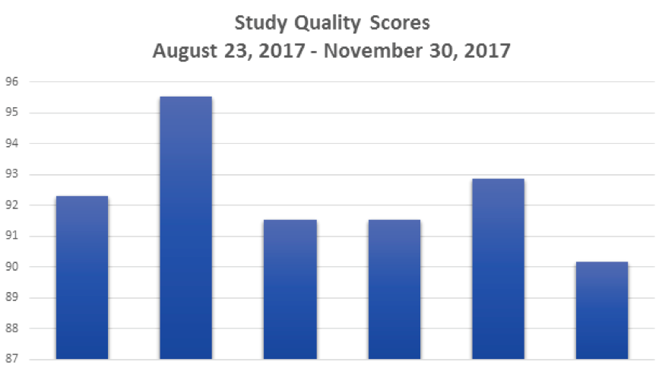
MESA Exam 6:
Echo Quality Scores by Site
Notes:
5% sample of echos analyzed each quarter are selected for QC reads. This only includes the echos that have had the complete read performed.
o I’ve attached a QC report from last July that details the QC process. It also includes Q1 QC results.
o QC measurements are finished for Q1-Q4. We will be taking a look at the numbers soon and putting out a new report.

Slide 7
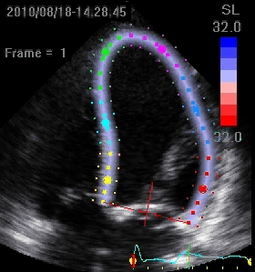
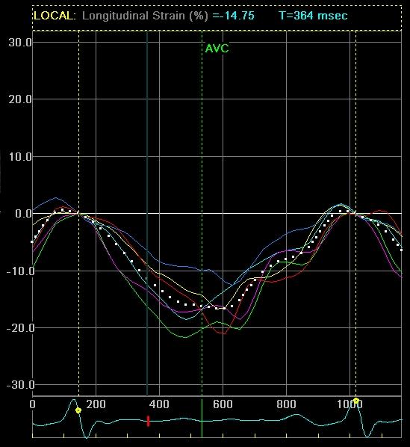
Speckle (tissue) tracking
LV longitudinal systolic strain:
Marker of the health
of the subendocardium
WORSE
BETTER
Absolute longitudinal strain:
lower limit of 95% CI = <18.9%
(Yingchoncharoen T et al, JASE 2013)
Notes:
2597 subjects from 24 studies

Slide 8
LVEF vs. longitudinal systolic strain
MESA 6 participants with both LVEF and longitudinal strain values: n=2,692
Pearson correlation: R=0.58, p<0.0001
Abnormal LVEF:
  LVEF < 55%: n=126/2692 = 4.8%
  LVEF < 50%: n=54/2692 = 2.0%
Abnormal longitudinal strain (LS):
  Absolute LS < 18.9%: n=1097/2692 = 40.7%
  Absolute LS < 17.0%: n=490/2692 = 18.2%
LS correlations: age (R=-0.06), male (R=-0.17), height (R=-0.14), weight (R=-0.15), BMI (R=-0.09)

Slide 9
Preliminary 6MWT results
N=2408
Mean age 73 years, 53% female, 41% White, 13% Chinese, 25% Black, 21% Hispanic
Mean Distance 412 meters, std dev 96. 25% pctile 348 Median 410, 75% 476

Slide 12
Of participants with 6MWT data, 26 (1%) had an adjudicated CHF event prior to 2014, 99% did not
  No HF: Mean 6MWT 412 meters, SD 96
  HF: Mean 6MWT 355 meters, SD 104

Slide 13
Regression
regress total chf age6 gender i.race
Source | SS df MS Number of obs = 2,407
-------------+---------------------------------- F(6, 2400) = 149.09
Model | 6060971.47 6 1010161.91 Prob > F = 0.0000
Residual | 16261182.5 2,400 6775.49273 R-squared = 0.2715
-------------+---------------------------------- Adj R-squared = 0.2697
Total | 22322154 2,406 9277.70325 Root MSE = 82.313
---------------------------------------------------------------------------------------------
total6 | Coef. Std. Err. t P>|t| [95% Conf. Interval]
----------------------------+----------------------------------------------------------------
chf | -39.9214 16.26691 -2.45 0.014 -71.82004 -8.022762
age6c | -5.025246 .2123859 -23.66 0.000 -5.441725 -4.608767
gender1 | 45.48804 3.363233 13.53 0.000 38.8929 52.08318
|
race1c |
2: CHINESE-AMERICAN | -35.88144 5.296812 -6.77 0.000 -46.26824 -25.49464
3: black, AFRICAN-AMERICAN | -31.91609 4.277976 -7.46 0.000 -40.305 -23.52718
4: HISPANIC | -55.64631 4.509845 -12.34 0.000 -64.48991 -46.80272
|
_cons | 780.0883 15.78405 49.42 0.000 749.1365 811.0401
---------------------------------------------------------------------------------------------
VERY PRELIMINARY. However adjusting for Exam 6 age, gender, and race, prior identification as incident HF associated with 39.9 meters lower walking distance.

Slide 14
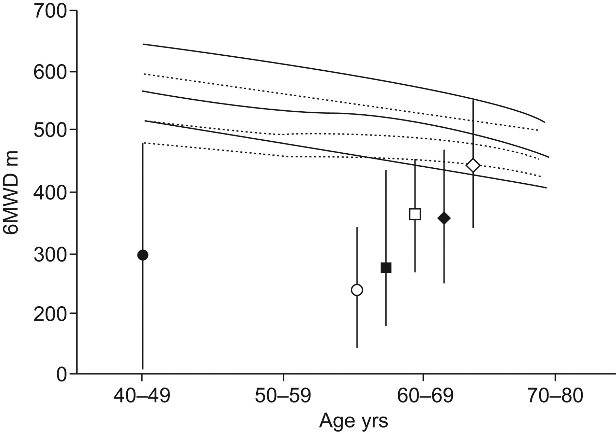
Percentiles (10th, 25th and 50th) curves for 6-min walk distance (6MWD; —–: males; -----: females) compared with the mean (range) published data of the 6MWD for several important chronic diseases
Primary pulmonary hypertension (•) idiopathic pulmonary fibrosis (▪),
CHF subdivided into New York Heart Association (NYHA) stages II (□) and III–IV (○)
COPD subdivided into Global Initiative for Obstructive Lung Disease stages II (⋄) and III–IV (♦).
Casanova et al. Eur Respir J 2011;37:150-156
Notes:
Percentiles (10th, 25th and 50th) curves for 6-min walk distance (6MWD; —–: males; -----: females) compared with the mean (range) published data of the 6MWD for several important chronic diseases: primary pulmonary hypertension (•) 19, idiopathic pulmonary fibrosis (▪) 20, congestive heart failure subdivided into New York Heart Association (NYHA) stages II (□) and III–IV (○) 21, and chronic obstructive pulmonary disease subdivided into Global Intitative for Obstructive Lung Disease stages II (⋄) and III–IV (♦) 7.

