Slide 1
MESA STEERING COMMITTEE MEETING 2019
MESA Early Heart Failure Study
Echo Core Lab Report
Sanjiv J. Shah, MD, FAHA, FACC, FASE
Stone Professor of Medicine
Director, T1 Center for Cardiovascular Therapeutics
Director, Northwestern HFpEF Program
Division of Cardiology, Department of Medicine
Northwestern University Feinberg School of Medicine
sanjiv.shah@northwestern.edu • http://www.hfpef.org • Twitter: @HFpEF
NORTHWESTERN UNIVERSITY FEINBERG SCHOOL OF MEDICINE

Slide 2
MESA Exam 6 echo analysis: progress
Phase 1 (complete May 2019):
  Chamber quantification (LV, LA, RV, RA):
  Tissue Doppler, Doppler, diastology, hemodynamics:
  Qualitative valve assessment:
  LV longitudinal strain, LA strain (A4c view only):
  Legs up analysis:
Phase 2 (complete Q4 2019):
  Completed strain analysis (LV, RV, LA, RA, bullseye), regional strain analysis
  Echo pulse wave velocity
Phase 3 (complete Q4 2020):
  Pressure-stress, pressure-strain analyses
  Deep learning / computer vision quantitation of echocardiograms
  Automated echo analysis, pattern detection

Slide 3
MESA Exam 6 echo analysis: progress
Phase 1 (complete May 2019): Total N=3035 echos
  Chamber quantification (LV, LA, RV, RA): 92% complete (EF 100% complete)
  Tissue Doppler, Doppler, diastology, hemodynamics: 100% complete
  Qualitative valve assessment: 100% complete
  LV longitudinal strain, LA strain (A4c view only): 100% complete
  Legs up analysis: 100% complete
Phase 2 (complete Q4 2019):
  Completed strain analysis (LV, RV, LA, RA, bullseye), regional strain analysis
  Echo pulse wave velocity
Phase 3 (complete Q4 2020):
  Pressure-stress, pressure-strain analyses
  Deep learning / computer vision quantitation of echocardiograms
  Automated echo analysis, pattern detection

Slide 4
MESA guide to echo phenotypes
Domain | Parameters
Cardiac structure | LV dimensions/volumes, LV mass, relative wall thickness, LA volume, RV areas, RA area
LV systolic function | LV ejection fraction, LV longitudinal strain
LV diastolic function | LV E/A ratio, E deceleration time, early diastolic (e’) velocity, LV early diastolic strain rate, E/e’ ratio
LA function | LA reservoir strain, LA booster strain, LA conduit strain
RV systolic function | RV fractional area change, RV s’ velocity, TAPSE
RV diastolic function | RV E/A ratio, E deceleration time, RV E/e’ ratio
Hemodynamics | Stroke volume, cardiac output, RA pressure, PA systolic pressure, estimated pulmonary capillary wedge pressure

Slide 5
MESA guide to echo phenotypes
Domain | Parameters
Cardiac structure | LV dimensions/volumes, LV mass, relative wall thickness, LA volume, RV areas, RA area
LV systolic function | LV ejection fraction, LV longitudinal strain
LV diastolic function | LV E/A ratio, E deceleration time, early diastolic (e’) velocity, LV early diastolic strain rate, E/e’ ratio
LA function | LA reservoir strain, LA booster strain, LA conduit strain
RV systolic function | RV fractional area change, RV s’ velocity, TAPSE
RV diastolic function | RV E/A ratio, E deceleration time, RV E/e’ ratio
Hemodynamics | Stroke volume, cardiac output, RA pressure, PA systolic pressure, estimated pulmonary capillary wedge pressure

Slide 6
Intra-observer variability (n=100)
Parameter | Mean ± SD | ICC (95% CI) | Mean bias (95% CI)
Septal wall thickness (cm) | 1.15±0.20 | 0.96 (0.94, 0.98) | 0.02 (0.01, 0.04)
LV end-diastolic dimension (cm) | 4.37±0.50 | 0.97 (0.95, 0.98) | -0.01 (-0.04, 0.03)
Posterior wall thickness (cm) | 0.96±0.13 | 0.83 (0.73, 0.89) | 0.02 (0.00, 0.04)
LV end-systolic dimension (cm) | 2.85±0.41 | 0.97 (0.96, 0.98) | 0.02 (-0.01, 0.04)
LA volume (ml) | 55.9±17.2 | 0.97 (0.95, 0.98) | -0.48 (-1.64, 0.67)
LV end-diastolic volume (ml) | 80.2±19.9 | 0.98 (0.96, 0.99) | 0.72 (-0.48, 1.91)
LV end-systolic volume (ml) | 29.7±10.9 | 0.98 (0.96, 0.99) | -0.30 (-0.93, 0.33)
LA strain peak positive (A4c, %) | 12.2±5.2 | 0.96 (0.94, 0.98) | 0.30 (-0.07, 0.67)
LA strain peak negative (A4c, %) | 13.2±3.2 | 0.91 (0.85, 0.94) | -0.12 (-0.45, 0.20)
Legs up LA strain peak+ (A4c, %) | 15.1±4.8 | 0.94 (0.90, 0.96) | 0.16 (-0.29, 0.62)
Legs up LA strain peak- (A4c, %) | 12.1±3.5 | 0.90 (0.84, 0.94) | -0.10 (-0.52, 0.32)
LV longitudinal strain (A4c, %) | 20.8±3.1 | 0.93 (0.89, 0.96) | 0.06 (-0.22, 0.34)
LV early diastolic strain rate (A4c, 1/s) | 1.2±0.4 | 0.94 (0.90, 0.96) | 0.02 (-0.02, 0.06)
Early mitral inflow (E) velocity (cm/s) | 78.6±18.8 | 0.98 (0.96, 0.99) | 0.87 (-0.43, 2.17)
Late mitral inflow (A) velocity (cm/s) | 83.9±21.1 | 0.97 (0.94, 0.99) | 0.30 (-1.24, 1.84)
Septal e’ velocity (cm/s) | 7.3±1.8 | 0.91 (0.82, 0.95) | 0.07 (-0.16, 0.31)
Lateral e’ velocity (cm/s) | 9.0±2.1 | 0.90 (0.81, 0.95) | -0.24 (-0.58, 0.10)

Slide 7
Inter-observer variability (n=100)
Parameter | Mean ± SD | ICC (95% CI) | Mean bias (95% CI)
Septal wall thickness (cm) | 1.15±0.20 | 0.80 (0.67, 0.89) | 0.01 (-0.01, 0.03)
LV end-diastolic dimension (cm) | 4.37±0.50 | 0.91 (0.85, 0.95) | -0.05 (-0.09, -0.02)
Posterior wall thickness (cm) | 0.96±0.13 | 0.81 (0.70, 0.89) | -0.02 (-0.04, 0.01)
LV end-systolic dimension (cm) | 2.85±0.41 | 0.83 (0.72, 0.90) | 0.06 (0.01, 0.11)
LA volume (ml) | 55.9±17.2 | 0.95 (0.91, 0.97) | -0.23 (-1.52, 1.06)
LV end-diastolic volume (ml) | 80.2±19.9 | 0.89 (0.81, 0.94) | -4.73 (-6.21, -3.25)
LV end-systolic volume (ml) | 29.7±10.9 | 0.87 (0.78, 0.93) | -2.82 (-3.79, -1.85)
LA strain peak positive (A4c, %) | 12.2±5.2 | 0.89 (0.82, 0.94) | -1.30 (-1.93, -0.67)
LA strain peak negative (A4c, %) | 13.2±3.2 | 0.81 (0.70, 0.89) | -0.97 (-1.44, -0.50)
Legs up LA strain peak+ (A4c, %) | 15.1±4.8 | 0.73 (0.57, 0.85) | -0.38 (-1.11, 0.36)
Legs up LA strain peak- (A4c, %) | 12.1±3.5 | 0.65 (0.47, 0.80) | -0.70 (-1.19, -0.22)
LV longitudinal strain (A4c, %) | 20.8±3.1 | 0.82 (0.71, 0.90) | -0.69 (-1.08, -0.30)
LV early diastolic strain rate (A4c, 1/s) | 1.2±0.4 | 0.90 (0.83, 0.95) | -0.07 (-0.11, -0.02)
Early mitral inflow (E) velocity (cm/s) | 78.6±18.8 | 0.99 (0.98, 0.99) | -1.04 (-1.58, -0.49)
Late mitral inflow (A) velocity (cm/s) | 83.9±21.1 | 0.96 (0.94, 0.98) | -1.07 (-2.10, -0.05)
Septal e’ velocity (cm/s) | 7.3±1.8 | 0.94 (0.90, 0.96) | -0.03 (-0.16, 0.11)
Lateral e’ velocity (cm/s) | 9.0±2.1 | 0.95 (0.93, 0.97) | -0.18 (-0.30, -0.05)

Slide 8
Inter-observer variability (n=100)
Parameter | Mean ± SD | ICC (95% CI) | Mean bias (95% CI)
Septal wall thickness (cm) | 1.15±0.20 | 0.80 (0.67, 0.89) | 0.01 (-0.01, 0.03)
LV end-diastolic dimension (cm) | 4.37±0.50 | 0.91 (0.85, 0.95) | -0.05 (-0.09, -0.02)
Posterior wall thickness (cm) | 0.96±0.13 | 0.81 (0.70, 0.89) | -0.02 (-0.04, 0.01)
LV end-systolic dimension (cm) | 2.85±0.41 | 0.83 (0.72, 0.90) | 0.06 (0.01, 0.11)
LA volume (ml) | 55.9±17.2 | 0.95 (0.91, 0.97) | -0.23 (-1.52, 1.06)
LV end-diastolic volume (ml) | 80.2±19.9 | 0.89 (0.81, 0.94) | -4.73 (-6.21, -3.25)
LV end-systolic volume (ml) | 29.7±10.9 | 0.87 (0.78, 0.93) | -2.82 (-3.79, -1.85)
LA strain peak positive (A4c, %) | 12.2±5.2 | 0.89 (0.82, 0.94) | -1.30 (-1.93, -0.67)
LA strain peak negative (A4c, %) | 13.2±3.2 | 0.81 (0.70, 0.89) | -0.97 (-1.44, -0.50)
Legs up LA strain peak+ (A4c, %) | 15.1±4.8 | 0.73 (0.57, 0.85) | -0.38 (-1.11, 0.36)
Legs up LA strain peak- (A4c, %) | 12.1±3.5 | 0.65 (0.47, 0.80) | -0.70 (-1.19, -0.22)
LV longitudinal strain (A4c, %) | 20.8±3.1 | 0.82 (0.71, 0.90) | -0.69 (-1.08, -0.30)
LV early diastolic strain rate (A4c, 1/s) | 1.2±0.4 | 0.90 (0.83, 0.95) | -0.07 (-0.11, -0.02)
Early mitral inflow (E) velocity (cm/s) | 78.6±18.8 | 0.99 (0.98, 0.99) | -1.04 (-1.58, -0.49)
Late mitral inflow (A) velocity (cm/s) | 83.9±21.1 | 0.96 (0.94, 0.98) | -1.07 (-2.10, -0.05)
Septal e’ velocity (cm/s) | 7.3±1.8 | 0.94 (0.90, 0.96) | -0.03 (-0.16, 0.11)
Lateral e’ velocity (cm/s) | 9.0±2.1 | 0.95 (0.93, 0.97) | -0.18 (-0.30, -0.05)

Slide 9
Temporal drift (n=10, measured q6mo x 5)
Parameter | Mean ± SD | ICC (95% CI) | Beta-coefficient | P-value
Septal wall thickness (cm) | 1.25 ± 0.22 | 0.97 (0.92, 0.99) | 0.000 (-0.008, 0.007) | 0.92
Posterior wall thickness (cm) | 0.93 ± 0.11 | 0.70 (0.36, 0.90) | 0.000 (-0.004, 0.003) | 0.84
LV end-diastolic dimension (cm) | 3.90 ± 0.49 | 0.95 (0.87, 0.99) | -0.002 (-0.019, 0.014) | 0.79
LV end-systolic dimension (cm) | 2.57 ± 0.33 | 0.94 (0.83, 0.98) | 0.002 (-0.009, 0.014) | 0.66
LV end-diastolic volume (ml) | 63.3 ± 10.82 | 0.97 (0.90, 0.99) | -0.032 (-0.398, 0.334) | 0.86
LV end-systolic volume (ml) | 23.5 ± 5.59 | 0.95 (0.86, 0.99) | 0.007 (-0.183, 0.196) | 0.94
LV ejection fraction (%) | 63.4 ± 3.47 | 0.77 (0.48, 0.93) | -0.007 (-0.124, 0.111) | 0.91
LA volume (ml) | 40.5 ± 9.25 | 0.92 (0.79, 0.98) | 0.102 (-0.210, 0.413) | 0.52
Mitral E velocity (cm/s) | 67.5 ± 15.24 | 0.97 (0.92, 0.99) | 0.080 (-0.435, 0.595) | 0.76
Mitral A velocity (cm/s) | 81.6 ± 18.35 | 0.98 (0.95, 1.00) | -0.020 (-0.641, 0.602) | 0.95
Septal e’ velocity (cm/s) | 7.3 ± 2.40 | 0.87 (0.67, 0.96) | -0.019 (-0.100, 0.063) | 0.65
Lateral e’ velocity (cm/s) | 9.3 ± 2.00 | 0.98 (0.95, 1.00) | -0.010 (-0.078, 0.058) | 0.77
LA strain peak positive (A4c, %) | 15.2 ± 2.64 | 0.69 (0.36, 0.90) | -0.016 (-0.106, 0.073) | 0.72
LA strain peak negative (A4c, %) | 8.8 ± 3.08 | 0.88 (0.70, 0.97) | -0.054 (-0.157, 0.050) | 0.30

Slide 10
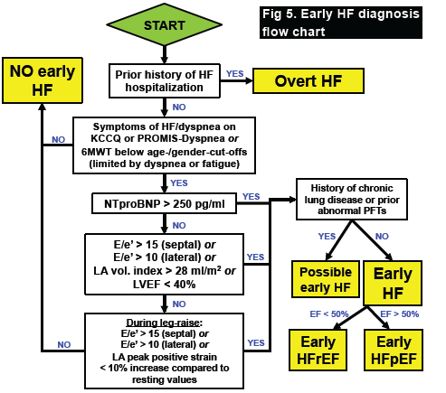
MESA Early HF definition
Prevalence estimates based on hospitalized HFpEF mainly
Sometimes defined by outpatient HFpEF dx.
Many cases of early HFpEF likely missed
HFpEF in US: 3 million vs. 6+ million?

Slide 11
Types of HFpEF: clinical presentation
ENVIRONMENT, DIET
COMORBIDITIES
GENETIC SUSCEPTIBILITY
VULNERABLE HEART,
VULNERABLE PATIENT
HFpEF
Type 1:
EXERCISE-INDUCED
LA PRESSURE
Type 2:
VOLUME
OVERLOAD
Type 3:
PULMONARY HTN,
RV FAILURE
Shah SJ. JACC 2013

Slide 12
Types of HFpEF: clinical presentation
ENVIRONMENT, DIET
COMORBIDITIES
GENETIC SUSCEPTIBILITY
VULNERABLE HEART,
VULNERABLE PATIENT
HFpEF
Type 1:
EXERCISE-INDUCED
LA PRESSURE
Type 2:
VOLUME
OVERLOAD
Type 3:
PULMONARY HTN,
RV FAILURE
Shah SJ. JACC 2013

Slide 13
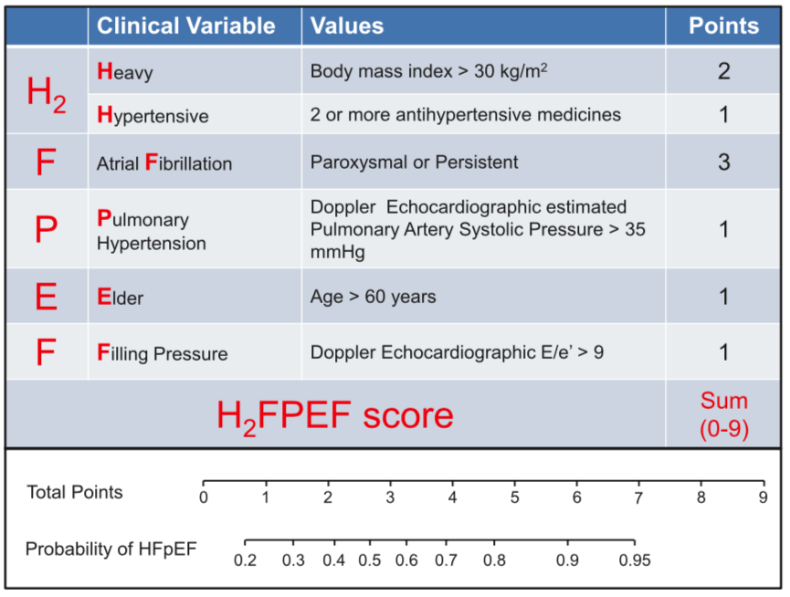
Diagnosis of HFpEF: H₂FPEF score
Dyspnea on exertion, normal EF
HFpEF vs. non-cardiac dyspnea?
Intermediate pre-test probability
Nomogram below table for probability of HFpEF based on score:
A score of 4 or higher = 70% probability of HFpEF
A score of 5 or higher = >80% probability of HFpEF
A score of 7 or higher = >95% probability of HFpEF
Reddy YN…Borlaug BA. Circulation 2018

Slide 14
Diagnosis of HFpEF: ESC HFA-PEFF score
MAJOR CRITERIA: 2 POINTS, MINOR CRITERIA: 1 POINT
Functional
Morphological
Biomarker
Septal e’ < 7,
Lateral e’ < 10,
or
E/e’ (avg) ≥ 15
LAVI > 34
or
LVMI > 149/122 (M/F) and RWT > 0.42
NTproBNP > 220/660 (SR/AF)
or
BNP > 80/240 (SR/AF)
*SR = sinus rhythm / AF = a.fib
MAJOR
E/e’ (avg) 9-14,
or
TR vel > 2.8,
or
GLS < 16%
LAVI > 29-34,
or
LVMI > 115/95 (M/F), or RWT > 0.42,
or LVWT > 12 mm
NTproBNP > 115-220 or
BNP 35-80 in SR
or
NTproBNP > 365-660 or
BNP 105-240 in AF
MINOR
HFA-PEFF score ≥ 5 points: HFpEF
HFA-PEFF score 2-4 points: diastolic stress test or invasive hemodynamics
HFA-PEFF score < 2 points: No HFpEF

Slide 15
H₂FPEF score in MESA at Exam 6
Clinical variable | Score | Mean ± SD | 25th-75th %-tile | Prevalence
Heavy (BMI > 30 kg/m²) | 2 | 28.5±5.8 | 24.5-31.6 | 34%
Hypertensive (2 or more anti-HTN) | 1 | 1.3±1.4 | 0-2 | 37%
Atrial Fibrillation (AF on echo) | 3 | — | — | 3%
Pulmonary hypertension (Doppler PASP > 35 mmHg) | 1 | 33±8 | 28-37 | 23%
Elder (age > 60 years) | 1 | 74±9 | 67-81 | 99%
Filling pressures (E/e’ > 9) | 1 | 28.5±5.8 | 7.6-11.4 | 48%
Total H₂FPEF Score | — | 2.7±1.4 | 0-9 | —

Slide 16
H₂FPEF score in MESA at Exam 6
Of N=3,254 with available data:
N=67 (2%) with pre-existing diagnosis of HF
N=17 (0.5%) with EF<40% on Exam 6 echo
N=320/3170 (10.1%) with H₂FPEF Score 5+: > 80% probability of HFpEF

Slide 17
Early HFpEF: QOL, exercise capacity
KCCQ-12 summary score
6MWT distance
Mean -8.3 point difference
P=2.5x10⁻²⁵
Mean -65 m difference
P=2.4x10⁻²²

Slide 18
Early HFpEF: cardiac structure/fxn
LV mass index
LV ejection fraction
LV longitudinal strain
Mean +6 g/m² difference
P=0.00002
Mean -0.29% difference
P=0.30
Mean -0.6 %-unit difference
P=0.0007

Slide 19
Early HFpEF: cardiac structure/fxn
LA volume index
LA reservoir strain
Mean +6.4 ml difference
P=3.5x10⁻³²
Mean -4.7%-unit difference
P=8.5x10⁻⁴⁰

Slide 20
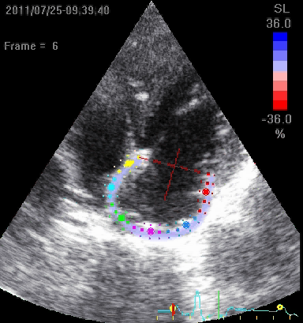
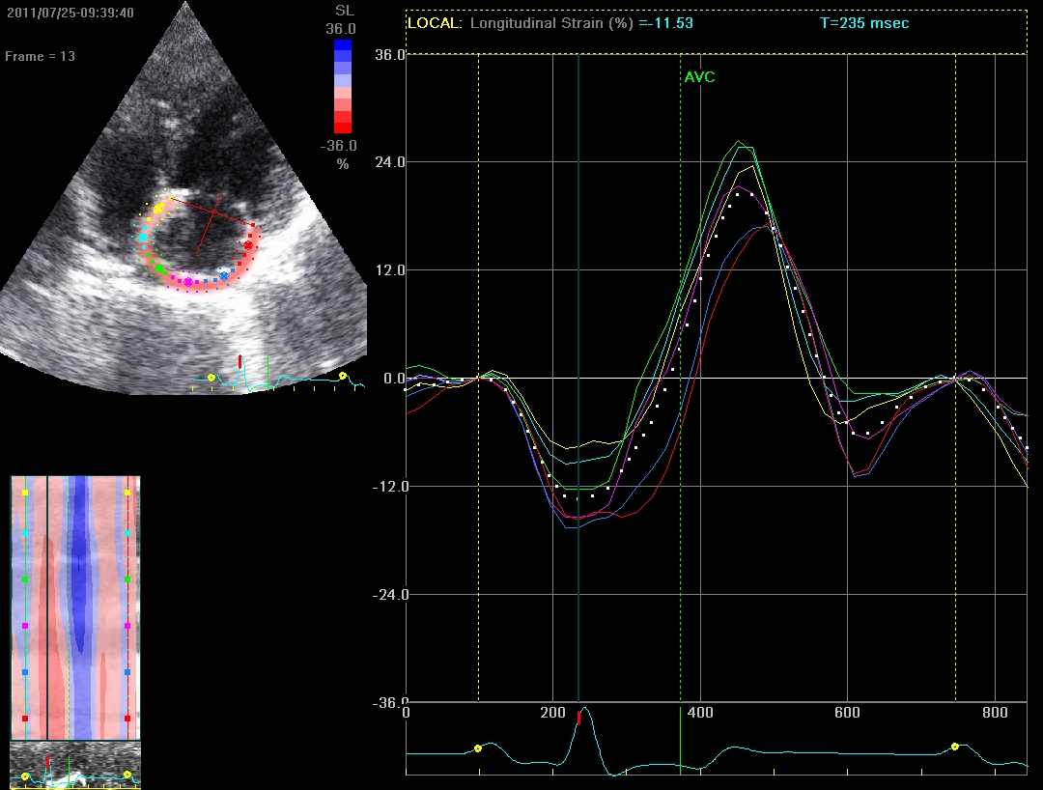
CONDUIT
LA strain
BOOSTER

Slide 21
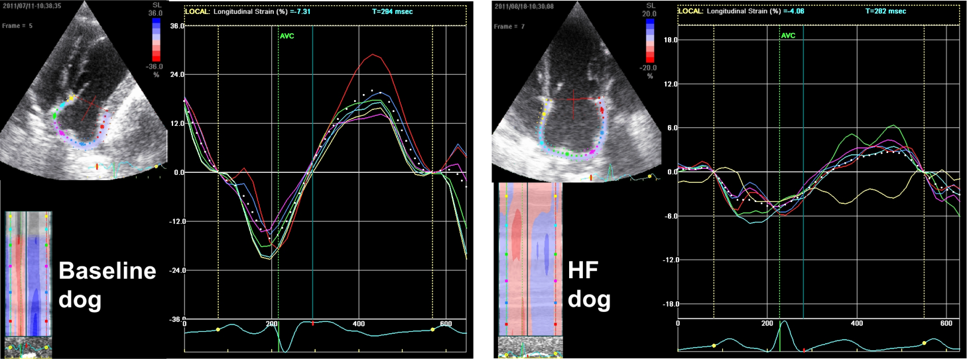
LA strain: baseline vs. HF

Slide 22
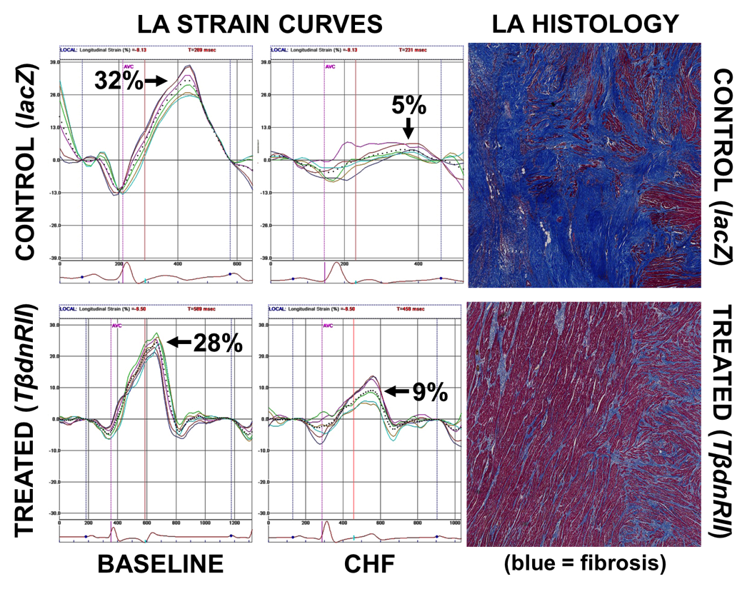
LA strain: A marker of LA fibrosis

Slide 23
Abnormal LA mechanics in HFpEF
Freed B…Shah SJ. Circ CV Imaging 2016
LA strain is a better predictor of outcomes compared to
LV or RV longitudinal strain

Slide 24
Abnormal LA mechanics in HFpEF
Freed B…Shah SJ. Circ CV Imaging 2016
LA strain is a key determinant of exercise capacity in HFpEF

Slide 25
Abnormal LA mechanics in HFpEF
EXERCISE INTOLERANCE
ADVERSE OUTCOMES

Slide 26
LA reservoir strain & submax VO₂
LA reservoir strain is the most closely associated echo variable with CPET submax VO₂ (n=126)
Association remains significant after adjustment for age, sex, BMI, a-fib
(Beta-coefficient = -0.6 ml/kg/min for each 1-SD decrease in LA reservoir strain, P<0.0001)
R=0.34
P<0.0001

Slide 27
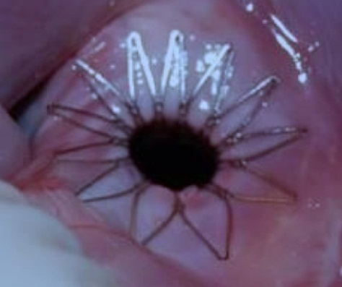
InterAtrial Shunt Device
8 mm
IASD proposed mode of action: dynamic decompression of
overloaded LA chamber by shunting blood from LA → RA
Feldman T…Shah SJ. Circ Heart Fail 2016

Slide 28
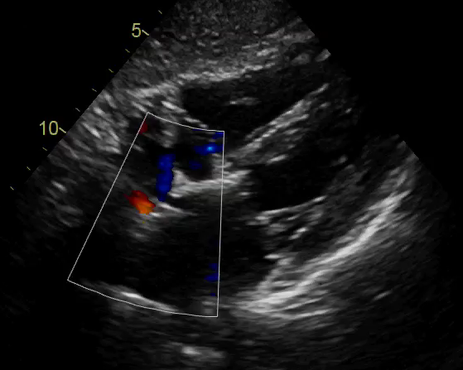
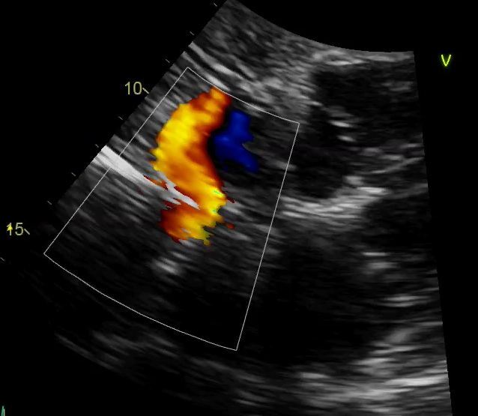
Example patient randomized to IASD
Subcostal view
Subcostal view (zoomed)
RV
RA
LV
LA
12-month echo

Slide 29
REDUCE LAP-HF I RCT
Feldman T… Shah SJ. Circulation 2018

Slide 30
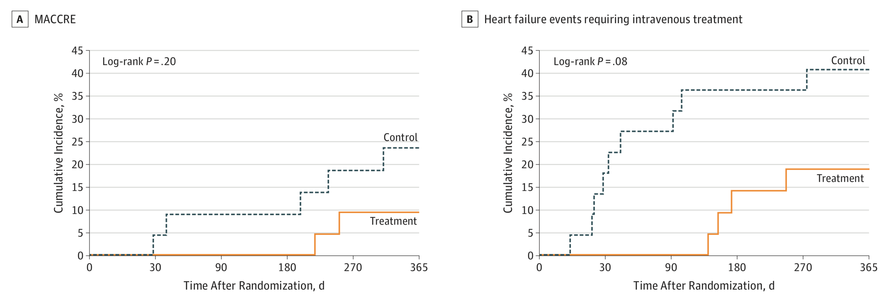
REDUCE LAP-HF I RCT: 1-yr. outcome
Shah SJ, et al. JAMA Cardiol 2018

Slide 31
Validation of MESA Early HF diagnosis
Cardiopulmonary exercise testing:
n=135 complete at Wake Forest (treadmill)
Goal to do additional CPEX exams in MESA participants (n=150 at the Chicago field center (semi-recumbent bike + echo + wearables)

Slide 32
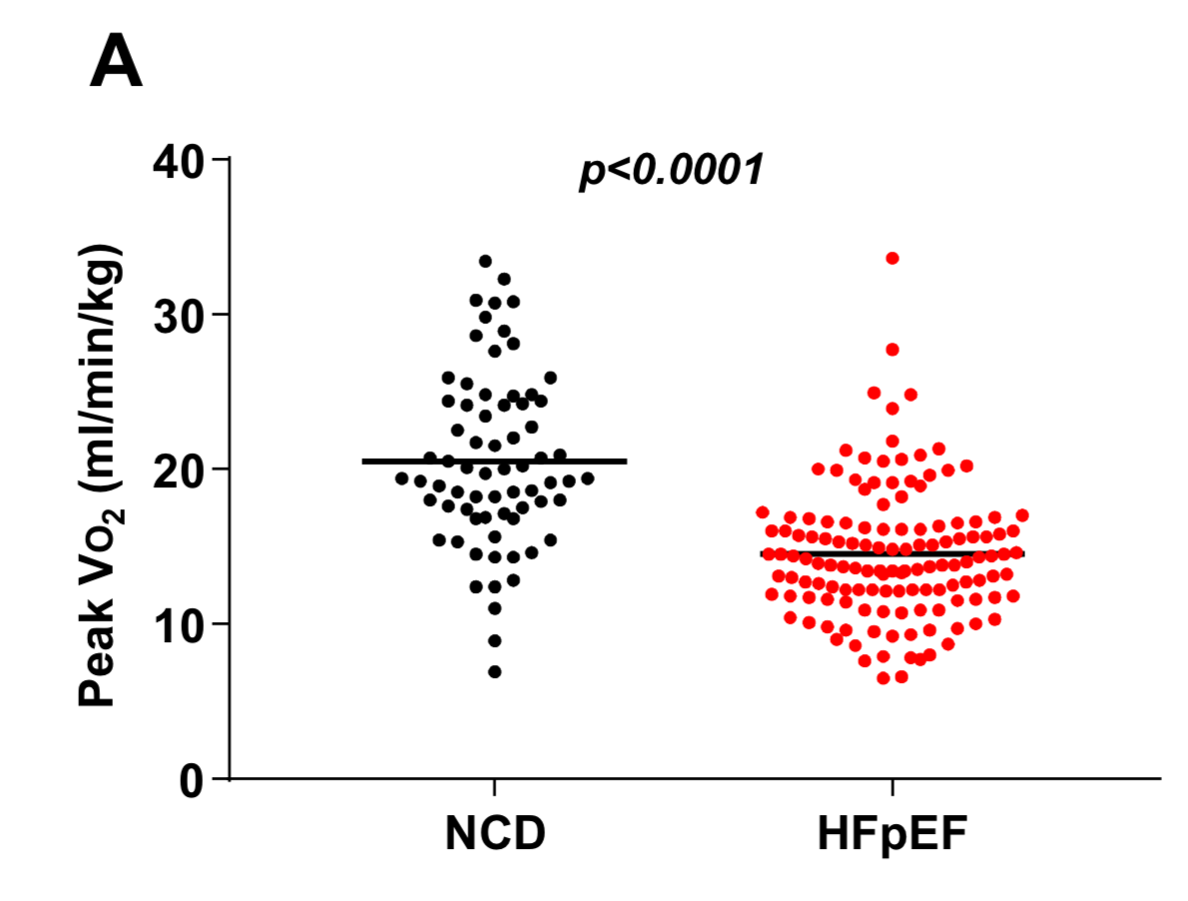
Validation of MESA Early HF diagnosis
Peak VO2 is insufficient to make early HFpEF diagnosis in “grey zone”
Reddy Y…Borlaug B. JACC Heart Fail 2018

Slide 33
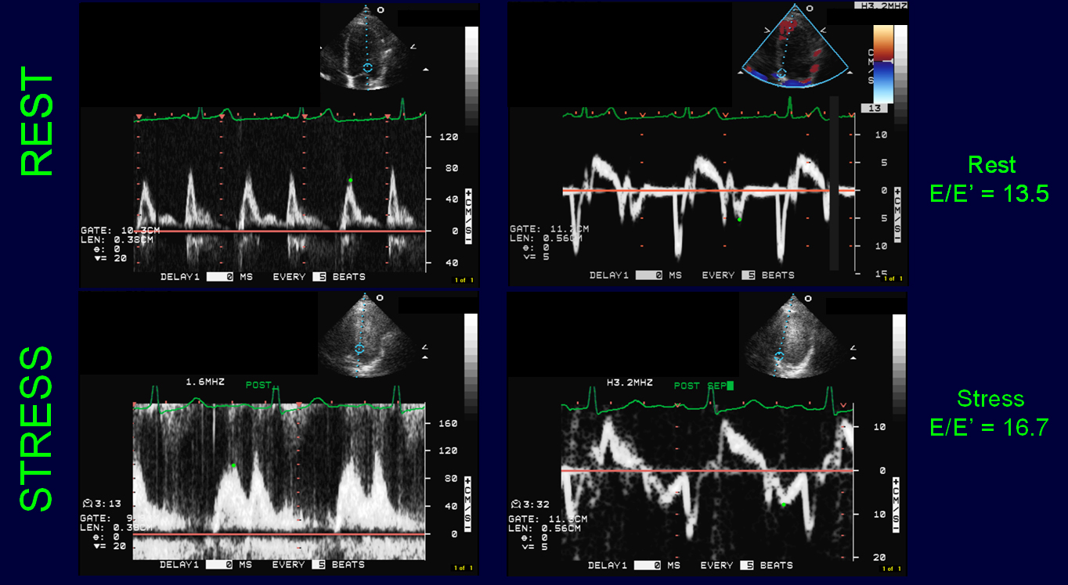
Validation of MESA Early HF diagnosis
Peak VO2 is insufficient to make early HFpEF diagnosis in “grey zone”
Diastolic stress echo to augment early HFpEF diagnosis
Reddy Y…Borlaug B. JACC Heart Fail 2018

Slide 34
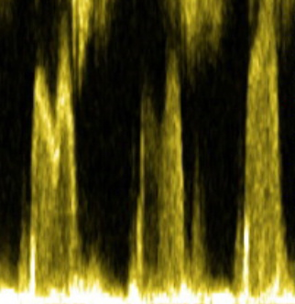
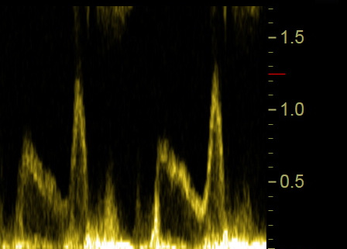
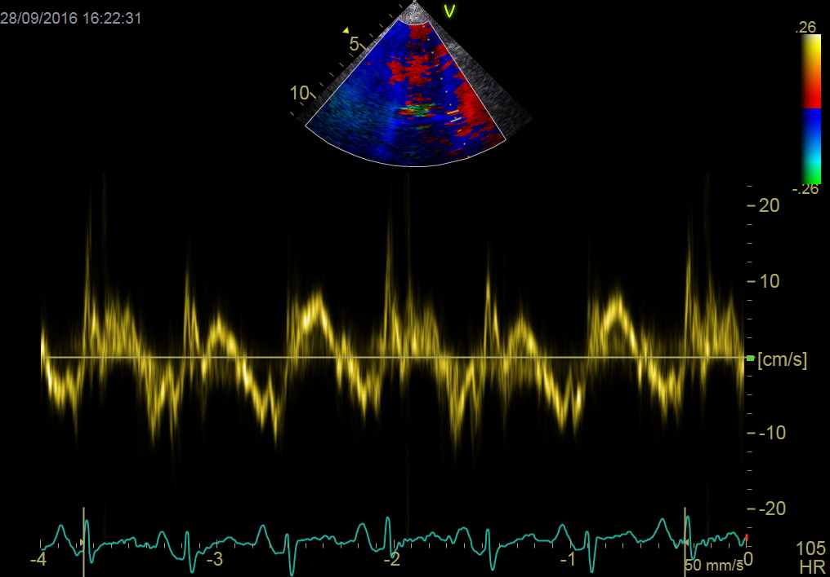
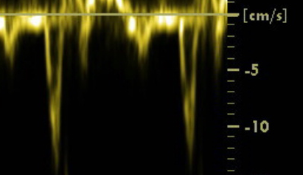
72-year-old woman with HFpEF
E/e’ = 18
E = 154 cm/s
E/e’ = 22
E=72 cm/s
e’ = 4 cm/s
a'
a'
e’ = 7 cm/s
Rest
25W exercise

Slide 35
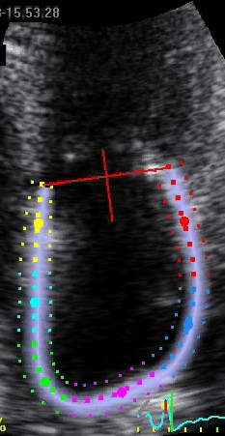
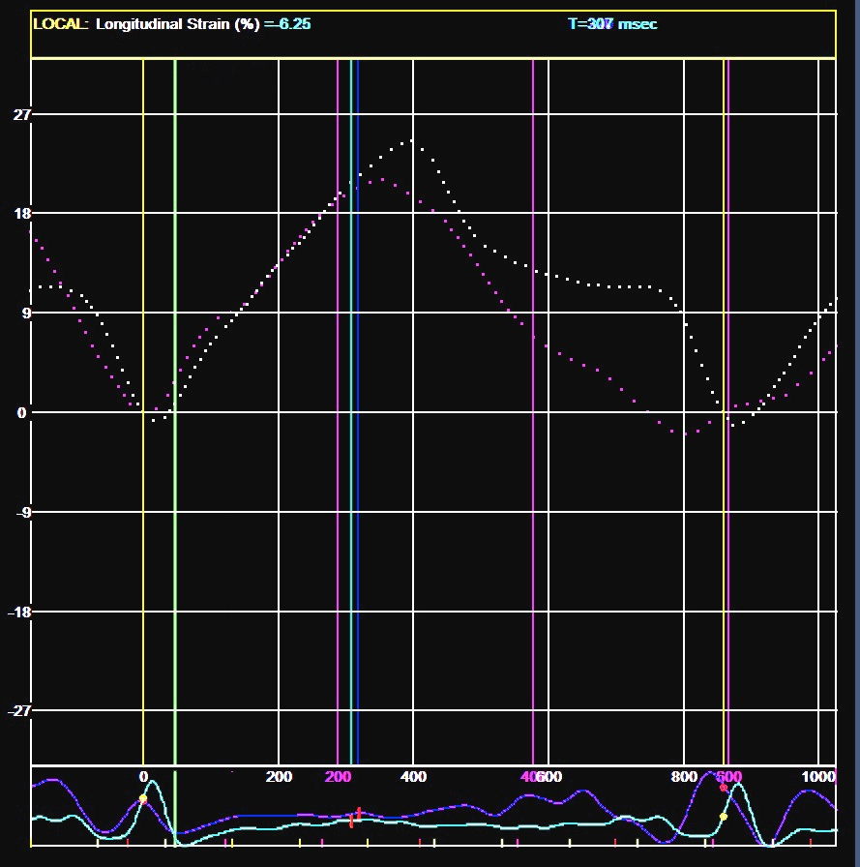
72-year-old woman with HFpEF
LA reservoir
Rest
25W
Exercise
LA booster

Slide 36
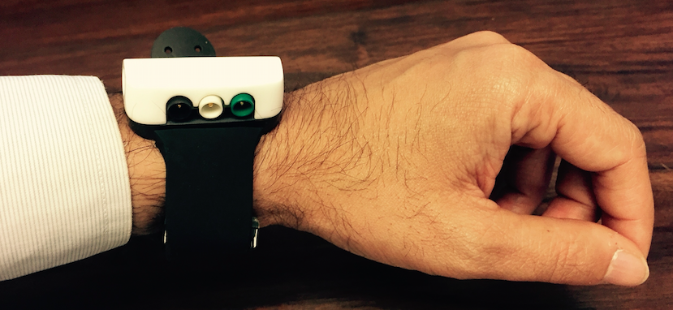
Microsoft Aurora wristwatch device
Continuous radial tonometry + accelerometer + HR monitor + position monitor

Slide 37
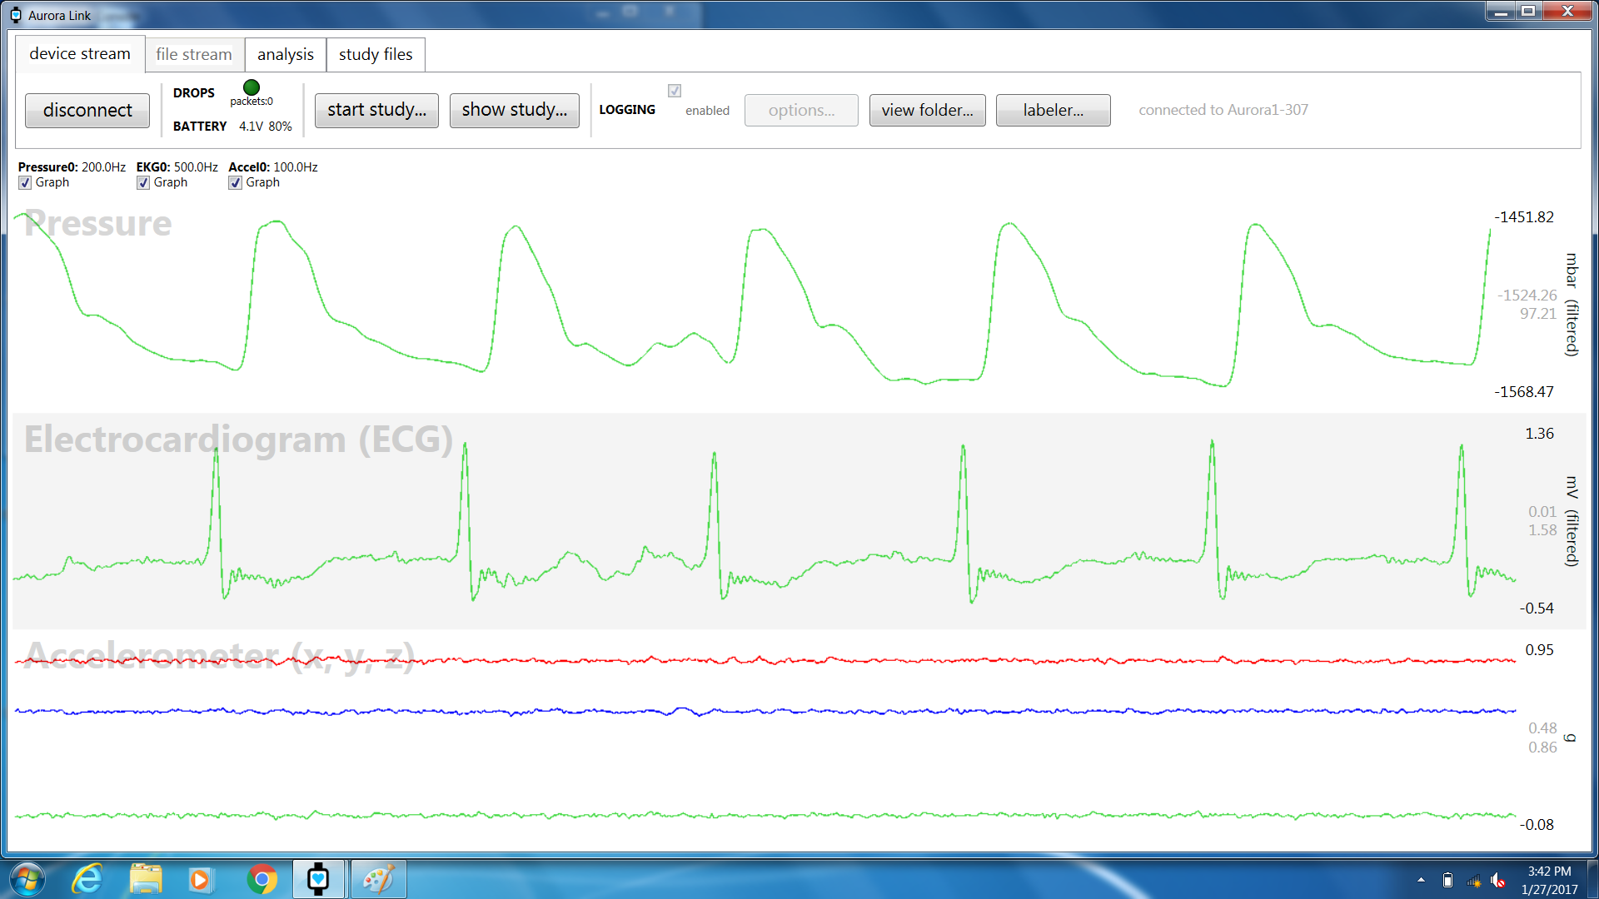
RESTING ARTERIAL TONOMETRY
Pulse pressure = 117 AU

Slide 38
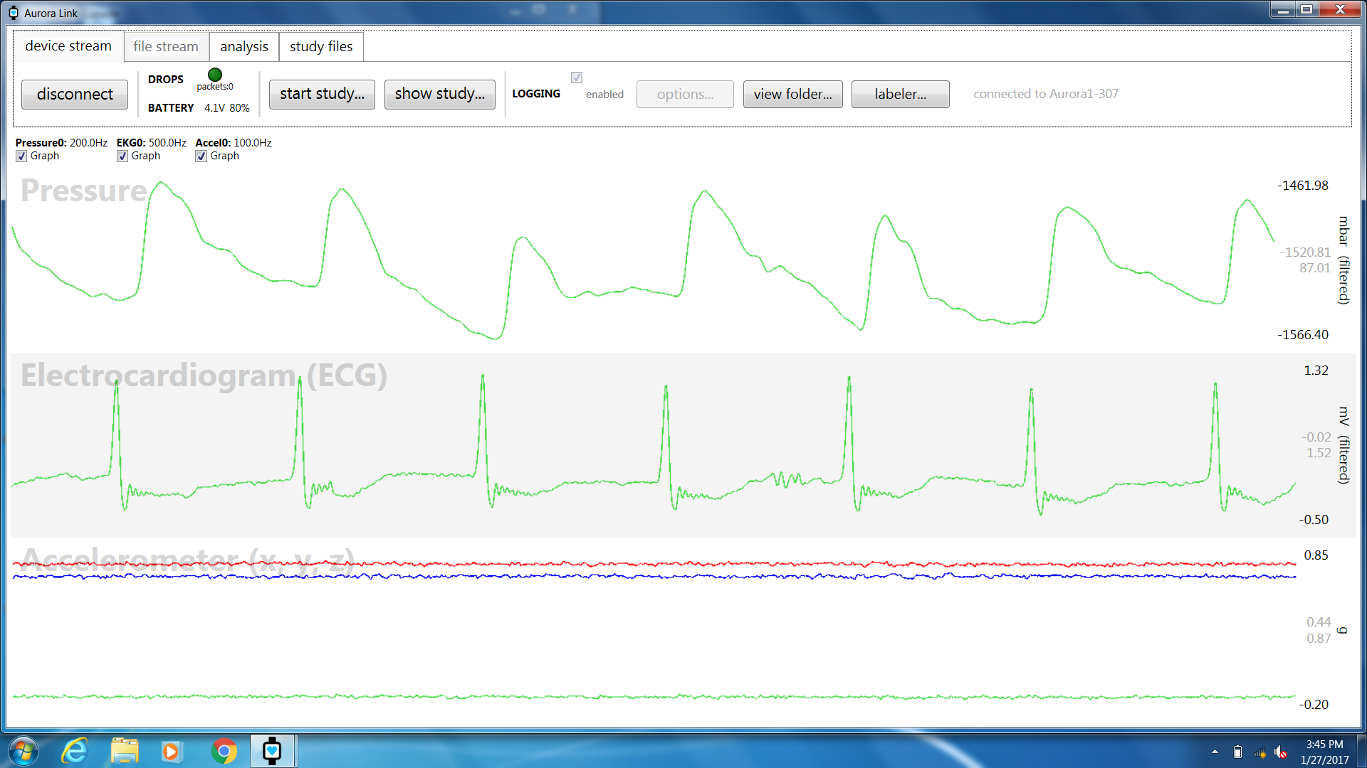
15W (PEAK STRESS) ARTERIAL TONOMETRY
Pulse pressure = 98 AU

Slide 39
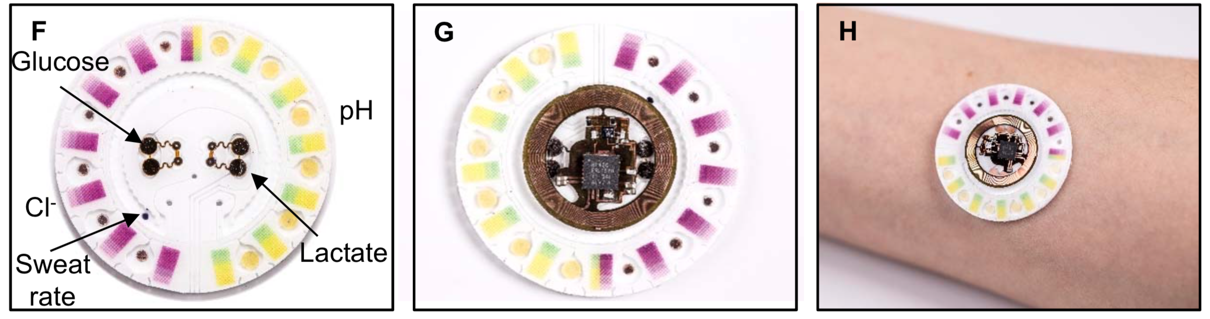
Exercise sweat analytics
Choi J, et al.
Science Advances 2018

Slide 40
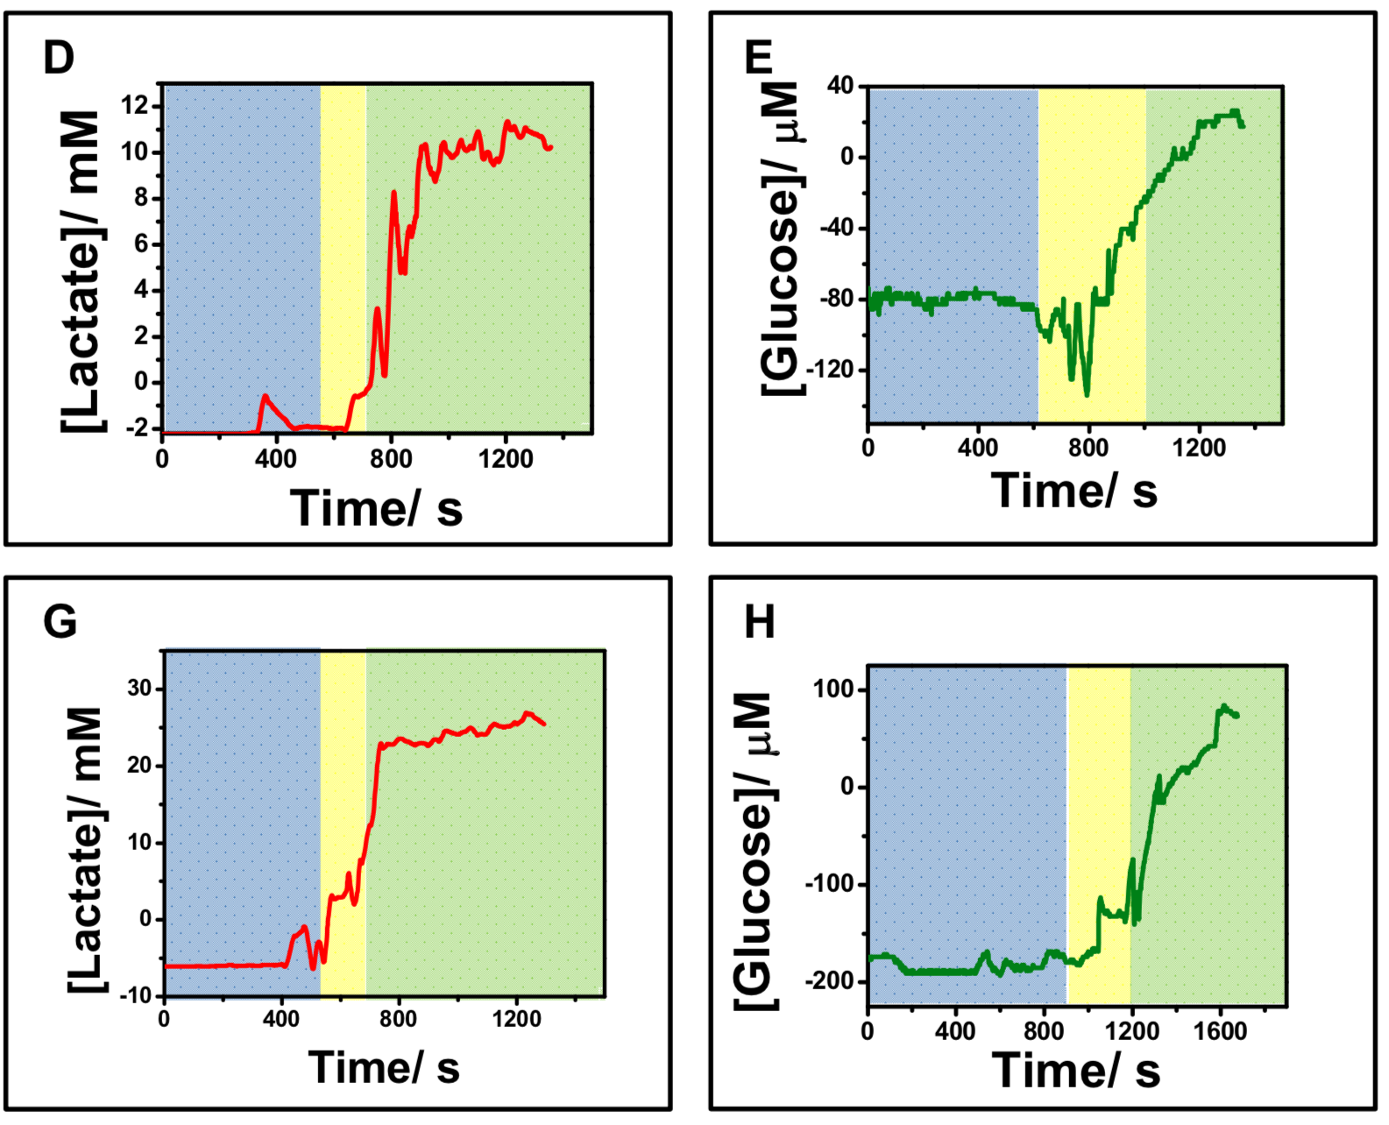
Exercise sweat analytics
Choi J, et al.
Science Advances 2018

Slide 41
PhysIQ vital patch + Samsung watch

Slide 42
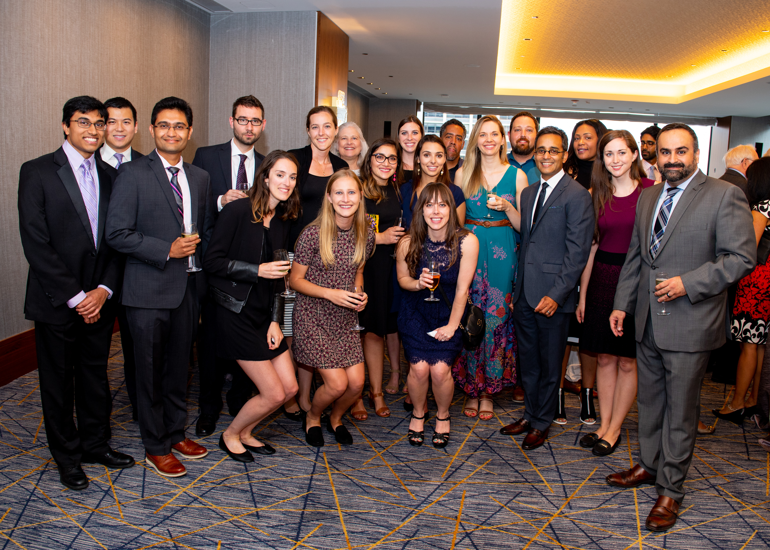
thank you
Shah Lab

