Slide 1
Early HF Steering
March 2019

Slide 2
MESA Heart Failure Study (Shah/Bertoni PIs)
Specific Aims:
Aim 1 (Prevalence): Determine the prevalence of early HF
Aim 2 (Pathogenesis): Examine associations between risk factors, biomarkers, and changes in risk factors with early HF and its pathophysiologic markers:
Cardiac mechanics
Ventricular-arterial coupling
Myocardial pressure-stress relationships
Aim 3 (Phenomics): Perform machine learning analyses of previously ascertained MESA quantitative data and relate risk factor phenotypic signatures to pathophysiologic markers and HF subtypes
All participants, all 6 sites:
Questionnaires:
KCCQ
6MWT
Echocardiography
GE Vivid T8 2D, M-mode, color Doppler, tissue Doppler, speckle-tracking
Resting echo
Passive leg raise maneuver
Arterial tonometry
Fukuda VaSera
Pulse-wave velocity
Augmentation index
Arterial waveform
Wake Forest only:
Cardiopulmonary exercise test

Slide 3
MESA Exam 6: Final
Heart Failure Study Components
Site | Selected | Echo | Arterial Stiffness | Physical Activity | KCCQ-12 | 6MWT
3: Wake Forest | 414 | 307 | 309 | 361 | 361 | 300
4: Columbia | 631 | 551 | 549 | 557 | 557 | 458
5: Johns Hopkins | 450 | 419 | 418 | 423 | 423 | 349
6: Minnesota | 568 | 547 | 525 | 555 | 555 | 447
7: Northwestern | 658 | 649 | 634 | 647 | 653 | 509
8: UCLA | 573 | 548 | 534 | 554 | 553 | 495
Total | 3294 100% | 3021 92% | 2969 90% | 3097 94% | 3102 94% | 2558 78%
CPET (Wake Forest only): n=135

Slide 4
Kansas City Cardiomyopathy Questionnaire Short Version (KCCQ-12)
KCCQ designed to capture heart failure symptoms/ quality of life limitations
Short Version derived from the 23-item KC questionnaire (Spertus & Jones 2015) with good psychometric properties. Score ranges from 0-100
Minimal clinically important difference: 5 points
 | Stable HF |  | Clinic Visit HF
NYHA Class | N | Mean (SD) | N | Mean (SD)
I | 310 | 86 (15) | 29 | 80 (15)
II | 267 | 73 (19) | 115 | 69 (20)
III | 80 | 50 (21) | 115 | 51(22)
IV | 7 | 29 (29) | 14 | 28(25)

Slide 5
Questionnaire

Slide 6
Final KCCQ12 summary score
Age Categories Exam 6 | Mean KCCQ12 FEMALE | Male
55-64 | 92.1 | 93.6
65-74 | 90.7 | 94.3
75-84 | 87 | 90.7
>=85 | 82.4 | 87.2
Sample N=3097 , mean age 74 years, 53% female, 40% White, 13% Chinese, 25% Black, 22% Hispanic
Mean Score 90.4, SD 13.8
25th percentile 87.5, Median 95.8, 75th percentile 100.

Slide 7
CHF and CVD adjudicated prior to Exam 6
KCCQ12 Means by CVD/CHF
 | CHF
CVD | No | Yes
No | N= 2826, 91 | N=32, 82
Yes | N=213, 86 | N=25, 81
Of participants with KCCQ12 data, 57 (1.8%) had an adjudicated CHF event prior to 2016 and 238 (7.7%) had a prior CVD endpoint
Adjusting for Exam 6 age, gender, and race, prior identification as incident HF associated with 8.2 units lower KCCQ1 score p<0.001, and prior CVD 5.3 meters lower , p<0.001

Slide 8
KCCQ12 groupings, prior CVD, and 6MWT
KCCQ Group | N | Mean KCCQ12 | Mean Age | Prior adjudicated CVD or HF | Completed 6MW Test
1 | 613 | 67.4 | 76.9 | 16% | 58%
2 | 588 | 89.1 | 74.6 | 10% | 81%
3 | 369 | 94.7 | 73.2 | 8% | 86%
4 | 550 | 97.4 | 72.3 | 7% | 89%
5 | 977 | 100.0 | 72.2 | 5% | 92%

Slide 9
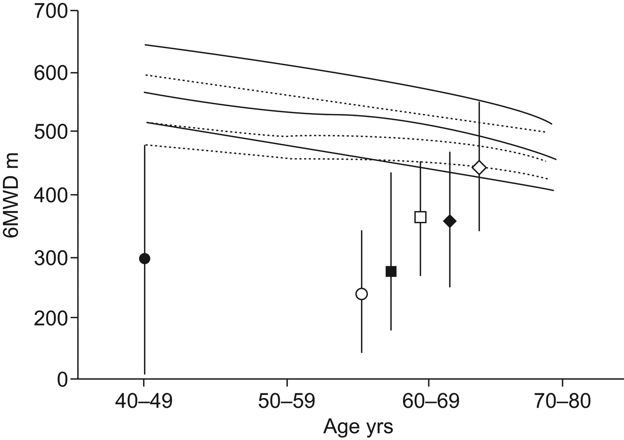
Percentiles (10th, 25th and 50th) curves for 6-min walk distance (6MWD; —–: males; -----: females) compared with the mean (range) published data of the 6MWD for several important chronic diseases
Primary pulmonary hypertension (•) idiopathic pulmonary fibrosis (▪),
CHF subdivided into New York Heart Association (NYHA) stages II (□) and III–IV (○)
COPD subdivided into Global Initiative for Obstructive Lung Disease stages II (⋄) and III–IV (♦).
Casanova et al. Eur Respir J 2011;37:150-156
Notes:
Percentiles (10th, 25th and 50th) curves for 6-min walk distance (6MWD; —–: males; -----: females) compared with the mean (range) published data of the 6MWD for several important chronic diseases: primary pulmonary hypertension (•) 19, idiopathic pulmonary fibrosis (▪) 20, congestive heart failure subdivided into New York Heart Association (NYHA) stages II (□) and III–IV (○) 21, and chronic obstructive pulmonary disease subdivided into Global Intitative for Obstructive Lung Disease stages II (⋄) and III–IV (♦) 7.

Slide 10
6MW Distance Distribution, MESA Exam 6
N=2531
Mean age 74 years, 53% female, 40% White, 13% Chinese, 25% Black, 22% Hispanic
Mean Distance 410 meters, std dev 96
25% pctile 348 Median 410, 75% 476
Notes:
CHS- 6MWT mean distance was 362M for men and 332 M for women.
Reference Equation for 6mwd from health subset of CHS
For the total distance walked in meters for women: 493 + (2.2 × height) − (0.93 × weight) − (5.3 × age), with height in centimeters and weight in kilograms.For men, add 17 m. Subtract 100 m for the lower limit of the normal range.
Criteria applied sequentially to exclude participants from the healthy subgroup: Arthritis in hips and knees, excluded 576 FEV₁ < 70% predicted, excluded 406AAI low (< 0.90) or high (> 1.5), excluded 108History of stroke, TIA, or claudication, excluded 84Diabetics receiving medications, excluded 74Weight or waist size > 95th percentile*, excluded 55Cognitive impairment (MMSE score < 80), excluded 39Diastolic hypertension (> 90 mm Hg), excluded 21

Slide 11
6MWD by Age and Gender

Slide 13
Six Minute Walk Distance by Race/Ethnicity
Notes:
CHS reported
After correcting for age, gender, height, weight, and other confounders, elderly African-American women and men walked a shorter distance when compared to white men and women in our study.
Investigators in Japan recently reported that the mean 6MWD of healthy elderly Japanese men and women³⁶ was similar to that reported for whites.³⁷ ³⁸d lower walk distance in AA participants (40 M less in health AA subset than health whites)

Slide 14
CHF and CVD adjudicated prior to Exam 6
 | CHF
CVD | No | Yes
No | N= 2350, 413m | N=18, 363m
Yes | N=146, 383m | N=16, 348m
Of participants with 6MWT data, 34 (1.3%) had an adjudicated CHF event prior to 2016 and 162 (6.4%) had a prior CVD endpoint
Adjusting for Exam 6 age, gender, and race, prior identification as incident HF associated with 34 meters lower walking distance, p=0.02 , and prior CVD 25 meters lower , p<0.001

Slide 15
Beta Coefficients for 6MWD (meters)
 | Unadjusted | Model 1 | Model 2 | Model3
Age (yr) | -4.9 | -5 | -5.5 | -5.3
Female (vs male) | -43 | -47 | -49 | -38
Height (cm) | 3.1 | 1.2 | ---- | 2.4
Weight (kilo) | -0.06 | -1.5 | ---- | -1.8
BMI | -3.7 | -5.3 | -4.9 | ----
Prediabetes | -9.6 | -8.9 | 2.6 | 2.3
Diabetes | -48 | -41 | -21 | -22
Hypertension | -48 | -25 | -8.9 | -8.6
Prior CVD | -33 | -25 | -19 | -18
Prior HF | -55 | -39 | ---- | ----
Former Smoking (ref never) | 2.6 | -7.4 | -5.4 | -5.9
Current Smoking | 2.5 | -25 | -33 | -33
Black (ref white) | -31 | -36 | -18 | -19
Chinese (ref white) | -31 | -20 | -34 | -30
Hispanic (ref white) | -52 | -32 | -16 | -13
Model 1 adjusts for age, gender, race and site
Model 2 and 3 includes all variables shown plus site

Slide 16
KCCQ12 and 6MWD

Slide 17
KCCQ12 Groups, 6MWD and prior CVD/HF
KCCQ Group | N | Mean KCCQ12 | Mean Age | Mean 6MWD | Prior CVD or HF
1 | 354 | 71 | 75 | 341 | 13.6%
2 | 475 | 89 | 74 | 388 | 8.4%
3 | 317 | 95 | 73 | 406 | 6.9%
4 | 487 | 97 | 72 | 426 | 5.7%
5 | 895 | 100 | 72 | 443 | 4.7%

Slide 18
Removing participants with prior CVD or HF
KCCQ Group | N | Mean KCCQ12 | Mean Age | Mean 6MWD | Excellent/Very Good General Health
1 | 306 | 71 | 74 | 342 | 16.4%
2 | 434 | 89 | 73 | 390 | 41.5%
3 | 295 | 95 | 73 | 405 | 45.4%
4 | 459 | 97 | 72 | 426 | 54.4%
5 | 853 | 100 | 72 | 445 | 66.4%

Slide 19
Walk Distance Difference (meters) by KCCQ Groups in participants without prior CVD/HF
P-trend <0.001 for both series
Adjusted for age, gender, race, site, education, exercise PA, general health status, HTN, diabetes, smoking status, height and weight.

