Slide 1
MESA Atrial Fibrillation Study
Atrial fibrillation burden, vascular disease of the brain and cardiac MRI in MESA
Project Update
3/27/19

Slide 2
Study components
Exam 5 Exam 6 12-21 mos after Ex 6 follow-up
Cardiac MRI
NT-proBNP
ECG monitoring
Cognitive function Qs
Physical function Q
Blood draw
Brain MRI
Physical function Q
Head injury Q
CV events ascertainment

Slide 3
AFib study participation
Approached for participation | 1930
Zio Patch received with data | 1557
Brain MRI completed to date | 869

Slide 4
Brain MRI Completion
Scans received at U Penn Reading Center, updated 3/23/19
Wake Forest | 97
Columbia | 138
Johns Hopkins | 101
Minnesota | 186
Northwestern | 158
UCLA | 189
TOTAL | 869

Slide 5
Brain MRIs
Original completion date: March 31, 2019
Extended completion date: May 31, 2019
Additional time needed for completion?

Slide 6
Manuscripts
Topic | Leads | Status
Zio Patch pilot study | Michael Zhang, Lin Yee Chen | Pacing Clin Electrophysiol 2018
Methods paper | Susan Heckbert, Tom Austin | J Electrocardiol 2018
Race/ethnicity and AF | Susan Heckbert | under review
Cardiac structure/function & supraventricular ectopy | Susan Heckbert, Paul Jensen | analyses complete; manuscript nearly drafted
Opiate and gabapentinoid use & AF, supraventricular ectopy | Barbara Harding, James Floyd | manuscript being drafted

Slide 7
Funding that builds on AFib study data
Grant | Topic | PI
MESA Memory R01 | Cardiometabolic determinants of AD | Tim Hughes
MESA Mind R01 | Multi-site study of vascular contributions to AD | Tim Hughes
AHA Atrial Fib SFRN | Atrial myopathy, AF & stroke | Phil Greenland
Omics R01 | Mitochondrial DNA copy number and sequence variation & brain structure/cognitive function | Chunyu Liu
Jackson Heart Study R01 | Zio Patch ancillary study | James Floyd
AD-focused supplement | Develop & apply automated reading of SWI pulse sequences | Susan Heckbert, Mohamad Habes

Slide 8
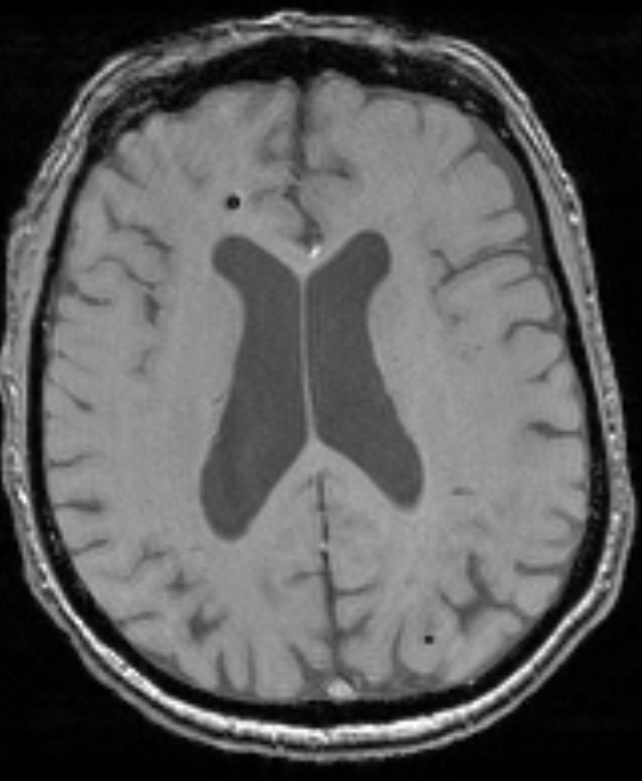
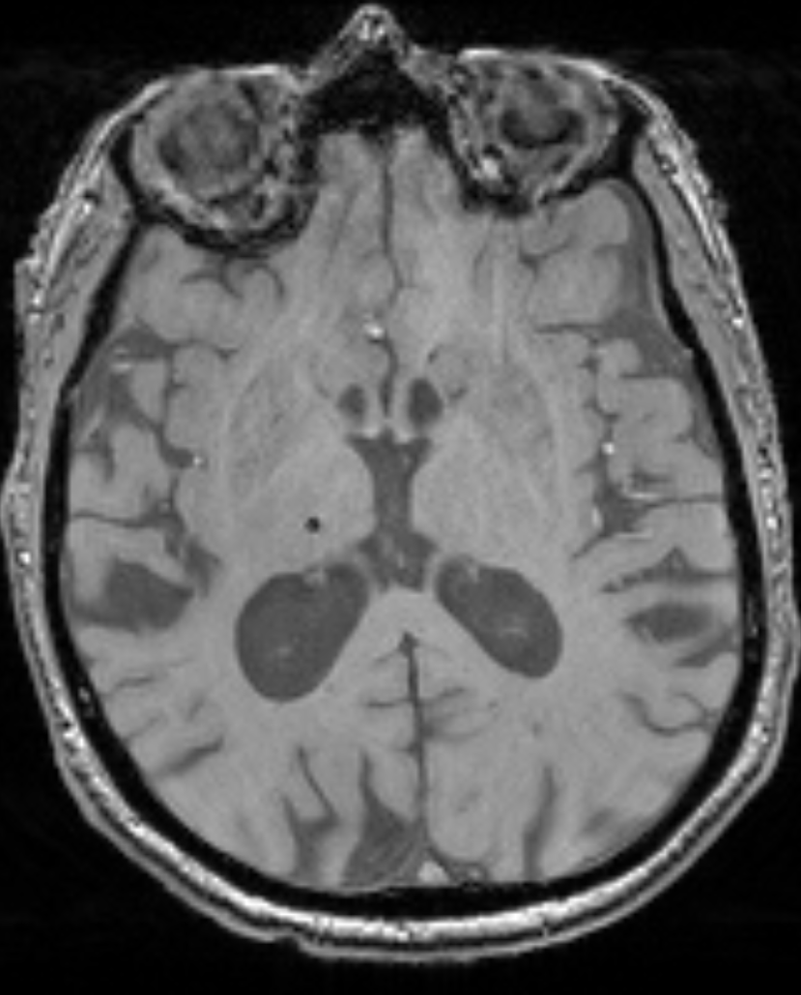
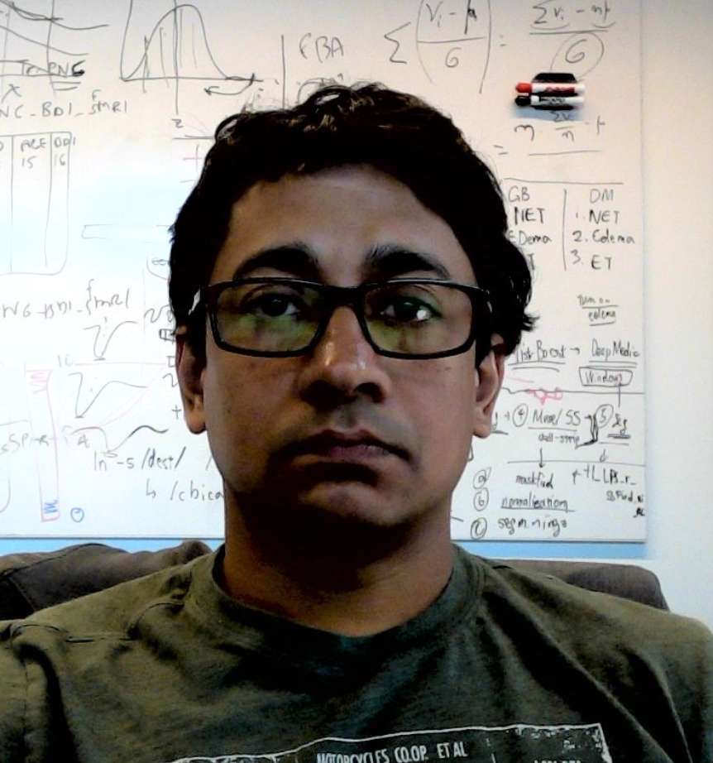
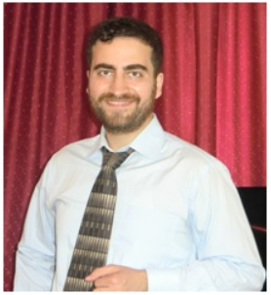
Supplement: Automated Cerebral Microbleed Quantification with Deep Learning
Cerebral Microbleeds (CMBs)
Microhemorrhages caused by small vessel disease, associated with cerebral amyloid angiopathy, hypertensive vasculopathy, AD
Small (< 5 mm), rounded/ovoid in shape
Difficult to detect, time consuming. Can be confused with mimics (calcifications, enlarged perivascular spaces)
Goal: automate detection and understand contribution to accelerated aging and Alzheimer’s disease-like patterns
Data
Manually segmented gold standard by two neuroradiologists
MR scans (SWI and T2) of 34 MESA subjects used for training
Method will be applied on the full MESA cohort
Tanweer Rashid, PhD
Postdoc
Mohamad Habes, PhD
Instructor of Radiology

Slide 9
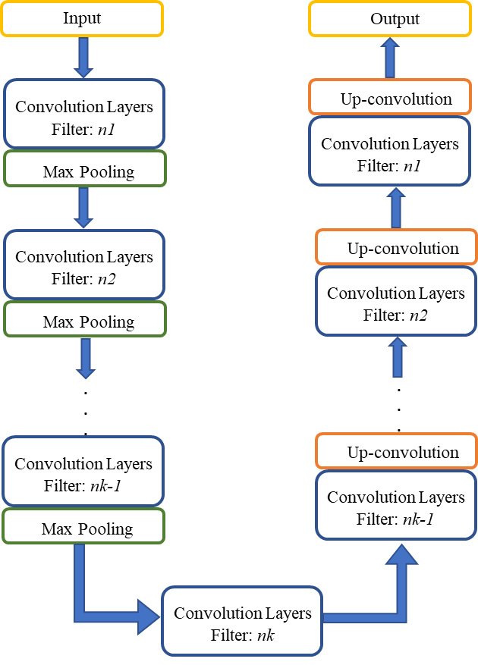
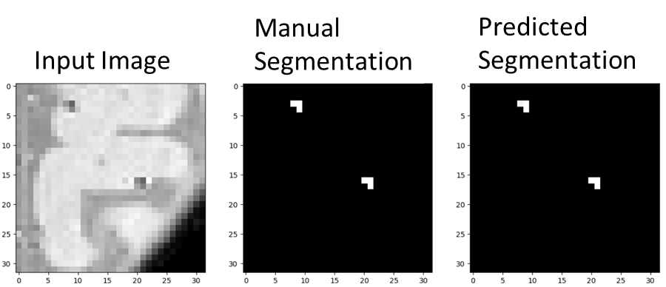
Automated Cerebral Microbleed Quantification with Deep Learning
Method
Deep learning is a type of supervised machine learning containing a large number of feature-extracting layers
Model is based upon networks named (U-Net)
Results
Initial results very encouraging
Validation work ongoing
Future work
Utilize multi-modal data (T2, QSM) to eliminate false positives due to CMB mimics
Rashid, et al. (in preparation)
Notes:
QSM = quantitative susceptibility mapping

Slide 11
MESA Brain MRI protocol
Outcome measure | Scanning Procedure | Time min:sec
(Localizer) | 3D Gradient Echo | 0:25
Structural/morphology | 3D T1 | 4:26
Structural/morphology | 3D FLAIR | 4:20
Structural/morphology | 3D T2 | 4:08
Cerebral blood flow | 2D Arterial Spin Labeling | 5:32
White matter integrity | Diffusion Tensor Imaging | 4:37
Functional connectivity | BOLD fMRI Resting State | 4:06
Vascular reactivity | BOLD fMRI Breath Hold | 3:36
Cerebral microbleeds | Susceptibility Weighted Imaging | 4:35
 | TOTAL | 35:20

Slide 12
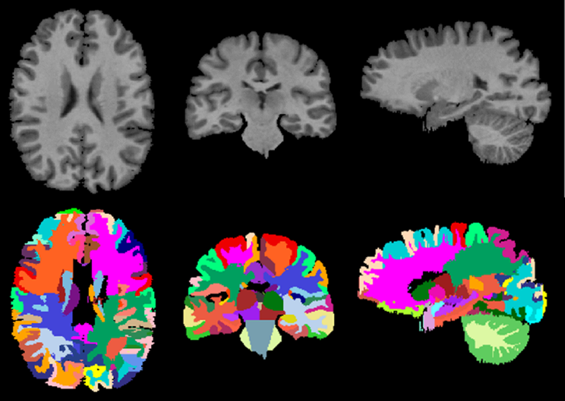
Brain MRI Variables
Total Brain Volume (TBV) and ROI volumes: calculated from T1, T2
White Matter Lesion (WML): Volume of lesions in each (ROI); calculated from T1, T2, FLAIR
Fractional Anisotropy (FA) and Mean Diffusivity (MD): Measures of white matter integrity, calculated from DTI
Cerebral Microbleeds (CMB): Calculated from SWI
Cerebral Blood Flow (CBF): Mean CBF value; calculated from ASL
Vascular reactivity (VR); calculated from breathhold fMRI
Functional Connectivity (FC): calculated from resting state fMRI

Slide 13
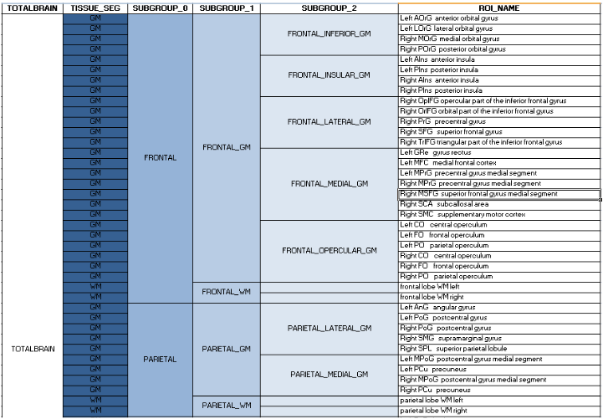
ROI hierarchy:
Volumes are reported for single ROIs (finest parcellation), as well as for derived ROIs, i.e. larger anatomic regions obtained by combining single ROIs.
13
Notes:
13

