Slide 1
Multi-Ethnic Study of Atherosclerosis
2018 Achievement Awards
Notes:
1

Slide 2
Multi-Ethnic Study of Atherosclerosis
MESA Young Investigator Award
Awarded to Paul J. Christine, MD, PhD
Christine PJ, Moore K, Crawford ND, Barrientos-Gutierrez T, Sanchez BN, Seeman T, Diez Roux AV.
Exposure to Neighborhood Foreclosures and Changes in Cardiometabolic Health: Results From MESA. Am J Epidemiol. 2017;185(2):106-114
March 28, 2018
__________________________
Lorraine M. Silsbee, M.H.S. MESA Project Officer
___________________________________
Gregory Burke, MD, MESA Steering Committee Chair
Notes:
2

Slide 3
Multi-Ethnic Study of Atherosclerosis
MESA Young Investigator Award
Awarded to Yacob Tedla, PhD, MSc
Tedla YG, Gepner AD, Vaidya D, Colangelo L, Stein JH, Liu K, Greenland P.
Association between long-term blood pressure control and ten-year progression in carotid arterial stiffness among hypertensive individuals: the Multi-Ethnic Study of Atherosclerosis. J Hypertens. 2017;35(4):862-869.
March 28, 2018
__________________________
Lorraine M. Silsbee, M.H.S. MESA Project Officer
___________________________________
Gregory Burke, MD, MESA Steering Committee Chair
Notes:
3

Slide 4
Multi-Ethnic Study of Atherosclerosis
MESA Young Investigator Award
Awarded to Isac Cyril Thomas, MD
Thomas IC, Shiau B, Denenberg JO, McClelland RL, Greenland P, de Boer IH, Kestenbaum BR, Lin GM, Daniels M, Forbang NI, Rifkin DE, Hughes-Austin J, Allison MA, Carr J, Ix JH, Criqui MH.
Association of cardiovascular disease risk factors with coronary artery calcium volume verses density. Heart. 2018;104(2):135-143.
March 28, 2018
__________________________
Lorraine M. Silsbee, M.H.S. MESA Project Officer
___________________________________
Gregory Burke, MD, MESA Steering Committee Chair
Notes:
5 1st author published paper with a focus on PVD
4

Slide 5
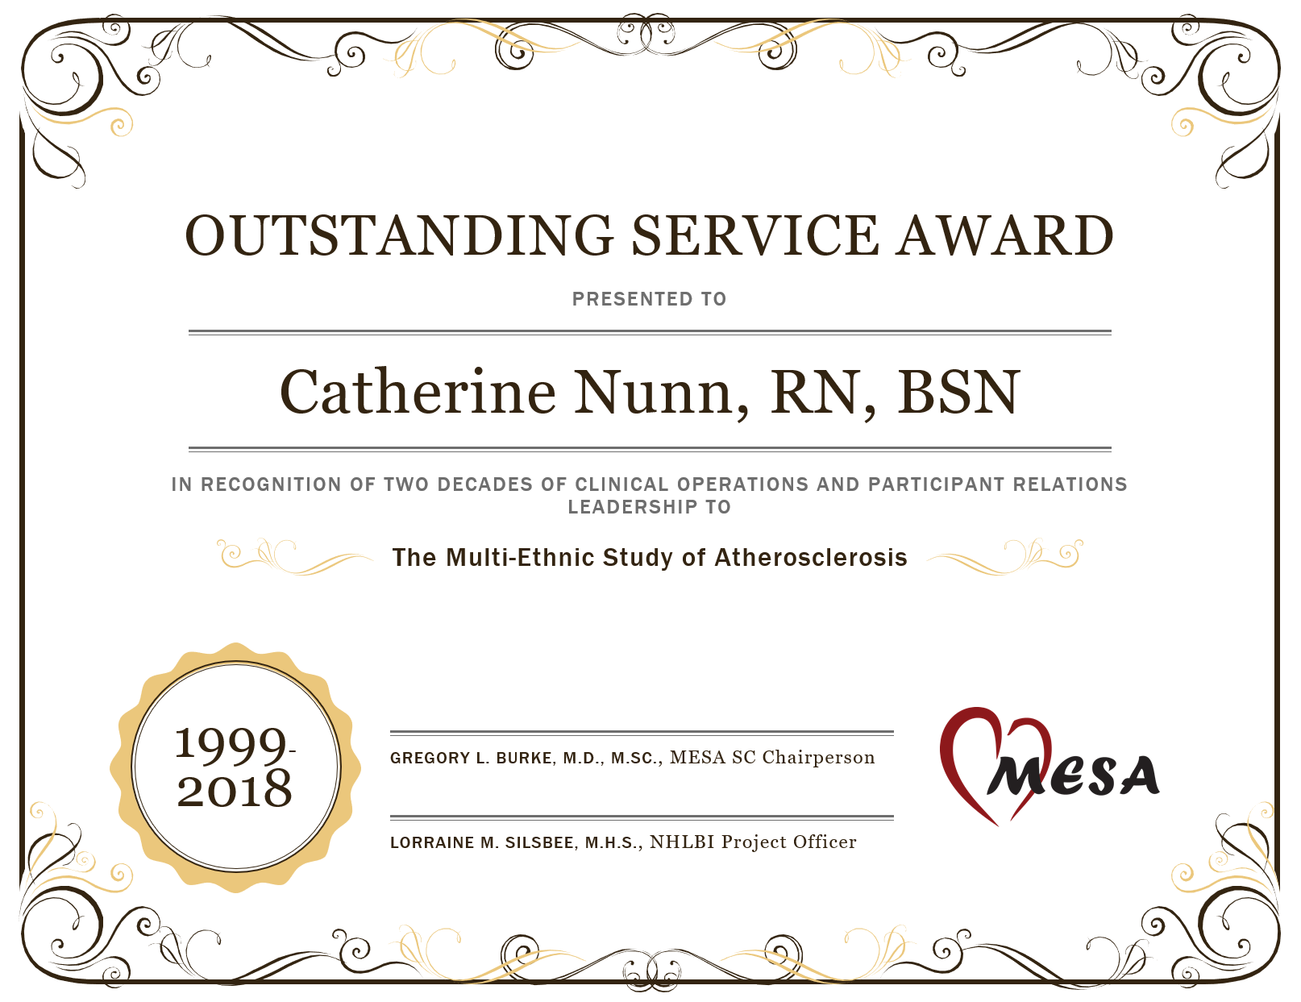

Slide 6
