Slide 1
MESA Operations

Slide 2
Operations Subcommittee Report
Timeline
Follow-up calls
Participant Relations Committee
Exam 6
Core and Ancillary Study Progress
Alerts
Results Reporting
Retention Strategies

Slide 3
MESA 3 Timeline
Exam 6 Sept 6, 2016 – May 31, 2018
Annual Follow-up phone calls run congruent with fiscal years

Slide 4
Follow-up Call Retention
85%
Retention = Completed / (Enrolled – Dead)

Slide 5
Follow-up Retention by Ethnicity
85%
Retention = Completed / (Enrolled – Dead) except FU 15 (windowed)

Slide 6
Follow-up 19 Completion by Site
Site Name | Follow-up Due | Contacts Made |  | Interviews Completed |  | Unable | Refused
Wake Forest | 431 | 197 | 46% | 170 | 39% | 26 | 1
Columbia | 479 | 229 | 48% | 191 | 40% | 32 | 3
Hopkins | 479 | 351 | 73% | 309 | 65% | 31 | 10
Minnesota | 479 | 250 | 52% | 221 | 46% | 28 | 0
NWU | 519 | 304 | 59% | 256 | 49% | 37 | 8
UCLA | 607 | 355 | 58% | 315 | 52% | 33 | 7
Total | 2994 | 1686 | 56% | 1462 | 49% | 187 | 29
Includes active and study drop out participants with closed contact windows for “true retention.”

Slide 7
Follow-up Retention by Site
85%
85%
Retention = Completed / (Enrolled – Dead) except FU 18 (windowed)

Slide 8
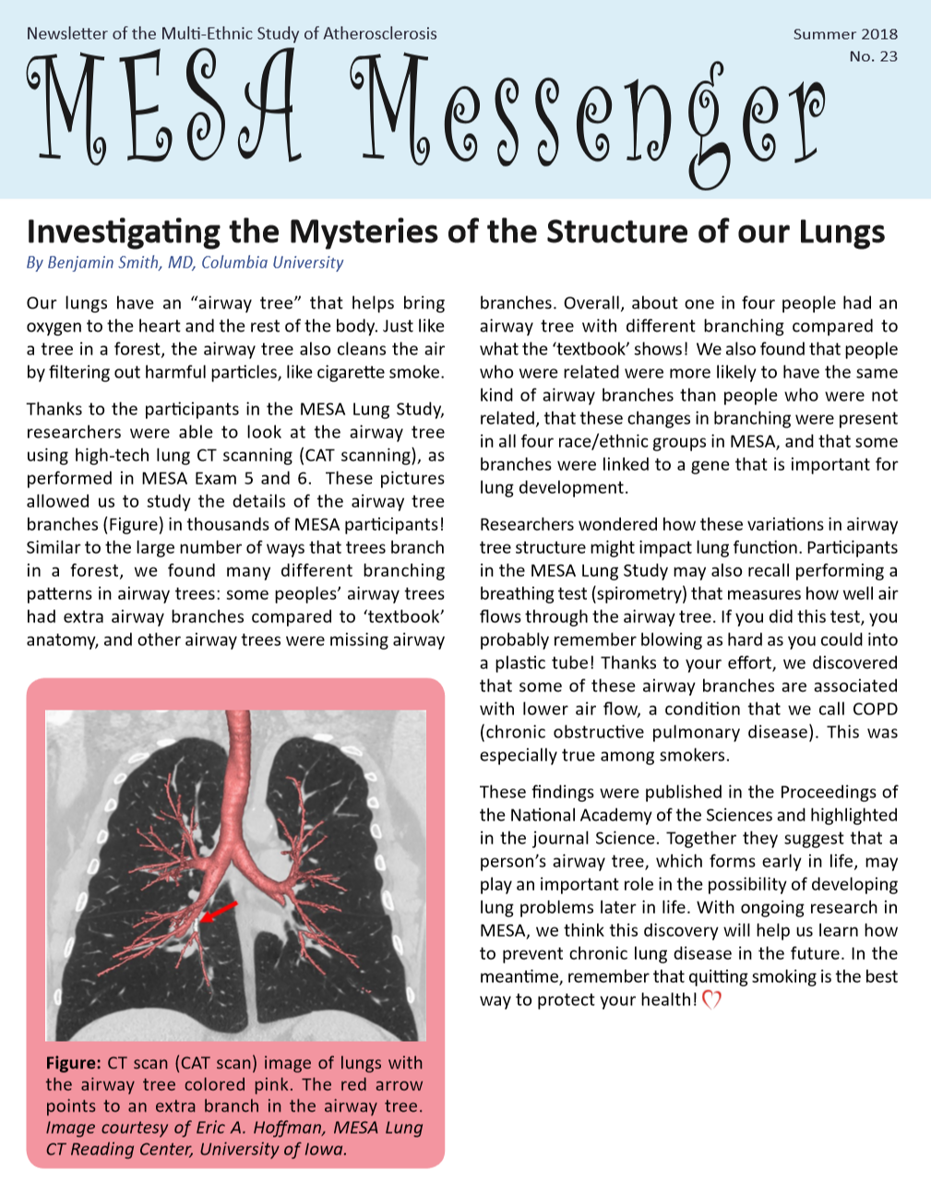
Participant Relations Committee
Newsletter
Scheduled for Summer 2018
Articles include
Lung structure (Ben Smith)
Air pollution and heart health (Amanda Gassett)
Heart Ryhthm and changes in brian structure/function (Susa Heckbert)
New BP guidelines (Seamus Whelton, Bill McEvoy)
One newsletter per year planned for remainder of MESA 3 contract

Slide 9
Participant Relations Committee
Letters to MESA Contacts to be distributed after Exam 6
Describes MESA and the role of named contacts
Participant Website Updates
Article summaries and press releases are added monthly

Slide 10
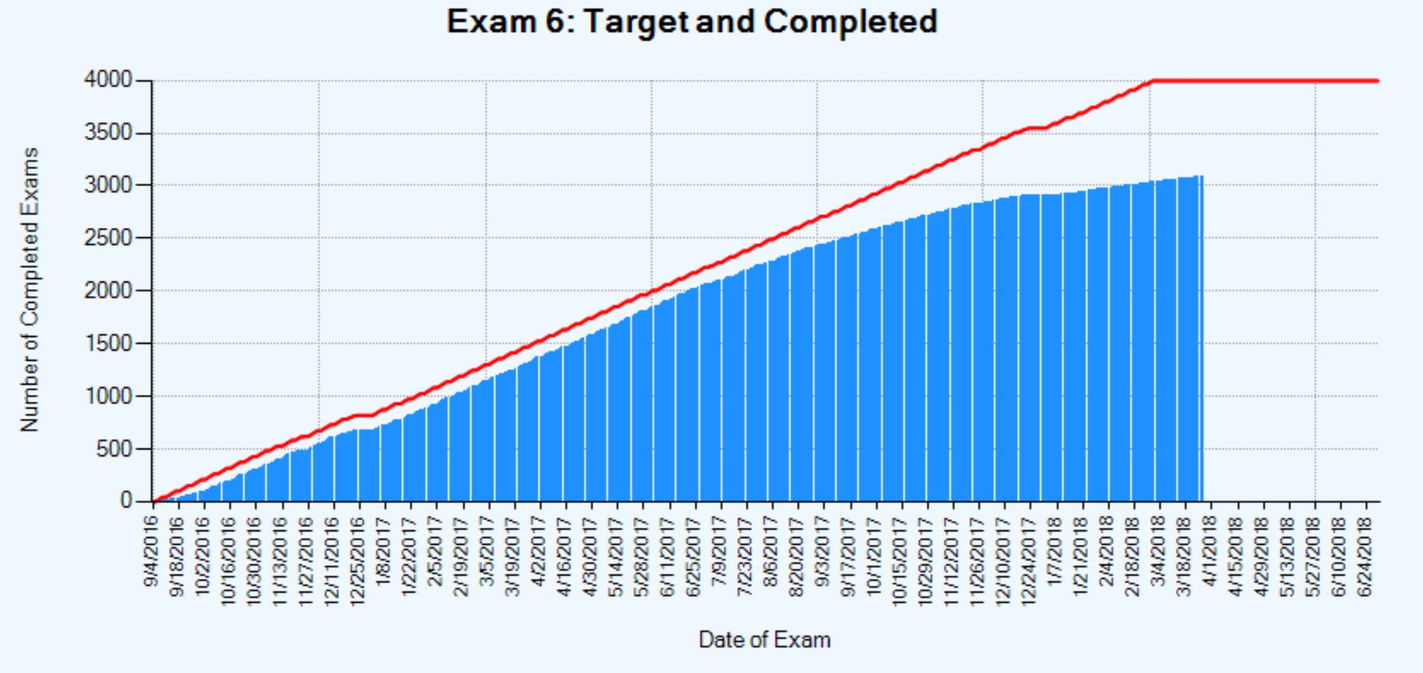
Exam 6 Completion – All Sites
Race | Enrolled | Active | Done | % Enrolled | % Active | Pending
African Am | 1413 | 1244 | 776 | 55% | 62% | 472
Chinese | 664 | 580 | 394 | 59% | 68% | 186
Hispanic | 1227 | 1091 | 653 | 53% | 60% | 440
White | 2042 | 1833 | 1261 | 62% | 69% | 579
Total | 5346 | 4748 | 3084 | 58% | 65% | 1677

Slide 11
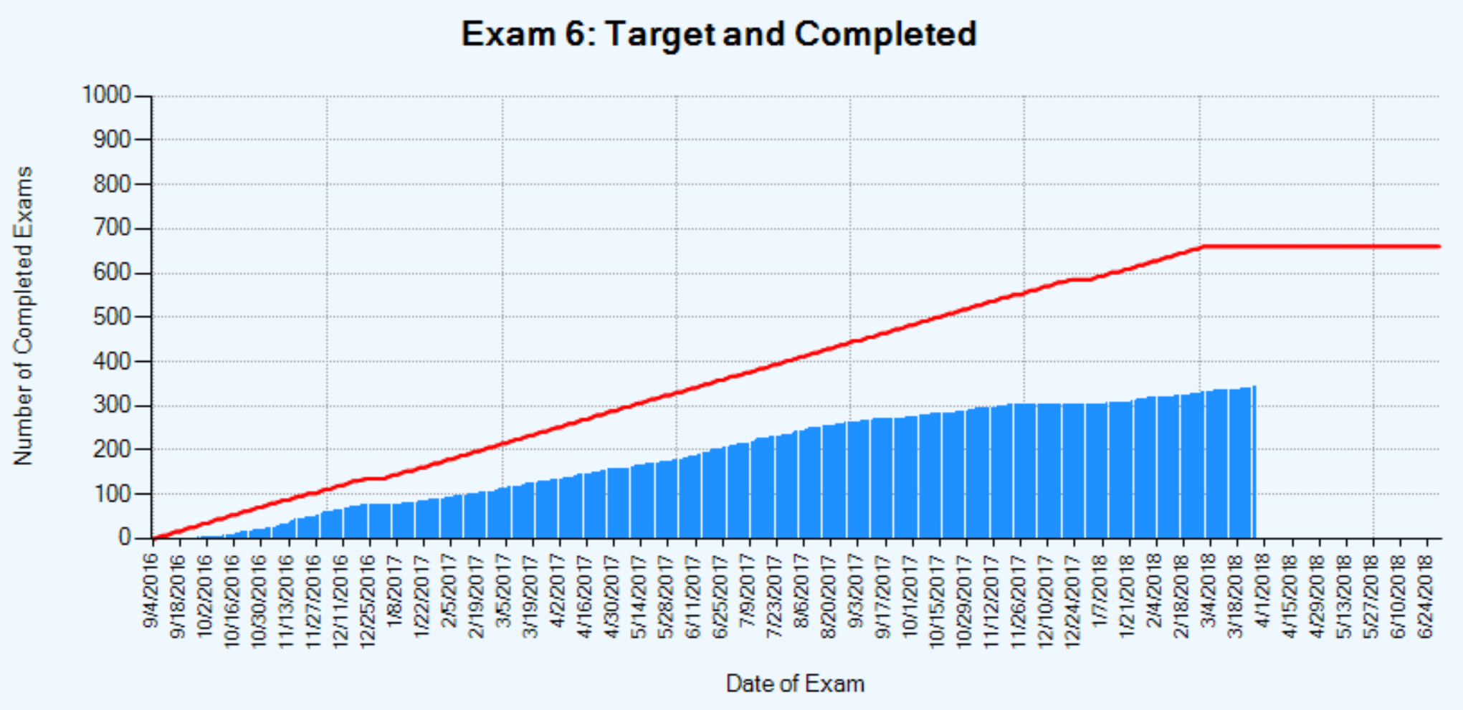
Exam 6 Completion – Wake
Race | Enrolled | Active | Done | % Enrolled | % Active | Pending
African Am | 370 | 354 | 168 | 45% | 47% | 186
Hispanic | 2 | 2 | 1 | 50% | 50% | 1
White | 429 | 408 | 173 | 40% | 42% | 237
Total | 801 | 764 | 342 | 43% | 45% | 424

Slide 12
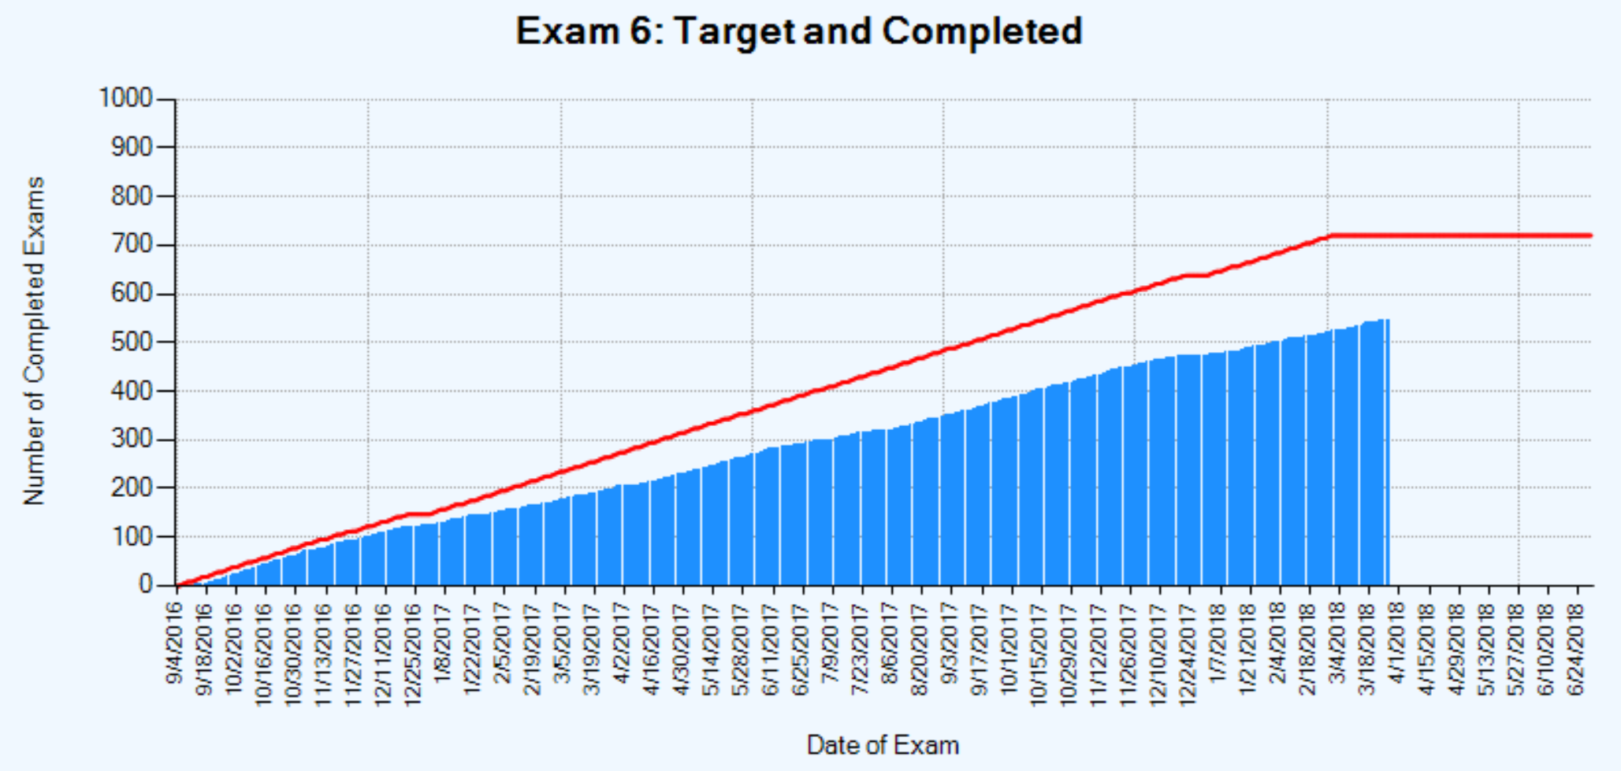
Exam 6 Completion – Columbia
Race | Enrolled | Active | Done | % Enrolled | % Active | Pending
African Am | 287 | 265 | 185 | 64% | 70% | 81
Chinese | 2 | 2 | 2 | 100% | 100% | 0
Hispanic | 405 | 372 | 231 | 57% | 62% | 142
White | 185 | 169 | 127 | 69% | 75% | 43
Total | 879 | 808 | 545 | 62% | 67% | 266

Slide 13
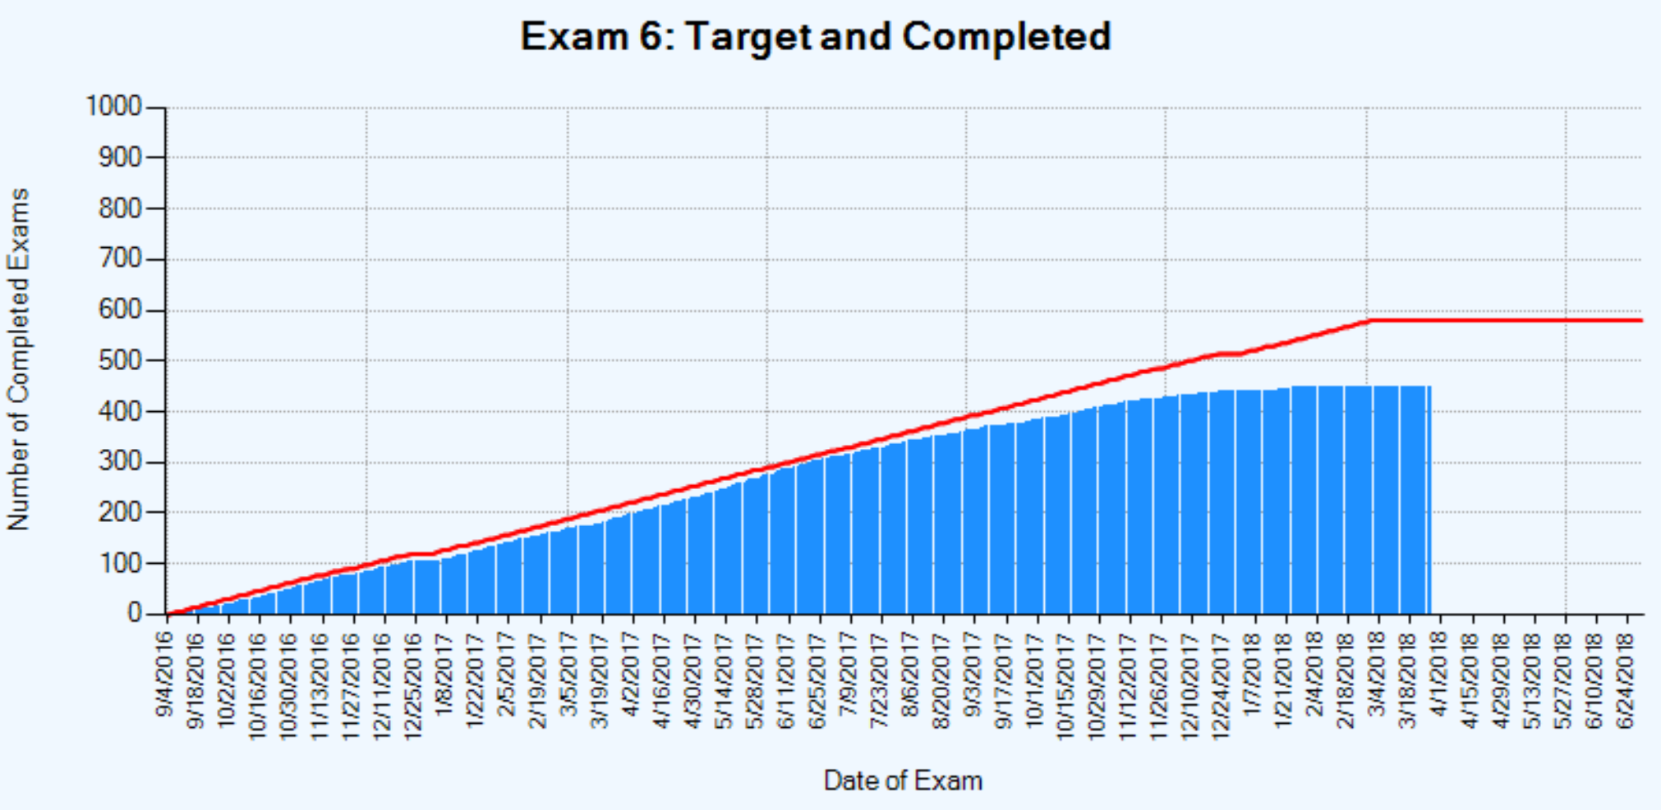
Exam 6 Completion – Hopkins
Race | Enrolled | Active | Done | % Enrolled | % Active | Pending
African Am | 411 | 317 | 207 | 50% | 65% | 112
White | 406 | 329 | 243 | 60% | 74% | 86
Total | 817 | 646 | 450 | 55% | 70% | 198

Slide 14
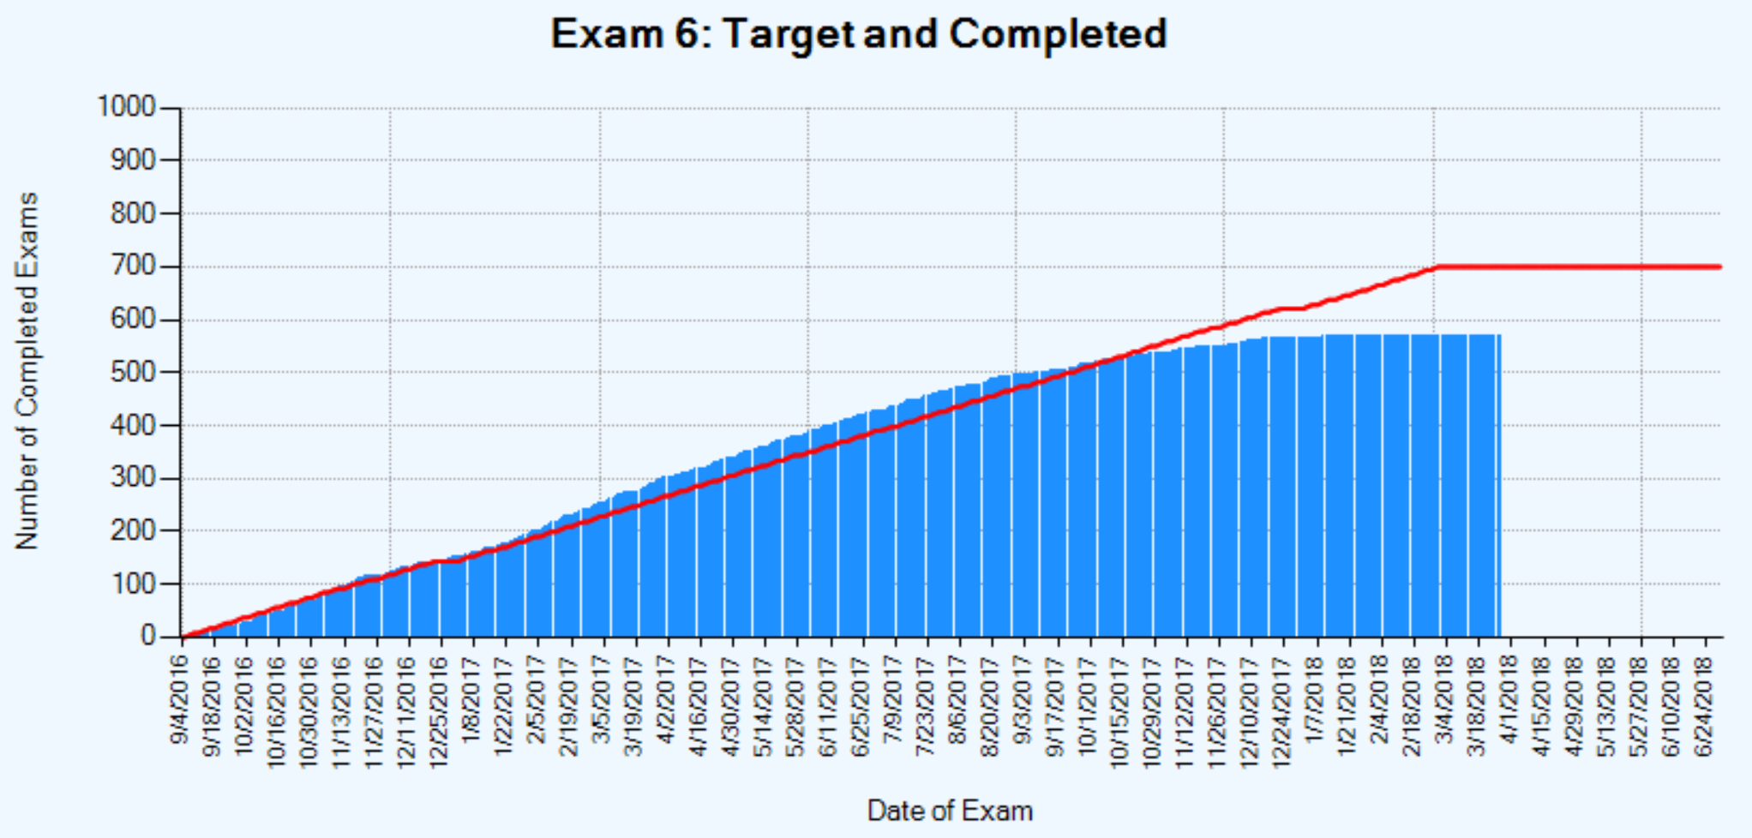
Exam 6 Completion – Minnesota
Race | Enrolled | Active | Done | % Enrolled | % Active | Pending
Hispanic | 392 | 354 | 225 | 57% | 64% | 130
White | 470 | 441 | 343 | 73% | 78% | 99
Total | 862 | 795 | 568 | 66% | 71% | 229

Slide 15
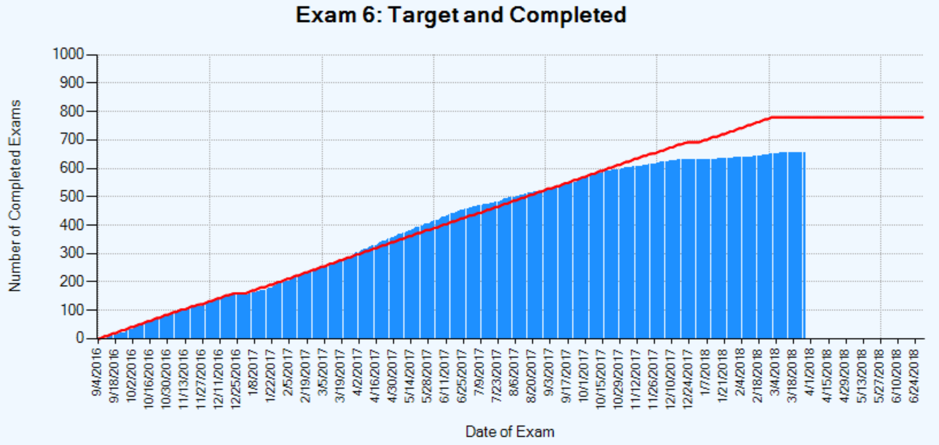
Exam 6 Completion – Northwestern
Race | Enrolled | Active | Done | % Enrolled | % Active | Pending
African Am | 225 | 203 | 155 | 69% | 76% | 49
Chinese | 261 | 235 | 191 | 73% | 81% | 44
White | 448 | 391 | 308 | 69% | 79% | 86
Total | 934 | 829 | 654 | 70% | 79% | 179

Slide 16
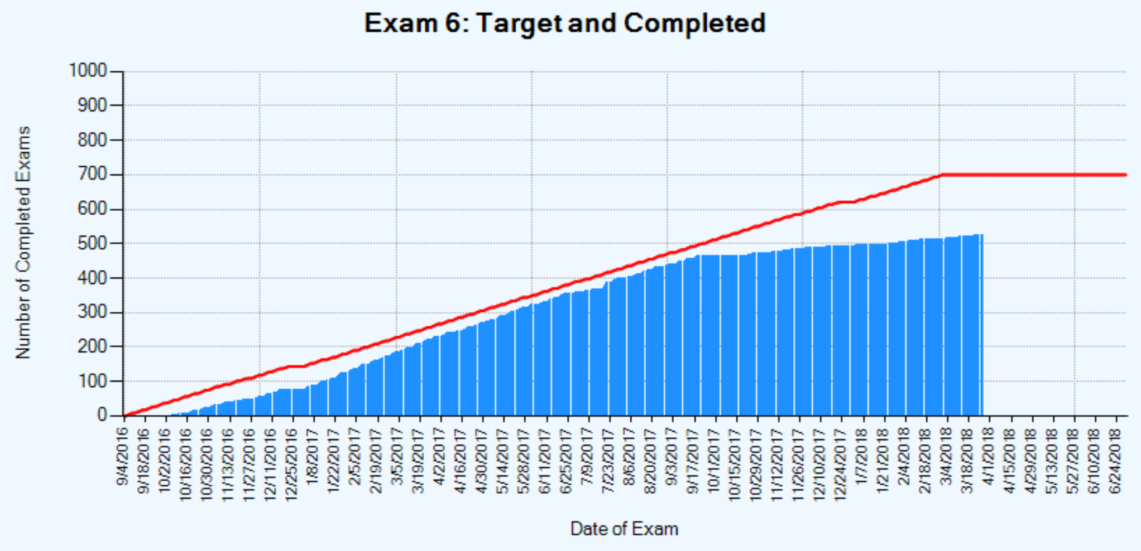
Exam 6 Completion – UCLA
Race | Enrolled | Active | Done | % Enrolled | % Active | Pending
African Am | 120 | 105 | 61 | 51% | 58% | 44
Chinese | 401 | 343 | 201 | 50% | 59% | 142
Hispanic | 428 | 363 | 196 | 46% | 54% | 167
White | 104 | 95 | 67 | 64% | 71% | 28
Total | 1053 | 906 | 525 | 50% | 58% | 381

Slide 17
Exam 6 Core Completion
Site | Visits | Home Visits | BP | O2 | Anthro | Phlebo | Urine
WFU | 342 | 12 | 339 | 338 | 340 | 318 | 318
COL | 545 | 41 | 544 | 541 | 542 | 514 | 469
JHU | 450 | 27 | 446 | 448 | 449 | 441 | 400
MN | 568 | 14 | 568 | 568 | 568 | 562 | 550
NWU | 654 | 0 | 654 | 654 | 654 | 638 | 647
UCLA | 525 | 8 | 524 | 524 | 524 | 507 | 511
Total | 3084 | 102 | 3075 | 3073 | 3077 | 2980 | 2895

Slide 18
Exam 6 Completion – AFib
Site | Eligible | Patch #1 Applied | Patch #2 Mailed t | Cog Function Testing | # with prior Afib (including E6 self-report) | # Alerts
WFU | 191 | 172 | 85 | 165 | 21 | 6
COL | 282 | 242 | 96 | 236 | 33 | 3
JHU | 212 | 204 | 108 | 201 | 25 | 6
MN | 303 | 287 | 196 | 283 | 35 | 6
NWU | 315 | 296 | 135 | 293 | 37 | 10
UCLA | 325 | 322 | 46 | 320 | 43 | 11
Total | 1628 | 1523 | 666 | 1498 | 194 | 42

Slide 19
Exam 6 Completion – Heart Failure
Site | Selected | Echo | Arterial Stiffness | Physical Activity | KCCQ-12 | 6MW | 6MW Exclusion
WFU | 342 | 229 | 232 | 327 | 326 | 281 | 38
COL | 545 | 500 | 497 | 497 | 498 | 411 | 82
JHU | 450 | 418 | 417 | 423 | 423 | 349 | 74
MN | 568 | 547 | 525 | 555 | 555 | 447 | 99
NWU | 654 | 647 | 632 | 645 | 650 | 496 | 147
UCLA | 525 | 506 | 492 | 517 | 516 | 461 | 52
Total | 3084 | 2847 | 2795 | 2964 | 2968 | 2445 | 492

Slide 20
Exam 6 Completion – Spirometry
Site | Selected | Consented | Pre-BD spiro | Selected Post-BD | Post-BD Spiro | Lung qqf
WFU | 342 | 301 | 238 | 47 | 41 | 235
COL | 489 | 434 | 396 | 21 | 89 | 396
JHU | 418 | 388 | 362 | 9 | 88 | 362
MN | 568 | 538 | 498 | 24 | 42 | 498
NWU | 613 | 589 | 488 | 80 | 46 | 488
UCLA | 487 | 472 | 428 | 31 | 50 | 427
Total | 2917 | 2722 | 2410 | 212 | 356 | 2406

Slide 21
Exam 6 Completion – Lung CT
 | Any CT |  |  | CT with Contrast
Site | Selected | Consent | CT | Selected | Consent | CT | Not eligible
WFU | 342 |  | 195 | 176 | 150 | 68 | 33
COL | 489 | 411 | 353 | 354 | 204 | 127 | 48
JHU | 418 | 367 | 362 | 306 | 185 | 143 | 30
MN | 568 | 522 | 507 | 196 | 161 | 114 | 52
NWU | 613 | 478 | 411 | 484 | 272 | 146 | 110
UCLA | 487 | 460 | 265 | 383 | 298 | 83 | 67
Total | 2917 | 2538 | 2093 | 1899 | 1270 | 681 | 340

Slide 22
Exam 6 AS Completion – INVITE
 |  | Total Screeners Complete |  |  |  |  |  | Screening Result |  |  |  | Consent status for those eligible |  |  | Study Drug Status for those consented |  | 6A Visit Complete
 |  | E6 Complete before INVITE start |  | E6 Complete after INVITE start |  | E6 Pending
Site | Selected | E6 Visits | Screener Complete | E6 Visits | Screener Complete | E6 not complete | Screener Complete | Refused | Not Eligible | Eligible | Missing/ Incomplete | Consented | Declined Consent | Pending Consent | Dispensed | Not Dispensed
WFU | 707 | 147 | 24 | 151 | 108 | 409 | 0 | 54 | 27 | 51 | 43 | 49 | 2 | 0 | 42 | 7 | 20
COL | 736 | 147 | 50 | 322 | 272 | 267 | 0 | 107 | 89 | 126 | 50 | 120 | 2 | 4 | 117 | 3 | 80
JHU | 631 | 91 | 91 | 304 | 304 | 236 | 5 | 130 | 163 | 107 | 0 | 106 | 1 | 0 | 106 | 0 | 101
NWU | 817 | 225 | 175 | 370 | 369 | 222 | 0 | 150 | 261 | 133 | 1 | 132 | 1 | 0 | 132 | 0 | 104
Total | 2891 | 610 | 340 | 1147 | 1053 | 1134 | 5 | 441 | 540 | 417 | 94 | 407 | 6 | 4 | 397 | 10 | 305
Of 1,398 screened participants, 30% are eligible, 39% ineligible, and 32% refused to participate.
69% of ineligible participants were excluded for exceeding 1000IU of vitamin D daily.

Slide 23
Exam 6 AS Completion – Memory

Slide 24
Exam 6 Completion – Epigenetics US
Site | Selected | Consented | Completed
WFU | 274 | 217 | 50
COL | 438 | 335 | 291
JHU | 301 | 270 | 265
MINN | 385 | 352 | 340
Total | 1398 | 1174 | 946

Slide 25
Exam 6 Alerts
Oximetry Alert | 0 | 4 | 3 | 1 | 1 | 1 | 10
BP Alert | 3 | 8 | 20 | 10 | 11 | 9 | 61
Echo Alerts | 2 | 14 | 5 | 6 | 13 | 11 | 51
Lipids Alert | 1 | 3 | 1 | 2 | 3 | 3 | 13
Carotid US Alerts | 5 | 23 | 21 | 26 | 0 | 0 | 75
1st Patch | 170 | 205 | 196 | 282 | 273 | 308 | 1434
Safety Read Complete (2 per ppt) | 245 | 299 | 275 | 446 | 389 | 347 | 2001
Patch Alert | 6 | 3 | 6 | 6 | 10 | 11 | 42
CT Complete | 192 | 351 | 362 | 507 | 407 | 266 | 2085
Safety Read Done | 188 | 347 | 362 | 507 | 406 | 256 | 2066
Lung CT Alerts* | 13 | 31 | 44 | 47 | 117 | 17 | 269

Slide 26
Exam 6 Results Reporting – Lab
Procedure | Count | Minimum | 25th Percentile | Median | 75th Percentile | Maximum
Wake | 295 | 18 | 29 | 35 | 45 | 410
CU | 415 | 13 | 28 | 39 | 49 | 87
JHU | 412 | 17 | 28 | 36 | 48 | 94
Minn | 543 | 16 | 27 | 34 | 47 | 260
NWU | 591 | 13 | 26 | 33 | 44 | 91
UCLA | 472 | 13 | 24 | 31 | 42 | 82
Total | 2728 | 13 | 29 | 34 | 46 | 410

Slide 27
Exam 6 Results Reporting -- Echo
Procedure | Count | Minimum | 25th Percentile | Median | 75th Percentile | Maximum
All Sites | 2811 | 2 | 44 | 57 | 72 | 402
Wake | 225 | 8 | 45 | 63 | 77 | 238
CU | 483 | 7 | 48 | 61 | 76 | 358
JHU | 417 | 6 | 39 | 52 | 68 | 199
Minn | 547 | 5 | 46 | 60 | 75 | 402
NWU | 643 | 4 | 41 | 53 | 70 | 383
UCLA | 496 | 2 | 48 | 60 | 73 | 252

Slide 28
Exam 6 Results Reporting – Spiro
Procedure | Count | Minimum | 25th Percentile | Median | 75th Percentile | Maximum
All Sites | 2214 | 2 | 45 | 58 | 75 | 455
Wake | 223 | 10 | 33 | 51 | 65 | 235
CU | 356 | 3 | 46 | 57 | 71 | 238
JHU | 356 | 3 | 37 | 50 | 63 | 143
Minn | 477 | 2 | 49 | 60 | 76 | 346
NWU | 472 | 4 | 43 | 55 | 71 | 455
UCLA | 330 | 20 | 65 | 92 | 196 | 399

Slide 29
Exam 6 Results Reporting Heart Patch Monitor
Procedure | Count | Minimum | 25th Percentile | Median | 75th Percentile | Maximum
All Sites | 1431 | 6 | 64 | 97 | 193 | 536
Wake | 168 | 13 | 57 | 84 | 166 | 413
CU | 221 | 26 | 68 | 103 | 199 | 418
JHU | 193 | 21 | 62 | 103 | 238 | 459
Minn | 278 | 7 | 62 | 85 | 138 | 441
NWU | 274 | 6 | 65 | 96 | 173 | 536
UCLA | 297 | 23 | 73 | 149 | 240 | 448

