Slide 1
MESA Operations

Slide 2
Operations Subcommittee Report
Timeline
Follow-up calls
On-going Exam 6 Ancillary Studies
Participant Relations Committee

Slide 3
MESA 3 Timeline

Slide 4
Follow-up Call Retention
85%
Retention = Completed / (Enrolled – Dead)

Slide 5
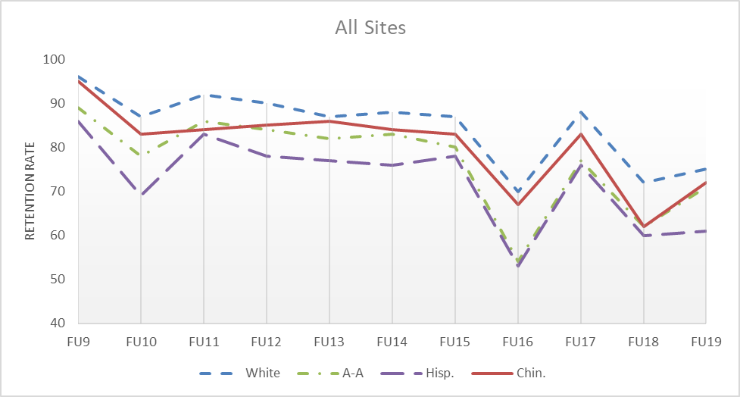
Follow-up Retention by Ethnicity
85%
Retention = Completed / (Enrolled – Dead)

Slide 6
MESA Follow-up 20 Completion by Site
Site Name | Follow-up Due | Contacts Made |  | Interviews Completed |  | Unable | Refused
Wake Forest | 387 | 355 | 87% | 298 | 77% | 26 | 11
Columbia | 412 | 365 | 89% | 319 | 77% | 39 | 5
Hopkins | 325 | 324 | 100% | 302 | 93% | 20 | 2
Minnesota | 402 | 379 | 94% | 326 | 81% | 48 | 5
NWU | 424 | 423 | 100% | 360 | 85% | 60 | 3
UCLA | 456 | 380 | 83% | 325 | 71% | 47 | 3
Total | 2406 | 2206 | 92% | 1930 | 80% | 240 | 29
Includes active and study drop out participants with closed contact windows for “true retention.”

Slide 7
MESA Air Follow-up 20 Completion by Site
Site Name | Follow-up Due | Contacts Made |  | Interviews Completed |  | Unable | Refused
Wake Forest | 15 | 11 | 73% | 11 | 73% | 0 | 0
Columbia | 116 | 78 | 67% | 67 | 58% | 10 | 1
Hopkins | 0 | 0 | 0% | 0 | 0% | 0 | 0
Minnesota | 37 | 23 | 62% | 20 | 54% | 2 | 1
NWU | 22 | 22 | 100% | 16 | 73% | 6 | 0
UCLA | 83 | 49 | 59% | 34 | 41% | 14 | 1
Total | 273 | 183 | 67% | 148 | 54% | 32 | 3
Includes active and study drop out participants with closed contact windows for “true retention.”

Slide 8
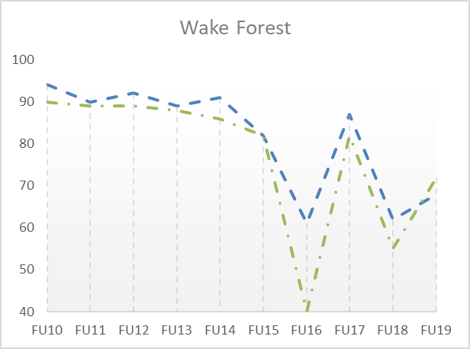
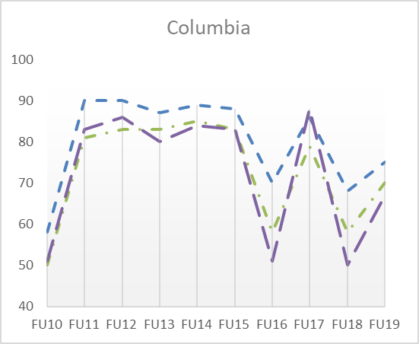
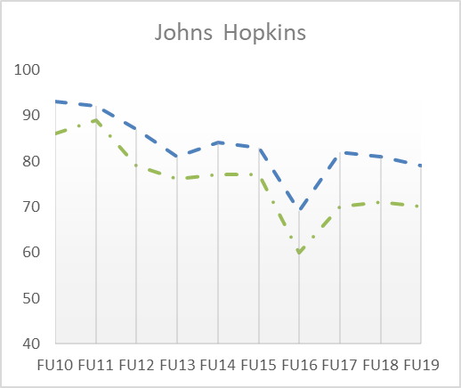
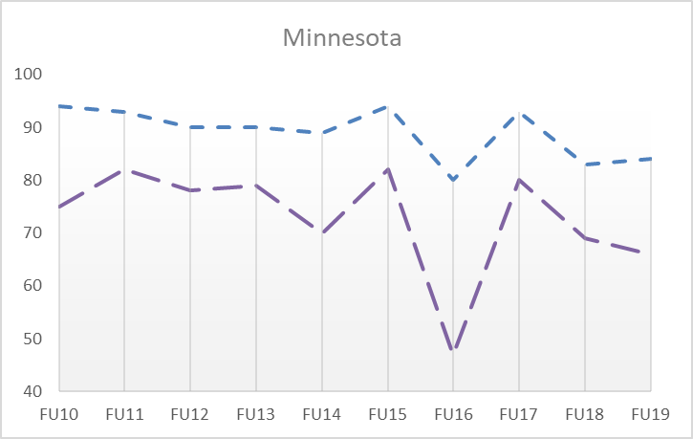
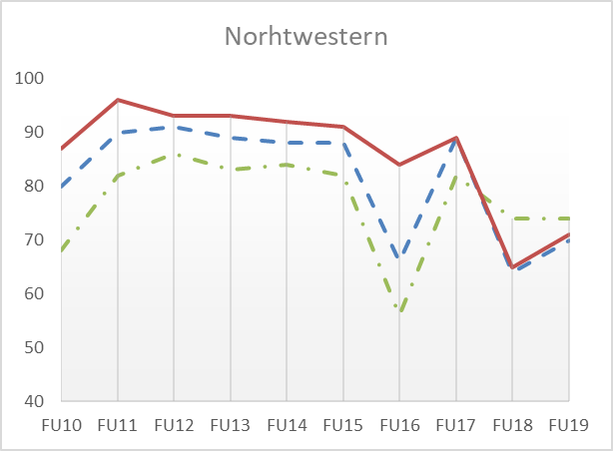
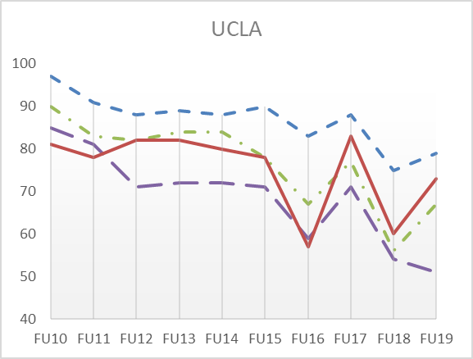
Follow-up Retention by Site
85%
85%
Retention = Completed / (Enrolled – Dead)

Slide 9
Continuing Exam 6 Ancillary Studies Atrial Fibrillation
Site | Eligible and Consented | Patch #1 Applied | Cog Function Testing Complete | # with prior Afib (including E6 self-report) | # Alerts | Brain MRI Complete | Brain MRI Alert
WFU | 226 | 187 | 183 | 24 | 6 | 63 | 6
COL | 286 | 276 | 274 | 39 | 3 | 132 | 10
JHU | 212 | 204 | 201 | 25 | 6 | 93 | 8
MN | 303 | 287 | 284 | 35 | 6 | 181 | 5
NWU | 320 | 301 | 299 | 37 | 10 | 144 | 19
UCLA | 335 | 341 | 339 | 49 | 12 | 168 | 11
Total | 1682 | 1596 | 1580 | 209 | 43 | 781 | 59

Slide 10
Continuing Exam 6 Ancillary Studies MESA Memory
Total MESA, N=675 | Cognitive Testing |  | MRI |  | Aβ-PET |  | LP sub-study
 | Phase 1 | Completed | n | Completed | n | Completed |  | n | Completed
AFIB | 197 | 29% | 185 | 27% | 179 |  | AFiB
Scheduled | 27 | 14% | 28 | 15% | 0 | 0% | Scheduled | 0 | 0%
Complete | 114 | 58% | 97 | 52% | 10 | 6% | Complete | 1 | 4%
In process | 56 | 28% | 60 | 32% | 169 | 94% | In process | 4 | 80%
Memory | 178 | 26% |  |  |  |  | Memory
Scheduled | 7 | 4% | 9 | 6% | 0 | 0% | Scheduled | 0 | 0%
Complete | 174 | 98% | 128 | 85% | 98 | 65% | Complete | 8 | 35%
In process | 7 | 4% | 9 | 6% | 48 | 32% | In process | 8 | 44%
Total Sample | 375 | 56% | 347 | 93% | 347 | 93% | Total Sample | 23 | 13%
Not Enrolled | 2 | 0% | 28 | 7% | 28 | 7% | Not Enrolled | 63 | 35%

Slide 11
Continuing Exam 6 Ancillary Studies MESA INVITE
Site | Enrolled | Enrolled | 2-Week phone call |  | 6A Visit |  |  |  | Results received at DCC | Results Letter Sent | Results Letter missing >12 weeks after 6A visit
 |  |  | complete | due - not done | complete | Not yet due | Over due (20+wks) | Refused/Lost
MESA Classic
WFU |  | 75 | 70 | 6 | 50 | 0 | 14 | 11 | 48 | 48 | 1
COL |  | 169 | 169 | 0 | 160 | 2 | 3 | 3 | 153 | 147 | 5
JHU |  | 121 | 120 | 1 | 116 | 0 | 1 | 4 | 116 | 115 | 1
NWU |  | 158 | 158 | 0 | 153 | 0 | 0 | 7 | 142 | 142 | 4
UCLA |  | 101 | 101 | 0 | 78 | 19 | 3 | 0 | 14 | 14 | 0
Total |  | 624 | 618 | 7 | 557 | 21 | 21 | 25 | 473 | 466 | 11
MESA Air
WFU |  | 1 | 1 | 0 | 1 | 0 | 0 | 0 | 1 | 1 | 0
COL |  | 17 | 16 | 1 | 9 | 8 | 0 | 0 | 0 | 0 | 0
JHU |  | 7 | 7 | 0 | 7 | 0 | 0 | 0 | 0 | 0 | 5
NWU |  | 17 | 17 | 0 | 16 | 0 | 0 | 1 | 7 | 7 | 0
UCLA |  | 0 | 0 | 0 | 0 | 0 | 0 | 0 | 0 | 0 | 0
Total |  | 42 | 41 | 1 | 33 | 8 | 0 | 1 | 8 | 8 | 5

Slide 12
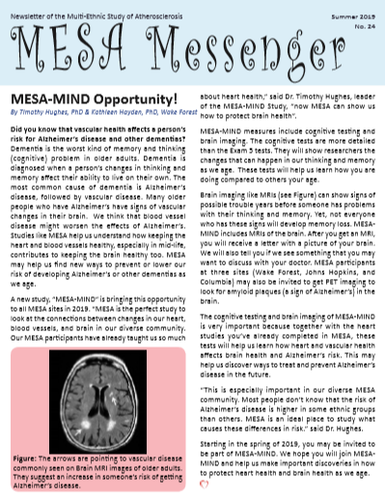
Participant Relations Committee
Newsletter #24
Scheduled for Summer 2019
Articles include
MESA Mind (Tim Hughes)
Heart Failure and adiposity (Erin Michos)
Prescribing Statins (Michael Blaha)
Physical Activity guidelines (NHLBI)
One newsletter per year planned for remainder of MESA 3 contract

Slide 13
Participant Relations Committee
Letters to MESA Contacts were distributed after Exam 6
Describes MESA and the role of named contacts
Participants consented at Exam 6 and at FU calls to send a letter or newsletter to each of their contacts
2 participants from Minnesota and one from Hopkins did not remember consenting or did not understand that letters would be sent to contacts.
Thought contacts would be contacted only for emergencies
Thought that contacts would be called regardless of participant status and didn’t understand why contacts would be called, if MESA can reach the participant.
At Columbia, 7 participant contacts called clinic staff to update their phone or address information.

