Slide 1
MESA Project Office Report
MESA Steering Committee Meeting
March 27, 2019
Lorraine Silsbee, M.H.S.
MESA Project Officer
Pothur Srinivas, Ph.D.
MESA Project Scientist
Epidemiology Branch
Division of Cardiovascular Sciences
National Heart, Lung, and Blood Institute

Slide 2
NHLBI MESA Team
Project Office
Lorraine Silsbee, M.H.S. – Project Officer
Pothur Srinivas, Ph.D. – Project Scientist, Acting Branch Chief
George Papanicolaou, Ph.D. – Research Geneticist
Colin Wu, Ph.D. – Biostatistician
Jean Olson, M.D. – Scientific Consultant
Contracting Office
Cornelius Moore – Contracting Officer
Kyle Wisor – Contracting Officer
Tahir Seeba – Contracting Specialist

Slide 3
FY2019 NHLBI Funding Paylines
Grant Program | Percentile | Priority Score | Description
R01 | 16 | N/A | Research Project Grant
ESI | 26 | N/A | Early Stage Investigators
K awards | N/A | 32 | Career Dev’t Awards
*Depending on the availability of funds, the Institute may make funding decisions on competing applications outside of the pay range, through selective pay actions.
**Next NHLBI Advisory Council meeting is June 4, 2019.

Slide 4
FY2018 NHLBI Funding Paylines – Zones of Consideration*
Grant Program | Description | Zone of Consideration (priority score)
P01 | Program Project Grant | 10-30
T32, T35 | Institutional NRSA Training | 10-35
*A zone of consideration is a range of priority scores within which competing applications will be considered for funding.
http://www.nhlbi.nih.gov/research/funding/general/current-operating-guidelines

Slide 5
Funding Opportunity Announcements
Administrative Supplement for Research on Bioethical Issues
PA-19-217
Applications accepted until May 13, 2019
Ethical, Legal, and Social Implications of Genomics Research Project
PA-17-444 (R01)
PA-17-446 (R21)
Maximizing the Scientific Value of the NHLBI Biorepository: Scientific Opportunities for Exploratory Research
RFA-HL-17-022 (R21)
Secondary Analyses of Existing Datasets in HLBS Diseases and Disorders
PAR-17-004 (R21)
Disparities Elimination through Coordinated Interventions to Prevent and Control Heart and Lung Disease Risk
DECIPHeR: https://grants.nih.gov/grants/guide/rfa-files/RFA-HL-20-003.html (clinical trial optional)
https://grants.nih.gov/grants/guide/rfa-files/RFA-HL-20-004.html (clinical trial not allowed)
Notes:
Admin Suppl Bioethical Issues; sponsored by Office of Science Policy, NIH Office of the Director.
ELSI R21 – accomplished in 2 years. (pilot or feasibility study in preparation for larger study) Data stewardship and sharing, clinical and personal utility of genomic health info; economics of genomic medicine, etc.
Biorepository: maximizing value of the biorepository
Secondary analyses: stimulate use of existing human datasets for focused secondary analyses;
DECIPHeR – test strategies for delivering proven-effective, evidence-based, community-level interventions for reducing or eliminating CV and/or pulmonary health disparities. Cooperative agreement; also FOA to provide organizational infrastructure.

Slide 6
NHLBI Workshops FY2019
Genetic Risk Scores: From Discovery to Implementation
Opportunities for Predictive Analytics Approaches to Enhance T4 Research for Health Inequities
Social Determinants of Cardiovascular Health and Health Disparities Virtual Workshop Series
Vascular Causes of Dementia: Are there Gaps in the Planned or Ongoing Prevention Trials?
Promoting Cardiovascular Health in the Workplace: A Collaboration of NHLBI, CDC and American Heart Association
Does Improved CVD Risk Assessment with Coronary Artery Calcium Screening and Other Cardiac Biomarkers Change the Benefits to Harms Ratio in Statin Therapy and in the treatment of Hypertension for the Primary Prevention of CVD in Low and Intermediate Risk Individuals
2019 NHLBI Trainee Session at AHA
Impact of Contemporary Acute and Chronic Particulate Air Pollution on Vulnerable Populations: Research Gaps on Mechanisms of Cardiopulmonary and Disease Outcomes and Personal Intervention Strategies
Digital Clinical Trials: The Future is Now
Developing a Multidisciplinary Collaborative Translational Research Agenda for Returning the Results of Genome Sequencing in Biobanks and Learning Health Systems
Harnessing the New Frontier of Imaging Genomics for Heart, Lung, Blood and Sleep Disorders
Privacy and Reidentification Risks in the Era of Big Data
Sleep Deficiency, Circadian Misalignment and Immune Dysfunction (Trans-HL and Trans-NIH)
Applying Circadian Biology to Heart, Lung and Blood Therapeutics (Trans-NIH)
Reaching the Rural COPD Population: Use of Novel Technologies to Deliver COPD Care Including Pulmonary Rehabilitation
Advancing the Plan: Engaging Partner in Ensuring the Implementation of the COPD National Action Plan

Slide 7
NHLBI Workshops FY2019 (continued)
Understanding Circadian Mechanisms of Sudden Cardiac Death (SCD)
Hypertension-related Cardiovascular Disease: When is the Optimal Time to Intervene?
NIMH and NHLBI Heart and Soul Workshop
TOPMed 2.0 (May 8,9)
K to R01 – Clinical and Population Sciences (July 11, 12)
https://www.nhlbi.nih.gov/events
Notes:
TOPMed 2.0: May 8-9, 2019 in Bethesda; feed available via the web.
Goal: gather outside expert input on the future direction of the TOPMed Program.
TOPMed will shortly generate ~150k WGS from multiple cohorts across a range of phenotypes. Also will have epigenomic, RNA seq and metabolomic data on a significant subset of these samples. Workshop will help brainstorm, provide insight and guidance on current opportunities and potential future directions for the TOPMed Program including data types, systems biology, machine learning analysis tools, and other considerations.

Slide 8
MESA Renewal
Activity | Date
Solicitations Issued | November 8, 2018
Proposals Due | February 15, 2019
Peer Review | Late May - mid June, 2019
Anticipated Award | December 19, 2019

Slide 9
NIH Guide Notice NOT-HL-18-668

Slide 10
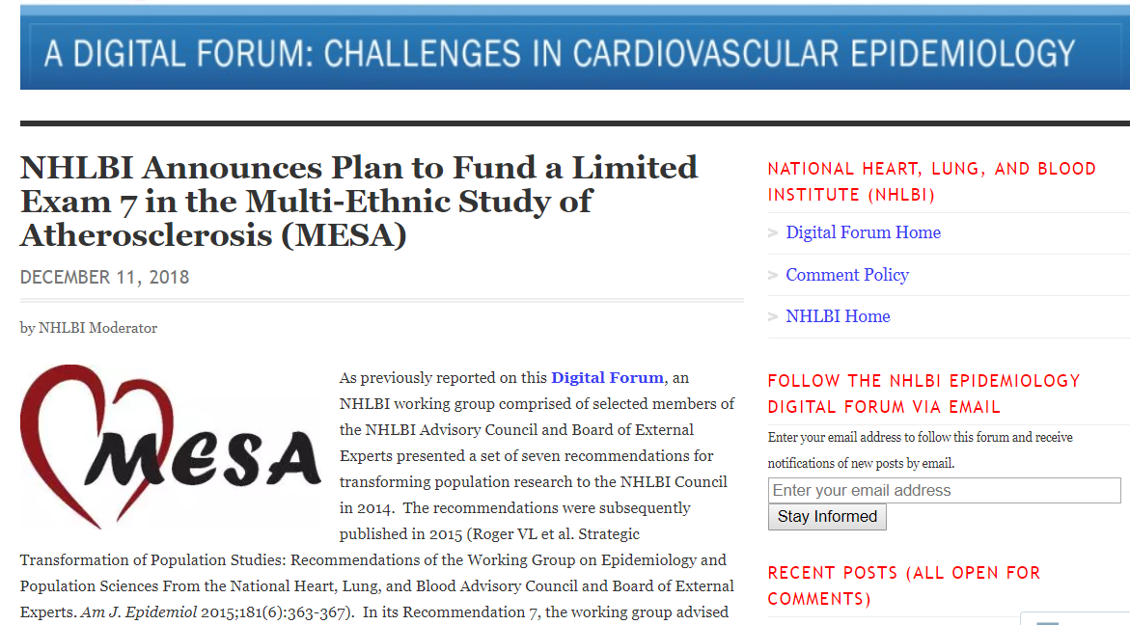
https://nhlbiepi.wordpress.com/category/epi-forum/

Slide 11
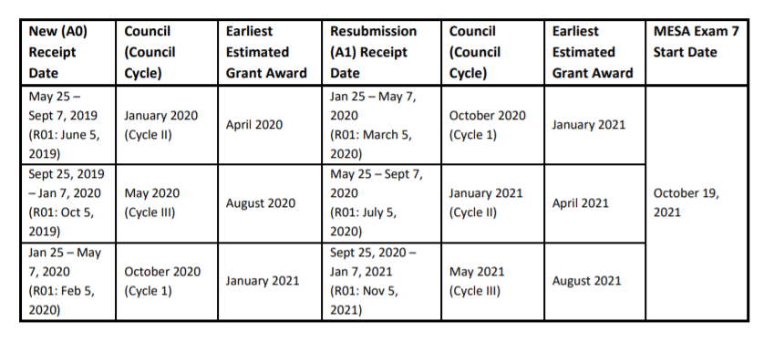
MESA Exam 7 Ancillary Studies Timetable

Slide 12
MESA Exam 7 Ancillary Studies Timetable
 |  |  |  |  | 2019 |  |  |  |  |  |  |  |  | 2020 |  |  |  |  |  |  |  |  |  |  |  | 2021 |  |  |  |  |  |  |  |  | Exam
App Submission
Deadline |  |  |  |  | Apr |  | Jun |  | Aug |  | Oct |  | Dec |  | Feb |  | Apr |  | Jun |  | Aug |  | Oct |  | Dec |  | Feb |  | Apr |  | Jun |  | Aug |  | Oct
Jun. 2019 |  |  | A0 |  |  |  |  |  |  |  |  |  |  |  |  |  | F
 |  |  | A1 |  |  |  |  |  |  |  |  |  |  |  |  |  |  |  |  |  |  |  |  |  |  | F
Oct. 2019 |  |  | A0 |  |  |  |  |  |  |  |  |  |  |  |  |  |  |  |  |  | F
 |  |  | A1 |  |  |  |  |  |  |  |  |  |  |  |  |  |  |  |  |  |  |  |  |  |  |  |  |  | F
Feb. 2020 |  |  | A0 |  |  |  |  |  |  |  |  |  |  |  |  |  |  |  |  |  |  |  |  |  |  | F
 |  |  | A1 |  |  |  |  |  |  |  |  |  |  |  |  |  |  |  |  |  |  |  |  |  |  |  |  |  |  |  |  |  | F
 |  |  | A0 |  |  | Grant prep |  |  |  |  | Submission and review |  |  |  |  |  |  |  |  |  | Council |  |  | F | Earliest Funding
 |  |  | A1 |  |  |  | A0 Grant prep and submission |  |  |  |  |  |  |  |  |  |  |  |  | A0 Summary statement available, A1 grant prep
 |  |  |  |  |  |  |  |  |  |  |  |  |  | A1 Submission and review |  |  |  |  |  |  |  |  |  |  |  | Council |  |  |  |  | F | Earliest Funding

Slide 13
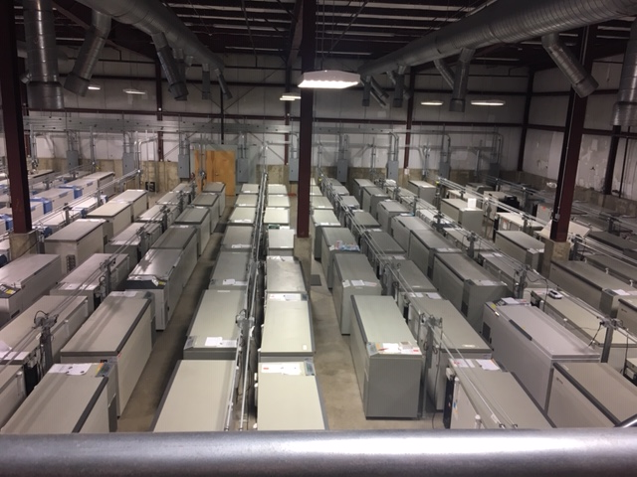
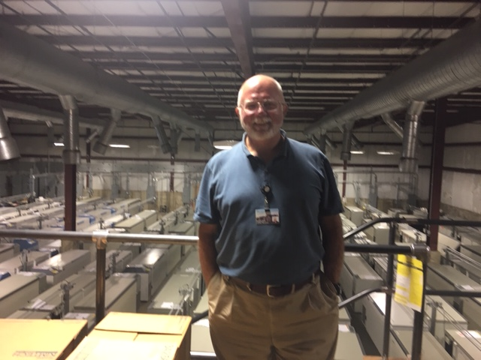
UVM Biorepository for MESA (and other studies)
Notes:
10,000 sq feet freezer space; ~4 mil samples
170 -80C or -145C freezers
MESA samples: 44 freezers; 1.1 mil vials; 1,600 sq. feet.

Slide 14
MESA Publications through 2018

Slide 15
Z Peak bloom expected April 1, 2019

