Slide 1
MESA Project Office Report
Lorraine Silsbee, M.H.S.
MESA Project Officer
Epidemiology Branch
Division of Cardiovascular Sciences
National Heart, Lung, and Blood Institute
MESA Steering Committee Meeting
March 28, 2018

Slide 2
NHLBI MESA Team
Project Office
Lorraine Silsbee, M.H.S. – Project Officer
Pothur Srinivas, Ph.D. – Project Scientist, Acting Branch Chief
George Papanicolaou, Ph.D. – Research Geneticist
Colin Wu - Biostatistician
Jean Olson, M.D. – Scientific Consultant
Contracting Office
Mark Brady – Contracting Officer
Cornelius Moore – Contracting Officer

Slide 3
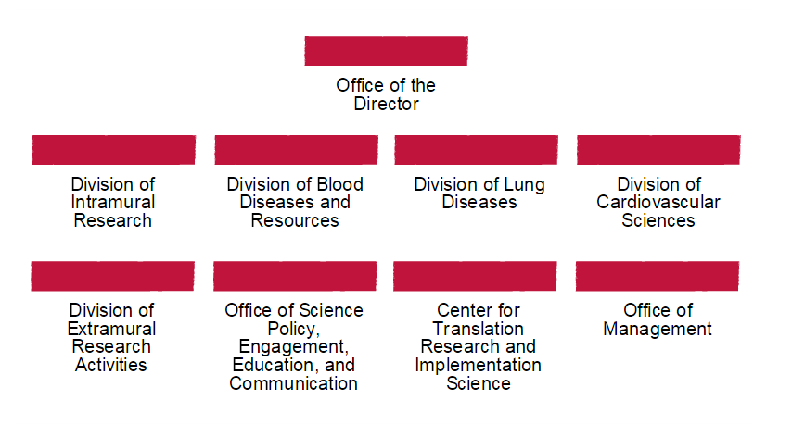
NHLBI Organization
Gary Gibbons, MD
Robert Balaban, PhD
Keith Hoots, PhD
Jim Kiley, PhD
David Goff, MD, PhD
Kathleen O’Sullivan
Laura Moen, PhD
George Mensah, MD
Lenora Johnson, DrPH, MPH

Slide 4
DCVS Organization
Office of the Director
David Goff, MD, PhD, Director
Office of Clinical Research
Gail Pearson, MD, ScD Director
Office of Research Training and Career Development
Jane Scott, ScD
Director
Office of Biostatistics Research
Nancy Geller, PhD Director
Scientific Program Offices
Basic and Early
Translational Research
Denis Buxton, PhD Director
Adult and Pediatric
Cardiac Research
Gail Pearson, MD, ScD
Director
Prevention and
Population Sciences
Gina Wei, MD, MPH
Director
Vascular Biology and Hypertension Branch
Zorina Galis, PhD
Chief
Advanced Technologies and Surgery Branch
Marissa Miller, DVM
Chief
Atherothrombosis and Coronary
Artery Disease Branch
Yves Rosenberg, MD, MPH
Chief
Heart Development and Structural Diseases Branch
Jonathan Kaltman, MD
Chief
Heart Failure and Arrhythmias Branch
Renee Wong, PhD
Acting Chief
Clinical Applications and Prevention Branch
Larry Fine, MD, DrPH
Chief
Charlotte Pratt, PhD
Acting Deputy Chief
Epidemiology Branch
Pothur Srinivas, PhD
Acting Chief
Sean Coady, MS
Acting Deputy Chief
Jared Reis, PhD
Acting Deputy Chief

Slide 5
FY2018 NHLBI Funding Paylines
Grant Program | Percentile | Priority Score | Description
R01 | 15 | N/A | Research Project Grant
ESI | 25 | N/A | Early Stage Investigators
K awards | N/A | 32 | Career Dev’t Awards
*Depending on the availability of funds, the Institute will make funding decisions on competing applications outside of the pay range, through selective pay actions.
**Next NHLBI Advisory Council meeting is June 12, 2018.
http://www.nhlbi.nih.gov/research/funding/general/current-operating-guidelines

Slide 6
FY2018 NHLBI Funding Paylines – Zones of Consideration*
Grant Program | Description | Zone of Consideration (priority score)
P01 | Program Project Grant | 10-30
T32, T35 | Institutional NRSA Training | 10-30
*A zone of consideration is a range of priority scores within which competing applications will be considered for funding.
http://www.nhlbi.nih.gov/research/funding/general/current-operating-guidelines

Slide 7
NHLBI Strategic Vision
NHLBI Strategic Vision Working Groups:
Enhancing resilience
Reducing burden of heart failure
Eliminating hypertension-related CVD
Preventing vascular dementia
Addressing social determinants of CV health and health disparities
Promoting CV health/preventing CVD across the lifespan
https://www.nhlbi.nih.gov/about/strategic-vision
Notes:
NHLBI Strategic Vision is comprised of a set of research priorities to help identify research gaps and create opportunities for future research progress. To help achieve the Strategic Vision priorities, NHLBI has convened several working groups within the past 6 months to drill down further in the areas you see here. Many groups are conducting portfolio analyses, and planning workshops with outside experts to help identify gaps and plan ways to approach future research opportunities. The results of these efforts will be reported to Institute leadership to consider ways to best implement recommendations.

Slide 8
NHLBI Strategic Vision
NHLBI Strategic Vision Working Groups:
Enhancing resilience
To explore the diverse set of cues that affect the physiologic processes, such as the immune and metabolic systems, responsible for the biochemical tolerance and protection from subsequent cardiovascular disease
Reducing burden of heart failure
To develop an implementation plan and timeline to guide future Heart Failure research
Eliminating hypertension-related CVD
To explore the pathophysiology and intervention strategies across the lifespan in diverse populations
Notes:
NHLBI Strategic Vision is comprised of a set of research priorities to help identify research gaps and create opportunities for future research progress. To help achieve the Strategic Vision priorities, NHLBI has convened several working groups within the past 6 months to drill down further in the areas you see here. Many groups are conducting portfolio analyses, and planning workshops with outside experts to help identify gaps and plan ways to approach future research opportunities. The results of these efforts will be reported to Institute leadership to consider ways to best implement recommendations.

Slide 9
NHLBI Strategic Vision
NHLBI Strategic Vision Working Groups:
Preventing vascular dementia
To identify research priorities within NHLBI’s mission in the next 5-10 years on vascular contributions to cognitive impairment and dementia
Addressing social determinants of CV health and health disparities
To develop a roadmap with short, medium and long- term goals related to understanding the contribution of social determinants of health to inequities in heart, lung, blood, and sleep (HLBS) diseases and disorders
Promoting CV health/preventing CVD across the lifespan
To understand the biological underpinnings and predictors of cardiovascular health in early childhood, adolescence and across the lifespan
Notes:
NHLBI Strategic Vision is comprised of a set of research priorities to help identify research gaps and create opportunities for future research progress. To help achieve the Strategic Vision priorities, NHLBI has convened several working groups within the past 6 months to drill down further in the areas you see here. Many groups are conducting portfolio analyses, and planning workshops with outside experts to help identify gaps and plan ways to approach future research opportunities. The results of these efforts will be reported to Institute leadership to consider ways to best implement recommendations.

Slide 10
NHLBI Diversity Supplements - Purpose
Increase diversity in the research workforce
Improve training opportunities
Expand the quality of the educational and training environment
Balance and broaden the perspective in setting research priorities
Increase recruitment of human subjects from diverse backgrounds into clinical research programs

Slide 11
Diversity Supplements Support Available for:
High school students
Undergraduate students
Post baccalaureate/Post master’s
Graduate Students
Medical Students
Post-doctoral level individuals
Junior faculty (within 24 months of appointment)

Slide 12
Diversity Supplements - Eligibility
Principal investigators with currently eligible NHLBI supported grants/contracts may apply on behalf of the candidate
Candidates must be US citizens or noncitizen nationals or permanent residents of the US
Individual must be from an underrepresented group in biomedical research

Slide 13
NHLBI Diversity Supplements – Key Features
Logical extension of “parent” grant or contract (complements but does not duplicate aims)
Mentoring
Some support for supplies/travel

Slide 14
NHLBI Diversity Supplement Guidelines
NHLBI Guidelines:
https://www.nhlbi.nih.gov/grants-and-training/training-and-career-development/nhlbi-research-supplement-application-guidelines
Notes:
The Diversity Supplement Program is Institute specific. Check with the Institute that supports your research.
Supplement cannot exceed the end date of your grant/contract.

Slide 15
MESA Publications through 2017

Slide 16
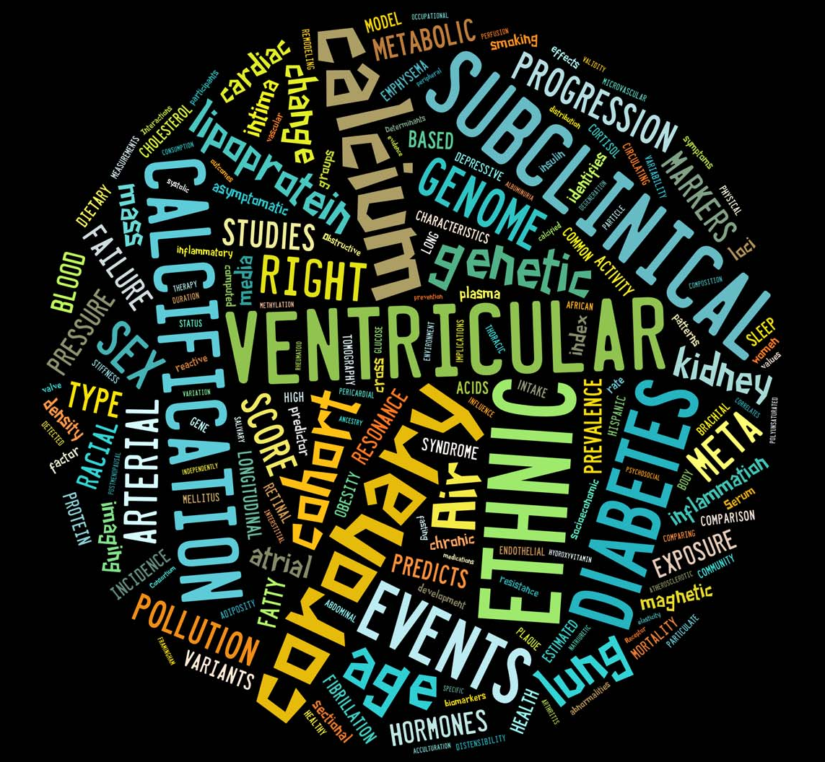
Breadth of MESA

Slide 17
