Slide 1
MESA “Multi-Omics”: Methods Development
on behalf of the
MESA Multi-Omics Pilot Project Committee

Slide 2
Why multi-omics multi-variate methods?
Obtaining the “big picture” of the entire “data landscape” requires integration of the multiple “omics” datasets with each other
eg Integrate phenotypes, metabolites, expression, methylation, and SNPs, into a single analysis
Yet also obtaining the “needle(s) in the haystack” requires feature selection appropriate to high dimensional data
eg Linear regression on high dimensional data can lead to erroneous conclusions
Lange et al 2014. Ann Rev Stat Appl 1:279-300.
Donoho, 2000. High Dimensional Data Analyses: The Curses and Blessings of Dimensionality.
Buhlmann & van de Geer 2011. Statistics for high dimensional data.
James, et al 2013. Statistical Learning.

Slide 3
Overview of Methods
Matrix-based methods
Integration of datasets
Dimension reduction
Robust to noise
Examples:
principal components association
partial least squares
canonical correlation analyses
Sparse methods
Feature selection
Examples
Penalized linear regression
LASSO or “Ridge” penalty

Slide 4
Example 1: “Current” MESA multiomics data
1191 subjects across 3 ethnic groups
Affy 6.0 GWAS data from MESA SHARE
CardioMetabochip data
Expression chip and methylation chip data from Lu ancillary
Further reduced:
CAD snps with MAF>0.05 for CM chip: 4655 SNPs
Expression data with SD in 4th quartile: 14,619 probes
Methylation data withSD in 4th quartile: 121,441 methylation sites

Slide 5
Canonical correlation analysis
Expression
Methylation
Variation In Expression NOT Associated
Variation Associated Across BOTH
Variation In Methylation NOT Associated

Slide 6
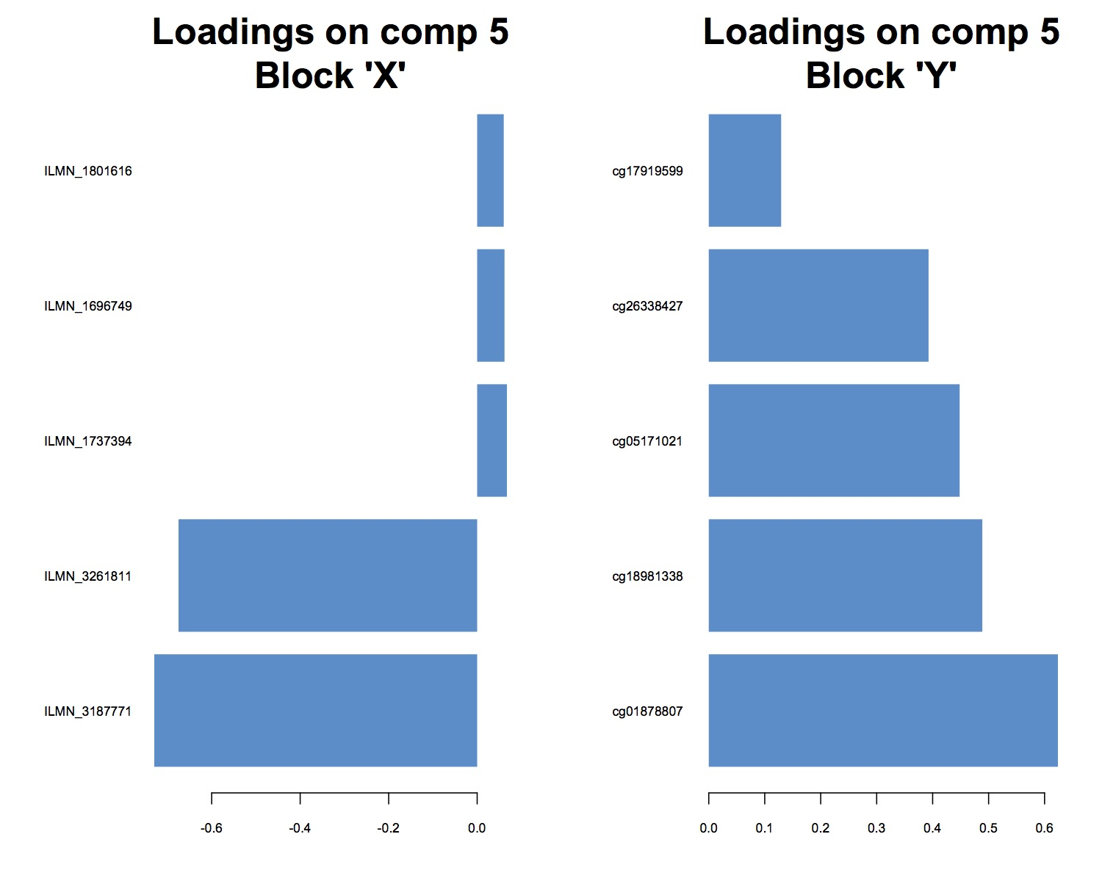
Expression
Methylation

Slide 7
Expression
Methylation
C14orf167, aka DHRS4-AS
Control of DHRS gene cluster
short chain dehydrogenase metabolism
mitochondrial protein

Slide 8
Example 2: IRAS Data Landscape
Phenotype:
Sensitivity Index measured by FSIGT
Residuals after covariate adjustment for age, gender, BMI
SNP:
773,965 nuclear SNPs with MAF > 0.1
14 mitochondrial SNPs
Metabolites:
LC-Mass Spec by Metabolon Inc.
848 targeted metabolites

Slide 9
Data Landscape as Multi-Omic Data “Blocks”
 |  | P (features) | N (subjects)
SI | Sensitivity Index residuals after covariate adjustment | 1 | 906
M | metabolites | 848 | 906
MT | MT snps | 14 | 906
G | SNPs | 773,965 | 906
Sparse partial least squares regression applied to data blocks
5 principal components analyzed
10 variates per component retained (sparsity)

Slide 10
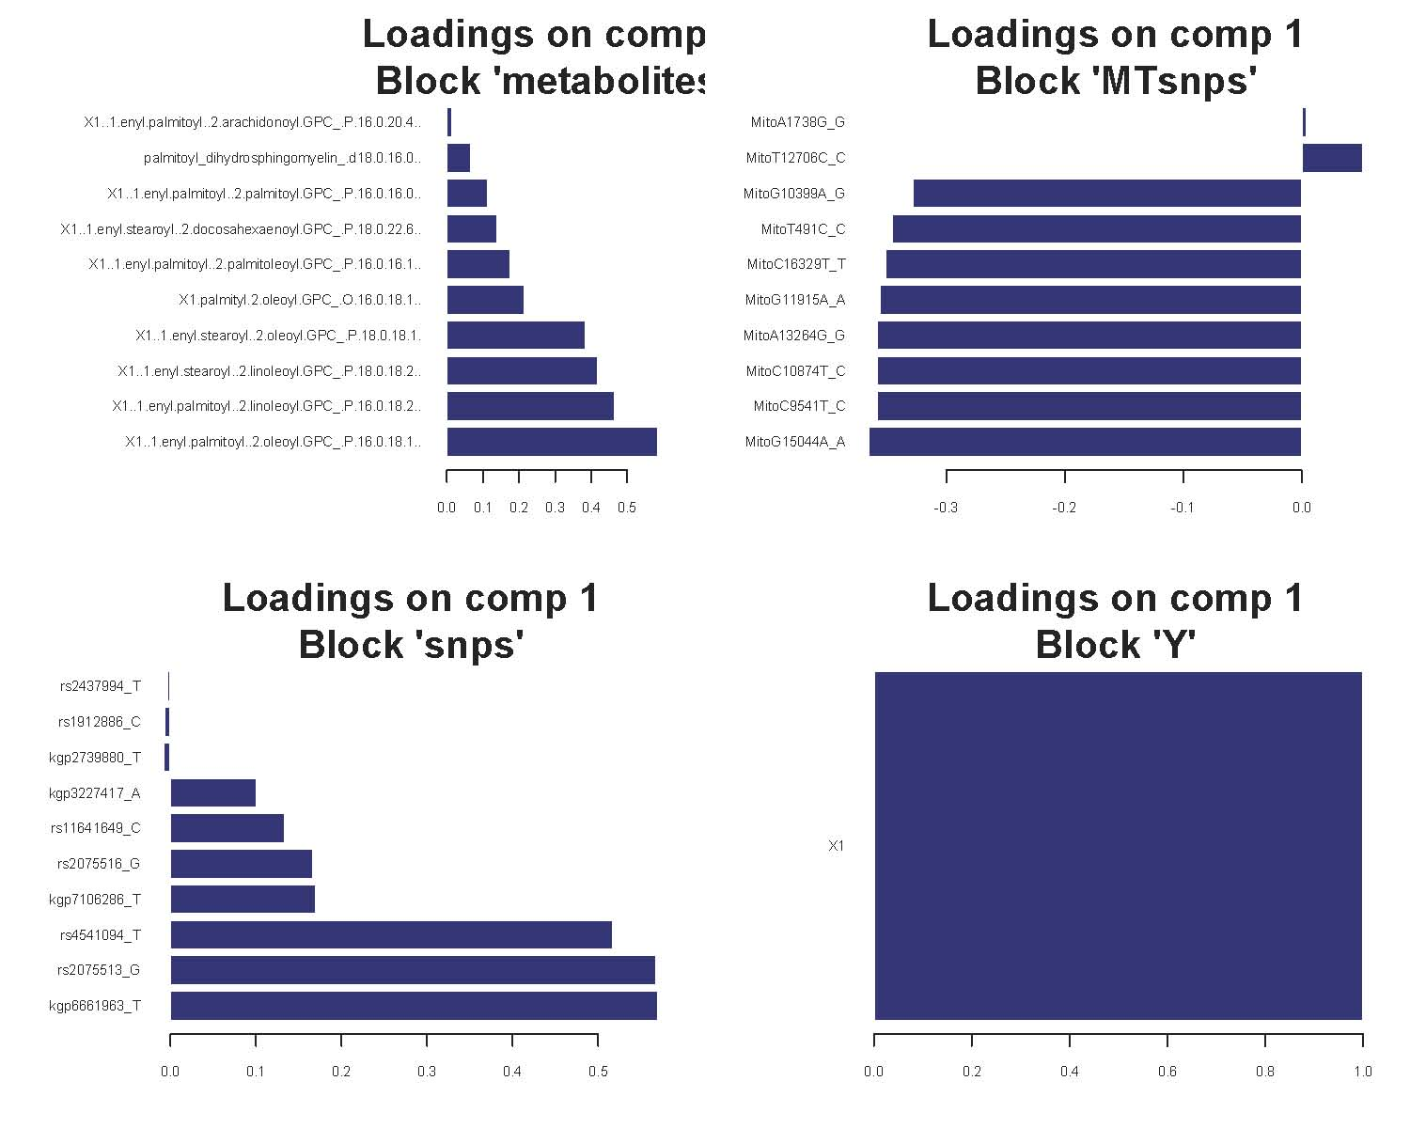
Results: Loadings from the first component associated with Insulin Sensitivity
for Each Block
Metabolites
MT SNPS
Loadings on component 1
Block “nuclear snps”
Genomic SNPs
Insulin Sens

Slide 11
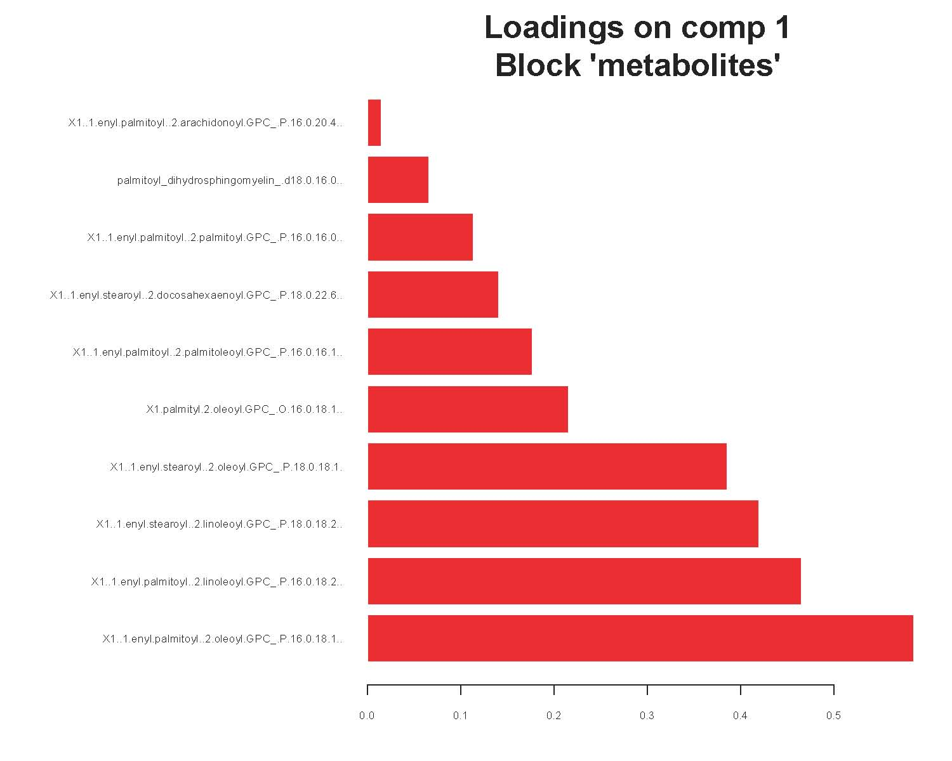
Metabolite block: Plasmalogen pathway metabolites
Loadings on component 1
Block “metabolites”
1-(1-enyl-palmitoyl)-2-arachidonoyl-GPC (P-16:0/20:4)*
1-(1-enyl-palmitoyl)-2-palmitoyl-GPC (P-16:0/16:0)*
1-(1-enyl-palmitoyl)-2-docosahexaenoyl-GPC (P-16:0/22:6)*
1-(1-enyl-palmitoyl)-2-palmitoleoyl-GPC (P-16:0/16:1)*
1-(1-enyl-stearoyl)-2-oleoyl-GPC (P-18:0/18:1)
1-(1-enyl-stearoyl)-2-linoleoyl-GPC (P-18:0/18:2)*
1-(1-enyl-palmitoyl)-2-linoleoyl-GPC (P-16:0/18:2)*
1-(1-enyl-palmitoyl)-2-oleoyl-GPC (P-16:0/18:1)*

Slide 12
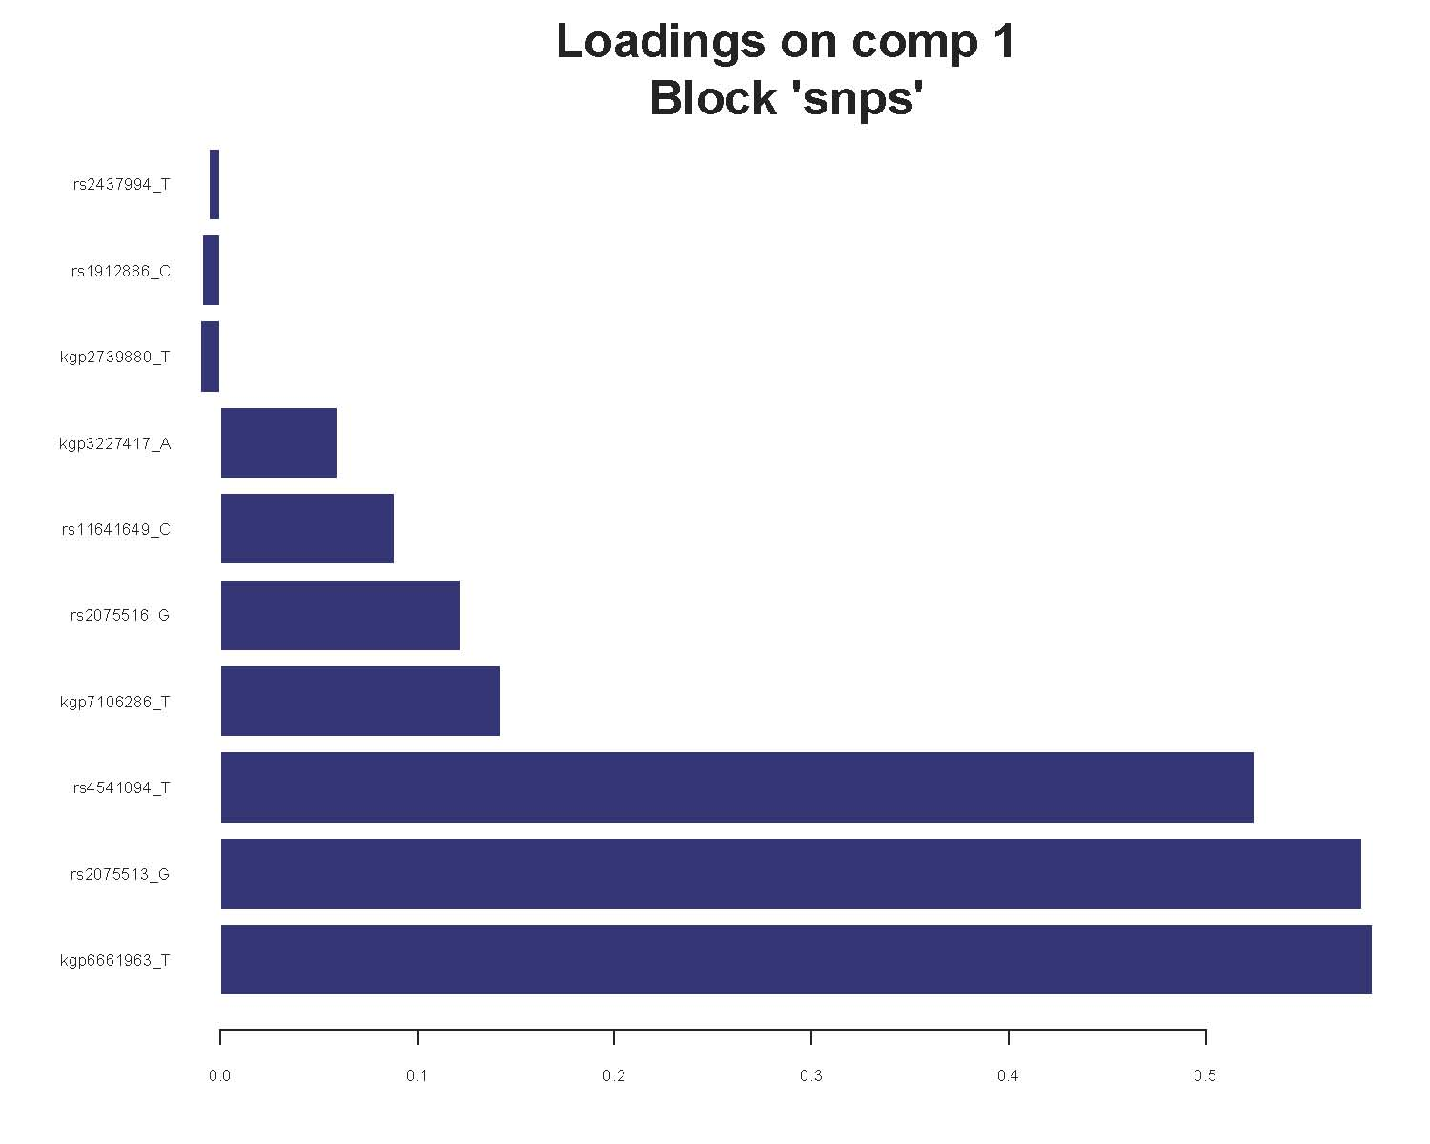
Genomic SNP block: Smooth muscle myosin (MYH11)
RP11-871F6.3 to REGL
Chr 12
MYH11
Smooth Muscle Myosin
Chr 11

Slide 13
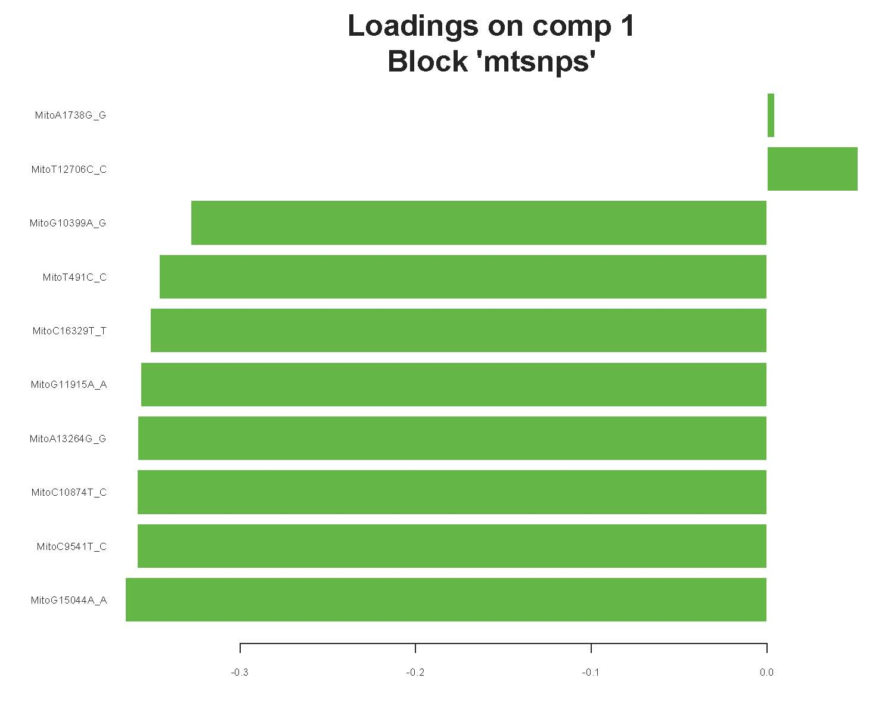
Mitochondrial Haplogroup Block:
Mitochondrial haplogroups C,D are negatively associated
with SI Component 1

Slide 14
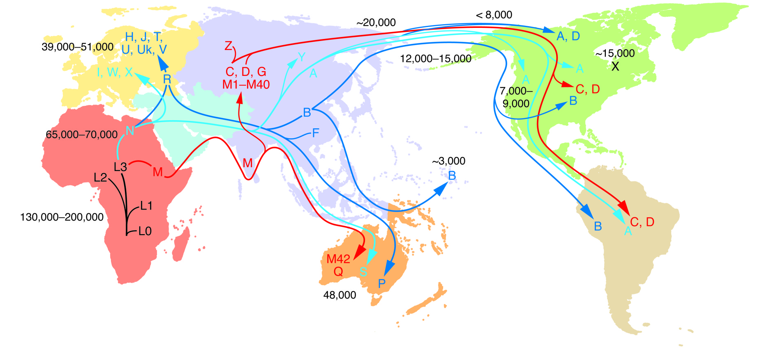
MT haplogroups C,D form one branch of MT haplogroups in Latino/Hispanics

Slide 15
Comparison with a linear model
Coefficients | Estimate | pvalue
Intercept | 5.23 | <2E-16
Age | -0.024 | 6.4E-10
BMI | -0.133 | <2E-16
Gender | 0.119 | ns
1-(1-enyl-palmitoyl)-2-oleoyl-GPC (P-16:0/18:1)* | 1.43 | 2.9E-14
rs8045778_T & MitoG15044A_G | -0.345 | 0.00064
rs8045778_T & MitoG15044A_A | -0.076 | ns
Adjusted R² 0.318; F statistic 71.53 on 6 and 905 DF; pvalue<2.2e-16

Slide 16
Discussion
A “multi-omic” analysis of several data blocks, insulin sensitivity phenotype, metabolite,mt-SNP, & genomic-SNP dataset using partial least squares suggested:
Smooth muscle is a location of insulin resistance in Latino/Hispanics
Changes in plasmalogen metabolites are involved in the physiology
The observed association occurs follows the “A & B” mitochondrial haplogroup lineage

Slide 17
Further work
Increase workspace/computer infrastructure
Develop “data shaping” tools
Increase ability to perform analyses on ever larger matrices
“BigData” methods
Increase speed of matrix calculations
Allows cross-validation procedure to determine the value of the penalty to use
“fastPCA” methods perform matrix calculations using approximation shortcuts
Parallelization and gpu’s under exploration

