Slide 1
Metabolomic Signature of CAD GWAS Hits
1 R01 HL133932, 1 R03CA211631 funded Oct 2016
Wake Forest, Virginia Bioinformatic Institute, Virginia Tech, Imperial College London, Erasmus University
MESA Steering Committee Mtg
4/19/17

Slide 2
Metabolomic Signature of CAD GWAS Hits
“Verified Associations”
CAD GWAS Hits
CAD Clinical Events
?? Mechanism ??

Slide 3
Metabolomic Signature of CAD GWAS Hits
“Verified Associations”
CAD GWAS Hits
CAD Clinical Events
~5% of variance
?? Metabolome ??
Interventions
diet, behavior, drugs
CAD Clinical Events
??>>5% of variance

Slide 4
Metabolomic Signature of CAD GWAS Hits
“Verified Associations”
CAD GWAS Hits
CAD Clinical Events
?? Metabolome ??
Cardiogram Plus C4D
Nature Genetics 2013
Nature Genetics 2015
CardioMetabochip
Nature Genetics 2017
CombiBio “Plus”
MESA (n=4000)
Rotterdam Study (N=2000)
Airwave (N=4000)
+
>300 SNPs
~100,0000 metabolomic “features”

Slide 5

Metabolomic Signature of CAD GWAS Hits
“Verified Associations”
CAD GWAS Hits
CAD Clinical Events
?? Metabolome ??
UK National Phenome Center
Untargeted Metabolomic Assays
NMR
  NOESY, CPMG, J-res
  Lipid subfractions
Mass-Spec
  HILIC +/(-)
  Lipid +/-

Slide 6
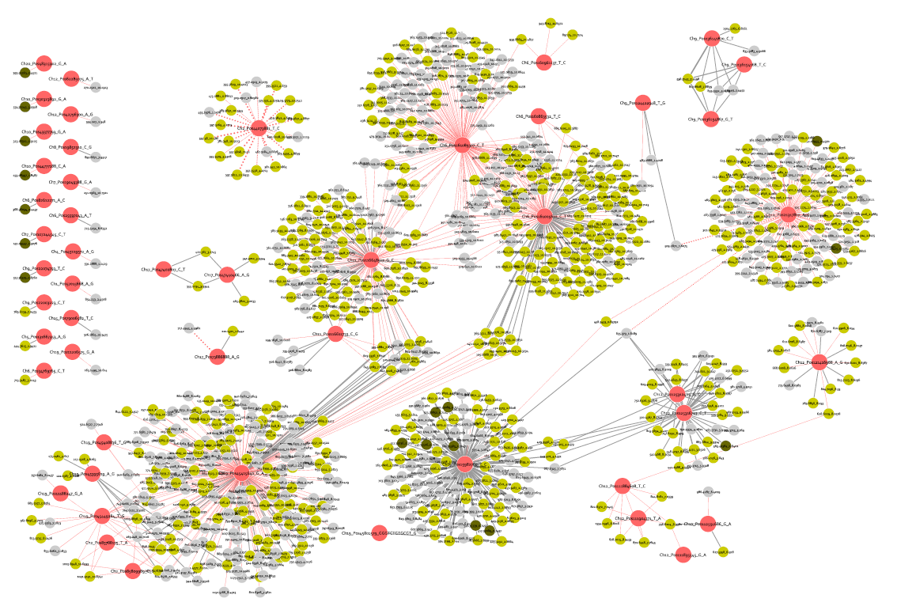
Preliminary Association Analyses
Airwave (N=3,000): MS
SNP
SLNEG
SLPOS
SHPOS

Slide 7
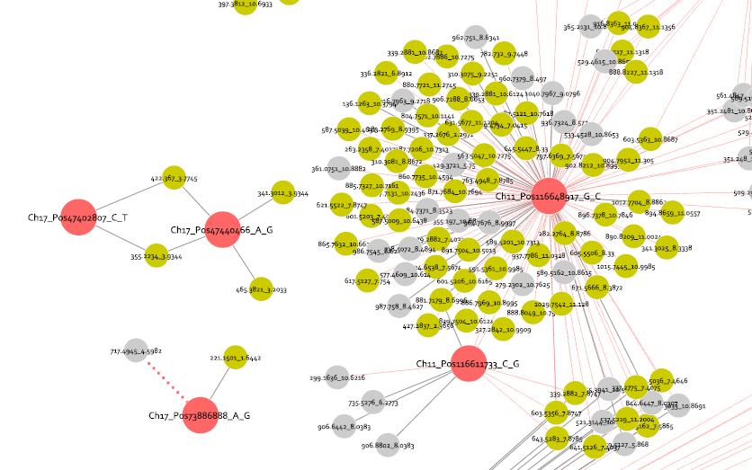
Preliminary Results: Airwave MS
ApoC3 Locus
APOC3
APOC3

Slide 8
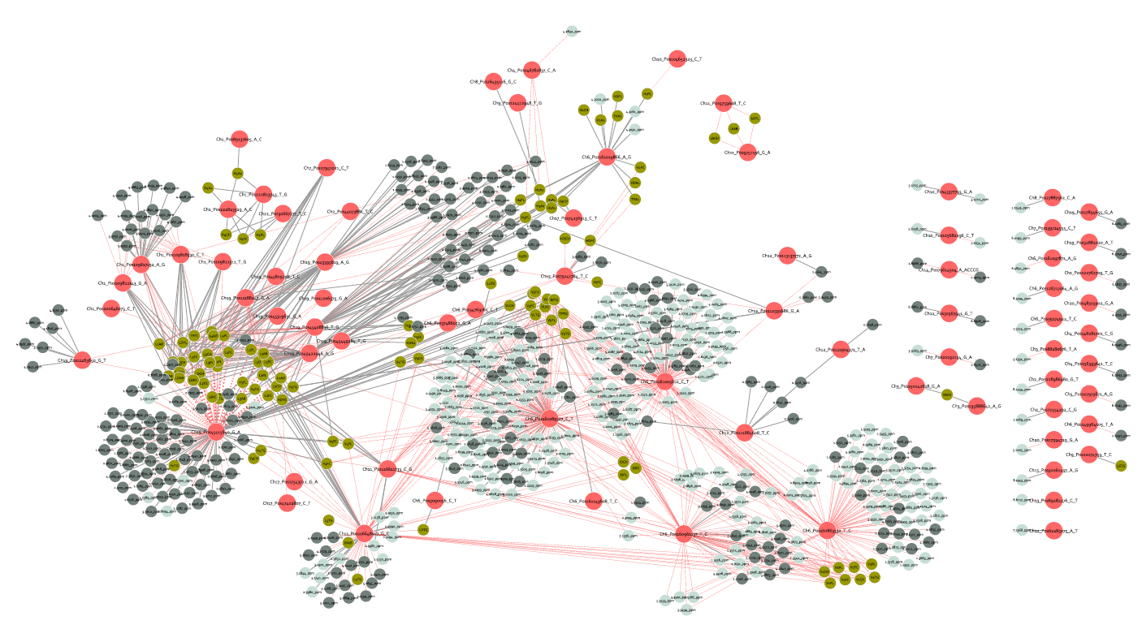
Preliminary Association Analyses
Airwave (N=3,000): NMR
SNP
NOESY
CPMG
LIPOPROT

Slide 9
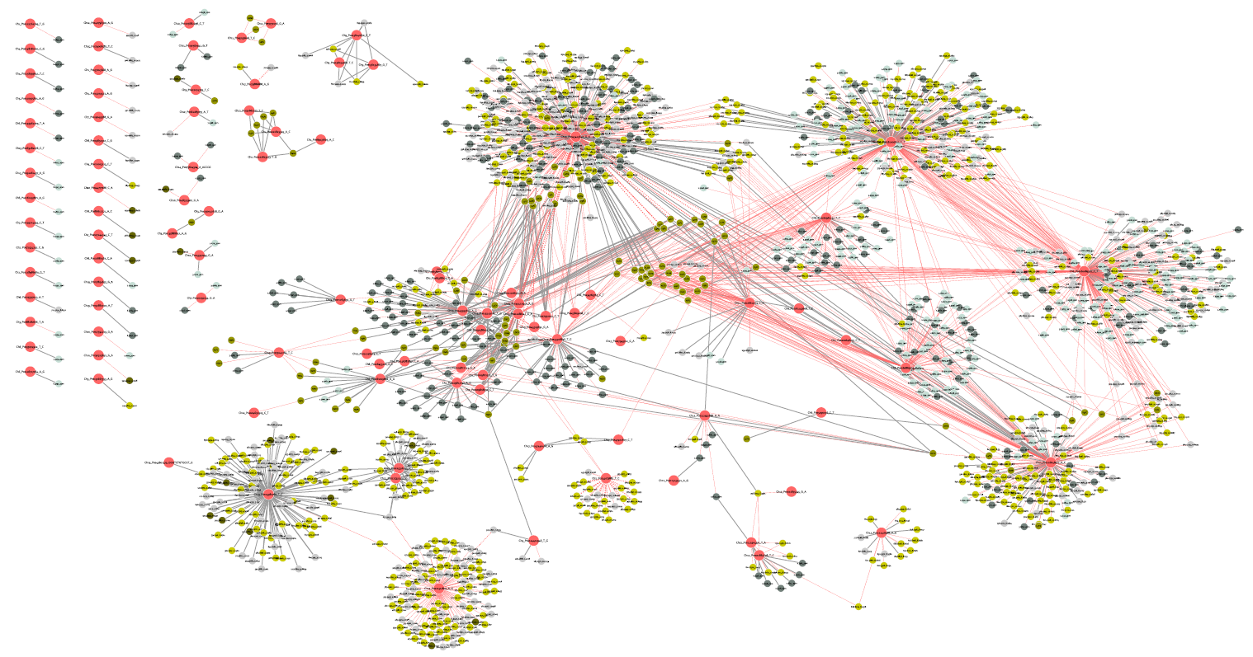
Preliminary Results: Airwave MS+NMR
~100 SNPs and 1000 Metabolomic Features

Slide 10
Where do we go from here?
Create the multi-cohort analysis data set
  Metabolomic data harmonization
  Principal component residualization of SNP data
  Execute the global SNP MWAS association analysis (including new SNPs from Metabochip data)
  Divide and prioritize the network map
  Annotate and identify the individual metabolites
  Perform mediation analyses
  Define the metabolic pathways represented by the metabolites

Slide 11
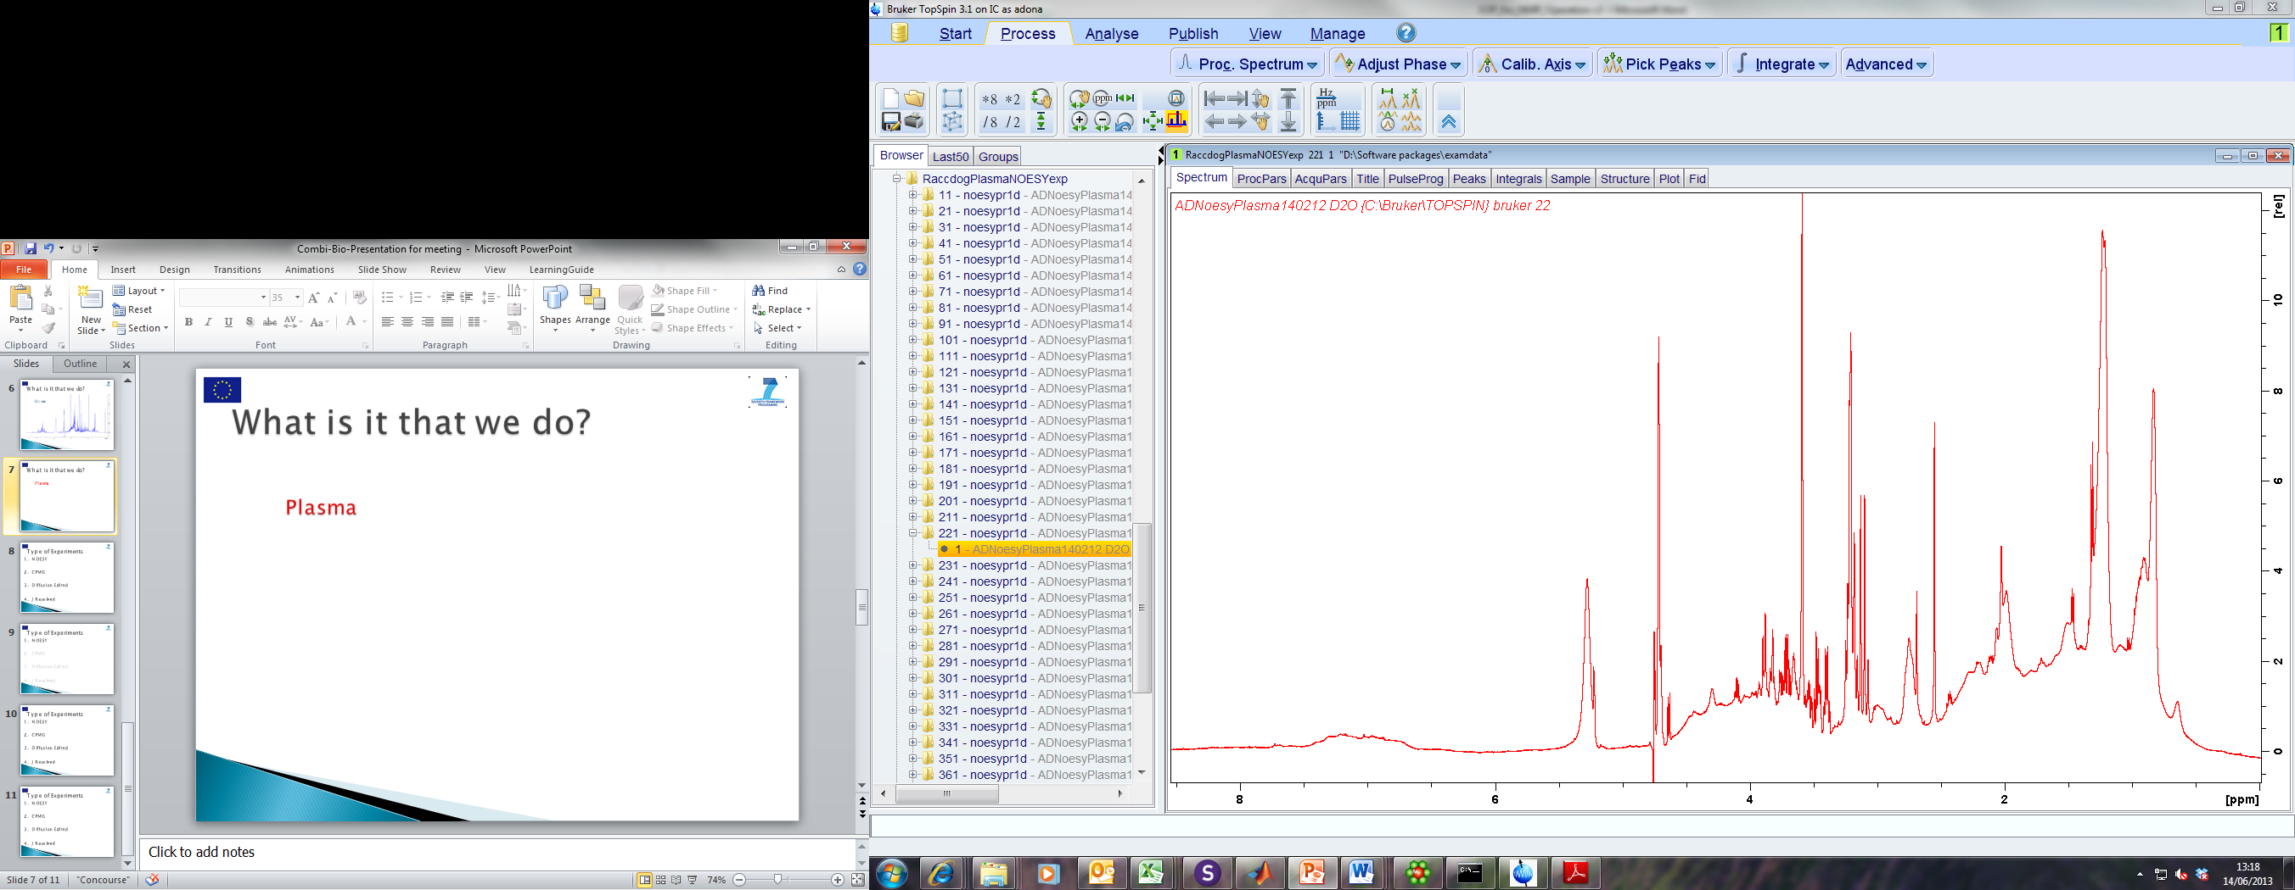
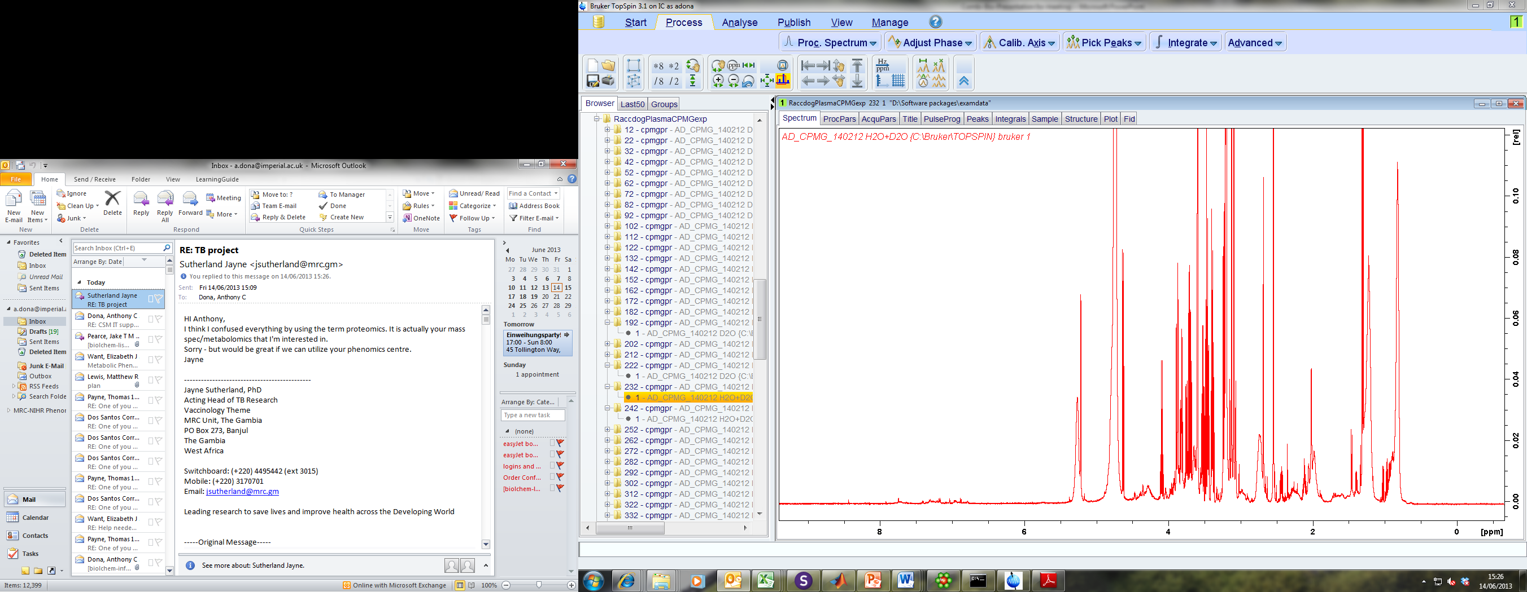
NMR Experiments
1D ¹H NMR (all compounds)
1D CPMG (small molecules)

Slide 12
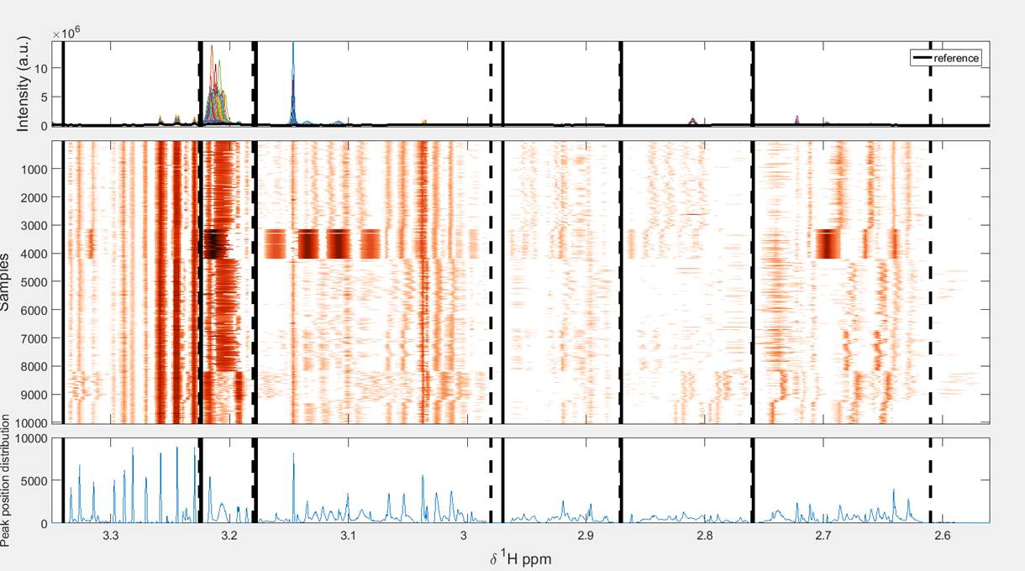
Metabolomic Data Harmonization: NMR
(normalization, artefact removal, alignment,)

Slide 13
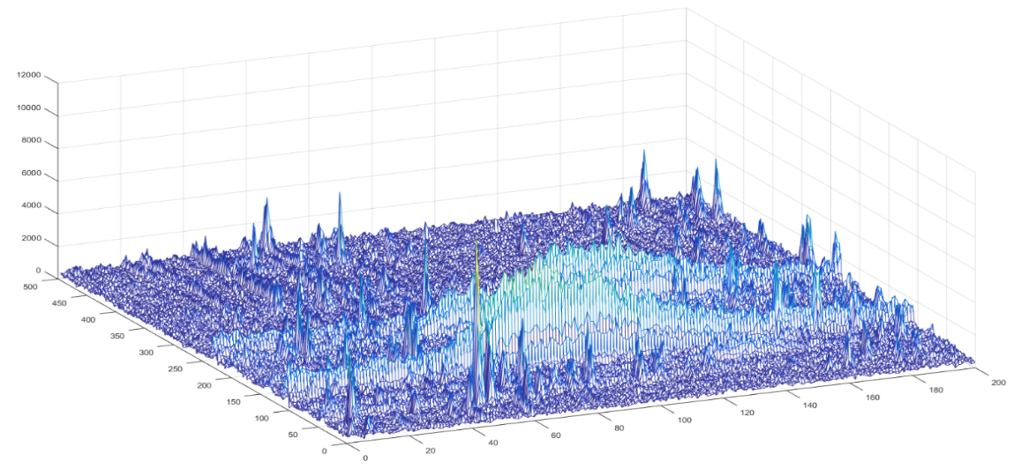
Metabolomic Data Harmonization: MS
(normalization, artefact removal, alignment,)
MS harmonization across cohorts is a much harder problem!
Retention time
mass/z

Slide 14
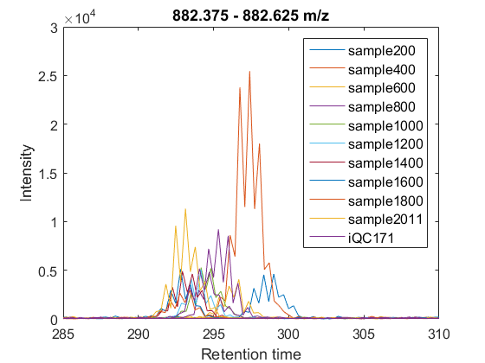
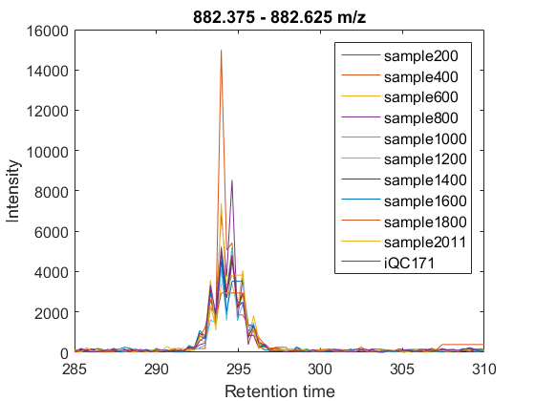
XCMS vs. Graphical Time Warping
XCMS
GTW

Slide 15
Divide and Prioritize the Network Map
~100 SNPs and 1000 Metabolomic Features

Slide 16
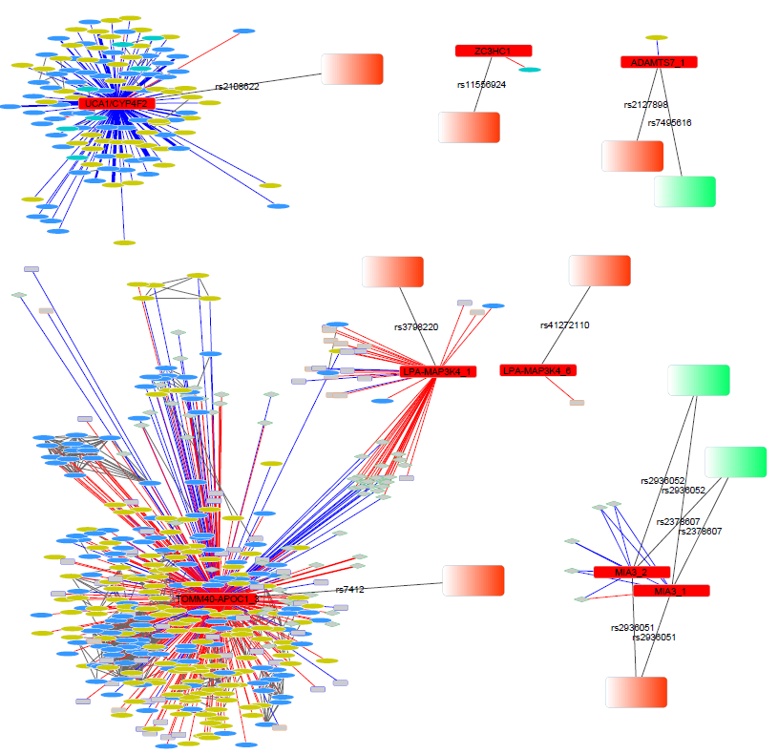
Prioritize SNPs with Poss or Prob Damaging Coding Changes in Genes

Slide 17
MS/MS DDA experiment for m/z 369.35
at RT=4.62 min
MS
MS/MS
Free Cholesterol

Slide 18
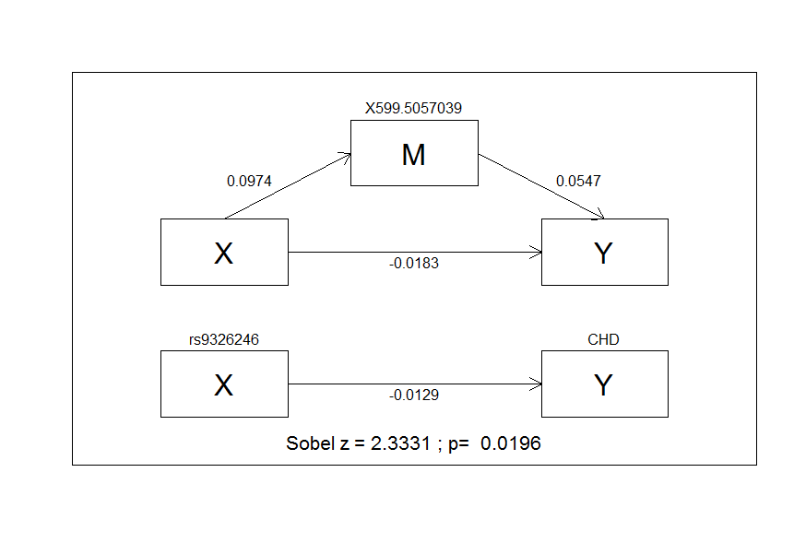
Preliminary Mediation Analysis Pipeline
MGE
metabolite
CHD
MGE: mediated genetic effect
DGE: direct genetic effect
SNP
DGE

Slide 19
Define the Metabolic Pathways
Ex. CombiBio CAC Pathways
Background shade:
Glutathione metabolism
Dietary metabolism
Urea cycle and related
Aromatic metabolism
1-Carbon metabolism
BCAAs metabolism
Sulfur metabolism
TCA cycle
Mitochondrial metabolism
Lipid, fatty acid and related
(Amino) sugars and carbohydrates metabolism
Purine and Pyrimidine metabolism
Node shade:
NMR detected metabolite directly associated with IMT and/or CAC
NMR detected metabolite inversely associated with IMT and/or CAC
NMR detected metabolite directly associated with IMT and/or CAC (with significant p value)
NMR detected metabolite inversely associated with IMT and/or CAC (with significant p value)
Bold nodes: metabolites significantly associated with IMT and CAC. Nodes with * : metabolites significantly associated with CAC

Slide 20
Comments or suggestions are most welcome!!

Slide 21
CAD GWAS-Metabolomic Study Work Flow
Raw Data
Technical QC
NMR
MS
CombiBio
Guoqiang, VT team
Alignment,
Standardization
NMR
MS
Ibrahim, Rui,
Joanna
DTW Alignment
Tim, Kate, Ibrahim
Stats QC
B-C Tx, PC resid
NMR
MS
Ibrahim, Rui,
Joanna
Multi-Block Analysis
SNP vs MF Assoc, Assoc. Network Map
NMR
MS
Rui, Joanna
*Talant, Eliana, Abbas, Oscar
David H, Georgia
Tim, Rui, Ibrahim, ID team
Stat. MF Consolidation
MF vs CHD Assoc,
Mediation Analysis*
SNP Genomic Bioinformatics**
**Tim, Nichol, David C., Don
Map Segmentation,
Prioritization
CAD GWAS Met Team
Analytic Chem Annotation and Identification
Mummichog
ID and Pathway Analysis
Elena, Claire, John, tba
Chunhong, Rui
Metabolic Network Mapping
Poss. Ext Validation
Chunhong, Rui

Slide 22
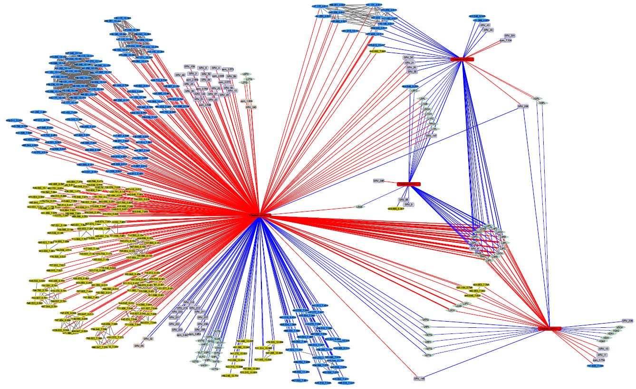
SNP Bioinformatic Pipeline: Ex. TOMM40/APOE

Slide 23
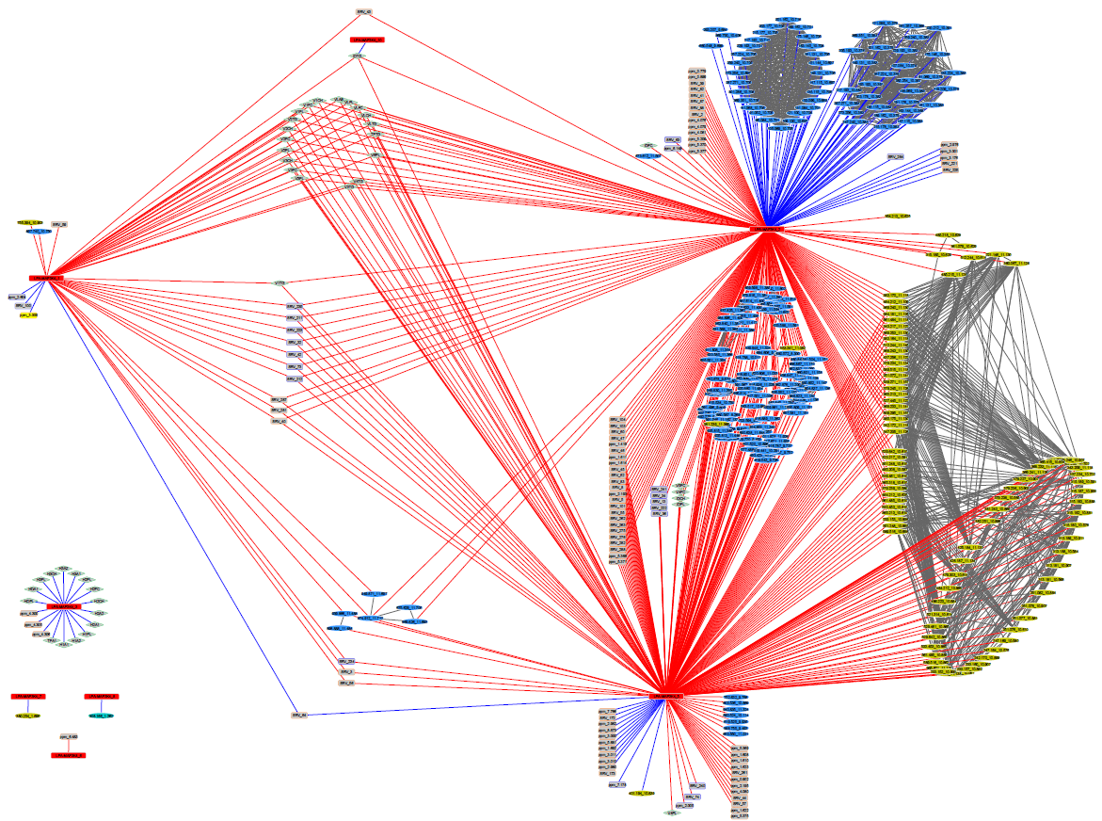

Slide 24
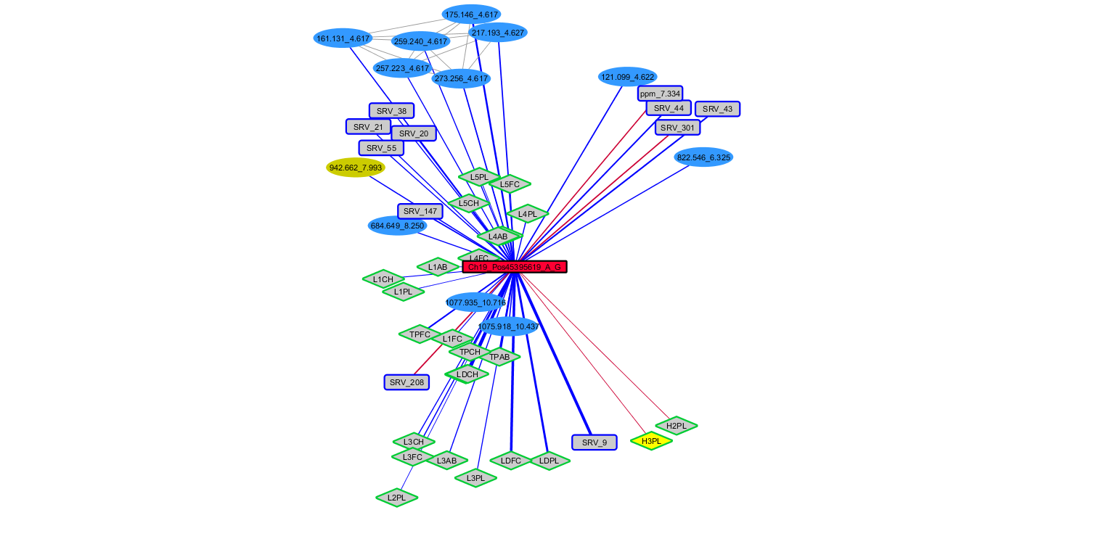
CAD SNPs sub-network:
Ch19-Po45395619_A_G

Slide 25
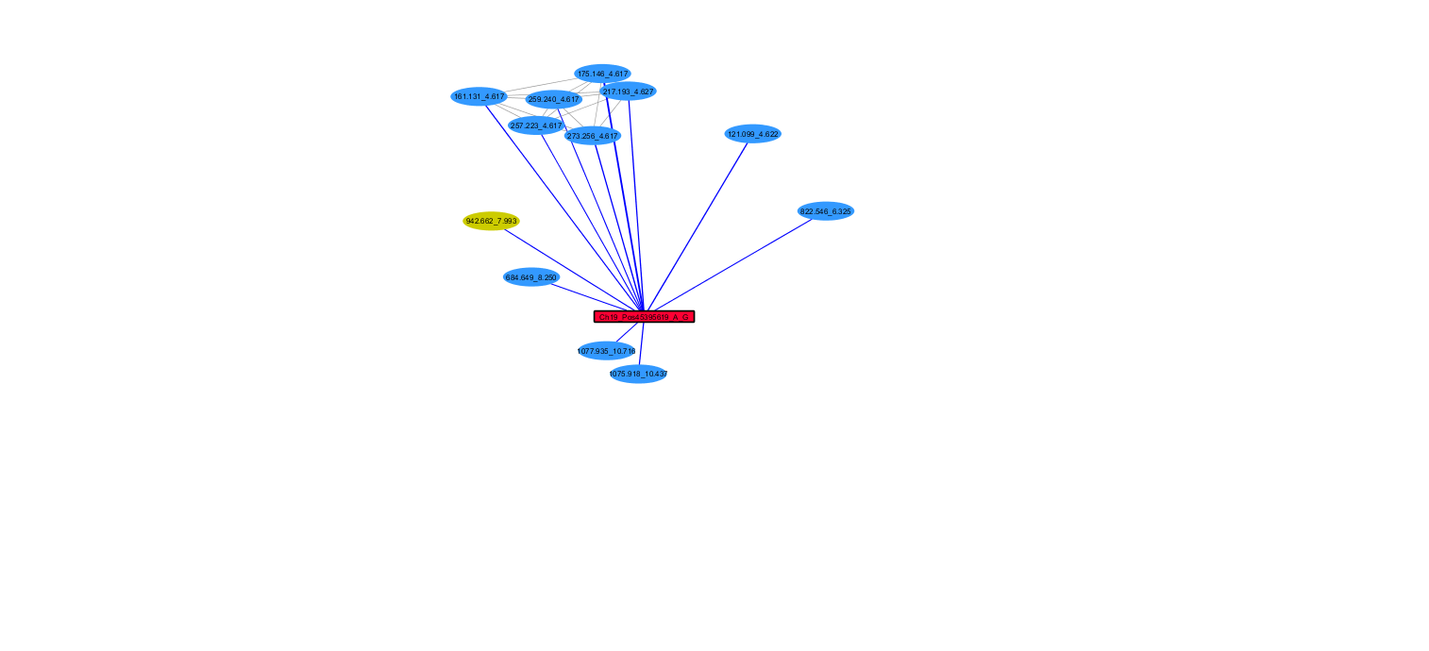
Assignment of the MS features
SLPOS
SLNEG

Slide 26
MS data: SLPOS and SLNEG
SUID | AnalysisTypeEdge | Correlation | CorrPosNeg | metaboliteMZ | metaboliteRT | pval
5511 | SLPOS | 0.1018 | 1 | 1075.9178 | 10.44 | 5.49E-06
5512 | SLPOS | 0.0970 | 1 | 1077.9354 | 10.72 | 1.50E-05
5513 | SLPOS | 0.0982 | 1 | 259.2399 | 4.62 | 1.18E-05
5514 | SLPOS | 0.1160 | 1 | 175.1461 | 4.62 | 2.20E-07
5515 | SLPOS | 0.1045 | 1 | 273.2559 | 4.62 | 3.09E-06
5516 | SLPOS | 0.1036 | 1 | 217.1928 | 4.63 | 3.71E-06
5517 | SLPOS | 0.0974 | 1 | 257.2227 | 4.62 | 1.38E-05
5518 | SLPOS | 0.1011 | 1 | 161.1308 | 4.62 | 6.43E-06
5519 | SLPOS | 0.1039 | 1 | 121.0987 | 4.62 | 3.54E-06
5520 | SLPOS | 0.0970 | 1 | 684.6488 | 8.25 | 1.50E-05
5521 | SLPOS | 0.0986 | 1 | 822.5457 | 6.33 | 1.09E-05
5522 | SLNEG | 0.0996 | 1 | 942.6618 | 7.99 | 8.63E-06
Highly correlated features at RT=4.62 min

Slide 27
MS/MS DDA experiment for m/z 369.35
at RT=4.62 min
MS
MS/MS
Free Cholesterol

Slide 28
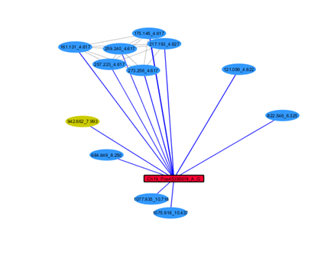
Free Cholesterol

Slide 29
Remaining MS features
SUID | AnalysisTypeEdge | Correlation | CorrPosNeg | metaboliteMZ | metaboliteRT | pval
5511 | SLPOS | 0.1018 | 1 | 1075.9178 | 10.44 | 5.49E-06
5512 | SLPOS | 0.0970 | 1 | 1077.9354 | 10.72 | 1.50E-05
5520 | SLPOS | 0.0970 | 1 | 684.6488 | 8.25 | 1.50E-05
5521 | SLPOS | 0.0986 | 1 | 822.5457 | 6.33 | 1.09E-05
5522 | SLNEG | 0.0996 | 1 | 942.6618 | 7.99 | 8.63E-06

Slide 30
m/z 822.5457 rt= 6.33 min in positive ion mode SLPOS
EIC m/z 822.554
Full spectrum

Slide 31
MS/MS for m/z 822.55
MS for m/z 822.55
m/z 184.0754 – characteristic fragment of PC and SM (phosphocholine head group)
m/z 162.9586 – fragment of K+ adduct

Slide 32
EIC m/z 784.588
[M+H]+
EIC m/z 822.554
[M+K]+

Slide 33
MS/MS for m/z 784.588
PC(36:3)
Zoom-in in the next slide

Slide 34
Fatty acyl chain fragments [M-H2O+H]+
PC(18:1/18:2)
PC(16:0/20:3)

Slide 35
m/z 684.6488 rt= 8.25 min in positive ion mode SLPOS
Correlation analysis of SLPOS vs SLNEG showed that m/z 684.65 in positive mode is correlated to m/z 942.662 rt=7.99 min in negative mode!!! r=0.99!
SUID | AnalysisTypeEdge | Correlation | CorrPosNeg | metaboliteMZ | metaboliteRT | pval
5511 | SLPOS | 0.1018 | 1 | 1075.9178 | 10.44 | 5.49E-06
5512 | SLPOS | 0.0970 | 1 | 1077.9354 | 10.72 | 1.50E-05
5520 | SLPOS | 0.0970 | 1 | 684.6488 | 8.25 | 1.50E-05
5521 | SLPOS | 0.0986 | 1 | 822.5457 | 6.33 | 1.09E-05
5522 | SLNEG | 0.0996 | 1 | 942.6618 | 7.99 | 8.63E-06
Correlation 0.99!

Slide 36
SLNEG
SLPOS
SHexCer(18:1/28:2)???

Slide 37
MS/MS NEGATIVE MODE
SULFATE
MS/MS POSITIVE MODE

Slide 38
684.6 + 260 = 944.6
[M+H]+
Sulfatide (3-O-sulfogalactosylceramide)
SHexCer
SHexCer(18:1/28:2)???

Slide 39
m/z 1077.9354 and m/z 1075.9178 rt= 10.72 and 10.44 min in positive ion mode SLPOS
SUID | AnalysisTypeEdge | Correlation | CorrPosNeg | metaboliteMZ | metaboliteRT | pval
5511 | SLPOS | 0.1018 | 1 | 1075.9178 | 10.44 | 5.49E-06
5512 | SLPOS | 0.0970 | 1 | 1077.9354 | 10.72 | 1.50E-05
5520 | SLPOS | 0.0970 | 1 | 684.6488 | 8.25 | 1.50E-05
5521 | SLPOS | 0.0986 | 1 | 822.5457 | 6.33 | 1.09E-05
5522 | SLNEG | 0.0996 | 1 | 942.6618 | 7.99 | 8.63E-06
Late elution – hydrophobic metabolites
Retention time characteristic for TG and CE

Slide 40
Correlation analysis across SLPOS showed that m/z 1077.94 and 1075.92 are correlated to each other. Also they are correlated to m/z 1051.92 rt=10.73 min (r>0.6)
EIC m/z 1075.92
EIC m/z 1077.94

Slide 41
MS/MS m/z 1077.94
282.253
m/z 184.0754 – characteristic fragment of PC and SM (phosphocholine head group)
m/z 795.6732 – sphingomyelin (SM), odd mass

Slide 42
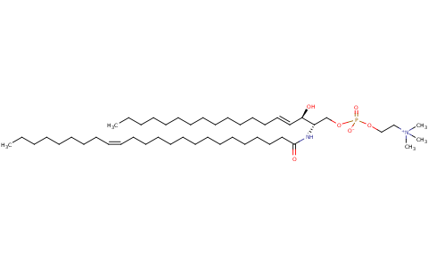
MS/MS m/z 795.65
by increasing in-source fragmentation
Possibly SM(d18:1/24:1) [M-H2O+H]
Modification – unknown….

Slide 43
MS: Alternative pre-processing options
Chiung-Ting Wu, Yue Wang and Guoqiang Yu

Slide 44
Introduction
The retention time (RT) shift/variability problem
  LC-MS data for one sample is a matrix.
    Can be viewed as a set of time curves indexed by m/z.
  Each peak represents a compound.
  Theoretically, across samples the peaks representing the same compound should have the same RT and m/z.
  However, RT may “shift”, so it is hard to identify which peaks correspond to the same compound.
Retention time
mass/z

Slide 45
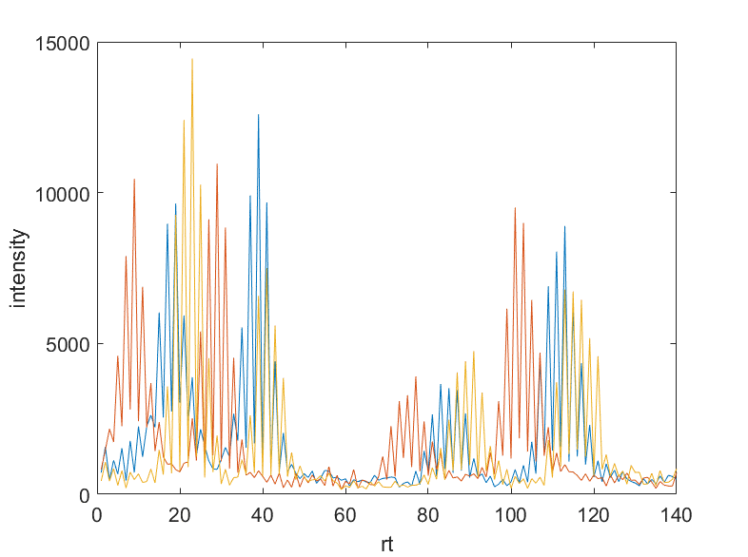
Causes of RT Shift and Implication
The physical or chemical properties of the column of the liquid chromatography (LC) system change over experiments, leading to retention time shift.
  Temperature, Pressure, Mobile phase composition
  Aqueous/Organic Ratio, Buffer Strength of the eluent
RT shift is observed in all current LC systems
RT shift causes a lot of problems in the follow-up analysis
The shift is non-linear across compounds and samples
  The nonlinearity makes the correction of RT challenging
1
2
1
2
1
4
4
2
4
3
3
3

Slide 46
Type I of Nonlinearity: with different RT
For a given m/z, different peaks have different RT shifts.
  The blue and yellow peaks in Group 2 are closer than Group 1.
Implication: A single time shift can not be used to correct the variation.
1
2
1
2
1
4
4
2
4
3
3
3

Slide 47
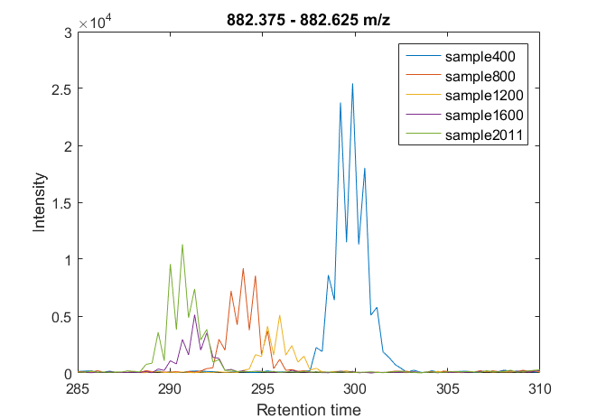
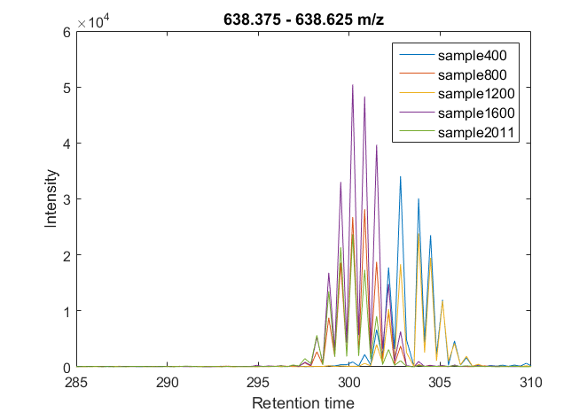
Type II of Nonlinearity: with different m/Z
At the similar RT, different m/z have different time shifts.
  In the right figure, the blue and yellow peaks are almost overlapped; Far away in the left figure.
Implication: The time shift obtained from one m/z can not be transferred to other m/z.
  Most existing methods overlooked this property.

Slide 48
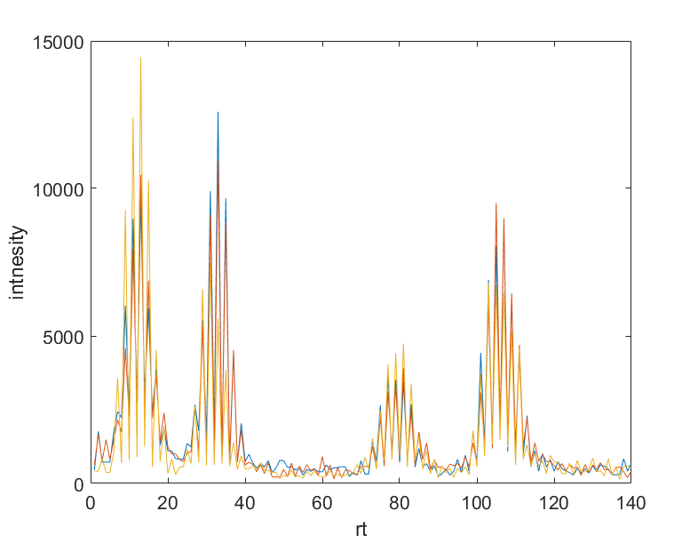
RT alignment
To identify which peaks represent the same material across samples, we need to align RT.
Though LC-MS data is two-dimensional, fortunately the value of m/z is much more accurate than rt. Thus, we just need to deal with one-dimensional alignment problem.
1
2
1
2
1
4
4
alignment
2
4
3
3
3

Slide 49
XCMS: Match Peaks across Samples
Meta-peaks
insignificant group
An example of a bin after smoothing: the red lines in the figure represent the peaks from all the samples. One can notice that different sd of smoothing function may cause a peak error grouped.

Slide 50
GTW: Graphical Time Warping
For a single pair of time curves, we transform the alignment problem to a shortest path problem in a directed graph.
Time point pairs are as nodes.
Alignment paths are as edges.
End
Start

Slide 51
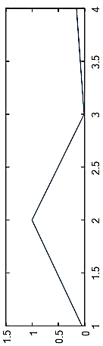
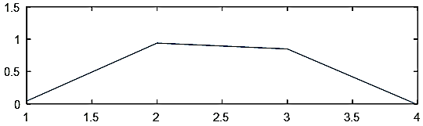
Example
End
0.0127
0.6141
0.4803
0.0010
0.0010
0.8627
0.8627
0.7027
0.7027
0.0006
0.0010
0.8627
0.7027
0.9235
0.9235
0.0042
0.0042
0.0240
0.0240
1.0365
0.9235
0.0240
Wrapping function
0.0042
0.0001
0.0001
0.7886
0.7886
0.6360
0.6360
0.0043
0.0001
0.7886
0.6360
Start

Slide 52
GTW- Main Idea
GTW can “link” several alignment problem together by adding “edges” between several graphs, so that several alignment problems can be solved at the same time, and dependency between wrapping functions is taken into account.
The cost of these additional edges is a parameter of GTW, which can control how similar we expect the neighboring wrapping functions to be.
End
End
End
Additional
edge
Additional
edge
Start
Start
Start

Slide 53
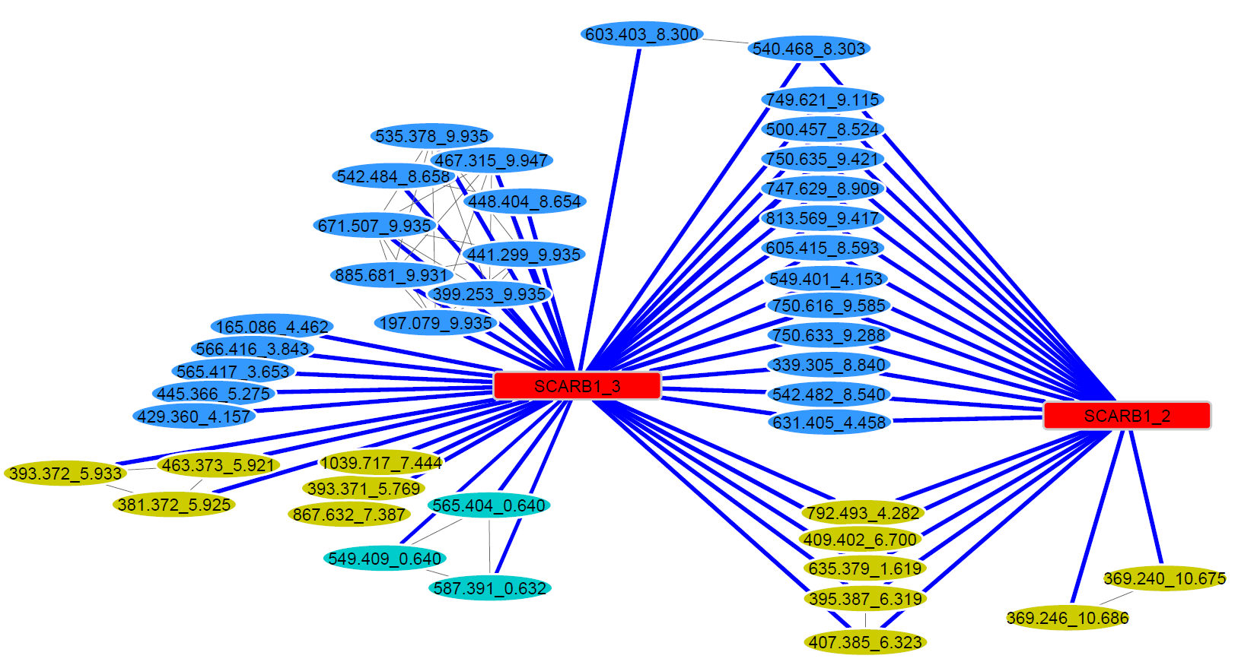
Common Genomic Loci but Different Metabolomic Patterns

Slide 54
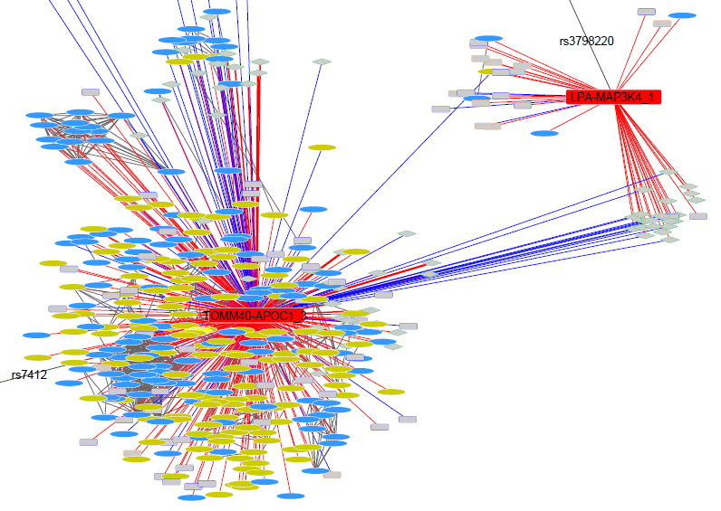
Different Genomic Loci with Shared Metabolomic Patterns

Slide 55
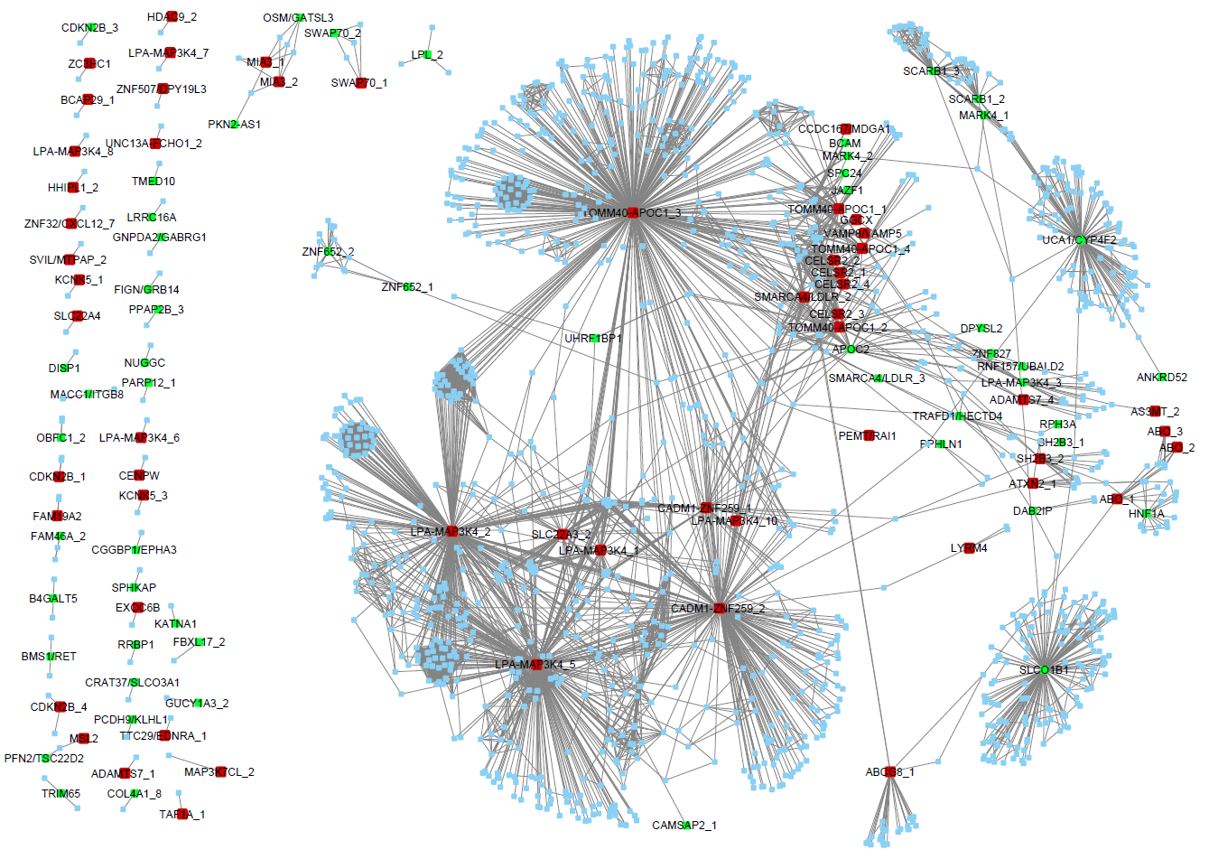
Level of Evidence for the GWAS SNPs
Genome-Wide
FDR 0.01

Slide 56
Sub-Network Prioritization: Which SNPs are most likely to have a metabolomic signature?
SNP Bioinformatic Pipeline
AA change?
r² > 0.5
(SNAP)
dbSNP
(UCSC)
No
Identify changes in TF binding sites
Input SNPs
Input & Proxy SNPs
HaploReg
Histone mods
Identify potential enhancers
PolyPhen-2
Yes
Determine effect of AA changes
GTEx eQTLs
(44 tissues)
Identify eQTLs
Prioritize by IPA, String
If not eQTL gene, use nearest gene(s)
Most likely functional SNPs/genes

Slide 57
Identify Proxy SNPs for all Input SNPs
SNP | Proxy | Distance (bp) | r2
rs2075650 | rs2075650 | 0 | 1
rs2075650 | rs34404554 | 290 | 1
rs2075650 | rs11556505 | 525 | 1
rs2075650 | rs71352238 | 1283 | 0.945
rs2075650 | rs12972156 | 8160 | 0.895
rs2075650 | rs34342646 | 7489 | 0.806
rs2075650 | rs12972970 | 8023 | 0.806
rs2075650 | rs769449 | 14383 | 0.778
rs2075650 | rs34095326 | 225 | 0.673
rs2075650 | rs7256200 | 20316 | 0.673
rs2075650 | rs59007384 | 1046 | 0.609
rs2075650 | rs157581 | 95 | 0.583
rs2075650 | rs157582 | 600 | 0.583
rs2075650 | rs184017 | 650 | 0.583
rs2075650 | rs283815 | 5286 | 0.559
rs2075650 | rs10119 | 11054 | 0.515
rs405509 | rs405509 | 0 | 1
rs405509 | rs157590 | 10120 | 0.807
rs405509 | rs157588 | 10572 | 0.777
rs405509 | rs157584 | 11937 | 0.777
rs405509 | rs157585 | 11324 | 0.693
rs405509 | rs7259620 | 1048 | 0.668
rs405509 | rs1038026 | 3774 | 0.668
rs405509 | rs741780 | 4405 | 0.668
rs405509 | rs760136 | 4978 | 0.668
rs405509 | rs1160985 | 5424 | 0.634
rs405509 | rs769450 | 1608 | 0.6
rs405509 | rs440446 | 331 | 0.538
rs405509 | rs1305062 | 3315 | 0.527
rs405509 | rs34878901 | 6359 | 0.527
rs405509 | rs8106922 | 7170 | 0.527
rs405509 | rs2075649 | 13506 | 0.527
rs445925 | rs445925 | 0 | 1
rs445925 | rs72654473 | 1241 | 1
rs445925 | rs80125357 | 2407 | 0.667
rs445925 | rs7412 | 3561 | 0.588
rs445925 | rs283810 | 27399 | 0.505
Using r² from 1000 Genomes Project
Ex. 3 SNPs from TOMM40/APOE region
  rs2075650
  rs405509
  rs445925
  Coding changes? (poss/Prob damaging?)
Only one AA change, in ApoE

Slide 58
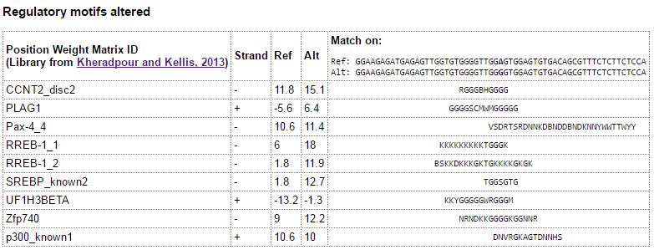
Identify Potential Changes in Transcription Factor Binding
Using HaploReg (v4.1), SNP2TFBS
  Determines binding potential of each SNP allele
  Example results from rs2075650

Slide 59
Histone Epigenetic Marks

Slide 60
eQTL search with GTEx Data (44 tissues)

Slide 61
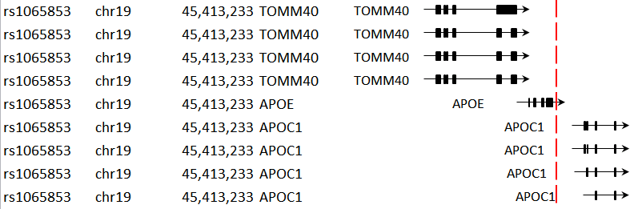
Identification of nearest genes
Select all genes around SNPs based on distance from SNP

Slide 62
SNP Bioinformatic Pipeline Output

Slide 63
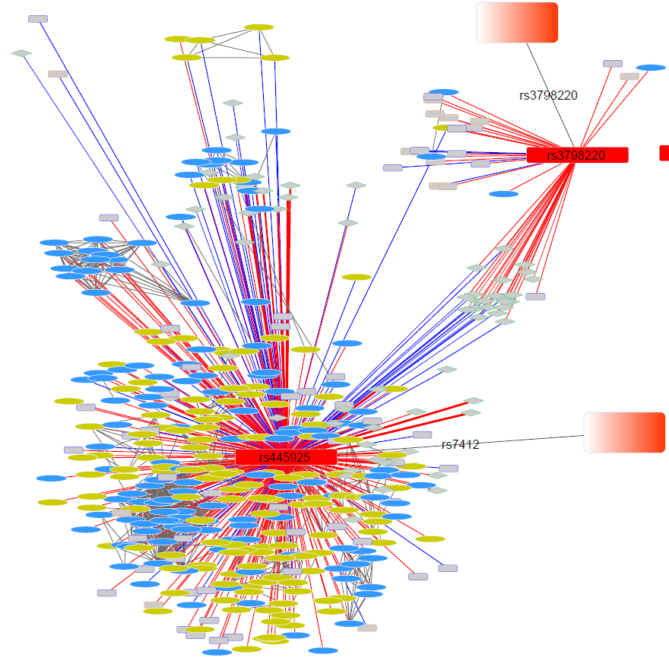
Prioritize SNPs with Poss or Prob Damaging Coding Changes in Genes

Slide 64
CAD SNPs sub-network:
Ch19-Po45395619_A_G

Slide 65
MS/MS DDA experiment for m/z 881
at RT=6.32 min
Fatty acyl chain fragments [M-H2O+H]+
PC(18:1/18:2)
PC(16:0/20:3)

Slide 66
Combining MS/MS DDA from Positive and Negative Ionization Modes
SLNEG
SLPOS
SHexCer(18:1/28:2)

Slide 67
Where do we go from here?
Create the multi-cohort analysis data set
  Metabolomic data harmonization
  Principal component residualization of SNP data
  Execute the global SNP MWAS association analysis (including new SNPs from Metabochip data)
  Divide and prioritize the network map
  Annotate and identify the individual metabolites
  Perform Mediation Analyses
  Define the metabolic pathways represented by the metabolites

Slide 68
Where do we go from here?
Create the multi-cohort analysis data set
  Metabolomic data harmonization
  Principal component residualization of SNP data
  Execute the global SNP MWAS association analysis (including new SNPs from Metabochip data)
  Divide and prioritize the network map
  Annotate and identify the individual metabolites
  Perform mediation analyses
  Define the metabolic pathways represented by the metabolites

Slide 69
Where do we go from here?
Create the multi-cohort analysis data set
  Metabolomic data harmonization
  Principal component residualization of SNP data
  Execute the global SNP MWAS association analysis (including new SNPs from Metabochip data)
  Divide and prioritize the network map
  Annotate and identify the individual metabolites
  Perform mediation analyses
  Define the metabolic pathways represented by the metabolites

Slide 70
Where do we go from here?
Create the multi-cohort analysis data set
  Metabolomic data harmonization
  Principal component residualization of SNP data
  Execute the global SNP MWAS association analysis (including new SNPs from Metabochip data)
  Divide and prioritize the network map
  Annotate and identify the individual metabolites
  Perform mediation analyses
  Define the metabolic pathways represented by the metabolites

Slide 71
Where do we go from here?
Create the multi-cohort analysis data set
  Metabolomic data harmonization
  Principal component residualization of SNP data
  Execute the global SNP MWAS association analysis (including new SNPs from Metabochip data)
  Divide and prioritize the network map
  Annotate and identify the individual metabolites
  Perform Mediation Analyses
  Define the metabolic pathways represented by the metabolites

Slide 72
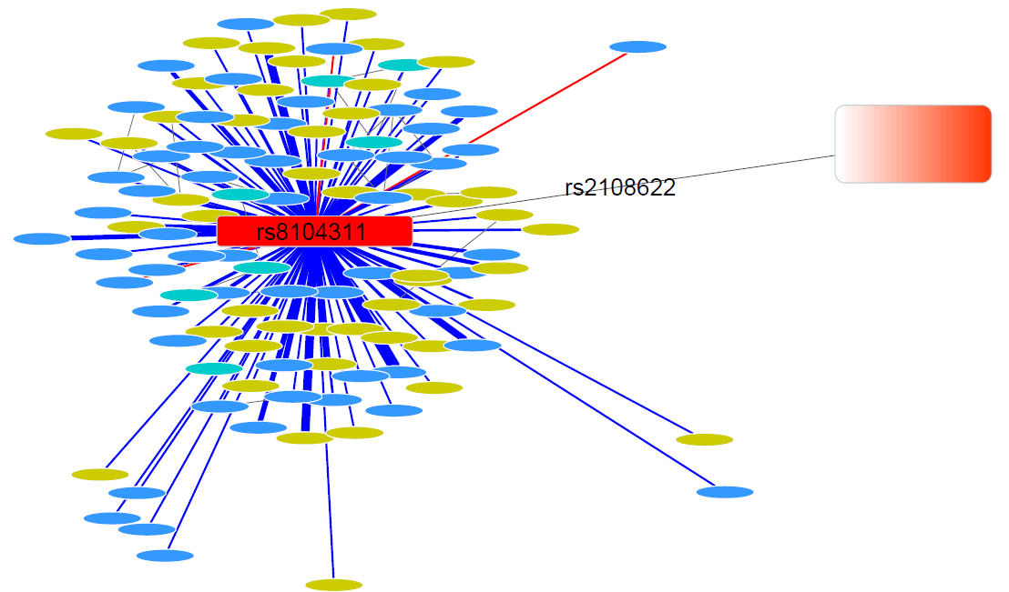
Prioritize SNPs with Poss or Prob Damaging Coding Changes in Genes

