Slide 1

Epigenomics & Transcriptomics
Studies in MESA
Yongmei Liu, MD, PhD, FAHA
Wake Forest School of Medicine

Slide 2
MESA Epigenomics Study
Funded through NIH Roadmap Epigenomics Program and NHLBI
At MESA Exam 5 (2009-2011), ~2500 participants
  mean age: 66, 51% female
  3 ethnicities: Caucasians, AAs, Hispanics
  Four field centers: WFU, JHU, Columbia, UMN
Purification of PBMC, Monocytes and CD4+ T Cells
  Using CPT tube, anti-CD14, anti-CD4 magnetic beads

Slide 3
Data Generated
DNA methylomic and transcriptomic profiling of1,486 monocytes & 600 T cell samples using:
  Illumina 450K DNA methylation: 485K CpG sites
  Illumina HumanHT-12 v 4: 48K probes
miRNA-seq on a subset of 873 monocytes samples
mRNA-seq on a subset of 373 monocyte samples

Slide 4
Publications
Methylomics of gene expression in human monocytes. Human Molecular Genetics. (2013) 22(24):5065-74. PMCID: PMC3836482
Age-related variations in the methylome associated with gene expression in human monocytes and T cells. Nature Communications. (2014) 5:5366 doi: 10.1038/ncomms6366 PMCID: PMC4280798
Transcriptomic Profiles of Aging in Purified Human Immune Cells; BMC Genomics (2015) 16:333, doi: 10.1186/s12864-015-1522-4 PMCID: PMC4417516
Alterations of a cellular cholesterol metabolism network is a molecular feature of obesity-related type 2 diabetes and cardiovascular disease; Diabetes PMCID: PMC4587646
DNA Methylation of the Aryl Hydrocarbon Receptor Repressor Associations With Cigarette Smoking and Subclinical Atherosclerosis; Circ Cardiovasc. Genet (2015) 8(5): 707-716 doi: 10.1161/CIRCGENETICS.115.001097. Epub 2015 Aug 25 PMCID: PMC4618776
Second hand Tobacco Smoke Exposure Associations with DNA Methylation of the Aryl Hydrocarbon Receptor Repressor. Nicotine & Tobacco Research 2016 August 31. PMID: 27613907

Slide 5
Publications
Epigenetic Signatures of Cigarette Smoking. Circulation: Cardiovascular Genetics 2016 September 20. PMID: 27651444
CHARGE consortium. The transcriptional landscape of human age. Nat. Commun.
A DNA methylation biomarker of alcohol consumption. Mol Psychiatry 2016 November 15. PMID: 27843151
Long-term outdoor air pollution and DNA methylation in circulating monocytes: Results from the Multi-ethnic Study of Atherosclerosis (MESA). Environmental Health 2016 Dec 1;15(1):119 PMID: 27903268
Interaction of methylation-related genetic variants with circulating fatty acids on plasma lipids: a meta-analysis of 7 studies and methylation analysis of 3 studies in the Cohorts for Heart and Aging Research in Genomic Epidemiology consortium. Am J Clin Nutr 2016: PMID:26791180.
Penalized Multi-Marker Versus Single-Marker Regression Methods for Genome-Wide Association Studies of Quantitative Traits. Genetics 2014.
Life Course Socioeconomic Status and DNA Methylation in Genes Related to Stress Reactivity and Inflammation: The Multi-Ethnic Study of Atherosclerosis. Epigenetics. 2015.

Slide 6
Consortium
CHARGE epi working groups:
  Smoking
  Alcohol
  Physical activity
  Liver fat
  Age of menarche/menopause
  Mediterranean diet
  Vitamin D
  DM
  CKD

Slide 7
Transcriptomic Associations with Carotid Plaque and CAC in 1,208 MESA Participants
Under revision by Nature Communication

Slide 8
Methylomic Associations with Carotid Plaque and CAC in 1,208 MESA Participants

Slide 9



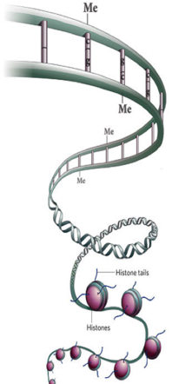
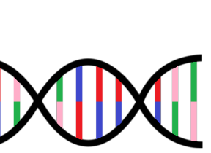
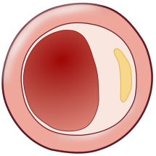
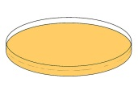
In MESA
1,208 Human CD14+ Monocyte samples
Transcriptome
DNA methylome
CVD risk factors, i.e. age, obesity, smoking
~
ARID5B
enhancer
methylation
(cg25953130)
~
ARID5B expression
~
Subclinical Atherosclerosis
In vitro
Human THP-1 Monocytes
LPS treatment
siRNA
Transcriptome
ARID5B
Inflammation (TNF, IL1A)
Functions of migration and phagocytosis

Slide 10
Data To be Generated for Exam 5 Samples
DNA methylomic profiling of ~1000 monocyte samples using TruSeq Methyl Capture Assay
miRNA-seq on additional ~400 monocyte samples
Total mRNA-seq on additional ~600 monocyte samples

Slide 11
Epigenomics studies in Exam 6
A longitudinal Epigenetics study of atherosclerosis (PI: Yongmei Liu, HL135009-01)
Epigenetics of T2D (PIs: Yongmei Liu, Jingzhong Ding; DK101921)
Epigenetics of Cognition/AD (PIs: Jingzhong Ding, Yongmei Liu; AG054474)

Slide 12
Sample/Data Collection
Repeat epigenomic and transcriptomic profiling of monocytes at Exam 6
  ~2500 participants
  WFU, JHU, Columbia, UMN
  CBC/diff, PBMC/monocyte/T cell purification
  DNA methylomic profiling using TruSeq Methyl Capture
  Transcriptomics: mRNA-seq or total RNA-seq

Slide 13
Sample/Data Collection
Repeat measures of known CVD risk factors
  Fasting glucose, HbA1C, insulin, etc.
Repeat carotid ultrasonography at Exam 6
  All returning participants who had ultrasonography at Exam 5 (N=~1,500)
  WFU, JHU, Columbia, UMN
  B-mode ultrasound images
Cognitive function assessment via questionnaire and proxy interview (WFU, JHU)

Slide 14
Acknowledgements
Wake Forest School of Medicine: Jingzhong Ding, Kurt Lohman, David Herrington, Gregory Burke
Johns Hopkins University: Wendy Post
University of Minnesota: David Jacobs. Aaron Folsom
Columbia University: Steven Shea
University of Vermont: Russ Tracy
University of Washington: Bruce M. Psaty, Joel Kaufman
New York Academy of Medicine: David Siscovick
University of Virginia: Stephen S. Rich
University of Wisconsin : James H. Stein
Virginia Tech: Ina Hoeschele
MESA: all participants, investigators, and staff
Funding Agency:
  NHLBI
  NIDDK
  NIA

