Slide 1
Multi-omics in MESA
An Update
Steve Rich (TOPMed WGS)
Mei Liu (Epigenomics)
David Herrington (Metabolomics)
Jerry Rotter (TOPMed Multi-omics Pilot)
Kent Taylor (Multi-omics Analytic Approaches)

Slide 3
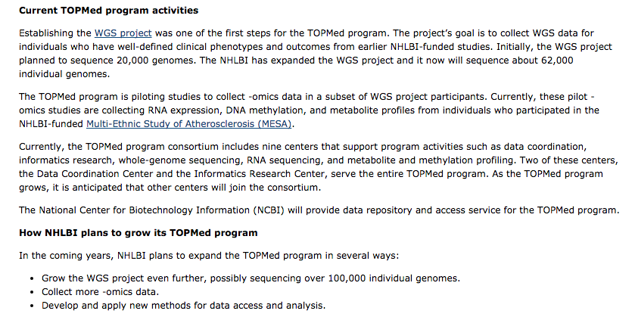

Slide 5
MESA Selection for TOPMed WGS
Required:
1. | MESA Classic participant
2. | Consented to MESA Genetics participation and have accepted DNA as indicated by participation in prior genotyping activities such as MESA SHARe genome wide scan or MESA Exomechip.
3. | Sufficient DNA volume in central lab repository (> 40 μg DNA).
Select top 4,595 according to the following weighted selection criteria with an additional 919 selected as replacements in case there is insufficient DNA quality or quantity (WGS will be completed in 4,595).
Prior Selection (20 point weight towards selection)
1. | MESA Family Study (AFA and HIS only) proband [+20 points]

Slide 6
Summary Description of MESA Selection for TOPMed WGS
 | MESA Classic (6,814) | Genetics Consent (6,467) | Consent and DNA ≥40 μg (6,391) | TOPMed Selected (4,595) | TOPMed Alternate (919)
Age (yrs) | 62.2 (10.23) | 62.2 (10.24) | 62.2 (10.26) | 61.1 (9.86) | 64.9 (10.38)
Female | 3,601 (53%) | 3,388 (52%) | 3,344 (52%) | 2,371 (52%) | 468 (51%)
CEU | 2,622 (38%) | 2,533 (39%) | 2,505 (39%) | 1,833 (40%) | 392 (43%)
CHN | 804 (12%) | 779 (12%) | 767 (12%) | 610 (13%) | 68 (7%)
AFA | 1,892 (28%) | 1,700 (26%) | 1,673 (26%) | 1,130 (25%) | 246 (27%)
HIS | 1,496 (22%) | 1,455 (23%) | 1,446 (23%) | 1,022 (22%) | 213 (23%)
Proband | 348 (5%) | 348 (5%) | 344 (5%) | 344 (7%) | 0 (0%)
MESA 1000 | 999 (15%) | 966 (15%) | 959 (15%) | 795 (17%) | 74 (8%)
CVD All | 791 (12%) | 753 (12%) | 747 (12%) | 536 (12%) | 97 (11%)
CHF | 279 (4%) | 262 (4%) | 261 (4%) | 184 (4%) | 34 (4%)
Atrial Fibrillation | 541 (8%) | 518 (8%) | 513 (8%) | 404 (9%) | 58 (6%)

Slide 7
Summary Description of MESA Selection for TOPMed WGS
 | MESA Classic (6,814) | Genetics Consent (6,467) | Consent and DNA ≥40 μg (6,391) | TOPMed Selected (4,595) | TOPMed Alternate (919)
Baseline CT | 6,814 (100%) | 6,467 (100%) | 6,391 (100%) | 4,595 (100%) | 919 (100%)
Follow-up CT | 6,068 (89%) | 5,773 (89%) | 5,702 (89%) | 4,559 (99%) | 841 (92%)
Baseline US | 6,726 (99%) | 6,386 (99%) | 6,312 (99%) | 4,574 (100%) | 907 (99%)
Follow-up US | 5,636 (83%) | 5,374 (83%) | 5,306 (83%) | 4,295 (93%) | 775 (84%)
Baseline MRI | 5,003 (73%) | 4,775 (74%) | 4,712 (74%) | 3,717 (81%) | 536 (58%)
COMBI-BIO | 3,999 (59%) | 3,999 (62%) | 3,944 (62%) | 2,948 (64%) | 520 (57%)
Epigenomics | 1,264 (19%) | 1,214 (19%) | 1,204 (19%) | 1,196 (26%) | 6 (1%)
Lung CT | 3,127 (46%) | 3,025 (47%) | 2,980 (47%) | 2,965 (64%) | 15 (2%)
Spirometry | 4,321 (63%) | 4,191 (65%) | 4,138 (65%) | 3,813 (83%) | 325 (35%)
MESA Sleep | 2,057 (30%) | 1,982 (31%) | 1,950 (31%) | 1,910 (42%) | 31 (3%)
Exam5 Complete | 4,655 (68%) | 4,424 (68%) | 4,367 (68%) | 4,018 (87%) | 277 (30%)

Slide 8
MESA WGS status
Whole genome sequencing
1. | 4,691 DNA samples shipped to Broad Institute 12/1/2015
2. | 4,636 samples passed pre-sequencing QC; 4,620 were sequenced and passed post-sequencing QC; 4,616 BAMs at Michigan IRC
3. | Alignment to reference genome, variant calls in progress
dbGaP Registration
1. | Requires all sites to have IRB approvals; data not available in the dbGaP Exchange Area for use in Working Group analyses

Slide 9
