Slide 1
MESA Steering Committee Genetics Committee Update
April 20, 2017
Jerome I. Rotter, MD and Stephen S. Rich, PhD
1

Slide 2
MESA Genetics Overview
Genetics Datasets Availability
Update on Genetics P&P
Return of Results
Epigenetics
NHLBI TOPMed program
a. WGS
b. Multi-Omics
2

Slide 3
Genetics Datasets Availability
Genetic dataset | Available w/MESA ID from CC | Available w/SHARe ID from CC | Available w/SHARe ID from dbGaP
Affy 6.0 | No | Yes | Yes
Candidate Gene 1&2 | Yes | No | No
CARe IBC iSelect | Yes | Yes | Yes
96 SNP | Yes | Yes | No
Metabochip | Yes | No | No
Exome Chip | Yes | Yes | Yes
Exome Sequence | Yes | Yes | Yes
Epigenomics methylation | Yes | No | No
Epigenomics expression | Yes | No | No
SHARe Principal Components | Yes | Yes | No
1000 G Imputation | No | Yes | No
Phenotype Updates | Yes | Yes | Yes
Whole Genome Sequence | In progress
TOPMed MESA ‘Omics - Methylation, Metabolomics, RNA Seq | In progress
3

Slide 4
MESA Genetics P&P Summary
 | All | SHARe
Proposals approved | 558 | 416
Pen Draft Pending (Proposals approved; pen draft not yet approved) | 275 | 211
Withdrawn | 40 | 16
Pen Draft approved | 240 | 187
Published | 146 | 113
Pen Draft approved; not yet published | 98 | 77
 | Pending Pen Draft | Pen Drafts not published
0-3 months | 6 | 15
3-6 months | 24 | 14
6-9 months | 16 | 11
9-12 months | 19 | 7
12+ months | 210 | 51
4

Slide 5
MESA Genetics Published Papers: Recent
Title | MESA Lead | Journal | Pub Date
G 347: Genetic variants associated with subjective well-being, depressive symptoms, and neuroticism identified through genome-wide analyses. | Alexis C. Frazier-Wood | Nat Genet. | 4/18/2016
G 077: KLB is associated with alcohol drinking, and its gene product β-Klotho is necessary for FGF21 regulation of alcohol preference. | Jennifer Nettleton | Proc Natl Acad Sci U S A. | 12/13/2016
G 431: Dairy Consumption and Body Mass Index (BMI): Mendelian Randomization and Gene-diet Interaction Analyses in CHARGE | Alexis C. Frazier-Wood | BMJ | 3/16/2017
G 200: Genetic Associations with Lipoprotein Subfraction Measures Differ by Ethnicity in the Multi-Ethnic Study of Atherosclerosis | Alexis C. Frazier-Wood | Hum Genet. | 3/28/2017
G 284: Meta-analysis of 49 549 individuals imputed with the 1000 Genomes Project reveals an exonic damaging variant in ANGPTL4 determining fasting TG levels. | Ani Manichaikul | J Med Genet. | 7/1/2016
G 320: Incidence of Age-Related Macular Degeneration in a Multi-Ethnic United States Population: The Multi-Ethnic Study of Atherosclerosis. | Diana E. Fisher | Ophthalmology. | 6/1/2016
5

Slide 6
MESA Genetics Published Papers: Recent
Title | MESA Lead | Journal | Pub Date
G 393: A DNA methylation biomarker of alcohol consumption. | Lindsay M Reynolds | Mol Psychiatry | 11/15/2016
G 415: Epigenetic Signatures of Cigarette Smoking. | Roby Joehanes | Circ Cardiovasc Genet. | 10/1/2016
G 427: Secondhand Tobacco Smoke Exposure Associations with DNA Methylation of the Aryl Hydrocarbon Receptor Repressor. | Lindsay M Reynolds | Nicotine Tob Res. | 8/31/2016
G 243: KCNK3 Variants Are Associated With Hyperaldosteronism and Hypertension. | Ani Manichaikul | Hypertension. | 8/1/2016
G 192: Genome-wide analysis identifies 12 loci influencing human reproductive behavior. | Leslie Raffel | Nat Genet. | 12/1/2016
G 450: Genome-wide association study of generalized anxiety symptoms in the Hispanic Community Health Study/Study of Latinos. | Xiuqing Guo | Am J Med Genet B Neuropsychiatr Genet. | 5/9/2016
6

Slide 7
MESA Genetics Published Papers: Recent
Title | MESA Lead | Journal | Pub Date
G 409: Meta-analysis of exome chip data in relation to electrocardiographic RR intervals in European and African ancestry individuals, with the CHARGE-EX EKG consortium: The Multi-Ethnic Study of Atherosclerosis | Henry J. Lin | Human Molecular Genetics, HMG-2017-TF-00044.R1 | 3/18/2017
G 256: Long-term outdoor air pollution and DNA methylation in circulating monocytes: results from the Multi-Ethnic Study of Atherosclerosis (MESA). | Gloria C Chi | Environ Health. | 12/1/2016
G 395: Genetic Risk Prediction of Atrial Fibrillation. | Henry J. Lin | Circulation. | 4/4/2017
7

Slide 8
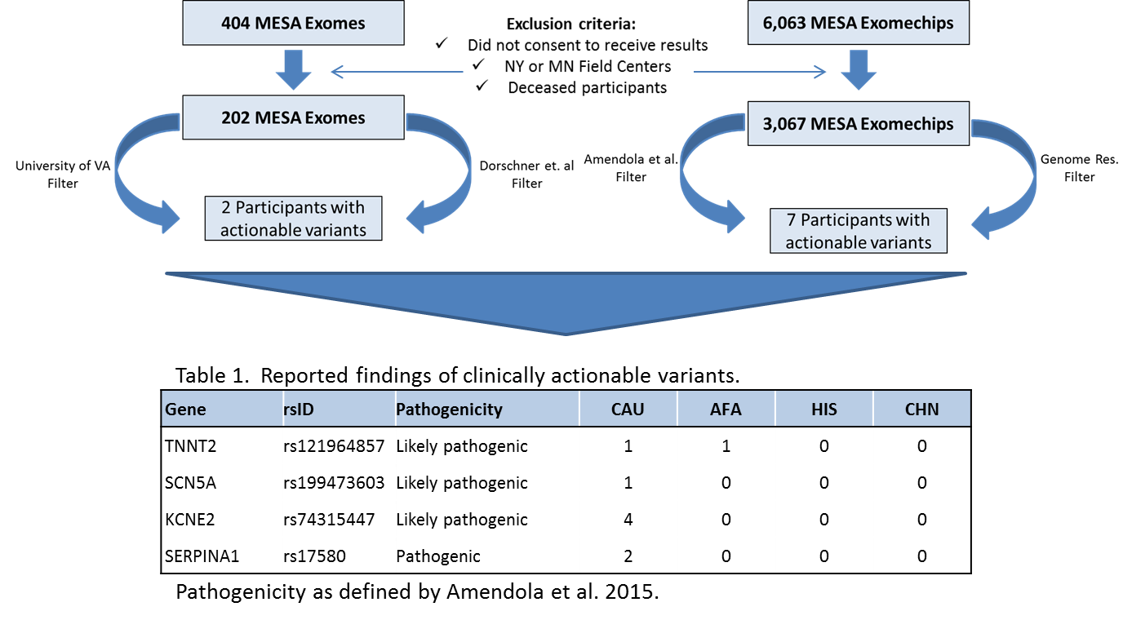
MESA Return of Results:
To Confirm and Return actionable Incidental
Findings to Qualified MESA Participants
8

Slide 9
MESA Return of Results Project Status
Completed | IRB Approvals
Protocol | UCLA – submitted 3/29
MOP | Northwestern – submitted, awaiting approval
Specific questionnaires | Wake Forest – will submit pending approval of TOPMed IRB submission
Scripts (field centers/counselors) | Johns Hopkins – IRB approved
Variant annotation
Secured testing in CLIA lab
Failed contact letter
Initial Decline letter
Results letter
9

Slide 10
MESA Epigenomic and
Transcriptomic Studies (PI: Y. Liu)
Data generated for MESA Exam 5 samples:
DNA methylomic and transcriptomic profiling of 1,564 monocytes & 600 T cell samples using Illumina microarray chips
miRNA-seq on a subset of 873 monocyte samples
mRNA-seq on a subset of 373 monocyte samples
Plans for Exam 6 samples:
DNA methylomic and transcriptomic profiling of 1,500 monocytes using sequencing technology
miRNA-seq of 400 monoctye samples
Total RNA-seq of 400 monocyte samples
10

Slide 11
Multi-omics in MESA
An Update
Steve Rich (TOPMed WGS)
Mei Liu (Epigenomics)
David Herrington (Metabolomics of CAD Loci)
Jerry Rotter (TOPMed Multi-omics Pilot)
Kent Taylor (Multi-omics Analytic Approaches)

