Slide 1
Age at Menopause and Incident Heart Failure: The Multi-Ethnic Study of Atherosclerosis
Steering committee meeting
February 25th, 2015
Imo Ebong, Karol Watson, David Goff, David Bluemke, Preethi Srikanthan, Tamara Horwich, Alain Bertoni
Notes:
Good day, My name is Imo and I am from Loma Linda in California. My research interests are focused on cardiovascular disease in women. I will be presenting findings from my study on age at menopause and incident heart failure in MESA.

Slide 2
The burden of heart failure
HF - Significant cause of morbidity and mortality
Prevalence is rising despite decline in CVD related morbidity and mortality
825,000 new cases/year with incidence of 10/1000 after age 65
5.1 million Americans ≥ 20 years have HF
Total cost of HF was 30.7 million in 2012
Effective prevention is necessary to stem cost
Notes:
Heart failure is a significant cause of morbidity and mortality. The prevalence of Heart Failure is rising despite an overall decline in cardiovascular disease related morbidity and mortality. There are 825000 new cases per year and the incidence approaches 10/1000 population after 65 years of age. An estimated 5.1 million Americans aged 20 years and above have Heart failure and this number is projected to reach 8 million in people aged 18 years and above by the year 2030. The total cost of Heart Failure was 30.7 million in 2012 and is projected to rise to 69.7 billion in the year 2030. Understanding the mechanisms of heart failure is necessary to stem the rising cost and decrease the burden on our limited healthcare resources.

Slide 3
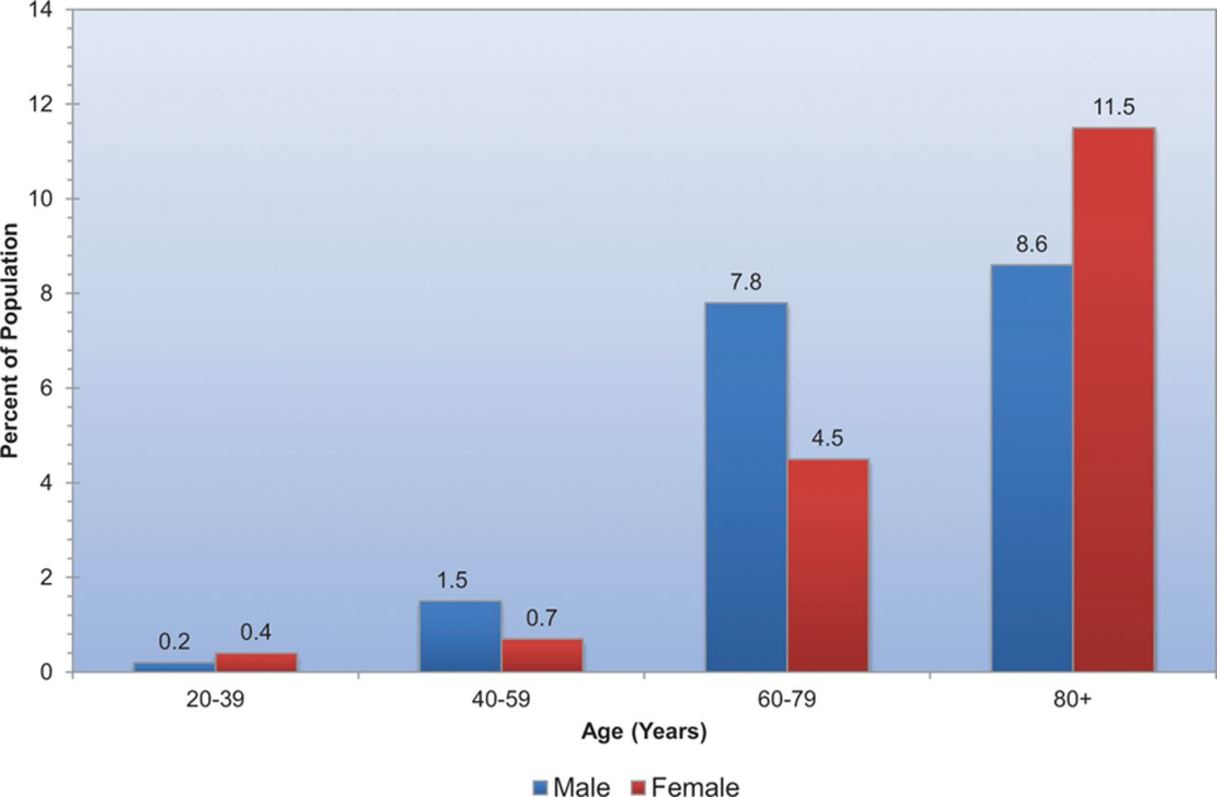
Prevalence of HF according to sex
Heart Disease and Stroke Statistics—2014 Update: A Report From the AHA. Go A S et al. Circulation. 2014;129:e28-e292
Notes:
The prevalence of Heart Failure is greater in men than women in the middle ages. Heart Failure prevalence becomes greater in women than men from age 80 years and above. The reason for these gender differences are unclear but heart failure with preserved ejection fraction is known to be more common in the elderly and female sex.

Slide 4
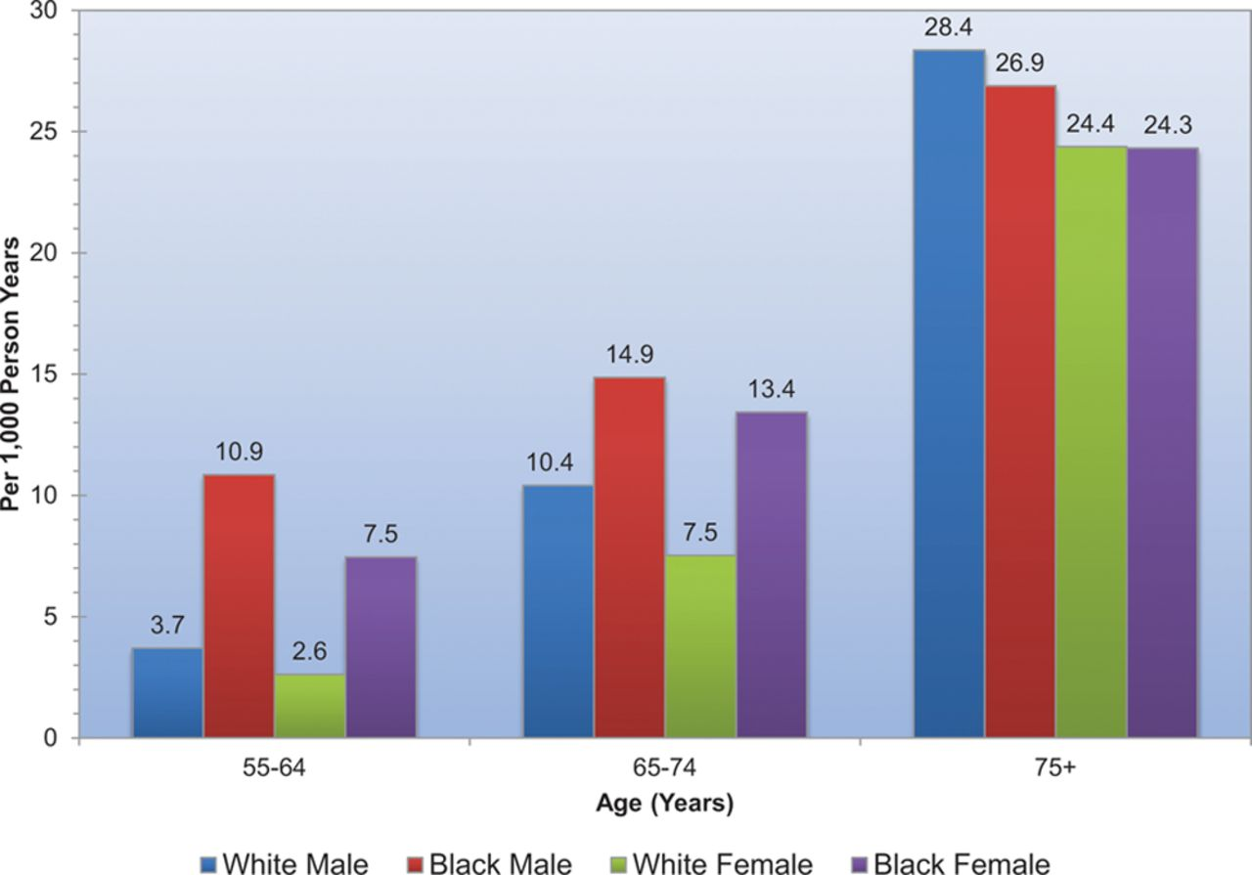
First acute decompensated HF annual event rates per 1000
From ARIC community surveillance 2005-2010
Heart Disease and Stroke Statistics—2014 Update: A Report From the AHA. Go A S et al. Circulation. 2014;129:e28-e292
Notes:
The incidence of acute heart failure decompensation varies by age and race with black women having a greater burden than white women in individuals aged 74 years and below. After 75 years of age, black and white women have a similar incidence of acute heart failure decompensation. Although the incidence of acute heart failure decompensation is greater in men than women in both races, the death rate is also higher in men and this results in a higher prevalence of heart failure in women than men in those aged 75 years and above as shown in the previous slide. Thus women contribute significantly to the burden of heart failure at older ages.

Slide 5
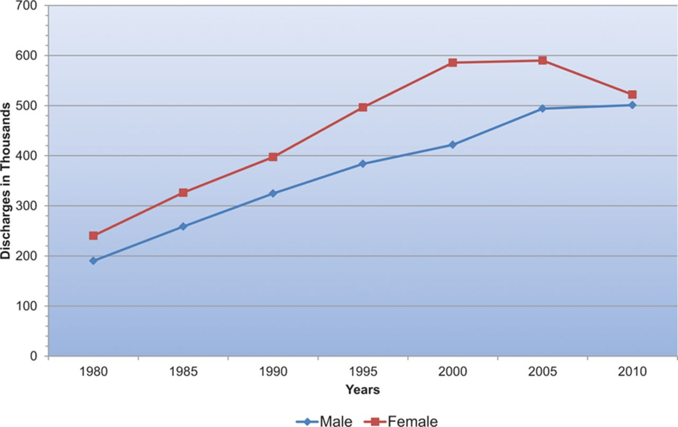
Hospital discharges for HF by sex in US (1980-2010)
Heart Disease and Stroke Statistics—2014 Update: A Report From the AHA. Go A S et al. Circulation. 2014;129:e28-e292
Notes:
The number of hospital discharges for HF was greater in women than men up till 2010 where a similar number of discharge was noted in both sexes.

Slide 6
Menopause and heart failure
HF is more common in elderly
Menopause is a consequence of aging
Estrogen deficiency and androgen predominance
Hormonal changes - adverse effects on the heart
Older menopausal age would delay adverse effect
Notes:
So, heart failure and menopause, what is the connection? HF is more common in the elderly. Menopause is a consequence of reproductive aging which correlates with chronological aging. The postmenopausal period is accompanied by hormonal changes such as estrogen deficiency and relative androgen predominance. These hormonal changes could have independent adverse effects on the heart. An older menopausal age would delay the onset of this deleterious effect.

Slide 7
Cardiac apoptosis in ovariectomized rats
In female rats, Lee et al showed that removal of the ovaries would result in activation of extrinsic and intrinsic cardiac apoptotic pathways. Apoptosis would result in loss of cardiomyocytes. This could be a mechanism for the development of heart failure in postmenopausal women .
Lee et al. Maturitas 2008; 61 (3): 268-77.
Notes:
Animal studies have supported the theory that estrogen loss has a role in the development of heart failure in postmenopausal women.

Slide 8
Menopause and cardiac structure
LV remodeling - known precursor of HF
Small sampled studies - associations of menopause with impaired LV function
Early menopause - subclinical cardiac dysfunction
Estrogen - myocardial protective actions - lost after menopause
Notes:
How about menopause and cardiac structure? Left ventricular remodeling is a known precursor of heart failure. Studies done with small sample sizes have shown associations of menopause with impaired left ventricular systolic and diastolic function. We considered that women with early menopause could have subclinical cardiac dysfunction without overt manifestations of heart failure. Estrogen could have myocardial protective actions which are lost after the onset of menopause. The effects of menopause or estrogen loss could be progressive over time and women with early menopause would be at greater risk.

Slide 9
Specific Aims
Primary Aim: To evaluate the associations of early menopause & age at menopause with incident HF in postmenopausal MESA women
Exploratory Aim: To evaluate the associations of early menopause & age at menopause with LV measures of structure & function obtained by MRI in postmenopausal MESA women
Notes:
Our primary aim was to evaluate the associations of early menopause and age at menopause with incident Heart Failure in postmenopausal MESA women. Our exploratory aim was to evaluate the associations of early menopause and age at menopause with left ventricular measures of structure and function obtained by cardiac MRI in postmenopausal MESA women.

Slide 10
MESA Cohort
6814 participants (3601 women) aged 45 - 84 years (2000 - 2002) & without known CVD
Data: Age at menopause, ethnicity, education, smoking, DM, Htn, HT use & no. of pregnancies
Exam data: Ht, Wt, WC, BP, ECG, MRI
Fasting blood samples for glucose, TG, HDL-C, il-6, & creatinine measurements
Notes:
The MESA cohort consisted of 6814 participants (including 3601 women), aged 45 - 84 years at baseline and without clinical CVD. Participants were recruited from 6 geographic regions and 4 ethnicities in the US. Questionnaires were used to collect information on age at menopause, ethnicity, social, educational medical, medication and reproductive history. Examination data included Ht, Wt, WC, BP, ECG and MRI. Fasting blood samples were collected for measurement of glucose, lipids, interleukin-6 and creatinine.

Slide 11
Study Sample
MESA cohort
N = 6814
Excluding 3213 male participants
Female participants
N = 3601
Excluding 652 pre- and perimenopausal women
Postmenopausal participants
N = 2949
Excluding 2 women missing information on heart failure
Sample size for primary analysis
N = 2947
Excluding 824 women who did not have cardiac MRI at baseline
Sample size for exploratory analysis
N = 2123
Notes:
This flow chart is a diagrammatic presentation of our study population and sample size. There were 2949 postmenopausal women, we excluded 2 women who were missing information on their heart failure data to obtain a sample size of 2947 for our primary analysis. Our exploratory analysis included 2123 women who had obtained cardiac MRI at baseline.

Slide 12
Heart Failure Definition
Endpoint was symptomatic HF defined as:
Physician diagnosed HF or medical therapy for HF and
Pulmonary edema or congestion on CXR and/or
Dilated ventricle or poor LV function on echo or ventriculography or LV diastolic dysfunction
MI was diagnosed based on symptoms, ECG findings or biomarker levels
Notes:
We defined our Heart Failure endpoint based on physician diagnosis or medical therapy for Heart failure and CXR or echocardiographic findings. CXR findings included evidence of pulmonary edema or congestion. Echocardiographic findings included left ventricular diastolic dysfunction, dilated ventricle or poor left ventricular systolic function. Myocardial infarction was diagnosed based on symptoms, ECG findings or biomarker levels.

Slide 13
Primary Analysis
Cox proportional hazards models
Variations in HF mechanisms/incidence by ethnicity
Most parsimonious model using backward elimination in which age was retained and variables eliminated if their p was > 0.10
Final model: Early menopause (age at menopause), age, smoking, BMI, DM, Htn, LVH and interim MI
Notes:
Cox proportional hazards models were used for our primary analysis. There are variations in the incidence and mechanisms of Heart Failure by ethnicity so we tested for the presence of interactions of menopausal age with ethnicity. We failed to observe any significant interactions. We selected the most parsimonious models using backward elimination in which age was retained and we eliminated variables if their p > 0.10. Our final model consisted of menopausal age, chronological age, smoking, body mass index, diabetes, hypertension, left ventricular hypertrophy and interim myocardial infarction.

Slide 14
Exploratory Analysis
Multivariable linear regression
LV measures: LVM, EDV, ESV, MVR, EF, SV
Interaction of early menopause and ethnicity (MVR at P_{interaction} of 0.02)
Adjusted for confounders & HF risk factors
Ht & Wt included for LV measures (except LVMVR & LVEF) to account for confounding by body size
BMI excluded from models with Ht & Wt to avoid colinearity
Notes:
Multivariable linear regression was used for our cross-sectional exploratory analysis. Our left ventricular outcome measures included; left ventricular mass, end diastolic volume, end systolic volume, mass to volume ratio, ejection fraction and stroke volume. We presented ethnic-stratified analysis due to the presence of significant interactions between early menopause and ethnicity for mass to volume ratio with P for interaction of 0.02. We adjusted for potential confounders including reproductive characteristics and known Heart Failure risk factors. Height and weight were included in models for all left ventricular measures except mass to volume ratio and ejection fraction to account for the confounding effects of body size. Body mass index was excluded from models that contained height and weight to avoid colinearity.

Slide 15
Baseline Characteristics
Notes:
730 participants experienced early menopause at baseline. Women with early menopause were more likely to be African-American, current smokers and had diabetes at baseline. Interleukin-6 and body mass index were greater in the early menopausal group.

Slide 16
Incidence of Heart Failure
Median follow up of 8.5 yrs - 71 incident HF cases
25 events in women with early menopause
Overall HF incidence was 3.14/1000 person-yrs
4.69 & 2.69 per 1000 person-yrs in women with and without early menopause respectively
2.93, 2.23, 4.02 & 2.92 in White, Chinese-American, African-American and Hispanic women respectively
Notes:
After a median follow-up of 8.5 years, we observed 71 cases of incident Heart Failure and 25 events occurred in women with early menopause. The overall Heart Failure incidence was 3.14/1000 person-years, with incidences of 4.69/1000 person-years in women with early menopause and 2.69/1000 person-years in women without early menopause. The Heart Failure incidence was 2.93/1000 person-years in White women, 2.23/1000 person-years in Chinese-American women, 4.02/1000 person-years in African-American women and 2.92/1000 person-years in Hispanic women.

Slide 17
Early menopause and Heart Failure
Notes:
The probability of being free from Heart Failure was significantly lower in women with early menopause with P for Log-Rank of 0.03. And you can see an early separation between the early menopausal and non-early menopausal group occurring even before two years of follow up.

Slide 18
Primary Analysis
Notes:
For our primary analysis: In model 1, we present our unadjusted analysis. In model 2, we present our age adjusted analysis. In our final models (model 3), early menopause was asociated with a 66% greater risk of incident Heart Failure while a one year increase in menopausal age was associated with a 4% lower risk of incident Heart Failure. Our final models were adjusted for age, smoking, body mass index, diabetes, hypertension, left ventricular hypertrophy and interim myocardial infarction.

Slide 19
Exploratory Analysis
Notes:
For our exploratory analysis: we presented ethnic-specific estimates due to significant interactions between early menopause and ethnicity for mass to volume ratio. Mass to volume ratio is an indicator of left ventricular remodelling which is a predisposing factor for heart failure. Stroke volume is an indicator of the volume of blood pumped out of the left ventricle with each heart beat and is a determinant of cardiac output. End diastolic volume is an indicator of the blood volume in the left ventricle at the end of diastole or the relaxation phase of the heart. In Chinese-American women, early menopause was associated with a 6.75 ml decrease in end-diastolic volume, a 5.20 ml decrease in stroke volume and a 0.11 g/ml increase in mass to volume ratio. In Chinese-American women, a one year increase in menopausal age was associated with 0.36 ml increase in end-diastolic volume, a 0.29 ml increase in stroke volume and a 0.004 g/ml decrease in mass to volume ratio. Mass to volume ratio and stroke volume are both derived variables. Mass to volume ratio is calculated by dividing left ventricular mass by end diastolic volume. Stroke volume is calculated by subtracting end systolic volume from end diastolic volume. The greater mass to volume ratio and lower stroke volume observed in Chinese-American women with early menopause may have been due to their lower end diastolic volume. The point estimates for left ventricular mass, end systolic volume and ejection fraction were not significant in all ethnicities and are not included in the table.

Slide 20
Possible Pathophysiological Mechanisms
Estrogen has cardio-protective effects
Early menopause – shorter exposure to endogenous estrogens
Direct effects of estrogen include:
Rapid vasodilatation via increased nitrous oxide production
Longer term effects via genomic mediated changes in expression of regulatory proteins
Indirect effects of estrogen involve:
Ventricular contractile function, endothelial calcium metabolism, coagulation and fibrinolysis, insulin resistance, inflammation and oxidative alterations of lipids
Notes:
Although not included in this study, we considered that our findings could be explained by the cardioprotective effects of estrogens and women with early menopause would have a shorter duration of exposure to endogenous estrogens. Estrogen has both direct and indirect effects on the heart. Direct effects of estrogen include rapid vasodilatation through increased nitrous oxide production and longer term effects resulting from genomic mediated changes in the expression of regulatory proteins. Indirect effects of estrogen involve ventricular contractile function, endothelial calcium metabolism, coagulation and fibrinolysis, insulin resistance, inflammation and oxidative alterations of lipids.

Slide 21
Study strengths
Novel - First
Highly standardized data collection
Multi-Ethnic population
Prospective study
Participants were free of CVD at baseline
Notes:
Our study has multiple strengths. We were the first to assess the associations of menopausal age and incident Heart Failure. The data collection methods in MESA are highly standardized. We have a multi-ethnic population consisting of Whites, Chinese-Americans, African-Americans and Hispanics. This prospective nature of our study allowed us to measure Heart Failure incidence. Our study participants were free of known clinical CVD at baseline.

Slide 22
Limitations
Sex hormones were not included
Recall bias: Age at menopause based on self report
Residual confounding from unmeasured risk factors
Modest number of HF events
Possibility of CAD even in the absence of MI
Notes:
We acknowledge limitations. Sex hormones were not included in this study. There is a possibility of recall bias because menopausal age was based on self report. There may be residual confounding resulting from unmeasured risk factors. We only observed a modest number of Heart failure events and had inadequate power for analysis by heart Failure subtype or type of menopause. We accounted for interim myocardial infarction but the absence of myocardial infarction does not completely exclude subclinical coronary disease.

Slide 23
Conclusion
An older menopausal age is associated with decreased risk of incident HF
Concentric LV remodeling, indicated by a higher LVMVR was present in Chinese-American women with early menopause at baseline
Notes:
We concluded that an older menopausal age is associated with decreased risk of incident Heart failure. We also concluded that concentric left ventricular remodelling indicated by a greater mass to volume ratio was present in Chinese-American women with early menopause at baseline, but not in other ethnicities.

Slide 24
Future Directions
Reproduce our findings in other cohorts
Sex hormones - associations of menopausal age with incident HF
Trials - Interventions to decrease HF risk in women with early menopause
Notes:
These findings should be reproduced in other cohorts. The role of sex hormones in the associations of menopause age and incident Heart Failure should be evaluated. In the future, trials should be designed to test interventions aimed at decreasing the risk of HF in women with early menopause.

Slide 25
Acknowledgements
Mentors
Alain Bertoni
David Goff
Other co-authors:
Karol Watson
Tamara Horwich
Preethi Srikanthan
David Bluemke
Staff and participants of MESA study
Notes:
I would like to acknowledge my mentors and co-authors as well as staff and participants of the MESA study.

Slide 26
THANK YOU!
Notes:
Thank you for keeping the goals of MESA alive.

