Slide 1
Carotid Artery Plaque Morphology and Composition in Relation to Incident Cardiovascular Events
The Multi-Ethnic Study of Atherosclerosis
A Zavodni MD, MHSc, B Wasserman MD, R McClelland PhD, A Gomes MD,
A Folsom MD, MPH, J Polak MD, MPH, J Lima MD, D Bluemke MD, PhD
February 25, 2015

Slide 2
Carotid MRI
Direct visualization
Large size
Superficial location
Relative immobility
Excellent soft-tissue
contrast

Slide 3
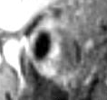
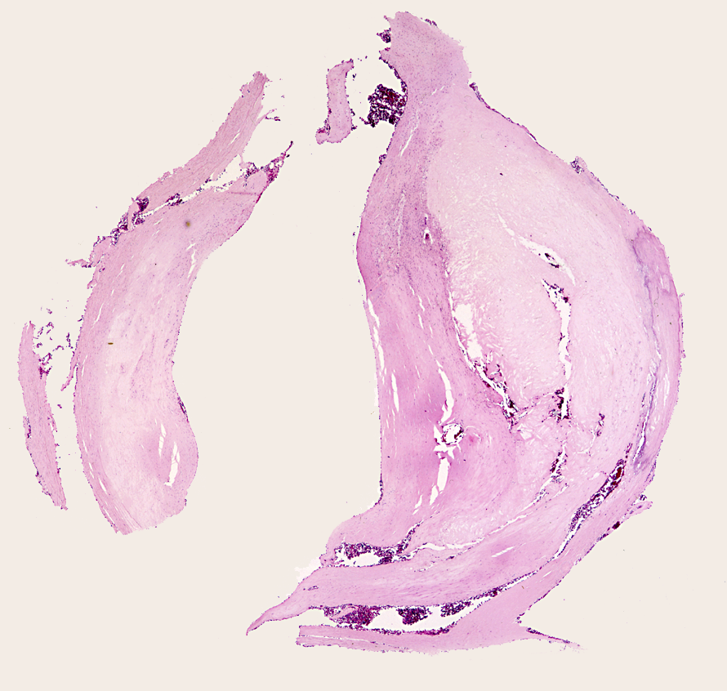
Wasserman, et al
MRI features of carotid atheroma
Lumen (L)
Fibrous cap
L
Calcium
Lipid core
Gadolinium T1 MRI
H&E
Radiology. 2002 May;223(2):566-73.

Slide 4
Purpose
To determine if carotid plaque morphology and composition with MR imaging can be used to identify asymptomatic subjects at risk for cardiovascular events.

Slide 5
Methods
946 participants (exam 2)
chosen according to the highest ~15% of IMT at all centers, random sampling done in Baltimore and Los Angeles
evaluated with MRI

Slide 6
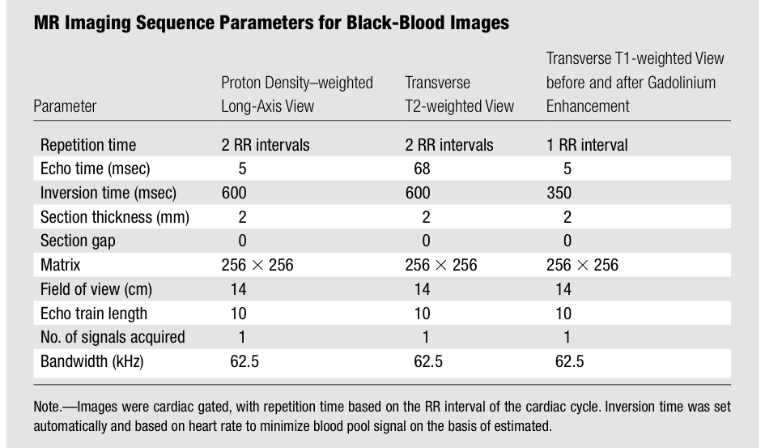

Slide 8
Methods
followed for ~5.5 years for MI, resuscitated cardiac arrest, angina, stroke and death
univariate and multivariate Cox proportional hazards models considering traditional (Framingham) and imaging risk factors
calculated the net reclassification index for the addition of the imaging markers to the traditional risk factor model

Slide 9
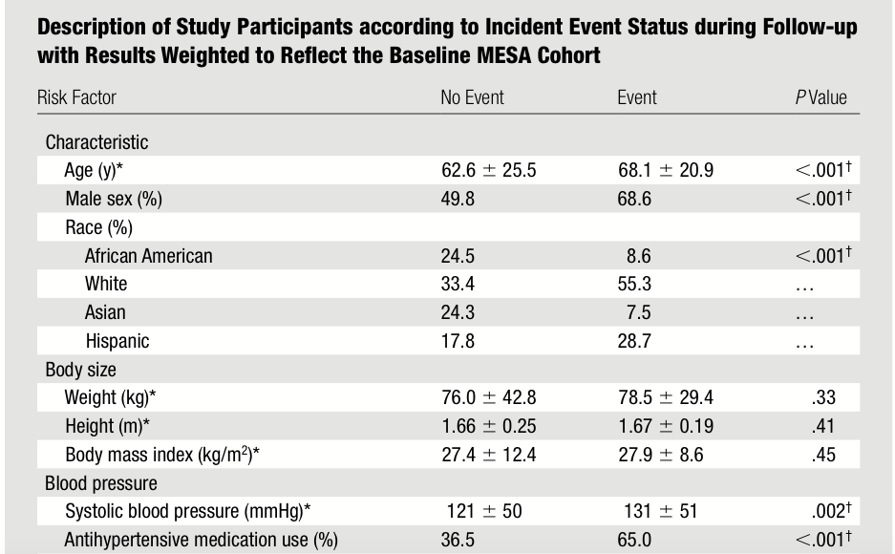

Slide 10
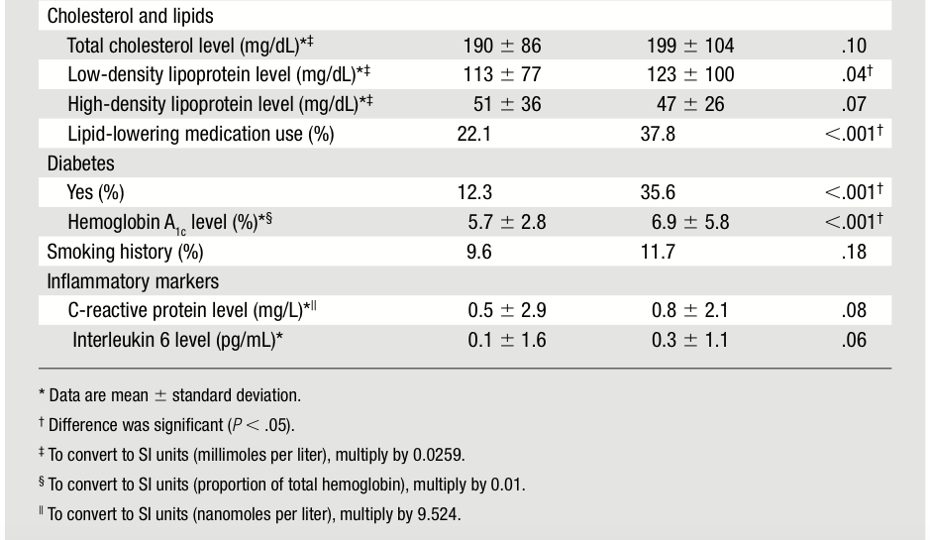

Slide 11
Results
59 participants experienced an event (6%)
traditional risk factors, C-statistic = 0.696
traditional risk factors + MRI remodelling index and the presence of a lipid core, C-statistic = 0.734
net reclassification (p = 0.02)
participants with an event = 7.4%
participants without an event = 15.8%

Slide 12
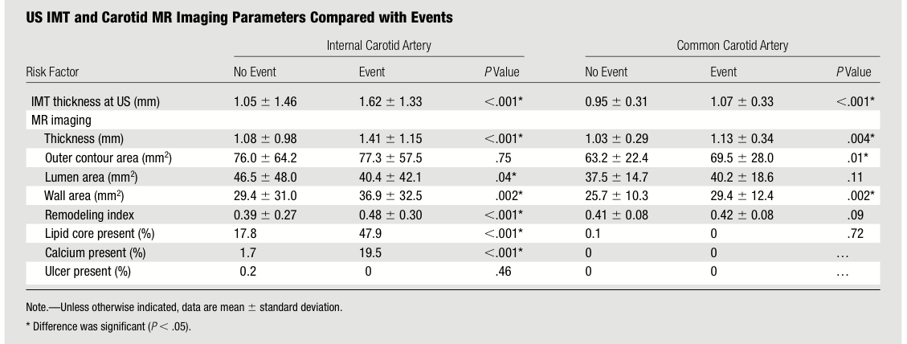

Slide 13
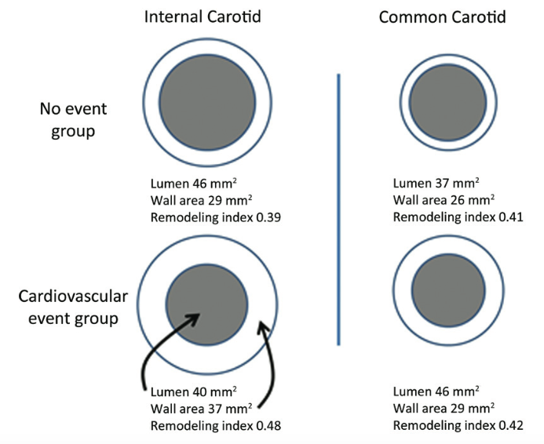
Remodeling Index

Slide 14
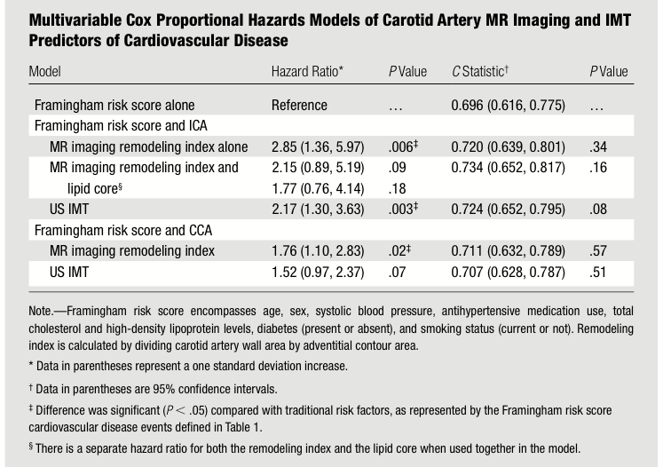

Slide 15
