Slide 1

MESA P&P REPORT
SC Meeting 4/19/17
Steve Shea
Moyses Szklo
Robyn McClelland

Slide 2
P&P Membership
Member | Site/Affiliation
Moyses Szklo, MD, DrPH | Johns Hopkins University – Chair
Steven Shea, MD, MS | Columbia University – Co-Chair
Norrina B. Allen, PhD | Northwestern University
*Matthew Allison, MD, MPH | UCSD
Alain Bertoni, MD | Wake Forest University
Michael Blaha, MD | Johns Hopkins Hospital
David Bluemke, MD, PhD | MRI Reading Center, NIH/CC/DRD
Ian de Boer, MD, MS | University of Washington
Lyndia Brumback, PhD | University of Washington
*Susan Heckbert, MD, PhD | University of Washington
Joao Lima, MD | MRI Reading Center
Kiang Liu, PhD | Northwestern University
Robyn McClelland, PhD | Coordinating Center, Univ. of Washington
Joseph Polak, MD, MPH | Tufts-NEMC Ultrasound Reading Center
*Benjamin Smith, MD | Columbia University

Slide 3
  MESA now has 1,679 approved paper proposals:
  1,015 papers published or in press
  172 penultimate drafts approved for submission
  21 penultimate drafts in revision and review process
  471 papers in progress

Slide 4
  33 MESA abstracts were submitted to the AHA Scientific Sessions meeting scheduled for November 12-16, 2016. 28 accepted.
  15 MESA abstracts were submitted to the AHA EPI/Lifestyle meeting scheduled for March 7-10, 2017. 15 accepted.
  63 MESA abstracts were submitted to 33 different conferences other than the 2 AHA meetings listed above. These 33 conferences will be held between June 2016 and August 2017.

Slide 5
  Complete and up-to-date website listing
    It is the responsibility of all first and Senior MESA authors to maintain accurate author lists and to notify P&P of any changes to these.
  44 notices were sent to authors of proposals aged 36 months or more as of November 1, 2016.

Slide 7
Central Analyst Local Analyst
Main Study 519 259
Ancillary Studies 595 313

Slide 8
Summary of Manuscripts as of March 14, 2017
 | Total Main & Ancillary | Main Study | Ancillary Studies
Papers Published or In Press | 1,015 | 472 | 543
Pen Drafts Approved | 172 | 79 | 93
Pen Drafts in Review | 21 | 12 | 9
Pen Drafts Pending | 471 | 207 | 264
0 – 3 months (from approval) >3 – 6 months >6 – 9 months >9 – 12 months >12 months | 45 33 36 33 324 | 18 17 13 14 145 | 27 16 23 19 179
Total Papers Approved | 1,679 | 770 | 909

Slide 9
Approved Paper Proposals (n=1691*)
Cumulative by Year
Data Cumulative Through 4/6/2017 Slide courtesy of Robyn McClelland *Does not include Air or Genetics
Notes:
Up 137 from this time last year.

Slide 10
Publications (n=1034*)
Cumulative by Year
Data Cumulative Through 4/6/2017 Slide courtesy of Robyn McClelland *Does not include Air or Genetics
Notes:
Up 157 since this time last year!

Slide 11
Abstracts (n=1320)
Cumulative by Year
Data Cumulative Through 4/6/2017 Slide courtesy of Robyn McClelland
Notes:
Up 125 since last time

Slide 12
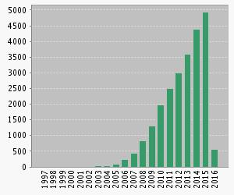
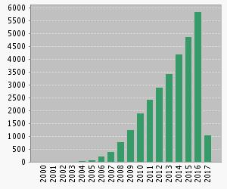
Citations by Year (with Multi-Ethnic Study of Atherosclerosis in “topic”—Web of Science search)
Citations in Each Year
Citations in Each Year
Last Year’s Report
This Year’s Report
Sum of times cited: 29514
Without self citation: 25150
Average citations per article: 19.2 (up from 17.5 last year)
h-index: 78 (up from 73 last year, 64 the year before)
Notes:
Interesting to compare this year with last year. 2015 looked like a banner year, with almost 5000 citations, but 2016 ended up exceeding it by almost 1000 citations. Note difference in Y-axis scale.

Slide 13
Advanced Metrics
2015
BS ratio = Abstracts (N=1047)/Publications (N=735) = 1.42
BS/H ratio = 1.42/64 = 0.022
2016
BS ratio = Abstracts (N=1195)/Publications (N=877) = 1.36
BS/H ratio = 1.36/73 = 0.019
2017
BS ratio = Abstracts (N=1320)/Publications (N=1034) = 1.28
BS/H ratio = 1.28/78 = 0.016

