Slide 1
Cardio-metabolic Abnormalities Among Normal Weight Individuals from Five Race/Ethnic Groups in the U.S.: Cross-sectional Analysis of Two Cohort Studies
Data from the MESA and MASALA Studies
Unjali Gujral, MPH, PhD
Postdoctoral Fellow
Emory University
Rollins School of Public Health
Hubert Department of Global Health

Slide 2
INTRODUCTION
Overweight and obesity are well known cardio-metabolic risk factors
There has been some exploration of the prevalence of cardio-metabolic risk and correlates in normal weight individuals
There have been no direct comparisons by race/ethnicity including East and South Asian populations

Slide 3
METHODS
Cross-sectional analysis of pooled data from the Multi-Ethnic Study of Atherosclerosis (MESA) and the Mediators of Atherosclerosis in South Asians Living in America (MASALA)

Slide 4
MESA
2,622 whites, 803 Chinese Americans, 1,893 African Americans, 1,496 Hispanic Americans
Aged 45-84 years
Recruitment from greater New York, Baltimore, Chicago, Los Angeles, Minneapolis-Saint Paul, and Winston-Salem areas.
Baseline data collection was conducted between July 2000 and July 2002.

Slide 5
MASALA
803 South Asian Americans
Aged 40-84 years
Analysis was done only on those aged 45-84 to remain consistent with MESA
Recruitment from greater San Francisco Bay and Chicago areas
Baseline data collection was conducted between October 2010 and March 2013
Approximately 90% foreign born
Median income, $88,000

Slide 6
MESA and MASALA
MASALA was designed to have similar measures and methods to MESA to allow for specific cross race/ethnic comparisons
Eligibility criteria was identical between the two studies
Identical protocols were used for seated blood pressure and anthropometry.

Slide 7
BMI Categories
WHO Standard cut-points for White, African-American and Hispanic participants
Normal weight: 18.5-24.9 kg/m²
Overweight: 25.0-29.9 kg/m²
Obesity: ≥ 30 kg/m²
WHO Asian cut-points for South Asian and Chinese American participants
Normal weight: 18.5-22.9 kg/m²
Overweight: 23.0-27.4 kg/m²
Obesity: ≥ 27.5 kg/m²

Slide 8
Classification of Cardio-metabolic abnormality (risk)
Based on National Cholesterol Education Program-Adult Treatment Panel III criteria
Considered “cardio-metabolically abnormal” if two or more of the following
Low HDL-Cholesterol | High Triglycerides | High Glucose | High Blood Pressure
< 40 mg/dL in men, < 50 mg/dL in women | Fasting triglyceride level ≥ 150 mg/dL | Fasting plasma glucose ≥ 100 mg/dL | Blood pressure ≥ 130/85
Any use of lipid lowering medication |  | Any use of glucose lowering medication | Any use of anti-hypertensive medication

Slide 9
Focused on discordant phenotype of cardio-
metabolically abnormal, normal weight (MAN)

Slide 10
STATISTICAL ANALYSIS
Pooled data from MESA and MASALA cohorts
Prevalence of metabolic abnormality calculated by BMI strata
Prevalence ratios of MAN by race/ethnicity compared to Whites were estimated using Poisson models
Models were adjusted for demographic, behavioral, and ectopic fat measures

Slide 11
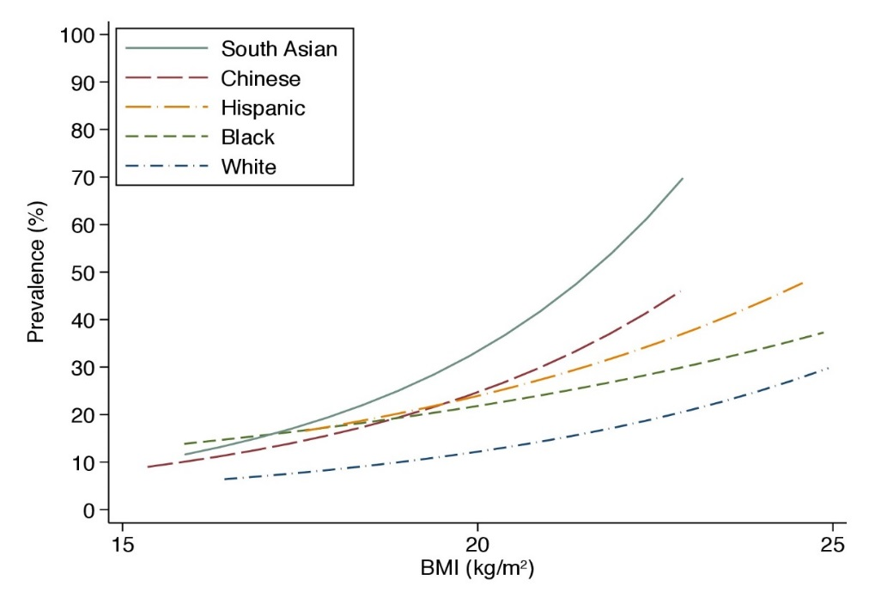
STATISTICAL ANALYSIS CONTINUED
Estimated values of BMI values for race/ethnic minority groups resulting in the same prevalence of MAN as in Whites with BMI of 25 kg/m²
Fit a proportional odds model for the number of cardio-metabolic abnormalities
Used group specific 4-knot cubic splines in BMI adjusting for sex and age

Slide 12
RESULTS
Prevalence of BMI category in total MESA/MASALA Sample
Gujral UP, Vittinghoff E, Mongraw-Chaffin M, Vaidya D, Kandula NR, Allison M, Carr J, Liu K, Narayan KM, and Kanaya AM, 2017. Cardiometabolic Abnormalities Among Normal-Weight Persons From Five Racial/Ethnic Groups in the United StatesA Cross-sectional Analysis of Two Cohort StudiesCardiometabolic Abnormalities Among Normal-Weight Persons. Annals of Internal Medicine.

Slide 13
Prevalence of BMI Category by Race/Ethnicity
Gujral UP, Vittinghoff E, Mongraw-Chaffin M, Vaidya D, Kandula NR, Allison M, Carr J, Liu K, Narayan KM, and Kanaya AM, 2017. Cardiometabolic Abnormalities Among Normal-Weight Persons From Five Racial/Ethnic Groups in the United StatesA Cross-sectional Analysis of Two Cohort StudiesCardiometabolic Abnormalities Among Normal-Weight Persons. Annals of Internal Medicine.

Slide 14
Prevalence of Metabolic Abnormality in Normal Weight by Race/Ethnicity*
Gujral UP, Vittinghoff E, Mongraw-Chaffin M, Vaidya D, Kandula NR, Allison M, Carr J, Liu K, Narayan KM, and Kanaya AM, 2017. Cardiometabolic Abnormalities Among Normal-Weight Persons From Five Racial/Ethnic Groups in the United StatesA Cross-sectional Analysis of Two Cohort StudiesCardiometabolic Abnormalities Among Normal-Weight Persons. Annals of Internal Medicine.

Slide 15
Characteristics of normal weight/metabolically abnormal (MAN) participants by race/ethnicity†
Characteristics | South Asian N=85 | White N=178 | Chinese American N=104 | African American N=104 | Hispanic N=97
Men (%) | 72.9 | 39.3* | 47.1* | 53.4* | 50.5*
Age (years) | 59.6 (8.9) | 68.0 (9.6)* | 66.8 (9.0)* | 67.0 (9.6)* | 64.6 (10.9)*
Diabetes (%) | 38.8 | 7.9* | 24.0 | 28.9 | 26.8*
Hepatic fat attenuation (HU) | 55.9 (9.5) | 64.0 (10.2)* | 64.3 (10.7)* | 63.4 (9.5)* | 63.7 (12.1)*
Never Smoker % | 81.2 | 46.6* | 73.1 | 39.4* | 66.0*
Data are given as %, mean (standard deviation) *P value vs. South Asian ≤ 0.05.
Gujral UP, Vittinghoff E, Mongraw-Chaffin M, Vaidya D, Kandula NR, Allison M, Carr J, Liu K, Narayan KM, and Kanaya AM, 2017. Cardiometabolic Abnormalities Among Normal-Weight Persons From Five Racial/Ethnic Groups in the United StatesA Cross-sectional Analysis of Two Cohort StudiesCardiometabolic Abnormalities Among Normal-Weight Persons. Annals of Internal Medicine.

Slide 16
Prevalence Ratios of the Metabolically Abnormal Phenotype Among Normal Weight Individuals
 | Prevalence Ratio (95% CI)
 | Unadjusted | Multivariate Adjusted*
Race/Ethnicity
White | 1.00 (Reference) | 1.00 (Reference)
South Asian | 2.07 (1.69, 2.55) | 2.53 (1.99, 3.22)
Chinese | 1.53 (1.25, 1.88) | 1.27 (1.02, 1.59)
African American | 1.48 (1.20, 1.82) | 1.66 (1.35, 2.04)
Hispanic | 1.83 (1.49, 2.24) | 1.56 (1.26, 1.92)
*Model is adjusted for age, sex education, alcohol use, smoking status, physical activity, daily caloric intake, hepatic fat attenuation, and pericardial fat volume.
Gujral UP, Vittinghoff E, Mongraw-Chaffin M, Vaidya D, Kandula NR, Allison M, Carr J, Liu K, Narayan KM, and Kanaya AM, 2017. Cardiometabolic Abnormalities Among Normal-Weight Persons From Five Racial/Ethnic Groups in the United StatesA Cross-sectional Analysis of Two Cohort StudiesCardiometabolic Abnormalities Among Normal-Weight Persons. Annals of Internal Medicine.

Slide 17
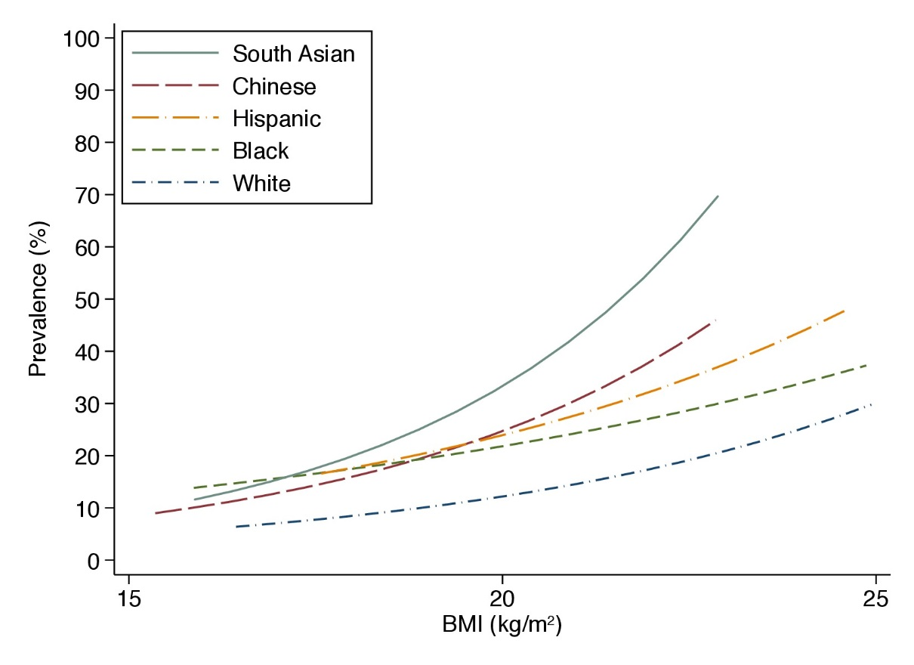
Race/ethnic-specific BMI values associated with prevalence of MAN
compared to Whites at BMI 25 kg/m²
100
South Asian
90
Chinese
Hispanic
80
African American
70
White
Prevalence (%)
60
50
40
30
20
10
0
15
19.6
20.9
21.5
22.9
25
BMI (kg/m²)

Slide 18
DISCUSSION
Cross-sectional study that included participants from multiple race/ethnic groups in the United States
Nearly one-third of individuals overall had the MAN phenotype
Approximately 40% of South Asian and Hispanic participants had MAN.
Adjustment for demographic, behavior and ectopic fat measures did not explain these differences

Slide 19
LIMITATIONS
Differences in timing of data collection between studies (10 years)
Differential use of food frequency questionnaires between studies
Generalizability of results to younger individuals or South Asians and East Asians born in the United States

Slide 20
CONCLUSIONS
High prevalence of cardio-metabolic abnormality in normal weight individuals
Individuals from race/ethnic minority populations have highest prevalence of MAN
Differences not explained by differences in demographic, behavioral or ectopic fat measures
Using body mass index as the main criteria for screening (per USPSTF) may miss a large proportion of at-risk individuals and could increase gaps in the detection and diagnosis of cardiometabolic risk among race/ethnic minority populations
Future research is needed to determine prospective associations between MAN and incident CVD

Slide 21
ACKNOWLEDGEMENTS
Dr. Alka Kanaya
Dr. Venkat Narayan
Dr. Eric Vittinghoff
Dr. Morganna Mongraw-Chaffin
Dr. Dhananjay Vaidya
Dr. Namratha Kandula
Dr. Matthew Allison
Dr. Jeffrey Carr
Dr. Kiang Liu
MESA and MASALA Study teams
Participants from MESA and MASALA Studies

Slide 22
THANK YOU! Future Directions? Questions?

Slide 23
Supplemental Table 2. Prevalence of Risk Factor Combinations Among Individuals with Two or More Cardio-Metabolic Risk Factors by Race/Ethnicity
Cardio-metabolic Risk Factor Combinations | Elevated Triglycerides/High Blood Pressure N (%) | Elevated Triglycerides/Elevated Glucose N (%) | Elevated Triglycerides/Low HDL N (%) | High Blood Pressure/Elevated Glucose N (%) | High Blood Pressure/Low HDL N (%) | Elevated Glucose/Low HDL N (%)
White | 104 (9.25) | 11 (0.98) | 172 (15.3) | 106 (9.43) | 449 (39.95) | 282 (25.09)
Chinese | 23 (5.68) | 13 (3.21) | 51 (12.59) | 58 (11.85) | 119 (29.38) | 151 (37.28)
African American | 38 (4.00) | 7 (0.74) | 24 (2.53) | 211 (22.23) | 324 (34.14) | 345 (36.35)
Hispanic | 57 (6.58) | 19 (2.19) | 137 (15.82) | 112 (12.93) | 213 (24.60) | 328 (37.88)
South Asian | 17 (3.79) | 9 (2.01) | 42 (9.38) | 65 (14.51) | 97 (21.65) | 218 (48.66)

