Slide 1

Long-term Exposure to Ozone and Progression of Subclinical Pulmonary and Arterial Disease
The Multi-Ethnic Study of Atherosclerosis (MESA)
Air Pollution and Lung Studies

Slide 2
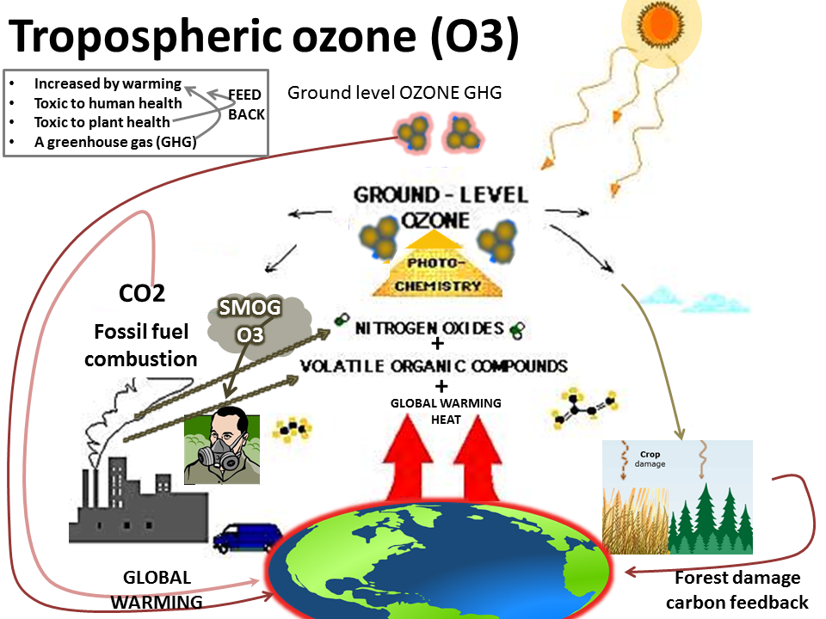

Slide 3
Ozone-induced health effects
Associations between short-term exposure to O₃ and respiratory disease is generally clear.
Health effect of long-term O₃ exposure has not been well-understood.
Little is known about pathophysiological mechanism of O₃-induced respiratory and cardiovascular mortality in observational studies
(Jerrett, 2009, NEJM)

Slide 4
Aims of the study
Whether long-term exposure to O₃ accelerates progression of
subclinical pulmonary outcomes in general population characterized by:
(1) Percent emphysema
(2) Lung function (LF)
And subclinical arterial outcomes in general population characterized by:
Intima-media thickness (IMT)
Carotid plaque (CP)
Coronary artery calcium (CAC)?

Slide 5
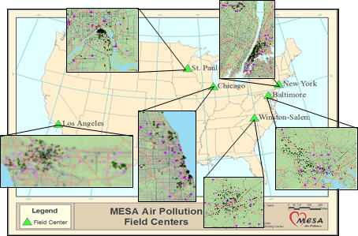


MESA Air Study
Population-based cohort study investigating associations between air pollution and progression of cardiovascular disease
>6,000 participants from six study areas
Longitudinal study with ten-year’s follow-up history and multiple repeat measurements
(2012, AJE)

Slide 6
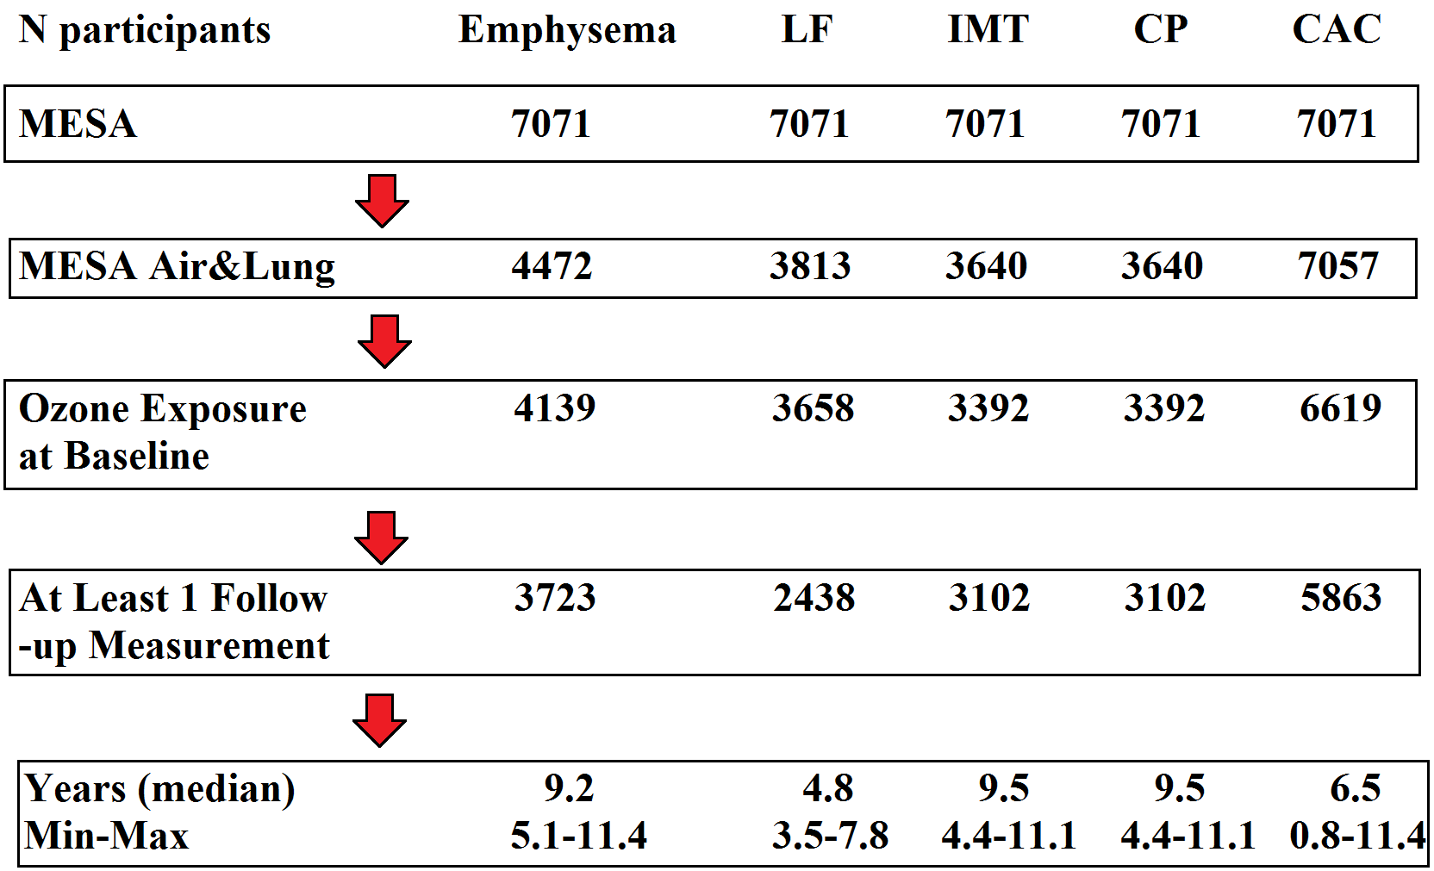
Study design
(MESA Air Pollution and Lung studies)

Slide 7
CT scanned percent emphysema
Percent emphysema was defined as the number of voxels below -950 Hounsfield units (HU) divided by the total number of lung voxels.
Validation:
Reproducibility within person: R=0.92-0.95
Comparability between scanners: R=0.94
Partial vs full lung scan: R=0.93
Sensitivity analysis:
Novel approach to the measurement of percent emphysma: hidden modified Markov field (HMMF)
Alternative approach: lowest 15th percentile point of the entire frequency distribution of lung density within subjects (PD15)
(Hoffman et al. 2009, Acad. Radiol.)
Note: Lung function baseline at exam 4 and repeated at exam 5

Slide 8
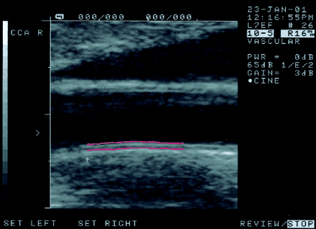
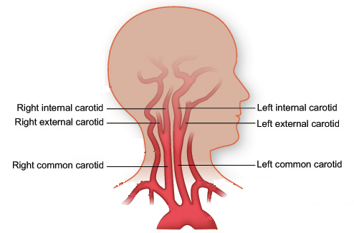
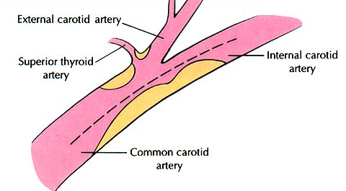
IMT and CP
Common carotid artery (right and left) IMT
CP
CP burden was defined by the CP scored as the number of carotid plaques (0-12) in the internal, bifurcation, and common segments of both carotid arteries.
Measured by B-mode ultrasound images

Slide 9
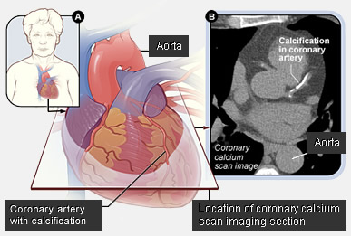
CAC
Agatston score

Slide 10
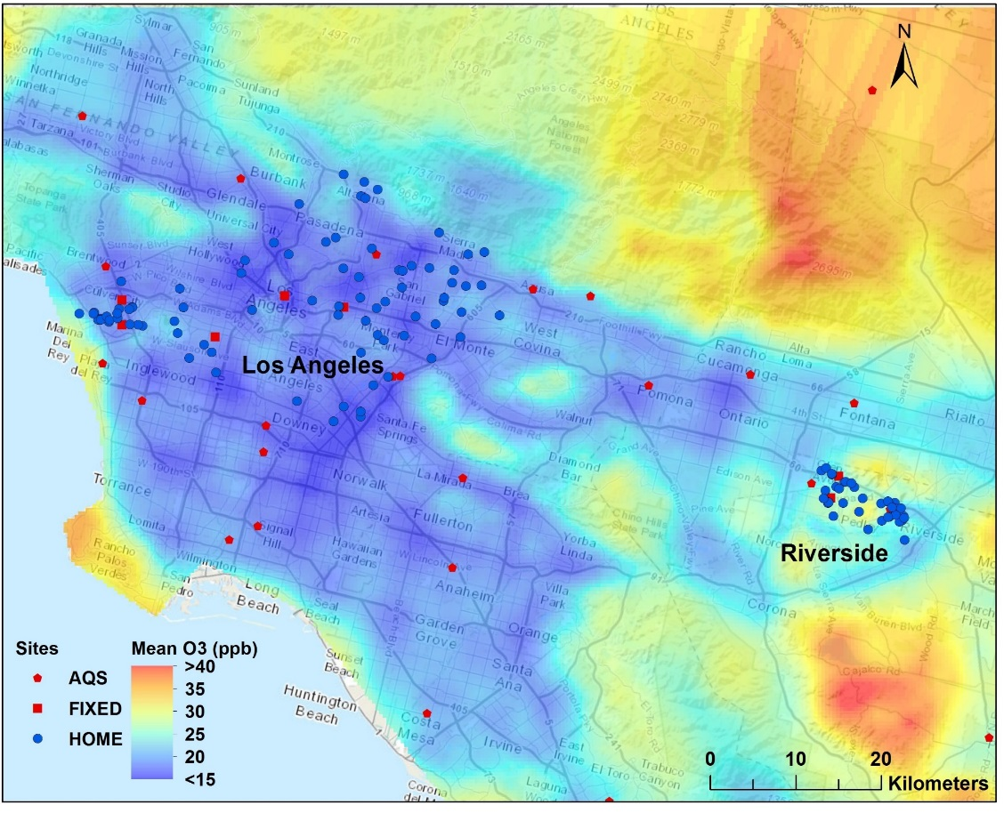
O₃ exposure model
Spatio-Temporal modeling approach was used to estimate O₃ exposure at the MESA participants’ addresses including cross-sectional exposure at baseline in 2000 and long-term average follow-up concentrations between each follow-up exam and baseline.

Slide 11
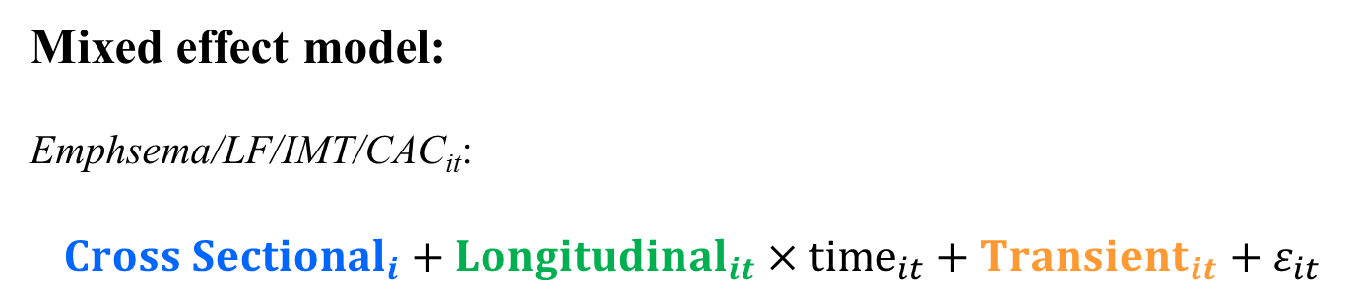
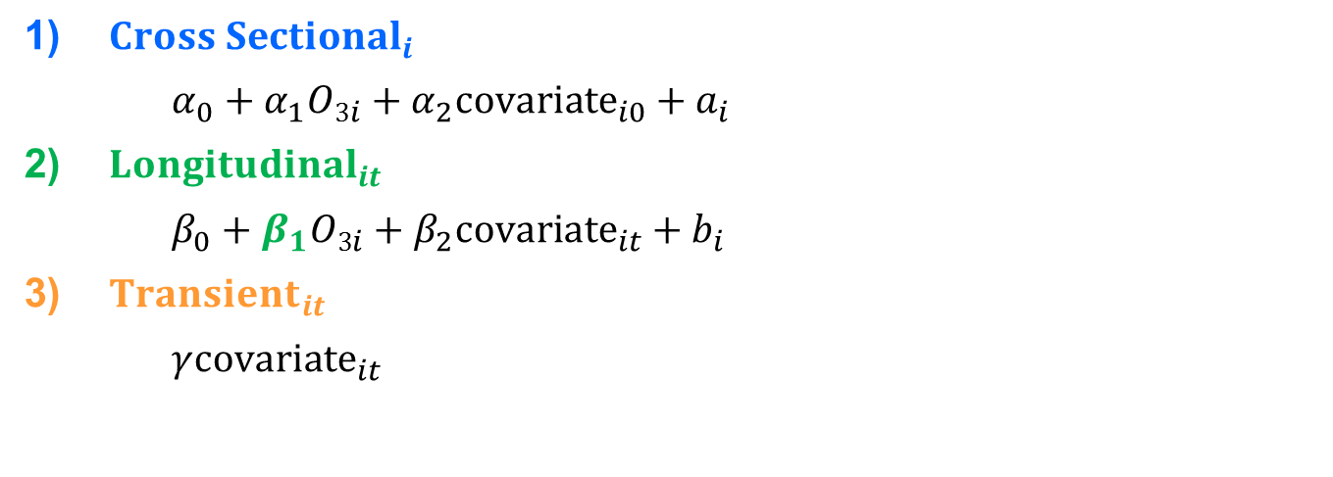
Health analysis model
Mixed effect model:
Emphsema/LF/IMT/CAC_{it}:
${Cross Sectional}_{i}+{Longitudinal}_{it}×{time}_{it}+{Transient}_{it}+ε_{it}$
${Cross Sectional}_{i}$
$α_{0}+α_{1}{O3}_{i}+α_{2}{covariate}_{i0}+a_{i}$
${Longitudinal}_{it}$
$β_{0}+β_{1}{O3}_{i}+β_{2}{covariate}_{it}+b_{i}$
${Transient}_{it}$
$γ{covariate}_{it}$
Parameters of interest: β₁
Logistic regression model:
CP formation: any increase in CP score from baseline

Slide 12
Covariates in staged models
Model 1 (base model): age, gender, race, height, weight, CT parameters (emphysema and CAC), study regions, and baseline O₃;
Model 2 (primary model): model 1 + risk factors such as, smoking status, second hand smoking, pack-year, cigarettes per day, physical activity, BMI, income, employ status, SES index, education, occupational exposure to gases and fumes (LF only);
Model 3 (extended model): model 2 +
IMT/CP/CAC: CVD risk factors, such as hypertension, adiposity, HDL, total cholesterol, triglycerides, statin use, fibrinogen antigen, CRP, high attenuation area.
Emphysema: occupational exposure to gases and fumes
LF: respiratory symptoms such as cold, flu, or sore throat in past two weeks; bronchitis in past two weeks; asthma before the age of 45; pneumonia in past two weeks.

Slide 13
Sensitivity analyses
1-year average O₃ exposure prior to CT exam;
Long-term O₃ exposure in warm season (April to September);
Two-pollutants adjusting for NOx and PM_{2.5}.

Slide 14
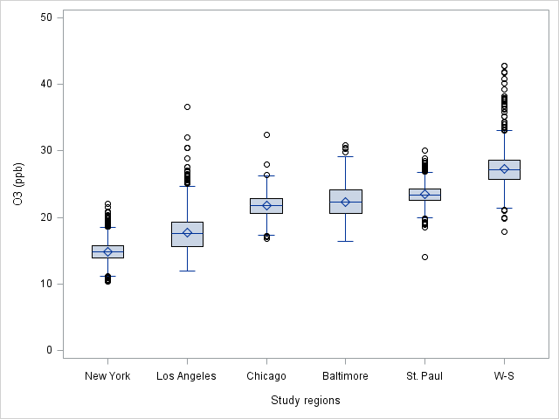
Results
Baseline exposure: Annual average O₃ concentration in 2000;

Slide 15
Associations between O₃ and progression of emphysema(%) and decline in lung function
 | Change of emphysema(%) (% x 10yrs, 95% CI per 3ppb) | Change of FEV₁ (ml x 5yrs, 95% CI per 3ppb) | Change of FVC (ml x 5yrs, 95% CI per 3ppb)
Main Analyses
Base | 0.19 (0.02, 0.36) | -12 (-24, 1) | -28 (-28, -11)
Primary | 0.24 (0.06, 0.43) | -14 (-27, -1) | -32 (-49, -14)
Extended | 0.24(0.06, 0.42) | -14 (-27, -1) | -30 (-30, -9)
Sensitivity Analyses
O₃ warm seasons | 0.23 (0.07, 0.40) | -9 (-21, 4) | -21 (-21, -3)
O₃ 1-year mean | 0.13 (0.01, 0.25) | -3 (-16, 9) | 0 (-16, 17)
Adjust for PM_{2.5} | 0.24 (0.04, 0.45) | -12 (-27, 4) | -24 (-45, -3)
Adjust for NO_{x} | 0.31 (0.10, 0.52) | -13 (-30, 3) | -22 (-44, 0)

Slide 16
Effect modifications for emphysema and LF
Effect modification | Emphysema (%)ª | P-value^{b} | FEV₁ (ml)^{c} | P-value^{b} | FVC (ml)^{c} | P-value^{b}
Gender |  | 0.01 |  | 0.45 |  | 0.43
Male | 0.41 (0.22, 0.61) |  | -12 (-26, 3) |  | -28 (-48, -9)
Female | 0.09 (-0.11, 0.28) |  | -17 (-31, -2) |  | -35 (-55, -15)
Age |  | 0.87 |  | 0.23 |  | 0.48
<65 | 0.25 (0.06, 0.44) |  | -11 (-25, 3) |  | -29 (-48, -9)
≥65 | 0.24 (0.02, 0.45) |  | -19 (-34, -4) |  | -35 (-55, -15)
Race |  | 0.03 |  | 0.92 |  | 0.70
White | 0.37 (0.15, 0.59) |  | -14 (-31, 3) |  | -27 (-31, 5)
Non-white | 0.15 (-0.05, 0.35) |  | -13 (-27, 1) |  | -31 (-51, -12)
Smoking status |  | 0.21 |  | 0.01 |  | 0.01
Never | 0.18 (-0.01, 0.38) |  | -9 (-24, 5) |  | -25 (-45, -5)
Former | 0.26 (0.06, 0.45) |  | -16 (-31, -2) |  | -33 (-53, -14)
Current | 0.40 (0.12, 0.68) |  | -54 (-83, -26) |  | -85 (-107, -34)
BMI |  | 0.05 |  | 0.55 |  | 0.78
< 30 | 0.30 (0.11, 0.49) |  | -11 (-25, 3) |  | -31 (-49, -12)
≥ 30 | 0.14 (-0.08, 0.35) |  | -15 (-31, 0) |  | -28 (-49, -7)
Presence of symptoms^{d} |  | 0.02 |  | 0.04 |  | 0.07
No | 0.21 (0.02, 0.40) |  | -13 (-27, 1) |  | -25 (-43, -6)
Yes | 0.60 (0.24, 0.95) |  | -29 (-47, -11) |  | -44 (-67, -20)
SES index^{e} |  | 0.01 |  | 0.09 |  | <0.01
> 0 | 0.37 (0.23, 0.51) |  | -18 (-34, -1) |  | -42 (-64, -20)
≤ 0 | 0.15 (0.00, 0.30) |  | -6 (-28, 15) |  | -7 (-36, 22)

Slide 17
Associations between O₃ and IMT, CAC progression and CP formation
 | Change of IMT ten years (µm x 10yrs, 95% CI per 3 ppb) | Odds Ratio (95% CI) CP formation per 3 ppb | Change of CAC ten years (Agatston units x 10yrs, 95% CI per 3ppb)
Main Analyses
Base | 5.6 (1.6, 9.6) | 1.3 (1.2, 1.4) | -9.8 (-18.5, -1.1)
Primary | 5.6 (1.4, 9.7) | 1.2 (1.1, 1.4) | -8.4 (-17, 0.1)
Extended | 5.7 (1.5, 9.9) | 1.3 (1.1, 1.4) | -6.6 (-15.2, 2.1)
Sensitivity Analyses
O₃ warm seasons | 6.5 (2.6, 10.3) | 1.0 (0.9, 1.1) | -6.8 (-15.6, 2.1)
O₃ 1-year mean | 3.5 (0.1, 7.1) | 1.0 (0.9, 1.2) | -7.3 (-15.8, 1.2)
Adjust for NO_{x} | 15.2 (7.2, 23.2) | 1.3 (1.1, 1.4) | -11.3 (-20.6, -2)
Adjust for PM_{2.5} | 7.8 (3.1, 12.6) | 1.3 (1.1, 1.5) | -8.3 (-17.2, 0.6)
Notes:
This table summarizes the main findings of our study. In the longitudinal analysis, an inter-quartile range (IQR) increment of 3 ppb in long-term average O₃ exposure was associated with a 5.6 μm faster increase in IMT over ten years. Increased long-term O₃ exposure was also associated with CP formation. The odds ratio is 1.2 in the full model. The associations were stable with little change for the different staged models. Addition of PM_{2.5} or NO_{x} as covariates did not weaken the associations with exposure to O₃. Furthermore, it is interesting to see that the associations with progression of IMT_{CCA}, and CP formation were stronger for long-term concentration averages than with a single-year average exposure, which suggested the importance of exposure window in our study. However, we did not observe association between O₃ exposure and changes of CAC in any analyses.

Slide 18
Effect modifications for IMT and CP
 |  | Change of IMT (µm) over ten years |  | Odds Ratio of CP formation
 | N | 95% CI | P-value | 95% CI | P-value
Sex |  |  | 0.99 |  | 0.69
Female | 1800 | 5.6 (0.3, 11.0) |  | 1.3 (1.1, 1.5)
Male | 1592 | 5.6 (-0.3, 11.5) |  | 1.2 (1.0, 1.4)
Race |  |  | 0.99 |  | 0.09
White | 1334 | 5.9 (0.8, 11.0) |  | 1.4 (1.2, 1.6)
Non-white | 2058 | 5.9 (-0.7, 12.4) |  | 1.1 (0.9, 1.3)
Age at Baseline |  |  | 0.25 |  | 0.58
< 60 Years | 1658 | 3.5 (-2.1, 9.0) |  | 1.3 (1.1, 1.5)
≥ 60 Years | 1734 | 7.8 (2.2, 13.4) |  | 1.4 (1.2, 1.6)
Smoking |  |  | 0.36 |  | 0.09
Never | 1658 | 3.9 (-1.7, 9.5) |  | 1.4 (1.2, 1.6)
Former and current | 1729 | 7.4 (1.6, 13.1) |  | 1.1 (1.0, 1.3)
Diabetes |  |  | 0.07 |  | 0.11
Not Diabetic | 2619 | 7.5 (2.9, 12.0) |  | 1.2 (1.1, 1.3)
Impaired Fasting Glucose | 443 | 1.2 (-9.9, 12.3) |  | 1.3 (1.0, 1.7)
Diabetes | 330 | -6.3 (-18.6, 6.0) |  | 1.6 (1.2, 2.3)
Hypertension |  |  | 0.91 |  | 0.30
No | 1996 | 5.4 (0.1, 10.7) |  | 1.1 (1.0, 1.3)
Yes | 1396 | 5.9 (0.0, 11.7) |  | 1.4 (1.2, 1.6)
Obesity |  |  | 0.25 |  | 0.69
BMI ≤ 30 kg/m2 | 2317 | 7.1 (2.1, 12.0) |  | 1.4 (1.2, 1.5)
BMI > 30 kg/m2 | 1075 | 2.6 (-4.2, 9.3) |  | 1.1 (0.9, 1.3)
Statin use |  |  | 0.87 |  | 0.19
No | 2880 | 5.9 (0.3, 11.4) |  | 1.2 (1.1, 1.4)
Yes | 511 | 5.3 (0.0, 10.6) |  | 1.3 (1.1, 1.5)
Presence of carotid plaque |  |  | 0.04 |  | 0.79
No | 1792 | 7.9 (2.0, 13.7) |  | 1.2 (1.1, 1.4)
Yes | 1600 | 0.5 (-5.4, 6.2) |  | 1.3 (1.1, 1.5)
Notes:
This table shows the results of the associations with IMT and CP stratified by several risk factors. There is no indications of effect modifications for most of the variables. However, we found suggestive differences from effect modification in effect estimates, with larger value in those without CP at baseline. One potential explanation is less exposure misclassification among healthy subjects who would be expected to spend more time outdoors, therefore have closer relationship with O3 exposure. Moreover, IMT may become an imprecise indicator in later stages of arterial injury due to the effect of risk-reducing medications on the endpoints^{16, 18}. Therefore, the association between O₃ exposure and progression of IMT may be stronger in the early stages of arterial injury.

Slide 19
Comparing with the previous study
Different underlying pathophysiologic processes reflected by IMT and CAC
1. IMT reflects early arterial injury from many processes, whereas CAC indicates
a more advanced stage of atherosclerosis with vessel wall calcification;
2. CAC is a more robust predictor of coronary artery disease events whereas IMT
and CP are similar or better predictors of stroke in the general population;
3. CAC and IMT may be associated with different risk factors and do not appear
to share common genes.
The biological mechanisms through which different air pollutants act on the
vasculature may differ.
1. Toxicological study: cardiac functional changes in response to O₃ are different
from exposure to PM;
2. Human study: effect estimate of personal exposure to O₃ on cardio-ankle
vascular index was twice as large as that of PM_{1-2.5} exposure in a panel study;
3. Population-based study, greater exposure to O₃ rather than PM was associated
with increased risk of IMT in young adulthood.
CAC progression
Strong associations between
PM_{2.5} (NOx) and CAC, but
Not with IMT
(2016 Lancet)
Notes:
Compared to the elevated risk of O₃-induced IMT_{CCA} observed in our study, a parallel analysis in the MESA study that used the same dataset did not find progression of IMT_{CCA} associated with PM_{2.5} or NO_{x}, but did for CAC²⁵, which was not associated with O₃ in our study. That difference could have been attributed to the different underlying pathophysiologic processes reflected by IMT_{CCA} and CAC measures. First, IMT reflects early arterial injury from many processes, whereas CAC indicates a more advanced stage of atherosclerosis with vessel wall calcification; Secondly, CAC is a more robust predictor of coronary artery disease events whereas IMT_{CCA} and CP are similar or better predictors of stroke in the general population; Thirdly, CAC and IMT may be associated with different risk factors and do not appear to share common genes³⁷. For example, hypertension causes a significant increase in IMT^{38, 39} and is considered a major cardiovascular disease risk factor, whereas hypertension does not appear to contribute strongly to the occurrence of plaque. Another important explanation would be the biological mechanisms through which different air pollutants act on the vasculature may differ. For example, toxicological studies have suggested that cardiac functional changes in response to O₃ are different from exposure to PM⁴². In human studies, the effect estimate of personal exposure to O₃ on cardio-ankle vascular index was twice as large as that of fine particles in a small panel study. In a cross-sectional study, greater exposure to O₃ rather than PM was associated with increased risk of IMT in young adulthood¹⁹.

Slide 20
Conclusion
Long-term outdoor concentrations of O₃ were associated with both an increase in progression of percent emphysema and a faster decline in lung function in a multiethnic population, with evidence of increased risk in people who had pre-existing respiratory disease;
Outdoor residential O₃ concentrations were also associated with increased carotid wall thickness and risk of plaque formation, suggesting arterial injury and a distinct pathological response to O₃ than observed with PM_{2.5} concentrations in this cohort.
In summary, long-term exposure to ambient O₃ may be an important risk factor for decline in pulmonary and arterial health with aging.

Slide 21
Acknowledgments
University of Washington
Meng Wang, Sverre Vedal, Paul Sampson, Lianne Sheppard
Columbia University
Graham Barr, Carrie Aaron, Jaime Madrigano, Elsa Angelini, Jie Yang, Andrew Laine
University of Wisconsin
James H Stein
University of Michigan
Sara Adar
University of Iowa
Eric Hoffman

Slide 22
Thank you for your attention!

