Slide 1


MESA Air Updates
Joel D. Kaufman

Slide 2
Research Progress
Main MESA Air Grant 2004-2014
All primary products completed
Events analysis underpowered in initial work
>100 papers

Slide 3
EPA: MESA Air Next Stage
The Multi-Ethnic Study of Atherosclerosis and Air Pollution (MESA Air): Next Stage
Update exposure models, conduct well-powered events analysis, improved data-sharing products
Submission dates
  Feb 2015 (non-competing), July 2016 (responding to RFA)
Role of MESA Field Centers
  Events follow-up for MESA Air participants (including MESA Family participants previously consented to MESA Air)
Current status
  Received top score in review and received agency recommendation for award, contingent on agency receiving budget.

Slide 4
R01: Cohorts Consortium
Full title
  Air Pollutants and Cardiovascular Risk: Investigating Thresholds with Pooled Cohorts and Electronic Health Records
  A1 submission reviewed February (Impact Score: 20; Percentile: 7.0); anticipate funding by the fall
Role of MESA Field Centers
  None (but using MESA/MESA Air data)
MESA is one of several cohorts totaling 1 million members; also studying HMO EHRs

Slide 5
NIH: Heart and Brain Aging (HF/AF)
Original title: Air Pollution, Heart Failure and Atrial Fibrillation in MESA
Revised title: Impact of Air Pollution Exposure on Heart and Brain Aging in MESA
Submitted April 2015, Nov 2015, Nov 2016
Role of MESA Field Centers
  air monitoring at participant homes (40/city) (in addition to long-term sites)
  Retrieval of pacemaker/ICD data
  Administration of shortened MESA Air Questionnaire
Current status
  Scored well but not in fundable range
  Currently have one year of related but limited R56 funding
  Resubmit? Want to discuss how best to work with MESA if funding is after Exam 6

Slide 6
NIH: R56
Role of MESA Field Centers
  JHU only: help with air monitoring at participant homes in Baltimore
Current status
  Funded for one year (partial funding of first year of R01)
  Air monitors set up at long-term sites in all six MESA cities
  Home monitoring planned for Baltimore in summer 2017 and winter 2017/18

Slide 7
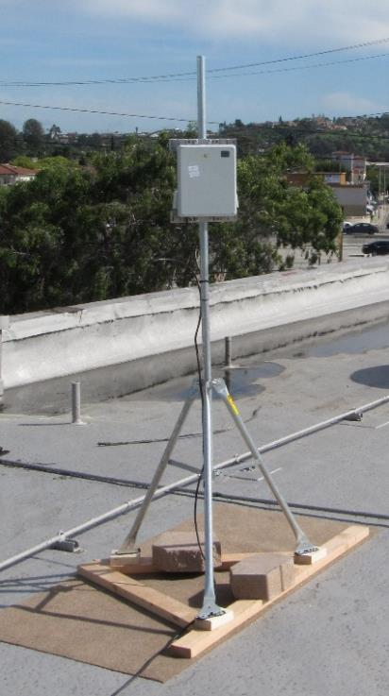
New Air Monitoring Equipment

Slide 8
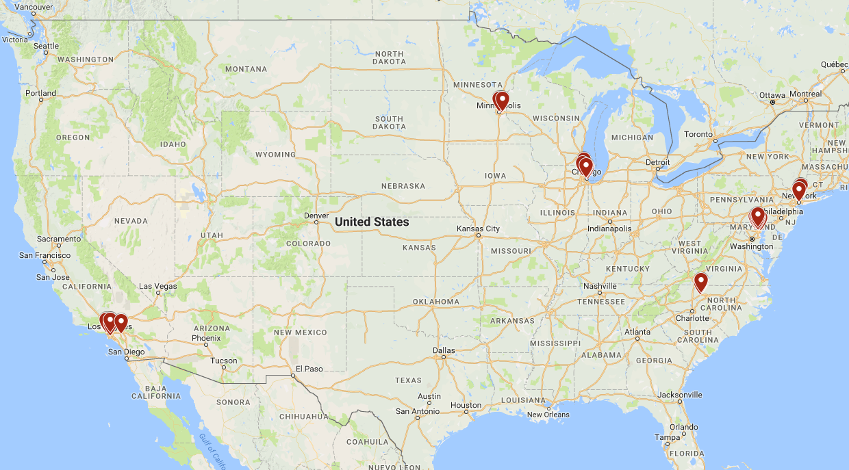
Long-Term Monitor Locations
Notes:
Link to map: https://drive.google.com/open?id=1l5HM5L27tAH6tEb29U4iZ6AvvmY&usp=sharing

Slide 9
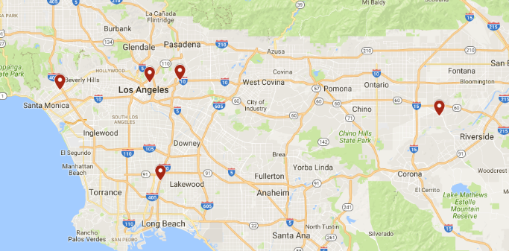
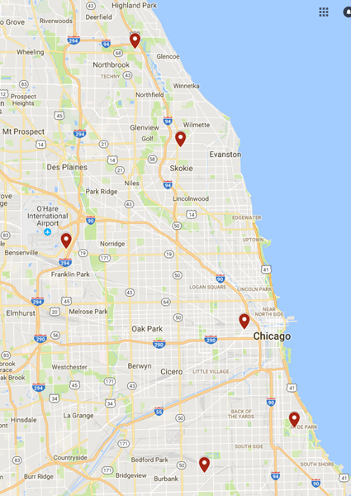
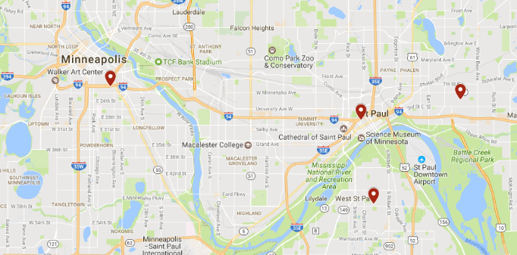
Long-Term Monitor Locations:
LA, St. Paul, Chicago

Slide 10
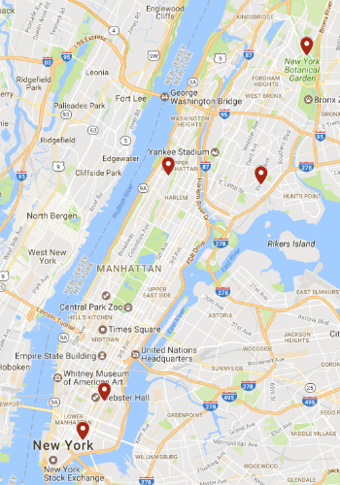
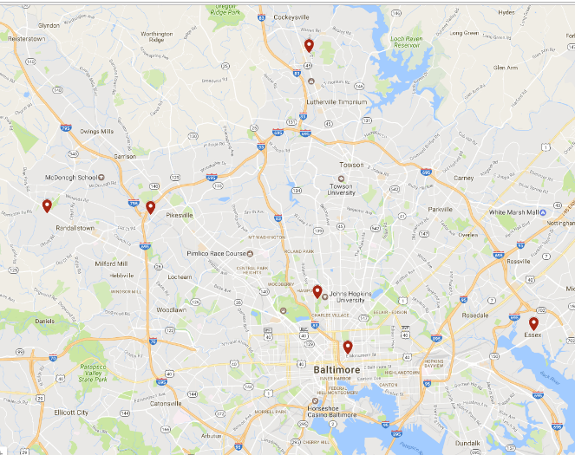
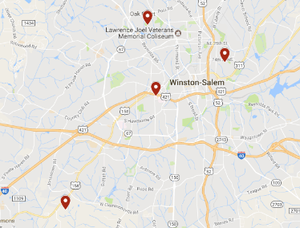
Long-Term Monitor Locations:
NYC, Winston-Salem, Baltimore

Slide 11
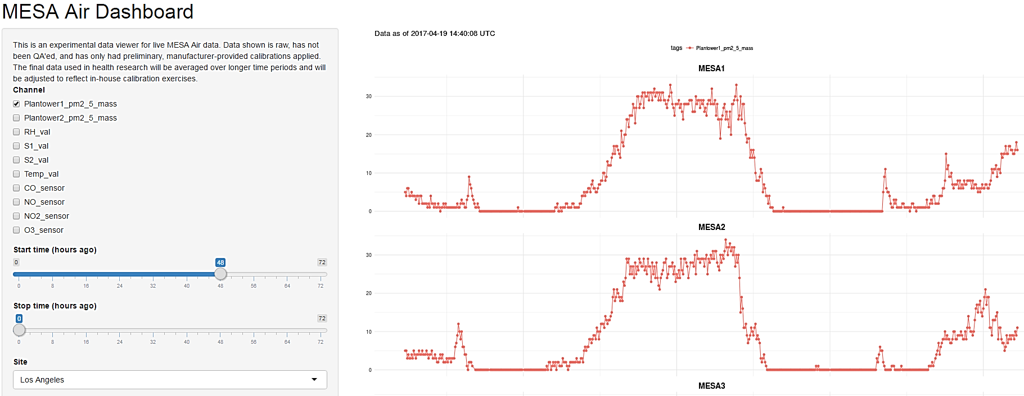
Real-time data transfer (5-minute PM_{2.5} data over 48 hours at 2 monitors in LA)
Notes:
https://shiny.deohs.washington.edu/app/uw-radical

Slide 12
Discussion
What Next?

