Slide 1
Epigenetics of Atherosclerosis
Yongmgei Liu, MD, PhD, FAHA
Wake Forest School of Medicine
Claudia E. Korcarz, DVM
Atherosclerosis Imaging Research Program
University Wisconsin

Slide 2
MESA Epigenomics Study in Exam 5
MESA epigenomics study funded by NIH Roadmap Epigenomic Program and NHLBI
~2500 participants
WFU, JHU, Columbia, UMN
Identify genomic features (DNA methylation and resultant mRNA expression) in monocytes (involved in atherogenesis) as novel risk factors or biomarkers of atherosclerosis
Limitation of the cross-sectional study design
Warrants a prospective follow-up study

Slide 3
A longitudinal Epigenetics Study of Atherosclerosis MESA Exam 6 (R01 HL135009-01 )
Aim 1. To test predictive effects of candidate genomic features on initiation/progression of atherosclerosis
New carotid plaque
Change in carotid plaque scores between the two exams
Aim 2. To characterize the associations of the “promising” genomic features with plaque vulnerability
Carotid plaque echolucency and other characteristics
Aim 3. To identify temporal and causal relationships between CVD risk factors (genetic or traditional), the “promising” genomic features, and plaque burden

Slide 4
Sample/Data Collection
Repeat epigenomic and transcriptomic profiling of monocytes in Exam 6
~2500 participants
WFU, JHU, Columbia, UMN
CBC/diff, PBMC/monocyte/T cell purification
DNA methylomic profiling using sequencing technology
Transcriptomics: mRNA-seq and total RNA-seq
Repeat measures of known CVD risk factors
Fasting glucose, HbA1C, insulin, creatine etc.

Slide 5
Sample/Data Collection
Repeat carotid ultrasonography in Exam 6
All returning participants who had ultrasonography at Exam 5 (N=~1,500)
WFU, JHU, Columbia, UMN
B-mode ultrasound images
Read ultrasound images at UW AIRP
Director: James Stein, MD
Manager: Claudia E. Korcarz, DVM

Slide 6
Exam 6 Ultrasound Equipment and Protocol
4 new Mindray M9s- GE Logiq 700 not serviceable
Abilities to detect plaque and derive plaque scores (binary, ordinal measures) do not differ qualitatively or quantitatively from E5
Nearly identical transducer frequency
Carotid plaque = discrete lesion ≥1.5 mm or focal thickening ≥50%
Wall thicknesses are >0.7 mm, plaques tend to be at least 1 mm thick which is much greater than the resolution of previous and current ultrasound systems
Verified on small parts phantom & DICOM image file data

Slide 7
Study Updates
US systems shipped and installed (2-3/2017)
All FC completed trainings
Web-based lectures
2 days on-site hands-on training
8 sonographers certified
Major hurdle dealing with FC-specific security issues regarding image transfer and speed of transfer – all troubles resolved
As of April 6, 2017 we have received N=114 studies

Slide 8
Carotid Scans Performed by 4/6/2017
Field Center | Potential Participants with Exam 5 data | # Scans | Mean (SD) quality score | Failed exams n,(%)
COL | 549 | 5 | 96.0 (5.5) | 0 (0%)
JH | 368 | 48 | 98.3 (4.8) | 0 (0%)
UMN | 500 | 22 | 84.1 (17.3) | 3 (13%)**
WFU | 475 | 39 | 88.2 (9.7) | 2 (5.1%)
TOTAL | 1,892 | 114 | 92.0 (11.5) | 5 (4.4%)
**Providing additional on-site training and help with scanning participants for one sonographer

Slide 9
Plaque Detection and Plaque Score
Reproducibility for carotid plaque detection and plaque score in E5 was excellent
Intra-reader (κ=0.83, 95% CI 0.70–0.96)
Inter-reader (κ=0.89, 95% CI 0.72–1.00)
The 2 readers assigned for E6 were readers for E5
E5 images reviewed in cases of discrepant findings
QC for inter- and intra-scorer reproducibility will be tested in an ongoing basis until the end of Exam 6

Slide 10
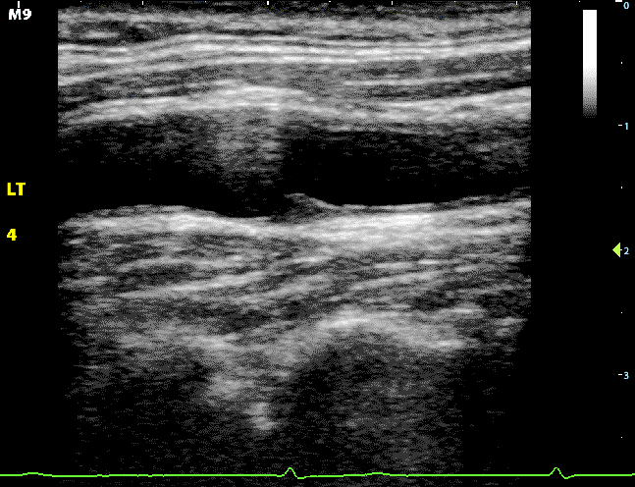
Exam 5 vs. Exam 6
Left Bulb far wall plaque

Slide 11
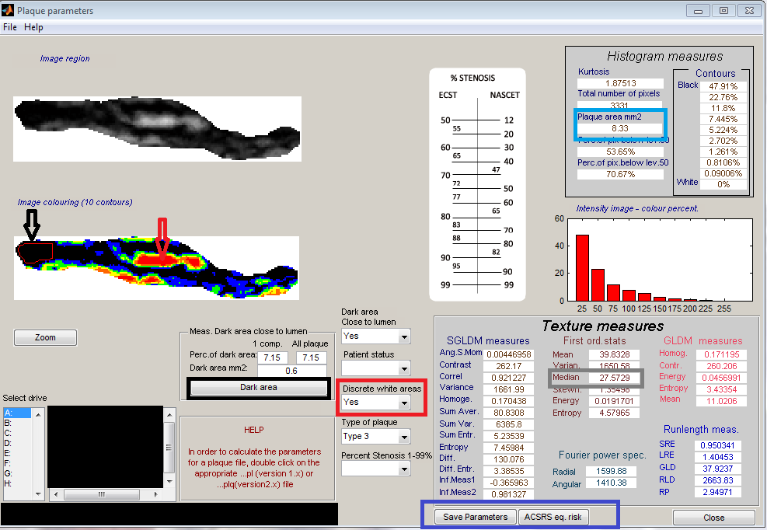
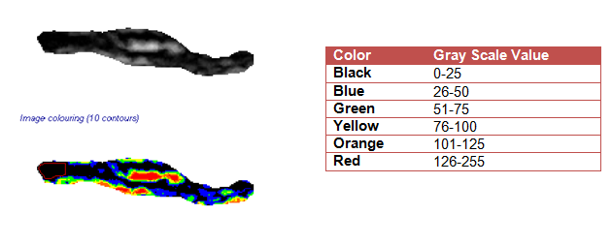
Carotid Plaque Echogenicity Analysis

Slide 12
Carotid Plaque Echogenicity Analysis
Images normalized and standardized to a pixel density of 20/mm
Image crop and feature extraction modules to measure GSM, plaque area
“Just black areas” manually traced; area calculated
“Discrete white areas” are noted
Black areas adjacent to the lumen with an echogenic border are noted
Drs. Mitchell and Dempsey validated these measures against autopsy specimens
Notes:
DWA was noted by the identification of a white area in the plaque without acoustic shadowing and a gray-scale value greater than 126
JBAs without an echogenic border and black areas with a border (BABs) were identified as areas with a gray-scale value of less than 25
near the lumen and color coded as black with the plaque analysis software. In patients with more than one black area, the largest black area was measured.
Plaque Type

Slide 13
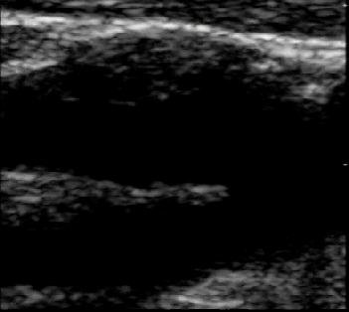
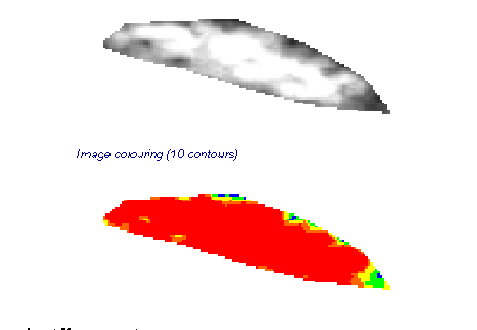
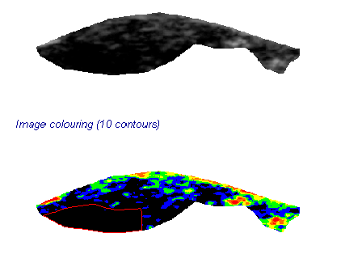
High GSM 184, Plaque area 5.95 mm²
Low GSM 19, Plaque area 50.77 mm²
Notes:
High GSM 8024170-1-Lipnr
Low GSM 5019966-1-LBIpnr

Slide 14
Ultrasound Plaque Characteristics Measurement Reproducibility - MESA Exam 1 plaques
 | Reader 1 |  |  | Reader 2 |  |  | Reader 1 vs Reader 2
Variable | Intra-observer Mean Delta | Within Subjects SD | ICC | Intra-observer Mean Delta | Within Subjects SD | ICC | Inter-reader mean Delta | Within Subjects SD | ICC
GSM (units) | 0.96 | 4.39 | 0.96 (0.92-0.98) | 5.22 | 5.30 | 0.95 (0.88-0.98) | 5.7 | 5.53 | 0.95 (0.88-0.98)
Plaque Area (mm²) | 0.20 | 1.11 | 0.99 (0.98-1.00) | 1.82 | 1.67 | 0.98 (0.95-0.99) | 1.93 | 1.66 | 0.98 (0.95-0.99)
Black Areas (mm²) | 0.13 | 0.37 | 0.96 (0.92-0.98) | 1.54 | 0.77 | 0.81 (0.61-0.91) | 0.37 | 0.61 | 0.86 (0.70-0.94)
24 plaque images from MESA Exam 1 were re-measured by the same 2 readers assigned for Exam 6 data analysis

Slide 15
QC Plan for Exam 6 Data
The DCC will select a set of 20 studies/FC (n=80) to be re-scored for plaque presence and plaque score. The representative set will be selected after each FC has scanned their first 50 MESA participants to assess intra- and inter-reader reproducibility
The DCC will randomly select a representative set of 60 plaques (15/FC) to assess intra- and inter-reader reproducibility for the plaque characteristic measures
Reader reproducibility will be repeated every 8 months until the end of Exam 6 reading phase

