Slide 1
Morphologic and Physiologic Connections of the Continuous Blood Pressure Waveform with Incident CVD MESA Elasticity Progress Report
David Jacobs
Daniel Duprez
Peter Hannan
MESA SC, Bethesda, Feb 26, 2015

Slide 2
Aims
To assess whether 10-year change in LAE and SAE adds to prediction of clinical cardiovascular (CVD) events
Pending further analysis of Ex 5 data and events
2) To derive and assess additional measures from the digitized radial artery pulse waveform
Presentation today
We also introduce an alternate approach to NRI

Slide 3
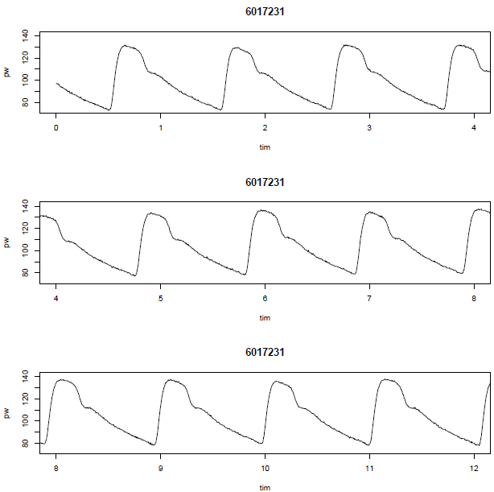
CR-2000 Waveforms, 2000-2002 in an arbitrarily selected person Slope changes are clear and shape is homogeneous

Slide 4
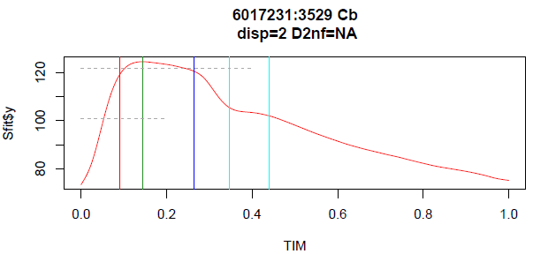
Median Waveform Standardized to 1 second and 75-125 mmHg, removing both absolute BP and heart rate

Slide 5
Morphology Marking Time & Pressure at Waveform Curvature Changes Automatically mark early curvature, upslope pressure 100 (50% of excursion; short green triangle), left shoulder (red), peak (green), right shoulder (blue), dicrotic notch (both turquoise) by noting more than trivial maxima, minima, and inflection points (2nd derivative = 0)

Slide 6
Physiology: ventriculo-vascular coupling
Time 0.0: opening of aortic valve (time delayed to radial pulse), end of IVCT, begin systolic upslope
Arrow: Early curvature, time ~0.030, relatively unimpeded by reflection wave, strong ventricular action quickly overcomes afterload
Green triangle: half the upward excursion
Red vertical (left shoulder) and Green vertical (peak): slowing acceleration of pressure wave, status of LV contraction/LV volume combination during ejection, mixing forward/backward pressures

Slide 7
Physiology: ventriculo-vascular coupling (2)
Blue vertical (right shoulder): probable point at which LV begins untwisting, ~pressure at central SBP
Blue oblique: line connecting pressure 100 to pressure at right shoulder
Turquoise verticals (dicrotic notch): D1 is aortic valve closure and beginning of IVRT, D2 ends IVRT, ~ time of mitral valve opening; D2 increase is reversing blood flow; backward pressure wave may persist and alter dicrotic notch shape
D2 to about 0.9: LV untwisting and filling, 0.9 is the approximate beginning time of IVCT

Slide 8
Murgo Types
Type A: Big excess on upslope (left), left shoulder is actually a separate peak, dip before peak, high right shoulder
Type C: Left shoulder is part of continuous upslope, close to peak, then clear downslope and low right shoulder
Type B: Dome (not shown) or flat top (Bb), left and right shoulders similar height, location of peak ambiguous (flat tops are about 1/3 of all MESA participants

Slide 9
Waveform as a Whole
The waveform is “coordinated”, for example, time to max early curvature has correlation
-0.15 with pressure at the right shoulder
0.10 with time between the left and right shoulders
0.17 with pressure difference at D2 minus D1
Information in the waveform is overlapping
Measures based on one part of the waveform may actually reflect physiologic occurrences in another part

Slide 10
Radial artery augmentation index (AIx)
Radial AIx may be defined as the ratio of pressures at the presumed 2nd to 1st central peak (peak/left shoulder for Murgo Type A, right shoulder/left shoulder for Murgo Type B, right shoulder/peak for Murgo Type C
Alternately, because Murgo Type is ambiguous in about 1/3 of participants with flat waveform tops, radial AIx can be the ratio of pressures at the right shoulder/left shoulder, correlation with first def’n 0.9.
Radial AIx correlates
-0.48 with pressure at D2 – pressure at D1
-0.38 with HDI ‘s C2R

Slide 11
Integrals: Slice and Sliver Detail
sliver
Slice: pie-slice with oblique base (line connecting pressure (eg 100) in upslope to pressure at right shoulder), including slice left of time of peak, slice right of time of peak, and full slice (slice left + slice right).
Sliver: thin slice, toothpick shape, 'extra' bulge in left systole

Slide 12
Integrals: Slice and Sliver Detail
Slice Left
Slice: pie-slice with oblique base (line connecting pressure (eg 100) in upslope to pressure at right shoulder), including slice left of time of peak, slice right of time of peak, and full slice (slice left + slice right).
Sliver: thin slice, toothpick shape, 'extra' bulge in left systole

Slide 13
Integrals: Slice and Sliver Detail
Slice Right
Slice: pie-slice with oblique base (line connecting pressure (eg 100) in upslope to pressure at right shoulder), including slice left of time of peak, slice right of time of peak, and full slice (slice left + slice right).
Sliver: thin slice, toothpick shape, 'extra' bulge in left systole

Slide 14
Composite Measures: Deconvolutions
HDI’s C2R deconvolutes the distal end of the waveform from the “near notch” to “near end” of diastole into a decaying exponential + a dampened cosine
C2R itself depends on 2 pressure time constants: general rate of decay and (often more strongly) rate of dampening of oscillations
Lyn Brumback’s PTC2 deconvolutes using a similar functional form from the peak to end diastole
Both strongly predict incident events
PTC2, C2R correlation = 0.63
PTC2, radial augmentation index = -0.53
HDI C2R defined over the range inflection (dotted verticals) around D1 to loss of monotonicity, most precise C2R among 20 start points over 10 beats
PTC2 defined over peak to end diastole

Slide 15
Incidence Prediction: Testing Strategy
We know that in MESA HDI’s C2R is strongly predictive of all CVD outcomes
We assume that the reflection waves are important adverse factors, at least partly reflected in the radial AIx
The competence of the LV and the ability to overcome arterial afterload is testable
Specific studies of different waveform measures against incident CVD help further describe (interpret p values cautiously)

Slide 16
Models and PHREG Prediction
At risk: 6165
Incident total CVD (includes HF, PAD): 715
Incident HF: 217
Incident CHD or Stroke : 570
Adjustment: Age, race, sex, height, heart rate, SBP, DBP, BP meds, BMI, smoking, cholesterol, HDL-C, TG, lipid meds, diabetes, CRP
Waveform measures unit: 1 SD

Slide 17
Associations with incident CVD, hazard ratio per SD of each predictor, separate regressions
 | Total CVD | HF | Any stroke or CHD
Continuous Predictor | HR (95% CI), p | HR (95% CI), p | HR (95% CI), p
Radial AIx (P2/P1) | 1.11 (1.03-1.21) p=0.01 | 1.18 (1.02-1.36) p=0.03 | 1.10 (1.01-1.21) p=0.04
Slice right | 0.80 (0.73-0.88) p<.0001 | 0.67 (0.57-0.79) p<.0001 | 0.85 (0.77-0.94) p=0.002
Vertical area peak to right shoulder | 0.85 (0.79-0.92) p<.0001 | 0.71 (0.62-0.82) p<.0001 | 0.89 (0.82-0.98) p=0.01
Time of max early curvature | 1.09 (1.01-1.17) p=0.02 | 1.21 (1.07-1.35) p=0.0017 | 1.04 (0.96-1.13) p=0.33
Time to reach upslope pressure 85 | 1.13 (1.04-1.22) p=0.003 | 1.28 (1.13-1.46) p=0.0002 | 1.07 (0.98-1.17) p=0.13
HDI's C2R | 0.81 (0.73-0.89) p<.0001 | 0.82 (0.68-0.98) p=0.03 | 0.82 (0.73-0.92) p=0.0005

Slide 18
Associations with incident CVD, incidence density per 100 people followed 10.1 y by quartile of each predictor, separate regressions
 | Total CVD | HF | Any stroke or CHD
Quartile Predictor | Q1 Q2 Q3 Q4 Q4/Q1 HR | Q1 Q2 Q3 Q4 Q4/Q1 HR | Q1 Q2 Q3 Q4 Q4/Q1 HR
Radial AIx (P2/P1) | 7.3 8.3 10.7 10.5 HR=1.44 | 1.6 2.2 2.5 2.8 HR=1.70 | 5.8 6.5 8.6 8.3 HR=1.43
Slice right | 11.5 10.2 8.1 7.2 HR=0.62 | 3.4 2.7 1.9 1.3 HR=0.38 | 8.3 8.0 6.6 6.4 HR=0.77
Vertical area peak to right shoulder | 11.6 9.3 8.3 7.5 HR=0.64 | 3.4 2.5 1.9 1.4 HR=0.40 | 8.9 6.9 7.1 6.3 HR=0.70
Time of max early curvature | 6.9 9.2 8.9 10.7 HR=1.56 | 1.6 2.0 2.6 3.0 HR=1.85 | 5.4 7.7 6.9 8.1 HR=1.51
Time to reach upslope pressure 85 | 8.0 10.0 8.1 10.9 HR=1.36 | 1.7 2.5 1.7 3.3 HR=1.96 | 6.4 8.2 6.6 8.1 HR=1.25
HDI's C2R | 10.9 9.8 9.7 6.4 HR=0.59 | 2.7 2.3 2.4 1.6 HR=0.57 | 8.2 8 .0 8.0 5.1 HR=0.61

Slide 19
Associations with incident CVD, hazard ratio per SD of each predictor, joint regressions
 | Total CVD | HF | Any stroke or CHD
Continuous Predictor | HR (95% CI), p | HR (95% CI), p | HR (95% CI), p
Slice right | 0.85 (0.78-0.93) p=0.0005 | 0.71 (0.60-0.83) p<.0001 | 0.89 (0.8-0.98) p=0.02
Time of max early curvature | 1.07 (1-1.15) p=0.05 | 1.19 (1.06-1.33) p=0.004 | NS
HDI's C2R | 0.85 (0.77-0.94) p=0.002 | NS | 0.85 (0.76-0.95) p=0.004
Quartile Predictor | Q1 Q2 Q3 Q4 Q4/Q1 HR | Q1 Q2 Q3 Q4 Q4/Q1 HR | Q1 Q2 Q3 Q4 Q4/Q1 HR
Slice right | 10.3 10.1 8.0 7.5 HR=0.73 | 3.1 2.8 1.8 1.4 HR=0.43 | 7.9 7.9 6.4 6.4 HR=0.81
Time of max early curvature | 6.8 9.1 8.7 10.4 HR=1.52 | 1.6 1.9 2.4 2.8 HR=1.77 | NS
HDI's C2R | 10.3 9.5 9.6 6.7 HR=0.65 | NS | 8.0 7.8 8.0 5.2 HR=0.66

Slide 20
Improvement in Prediction Probability
Alternative to NRI
Estimate P_{base}: P(incidence|base model): no waveform predictors
Estimate P_{alt}: P(incidence|alternative model): including waveform predictors
Reclassification probability is P_{alt} – P_{base}: positive means reclassify up, negative means reclassify down
Successful reclassification means that observed risk increases as P_{alt} – P_{base} increases

Slide 21
Improvement in Prediction Probability (alternative to NRI), Total CVD % events
 | P_{alt} - P_{base} prediction of Total CVD
P_{base} Quartile | Reclass down | Reclass Up | Rel Risk
1 | 1.8 (15/822) | 2.6 (19/719) | 1.45
2 | 5.2 (42/805) | 5.6 (41/736) | 1.07
3 | 13.2 (100/757) | 14.0 (110/785) | 1.06
4 | 19.0 (151/795) | 31.8 (237/746) | 1.67
Total | 9.7 (308/3179) | 13.6 (407/2986) | 1.41
Proportional hazards regression of observed total CVD on P_{alt} – P_{base}, adjusted for P_{base} : p<0.0001

Slide 22
Improvement in Prediction Probability (alternative to NRI), HF % events
 | P_{alt} - P_{base} prediction of HF
P_{base} Quartile | Reclass down | Reclass Up | Rel Risk
1 | 0.4 (3/839) | 0.7 (5/702) | 1.97
2 | 0.8 (7/898) | 0.8 (5/643) | 1
3 | 3.0 (26/874) | 5.5 (37/668) | 1.87
4 | 6.8 (59/863) | 11.1 (75/678) | 1.62
Total | 2.7 (95/3474) | 4.5 (122/2691) | 1.66
Proportional hazards regression of observed HF on P_{alt} – P_{base}, adjusted for P_{base} : p=0.003

Slide 23
Improvement in Prediction Probability (alternative to NRI), any Stroke or CHD % events
 | P_{alt} - P_{base} prediction of Stroke or CHD
P_{base} Quartile | Reclass down | Reclass Up | Rel Risk
1 | 1.3 (10/790) | 1.9 (14/751) | 1.46
2 | 4.7 (37/796) | 5.5 (41/745) | 1.18
3 | 9.3 (67/718) | 11.3 (93/824) | 1.21
4 | 17.3 (132/763) | 22.6 (176/778) | 1.31
Total | 8.0 (246/3067) | 10.5 (324/3098) | 1.30
Proportional hazards regression of observed Stroke or CHD on P_{alt} – P_{base}, adjusted for P_{base} : p<0.0001

Slide 24
Conclusion
Radial AIx predicts arteriosclerotic disease and HF, yet there is more in the waveform that predicts future disease, in particular slice right and HDI’s C2R
The onset of systole is interesting as a measure of ventricular competence and its relation to afterload. It predicts HF.
The waveform is coordinated, with different parts informing other parts. Multiple measures predict better than single measures, and their combination informs the biology.
We continue to investigate HDI’s C2R and related measures that are based on the waveform in diastole
An important issue is whether the backward wave persists into diastole and alerts the shape of the DN.

Slide 25
Thank you

Slide 26
Median Beat Method Median beats are computed by fitting a spline (Sfit$y) to each time- and pressure-standardized beat at each of 1000 millisec (TIM), then excluding individual beats for which Σ ln(E/O) > 0.3 (K-L criterion, all beats accepted here)

Slide 27
Physiology: ventriculo-vascular coupling
Time 0.0: opening of aortic valve, end of IVCT, begin systolic upslope
Arrow: Early curvature, time ~0.030, relatively unimpeded by reflection wave, strong ventricular action quickly overcomes afterload
Green triangle: half the upward excursion
Red vertical (left shoulder) and Green vertical (peak): slowing acceleration of pressure wave, status of LV contraction/LV volume combination during ejection, mixing forward/backward
Blue vertical (right shoulder): probable point at which LV begins untwisting, ~pressure at central SBP, hand influence above line connecting pressure 100 to pressure at right shoulder
Turquoise verticals (dicrotic notch): D1 is aortic valve closure and beginning of IVRT, D2 ends IVRT, ~ time of mitral valve opening; D2 increase is reversing blood flow; backward pressure wave may persist and alter dicrotic notch shape
Time D2 to about 0.9: LV untwisting and filling, 0.9 is the approximate beginning time of IVCT

Slide 28
Waveform as a Whole
The waveform is “coordinated”, for example, time to max early curvature has correlation
-0.15 with pressure at the right shoulder
0.10 with time between the left and right shoulders
0.17 with pressure difference at D2 minus D1
Composite measures reflect aspects that are not in the composite computation. For example HDI’s C2R has correlation
-0.42 with pressure at right shoulder
-0.34 with time to peak
-0.07 with time to max early curvature
0.41 with pressure difference at D2 minus D1 (included with C2R range)
Information in the waveform is overlapping
Measures based on one part of the waveform may actually reflect physiologic occurrences in another part
Multiple measures should be studied and contrasted

Slide 29
Composite Measures: Integrals
Vertical integrals: walls are perpendicular to time axis
0 to left shoulder, left shoulder to peak, peak to right shoulder, right shoulder to dicrotic notch

Slide 30
Composite Measures: Integrals (2)
Slice: pie slice with oblique base (line connecting pressure (eg 100) in upslope to pressure at right shoulder), including slice left of time of peak, slice right of time of peak, and full slice (slice left + slice right).
Slice right and full slice capture more of the waveform shape than does the radial augmentation index
Sliver: thin slice, toothpick shape, 'extra' bulge in left systole
Sliver and slice left predict incidence oppositely, but are explained when slice right is in the model.

