Slide 1
ANCILLARY STUDIES COMMITTEE February 2015

Slide 2
~6 months of activity Sept 2014 – Feb 2015 22 new proposals approved by SC

Slide 3
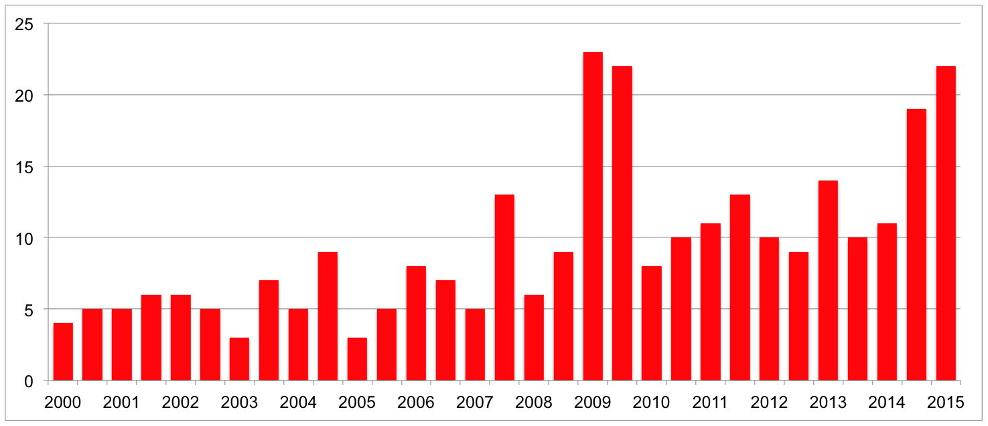
New MESA Ancillary Studies approved, 2000 - present

Slide 4
ANCILLARY STUDIES COMMITTEE February 2015
New proposals, SC approved:
A264 | Rich | WGS supplement for rare variants & NHLBI traits
A265 | Manichaikul | RAGE in emphysema & pulmonary fibrosis
A266 | Thanassoulis (Post) | Lipoprotein(a) & aortic valve calcification
A267 | Ventetuolo (Kawut) | Testosterone deficiency in pulmonary arterial hypertension
A268 | Murthy (Budoff, Lima) | Serial assessment of hepatic adiposity & cardiometabolic risk
A269 | Needham (Diez Roux) | SES disadvantage, stress, & CVD

Slide 5
ANCILLARY STUDIES COMMITTEE February 2015
New proposals, SC approved:
A270 | Levey (Katz) | Panel eGFR in MESA Kidney
A271 | Oelsner (Barr) | Coagulation biomarkers & chronic lower respiratory disease exacerbations
A272 | Majka (K. Liu) | Autoimmunity and CVD
A273 | Dai (Tsai) | MicroRNA, whole diet and CHD
A274 | Y. Liu (Burke) | Novel biomarkers for CKD using transcriptomics
A275 | S. Cheng (Lima) | Eicosanoid profiles & longevity pathways

Slide 6
ANCILLARY STUDIES COMMITTEE February 2015
New proposals, SC approved:
A276 | Raj (Cushman) | Biomarkers of fibrosis in CKD
A277 | Seeman (Watson) | MESA Brain pilot study
A278 | Lederer (Redline) | Sleep apnea and alveolar epithelial cell injury
A279 | Venkatesh (Lima) | Ventricular strain measured by feature-tracking CMR
A280 | Kaufman | MESA Air Pollution: NEXT Stage (CV events, exposure modeling)
A281 | Kaufman | CV impacts of regional change in ambient particles & gases

Slide 7
ANCILLARY STUDIES COMMITTEE February 2015
New proposals, SC approved:
A282 | Mitchell (Kaufman) | Traditional CV risk factors, PM2.5, & carotid plaque characteristics
A283 | Smith, B. (Barr) | Pulmonary emphysema & COPD in the absence of smoking history
A284 | Leary (Kronmal) | Markers of angiogenesis
A285 | Diez Roux | Changes in cardiometabolic risk factors & outcomes in relation to policy change

Slide 8
ANCILLARY STUDIES COMMITTEE
Exam 6 Ancillary studies with fundable scores:
Barr – Pulmonary perfusion (MESA Lung III) Bertoni – From risk factors to early heart failure Heckbert – Atrial fibrillation, cardiac MRI and vascular disease of brain Y. Liu – Obesity-related epigenetic changes and type 2 diabetes

Slide 9
ANCILLARY STUDIES COMMITTEE
Exam 6 Ancillary studies submitted:
October 2014 deadline:
Needham – Socioeconomic disadvantage, stress, CVD Kestenbaum – Individual response to Vitamin D treatment Goodarzi – Insulin axis, diabetes, microbiome, genome Ding – Obesity, immunity, epigenetics & cholesterol

Slide 10
ANCILLARY STUDIES COMMITTEE
Exam 6 Ancillary studies submitted/planned:
Feb/March 2015 deadlines:
Kaufman – MESA Air: Next Stage Kaufman – CV impacts of regional change in ambient particles & gases B. Smith – COPD & emphysema in non-smokers Diez Roux – Change in cardiometabolic factors, outcomes, & policy change Liu/Ding – Longitudinal epigenetic study of atherosclerosis Allison – MESA mobility (DVT, PVD) Budoff – Coronary athero, intestinal microbiota, diet, & genetics Kramer – Urinary KNOWledge study Shea – HDL-mediated cholesterol effux & plaque inflammation Kaufman – Air pollution, heart failure, atrial fibrillation burden
June 2015 deadline:
Seeman – CVD risk and brain structure/function Ashikaga – Left atrial function and AF-related cerebrovascular events

Slide 11
ANCILLARY STUDIES COMMITTEE February 2015
All Ancillary studies
 | N (%)
Proposals | 290 (100)
Withdrawn | 48 (17)
Funding pending | 104 (36)
Funded/active | 105 (36)
Completed | 33 (11)

Slide 12
ANCILLARY STUDIES COMMITTEE February 2015
Committee members
Matt Allison | Phil Greenland
Sue Bielinski | Susan Heckbert
David Bluemke | Jean Olson
Chris Delaney | Nels Olson
Coordinator: Sandi Shrager

