Slide 1

The MESA and CARDIA Urinary Sodium Study
Norrina B. Allen, PhD; Lihui Zhao, PhD; Catherine Loria, PhD; Linda Van Horn, PhD, RD; Chia-Yih Wang, PhD; Mary Cogswell, RN, DrPH; Jacqueline Wright, DrPh; Christine M. Pfeiffer, PhD; Kiang Liu, PhD

Slide 2
Background
⇧ sodium is associated with increased BP, CVD and mortality
Up to 1.65 million deaths worldwide can be attributed to excess sodium intake¹
Gold standard is multiple 24-hr urine collections
Equations predicting 24-hr sodium from a single urine void have been used
Their validity in a diverse, older population many with hypertension remains unknown
1. Mozaffarian D, Fahimi S, Singh GM, Micha R, Khatibzadeh S, Engell RE, et al. Global sodium consumption and death from cardiovascular causes. N Engl J Med. 2014;371(7):624-34.

Slide 3
Objectives of the first three papers
To examine the population distribution of UNa and the validity of existing equations predicting 24-h Na excretion from a single spot urine sample among older adults with and without hypertension. (Under Review at Lancet)
To develop new prediction equations for 24-hour urine sodium excretion among older and hypertensive adults using spot urine samples. (Being Presented at AHA Epi Next Week)
To determine whether the use of two timed spot urine specimens can accurately predict the population distribution and individual estimates of usual 24-hour excretion among older adults aged 45 to 79 years of age. (Proposal Submitted to P&P)

Slide 4
Study Population
Inclusion criteria:
  Participants of CARDIA, MESA or MESA Family Studies recruited at the Northwestern site and who reside in the Chicago area
  Aged 45 to 79 yrs old
  White or African American
  No Evidence of severe kidney disease (eGFR was ≥30)

Slide 5
Study population (recruited from March thru Aug 2013)
1,130 eligible participants
575 consented and attended exam (51%)
Excluded:
16 had incomplete urine collections
4 were deemed ineligible
554 completed exam (96%)

Slide 6
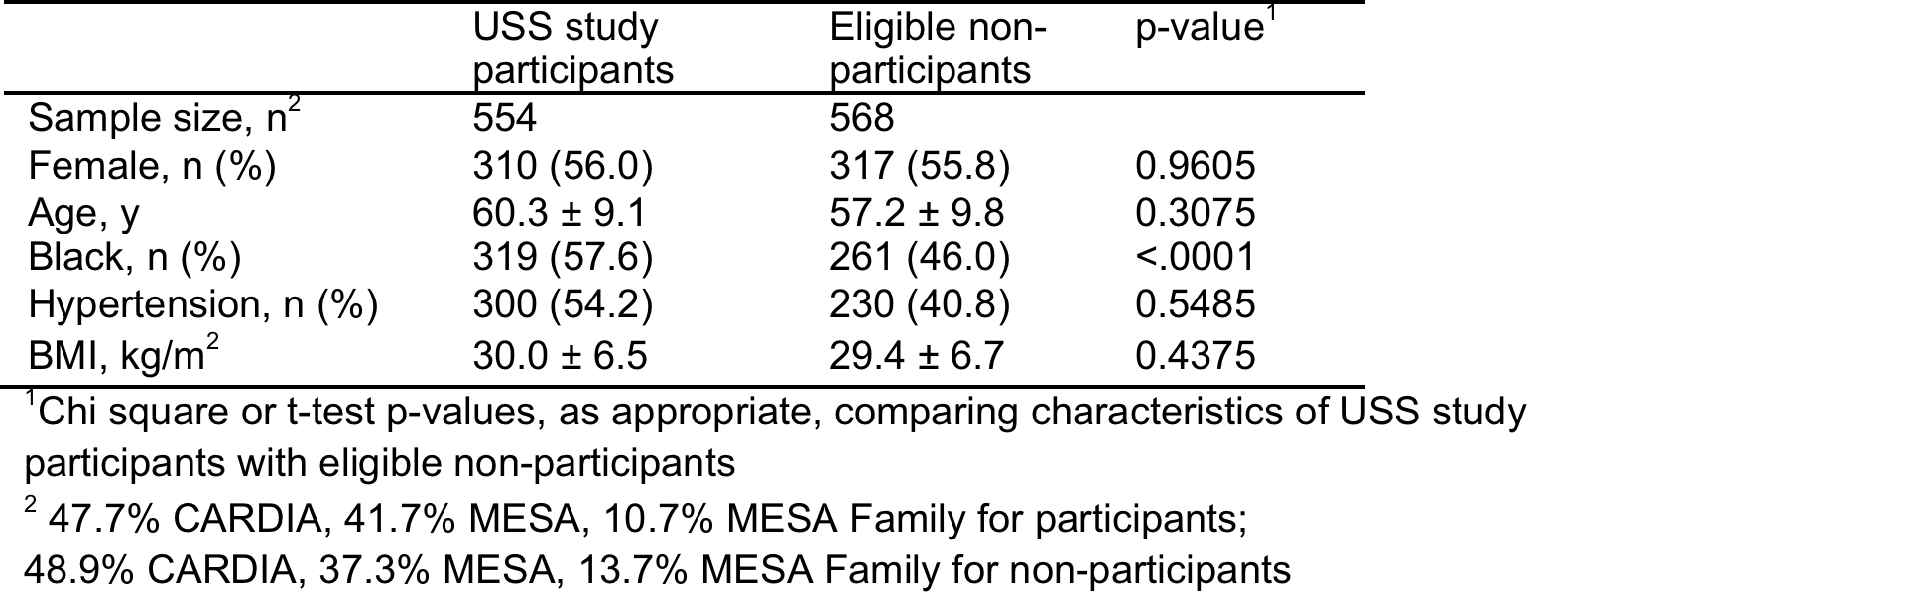
Demographics for participants in the study compared with all eligible participants

Slide 7
Data Collected
Demographics
Medications (participants were asked to bring medications with them)
Height and weight
Blood pressure (defined as the avg of 2nd and 3rd readings)
Dietary Assessment (using the Automated Self-Administered 24 Hour recall [ASA24])
Blood draw (for eGFR and creatinine)
24-hr Fractional Urine Collection (1/3 completed a 2nd 24-hr urine collection)

Slide 8
Fractional 24-Hour Urine Collection
Started and ended in the clinic
Participants collected each void in a separate container labeled with date and time
Upon return to the clinic participants completed a questionnaire on the completeness of their collections and all voids were weighed and logged
collections were considered completed if:
  the total urine volume was greater than or equal to 500 mL
  women did not report menstruation at any time during collection
  the length of collection was greater than 20 hours
  no reports of spilling urine nor missing a void more than once during the collection.

Slide 9
Lab Methods
Four timed voids were chosen to correspond to CDC study:
  overnight (the first void after the longest period of sleep and between 04:00 -12:00)
  morning (the first void between 08:30 and 12:30)
  afternoon (the first void between 12:31-17:30)
  evening (the first void between 17:31-23:59)
A 1-mL aliquot was taken from the composite 24-hour urine sample and from each of the 4 timed-spot urine specimens.
All vials were shipped frozen on dry ice to the CDC’s National Center for Environmental Health for analysis

Slide 10
Analysis: Analyte Concentrations
The amount of each individual analyte was defined by multiplying the analyte concentration by the corresponding volume of the specimen
  The volume for the 24-hour urine collection was adjusted for the self-reported collection time (i.e. (Total volume/total collection time in hours)*24)
  We examined the mean and standard deviation of each analyte overall and within gender, race and hypertension status subgroups.
  paired t-tests were adjusted for multiple comparisons using the Bonferroni method.
Within person covariance (mean coefficient of variation) = the square root of the within-person variance divided by the mean Day-to-day variability was calculated as the ratio of within- to between-person variances.

Slide 11
Analysis: Validity of Equations
Examined validity of 4 published equations
Calculated the means and standard deviations for the measured and the predicted 24-hour sodium excretion
bias was calculated as the difference between the predicted and measured 24-hour sodium excretion
  was examined by equation and timing of spot sample (overnight, morning, afternoon, evening) overall and by gender, race, and hypertension status subgroup

Slide 12
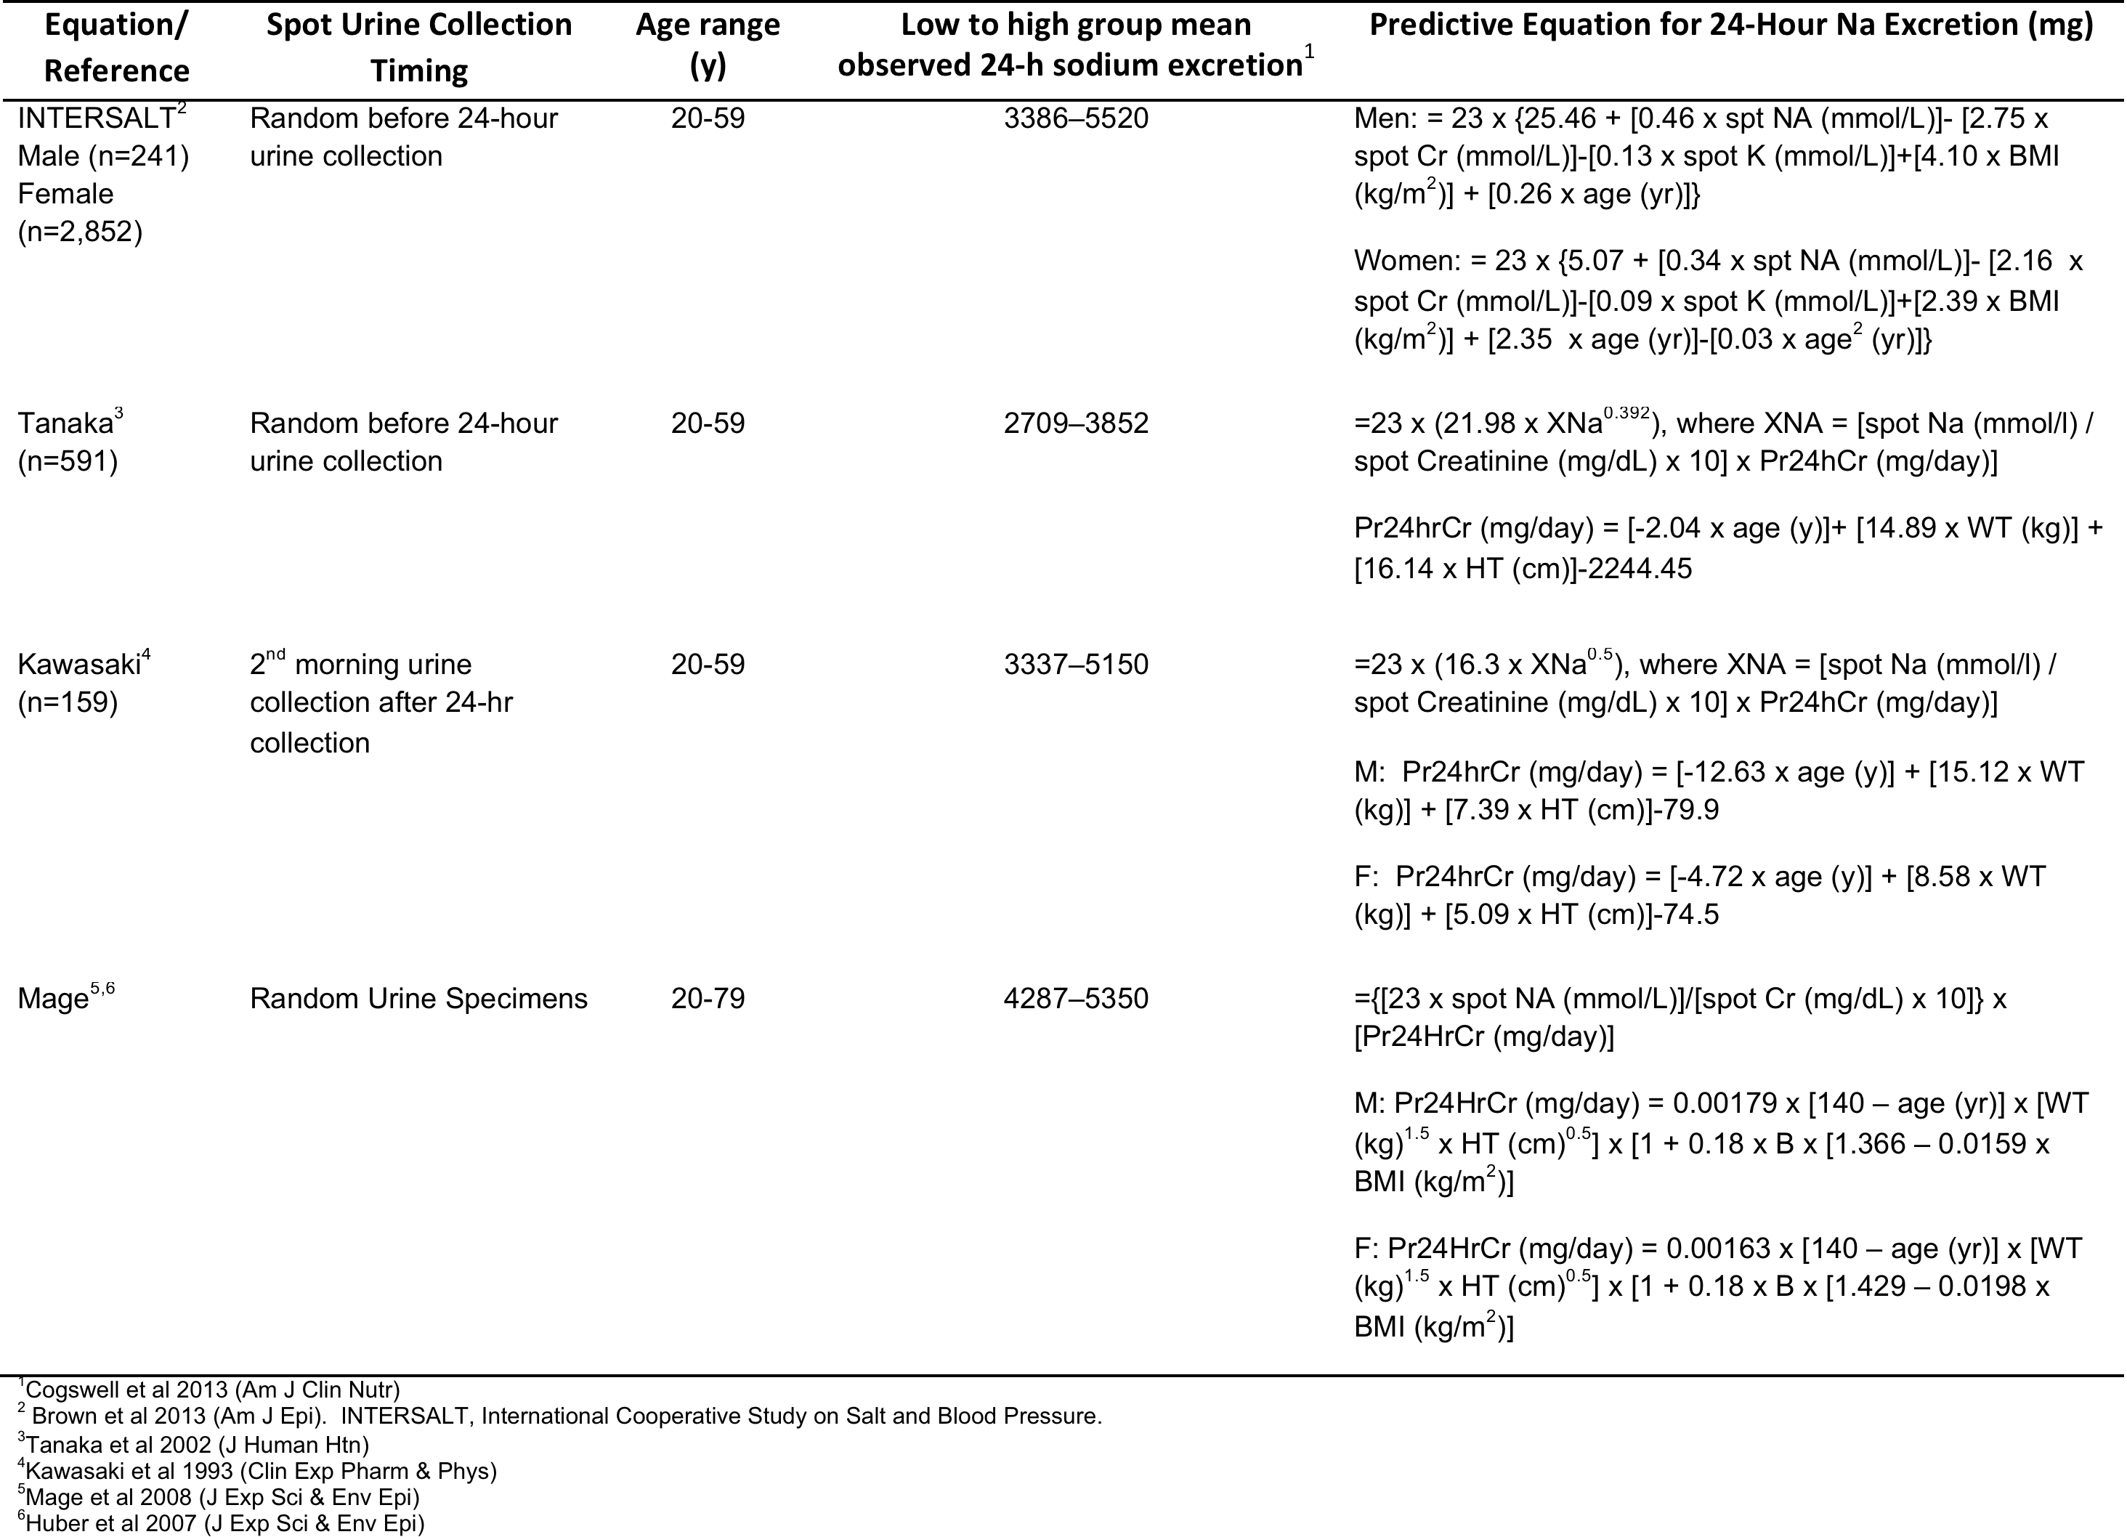
Predictive Equation for 24-Hour Na Excretion (mg)

Slide 13
Analysis: Individual Bias
Because the biases were skewed we used Bland-Altman relative bias plots to describe the agreement between the estimated and the measured 24-hour sodium excretion
  The Bland-Altman relative bias is the individual difference between the predicted and the measured sodium excretion divided by the mean of the measured sodium
  To assess the difference in individual bias across the range of 24-hour sodium excretion, we plotted the relative bias for each individual against the mean of the individual’s predicted and measured sodium and determined the 95% limits of agreement (relative bias ± 1.96 SD).
  Spearman correlation coefficients

Slide 14
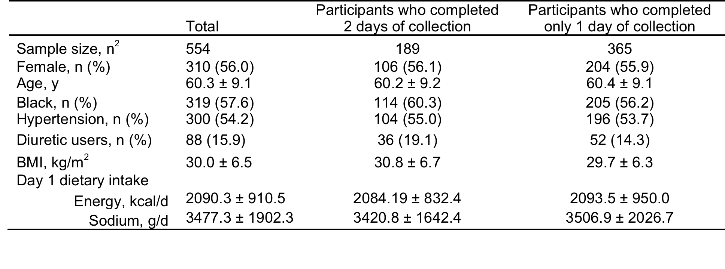
Characteristics of study participants
¹Values are n (%) or means ± SDs.
²Missing two participants for BMI: Total, n= 552; among those who completed 2 days of collection, n= 187. Missing
eight participants for Dietary intake: Total, n = 546; among those who completed 2 days of collection, n= 188.

Slide 15
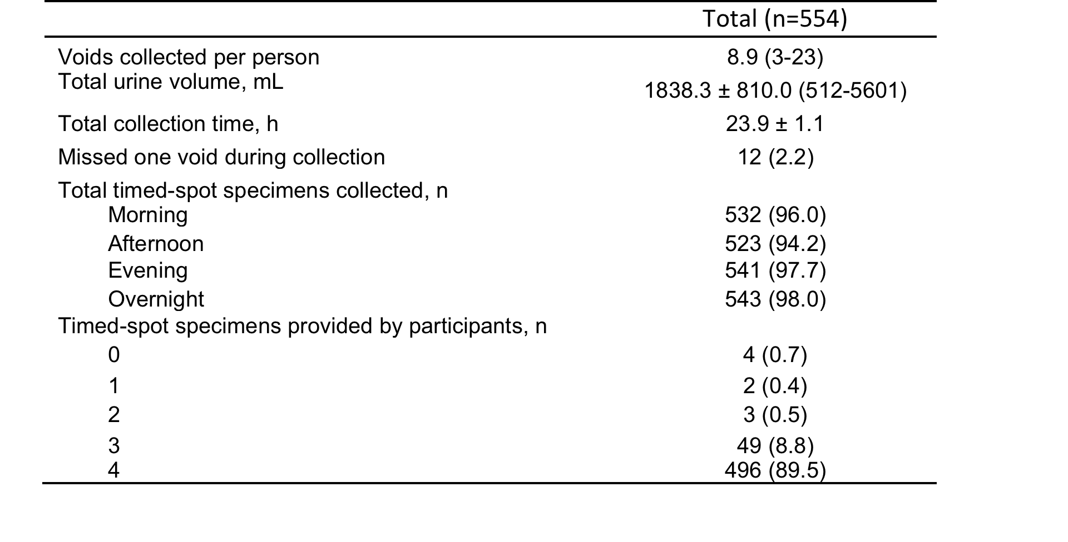
Characteristics of Day 1 urine collections

Slide 16
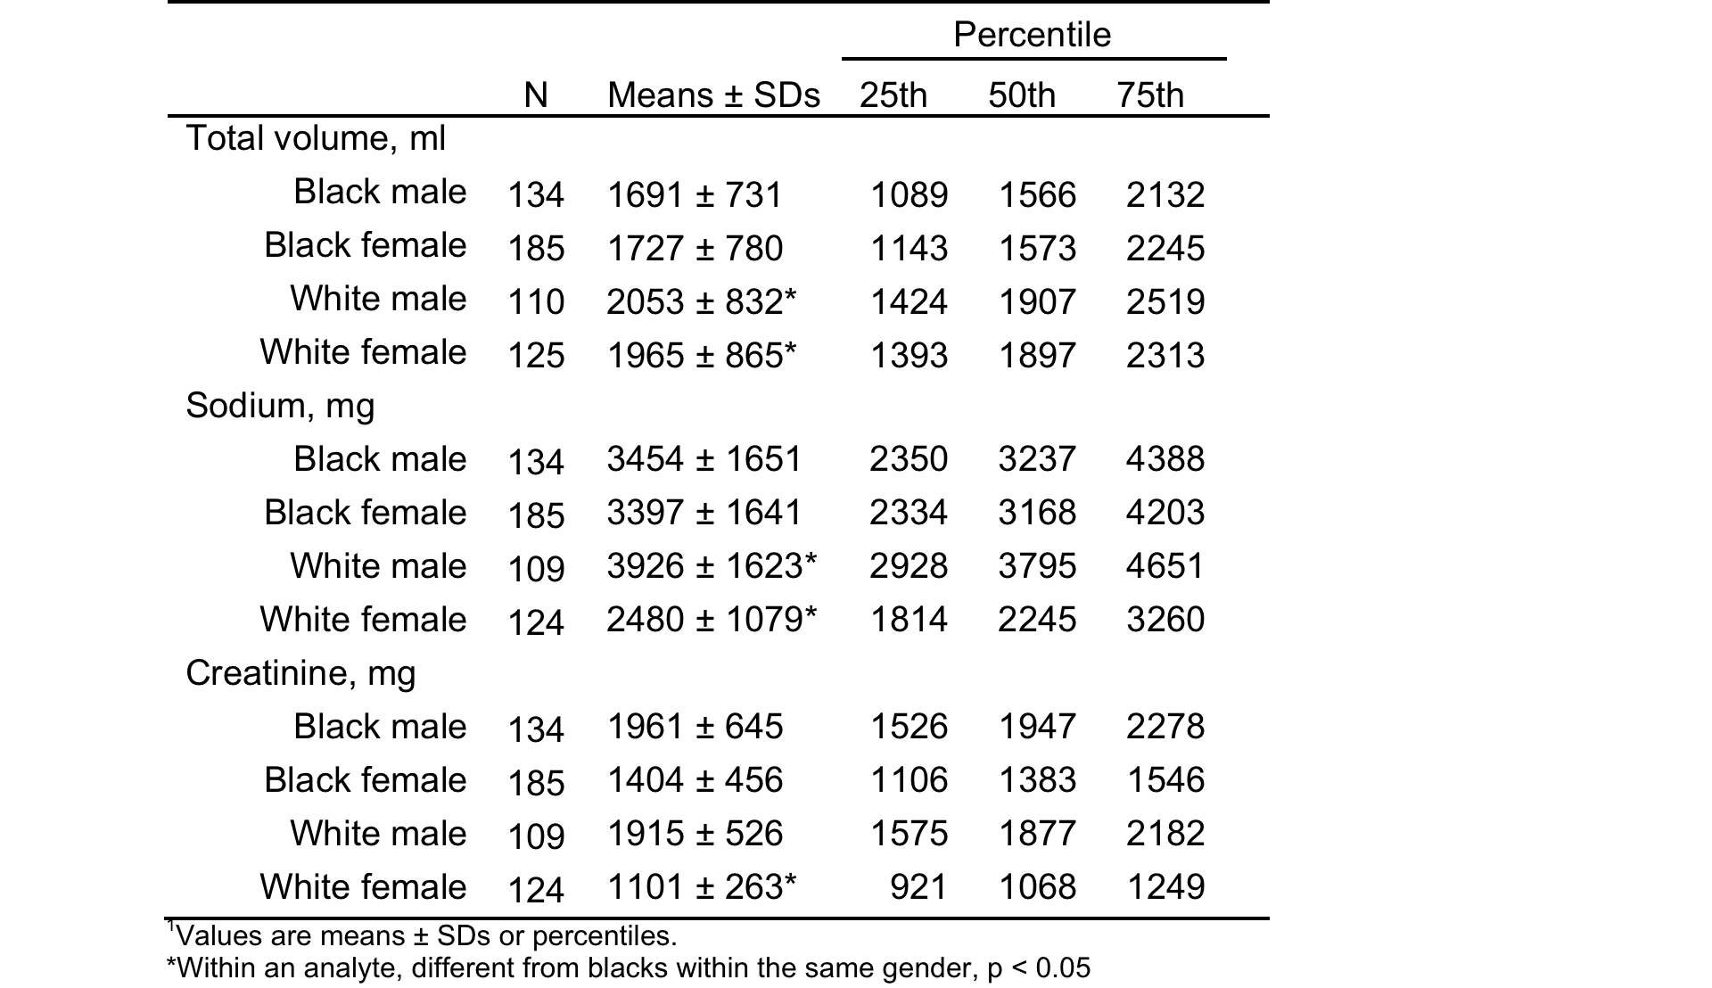
Distributions of 24-h excretion of sodium and creatinine

Slide 17
Variation in concentration by timing
Sodium (mmol/L)
Black Males
Black Females
White Males
White Females
Creatinine (mmol/L)
Black Males
Black Females
White Males
White Females

Slide 18
Mean bias in overall population
Overnight
Morning
Afternoon
x
Evening
BIAS (MG)
INTERSALT
TANAKA
KAWASAKI
MAGE
PREDICTION EQUATION

Slide 19
Black Men
Black Women
A
B
BIAS (MG)
BIAS (MG)
INTERSALT
TANAKA
KAWASAKI
MAGE
INTERSALT
TANAKA
KAWASAKI
MAGE
PREDICTION EQUATION
PREDICTION EQUATION
C
D
White Men
White Women
BIAS (MG)
BIAS (MG)
INTERSALT
TANAKA
KAWASAKI
MAGE
INTERSALT
TANAKA
KAWASAKI
MAGE
PREDICTION EQUATION
PREDICTION EQUATION
Overnight
Morning
Afternoon
x
Evening

Slide 20
Bland Altman Plot for INTERSALT
Overnight
Morning
Afternoon
Evening

Slide 21
Bland Altman Plot for Tanaka
Overnight
Morning
Afternoon
Evening

Slide 22
Bland Altman Plot for Mage
Overnight
Morning
Afternoon
Evening

Slide 23
Bland Altman Plot for Kawasaki
Morning

Slide 24
Results
Correlations between predicted and measured 24-h Na excretion were moderate to high; coefficients varied by race-gender subgroup and timing of spot specimens.
  The Mage equation had the highest coefficients (range 0.58 to 0.68).
  Overnight or morning timed spot samples had the highest coefficients (range 0.60-0.67).
Day-to-day variation (within-person Coefficient of Variation) in 24-hour sodium, potassium, and creatinine ranged from 31-37%, 24-27%, and 23-51% respectively.

Slide 25
Sensitivity Analyses
Results were not appreciably different when examined by the following subgroups:
  Individuals who reported not missing any voids and not spilling or missing any urine at any void (n=442)
  Only individuals who had a measured-to-expected 24-hr urine creatinine ratio of ≥0·6 based on equations for expected (predicted) creatinine using age, weight, height and race (n=541).
  hypertension status (controlled HTN, uncontrolled HTN, no HTN)
  use of diuretics (Y/N)
  eGFR (≤60, >60)

Slide 26
Conclusions
All four equations resulted in significant over- or under-estimation of 24-hour sodium excretion at the population level.
No single published equation produced unbiased sodium estimates for all four gender-race subgroups and bias varied by specimen timing, sex, and race.
  Tanaka equation using the evening sample produced the least bias in the overall sample but overestimated the sodium excretion of White women and underestimated in White men.
Individual bias in estimated 24-hour sodium excretion varied greatly and appeared to change from low to high sodium levels despite moderate correlations with 24-hour sodium excretion.
Notes:
In contrast to Mente which found that the Kawasaki produced the least bias(n=1000 from 11 countries)

Slide 27
Discussion
A single spot urine is not a valid estimate of individual intake.
The use of a timed-spot urine specimen could represent a feasible and cost effective approach for monitoring national sodium intake; however, current equations are biased in a diverse older population
Next Steps:
  the use of more than one spot urine specimen
  sex- and race-specific equations
  adjustment for within person day-to-day variability
Notes:
Extends our understanding of the ability of timed-spot urine specimens to predict 24-hour sodium excretion among a population of older adults, over half with hypertension.

Slide 28
Development of a New Predictive Equation
Lihui Zhao, PhD; Norrina B. Allen, PhD; Catherine M. Loria, PhD; Linda Van Horn, PhD, RD; Chia-Yih Wang, PhD; Mary E. Cogswell, RN, DrPH; Jacqueline Wright, DrPH; Alicia Carriquiry, PhD; Kiang Liu, PhD
Being Presented at AHA Epi March 2015

Slide 29
Aim
To develop a new equation for 24-hour UNa which is unbiased across gender-race groups of older adults

Slide 30
Statistical Methods
We used the first day samples to build gender specific equations for 24-h UNa using spot urine specimens.
  Candidate predictors included age, age-squared, gender, race, height, weight, body mass index (BMI), hypertensive status, diuretic use, estimated Glomerular Filtration Rate (eGFR), and timed-spot Na/creatinine (Cr)/potassium (K)/chloride (Cl) concentrations and excretions, with the interactions between race and all the variables.
Stepwise regression and the lasso procedures were used to develop parsimonious candidate equations for predicting 24-h UNa.
We chose the best fitted model based on the first day sample and then used the second day sample to compare the mean biases in 24-h UNa of the resulted equation with existing equations.

Slide 31
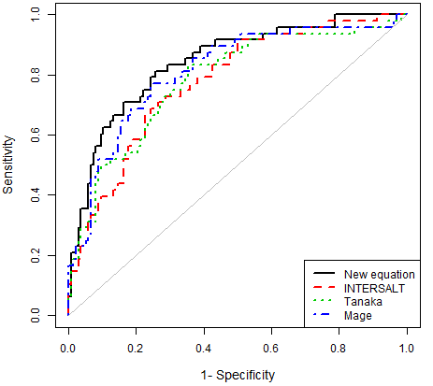
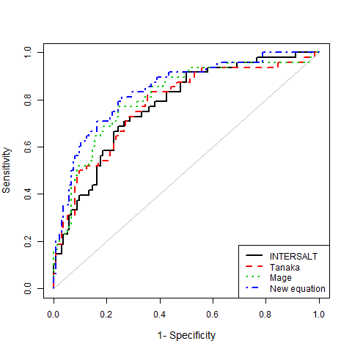
ROC Curves predicting <2,300 mg/d of UNa
Based on overnight spot sample.
The AUCs:
  INTERSALT - 0.78 (0.70-0.85)
  Tanaka - 0.78 (0.71-0.86)
  Mage - 0.81 (0.74-0.89)
  New Eqn - 0.84 (0.78-0.91)
Roc curves for predicting whether the 24-h Una excretion level is no more than the currently recommended 2,300 mg/d based on existing equations and the new equation.
All predictive equations are based on overnight spot sample.
The AUCs are 0.78 (95% CI, 0.70-0.85) for the INTERSALT equation, 0.78 (0.71-0.86) for the Tanaka equation, 0.81 (0.74-0.89) for the Mage equation, and 0.84 (0.78-0.91) for the new predictive equation.
Roc curves for predicting whether the 24-h Una excretion level is no more than the currently recommended 2,300 mg/d based on existing equations and the new equation.
All predictive equations are based on overnight spot sample.
The AUCs are 0.78 (95% CI, 0.70-0.85) for the INTERSALT equation, 0.78 (0.71-0.86) for the Tanaka equation, 0.81 (0.74-0.89) for the Mage equation, and 0.84 (0.78-0.91) for the new predictive equation.
Roc curves for predicting whether the 24-h Una excretion level is no more than the currently recommended 2,300 mg/d based on existing equations and the new equation.
All predictive equations are based on overnight spot sample.
The AUCs are 0.78 (95% CI, 0.70-0.85) for the INTERSALT equation, 0.78 (0.71-0.86) for the Tanaka equation, 0.81 (0.74-0.89) for the Mage equation, and 0.84 (0.78-0.91) for the new predictive equation.

Slide 32
Mean Bias and 95% CI by Gender and Race
First Morning
Elected Morning
Elected Afternoon
Elected Evening
Overnight
Elected Morning
Elected Afternoon
Elected Evening

Slide 33
Conclusions
  The proposed equation generally produced less or equivalent bias than previous equations.
  The proposed equation performed best using the overnight urine specimen, with unbiased prediction of 24-h UNa overall (mean bias=9.3) and across gender-race subgroups (mean bias <300 mg/d).
  Using overnight spot urine, the new predictive equation is:
    Men: 23 x {207.70 – 2.16 x Age (y) + 2.54 x BMI (kg/m2) + 22.84 x D + 0.10 x spot Na (mmol) – 0.081 x spot Cr (mmol) - 0.056 x spot K (mmol) – 152.71 x B+ 1.89 x B x Age (y) + 0.030 x B x spot Na (mmol)}
    Women: 23 x {-25.97 + 0.21 x weight (kg) + 1.28 x BMI (kg/m2) +0.59 x eGFR + 0.10 x spot Na (mmol) – 0.10 x spot Cr (mmol) - 0.028 x spot K (mmol) + 23.59 x B + 0.82 x B x weight (kg) – 5.12 x B x BMI (kg/m2)}
    where B, D are indicators for black and diuretic, respectively.

Slide 34
Discussion
The proposed equation may result in less biased estimates for the overall and subgroup mean UNa excretion among older US biracial adults, especially using an overnight urine specimen.
This new equation will need to be validated in other populations

Slide 35
Next Steps……
To examine the use of two timed spot samples improves estimation of the population mean and population distribution of sodium excretion
Will extend some of the findings from the younger CDC urinary sodium study for models of usual intake to our population of older adults

Slide 36
Acknowledgements
Lihui Zhao, PhD
Catherine M. Loria, PhD
Linda Van Horn, PhD, RD
Chia-Yih Wang, PhD
Te-Ching Chen, PhD
Alicia Carriquiry, PhD
Christine M. Pfeiffer, PhD
Mary E. Cogswell, RN, DrPH
Jacqueline Wright, DrPh
Kiang Liu, PhD
USS Participants from MESA, MESA Family and CARDIA

Slide 37
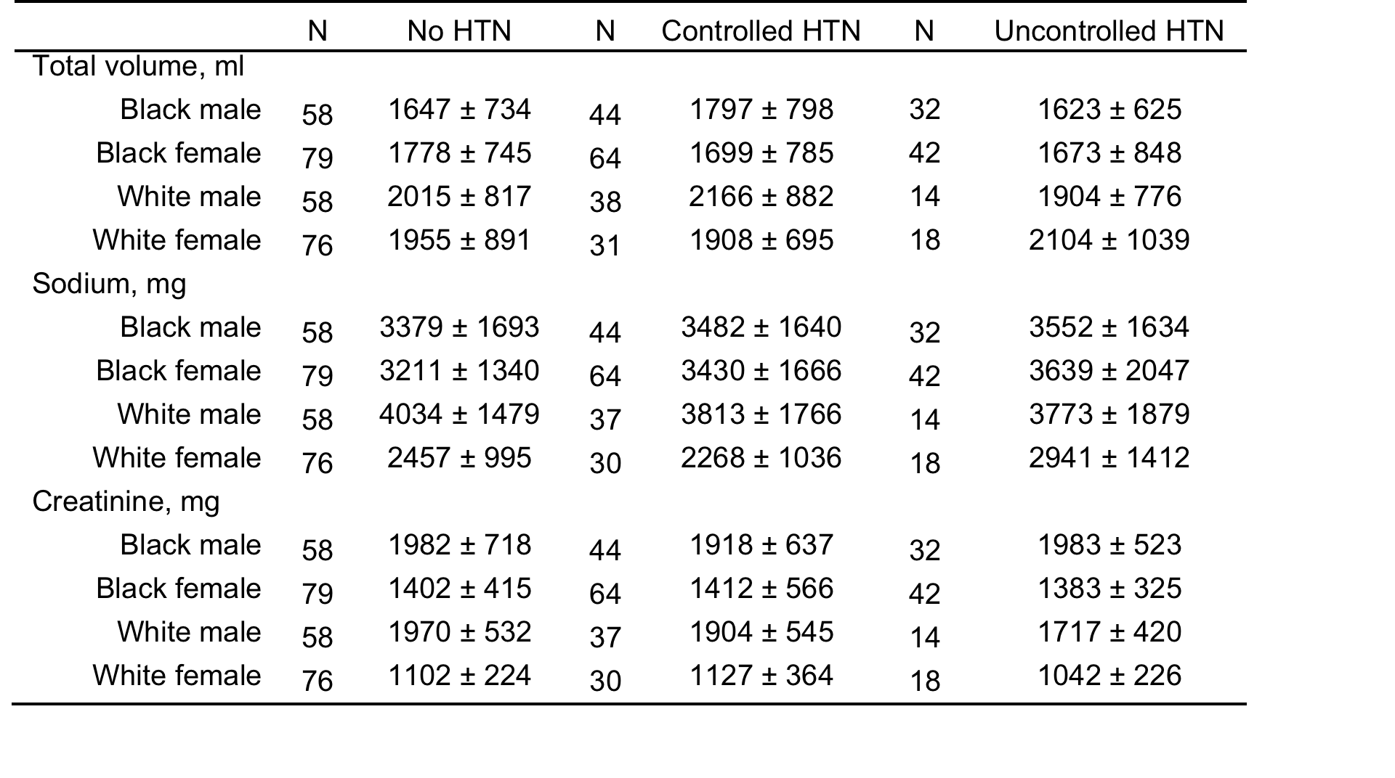
Distributions of total urine volume and 24-h excretion of sodium and creatinine in the day 1 collection by race and gender by hypertension status

Slide 38
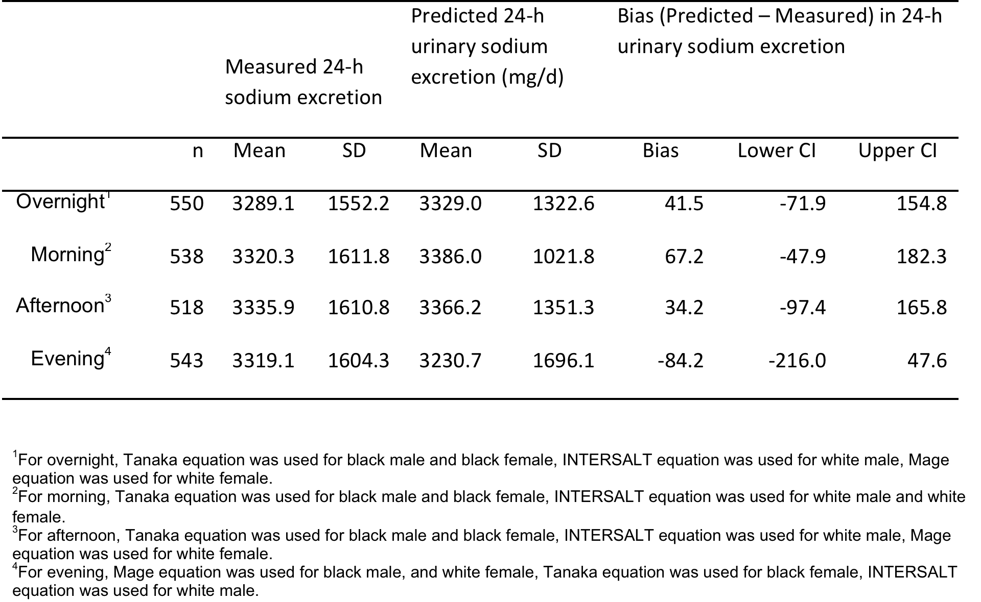
Predicted 24-h Sodium Excretion and Mean Bias Produced by using the Equation with the Least Bias for Each Gender-Race Group

