Slide 1
MESA Operations
Subcommittee Meeting

Slide 2
Operations Subcommittee Report
Follow-up calls
Participant Communications
Exam 6

Slide 3
Follow-up Call Retention
85%
Retention = Completed / (Enrolled – Dead)
Notes:
Done. Final FU13 retention is 84%, FU14 is 84%, FU15 is 77%

Slide 4
Follow-up Retention by Ethnicity
85%
Retention = Completed / (Enrolled – Dead) except FU 15 (windowed)
Notes:
done

Slide 5
Follow-up 14 Completion by Site
Site Name | Follow-up Due | Contacts Made |  | Interviews Completed |  | Not Completed | Contact not made
Wake Forest | 907 | 875 | 96% | 788 | 87% | 87 | 32
Columbia | 956 | 900 | 94% | 800 | 84% | 100 | 56
Hopkins | 938 | 793 | 85% | 747 | 80% | 46 | 145
Minnesota | 933 | 892 | 96% | 789 | 85% | 103 | 41
NWU | 1028 | 960 | 93% | 902 | 88% | 58 | 68
UCLA | 1153 | 1033 | 90% | 889 | 77% | 144 | 120
Total | 5915 | 5453 | 92% | 4915 | 83% | 538 | 462
Notes:
Done. % of FU complete does not include drop outs.

Slide 6
Follow-up 15 Completion by Site
Site Name | Follow-up Due | Contacts Made |  | Interviews Completed |  | Not Completed | Contact not made
Wake Forest | 620 | 443 | 71% | 411 | 66% | 32 | 177
Columbia | 643 | 602 | 94% | 565 | 88% | 37 | 41
Hopkins | 557 | 547 | 98% | 524 | 94% | 23 | 10
Minnesota | 637 | 604 | 95% | 562 | 88% | 42 | 33
NWU | 686 | 686 | 100% | 655 | 95% | 31 | 0
UCLA | 735 | 734 | 100% | 623 | 85% | 111 | 1
Total | 3878 | 3616 | 93% | 3340 | 86% | 276 | 262
Notes:
UPDATE. % of FU complete does not include drop outs.

Slide 7
Follow-up Retention by Site
85%
85%
Retention = Completed / (Enrolled – Dead) except FU 14 and 15 (windowed)
Notes:
Cut and paste

Slide 8
Follow-up 16 Completion by Site
Site Name | Follow-up 16 Due | Contacts Made |  | Interviews Completed |  | Not Completed | Contact not made
Wake Forest | 140 | 53 | 38% | 51 | 36% | 2 | 87
Columbia | 146 | 93 | 64% | 89 | 61% | 4 | 53
Hopkins | 134 | 127 | 95% | 123 | 92% | 4 | 7
Minnesota | 148 | 106 | 72% | 103 | 70% | 3 | 42
NWU | 155 | 152 | 98% | 145 | 94% | 7 | 3
UCLA | 177 | 164 | 93% | 147 | 83% | 17 | 13
Total | 900 | 695 | 77% | 658 | 73% | 37 | 205
Notes:
UPDATE. % of FU complete does not include drop outs.

Slide 9
Follow-up Retention
F/U 14 finished in October 2014
Included Medications Inventory and Residential History Review
F/U 15 will end in June 2015 (70% done)
No Medications Inventory or Residential History Review
FU 16 started October 2015 (16% done)
Includes Medications Inventory, new questions for gout, food security, e-cigarette use, blood thinner/anticoagulant use
Notes:
UPDATE

Slide 10
Contacts and Proxies
We have multiple “contacts” per participant currently
Proposal:
Ask participant to name a “proxy” who could provide health data for them
Contact the “proxy” to let them know about MESA, etc
Obtain a signed letter from the participant for future use

Slide 11
Newsletter
Will mail in early March
Next newsletter planned for June 2016
Notes:
done

Slide 12
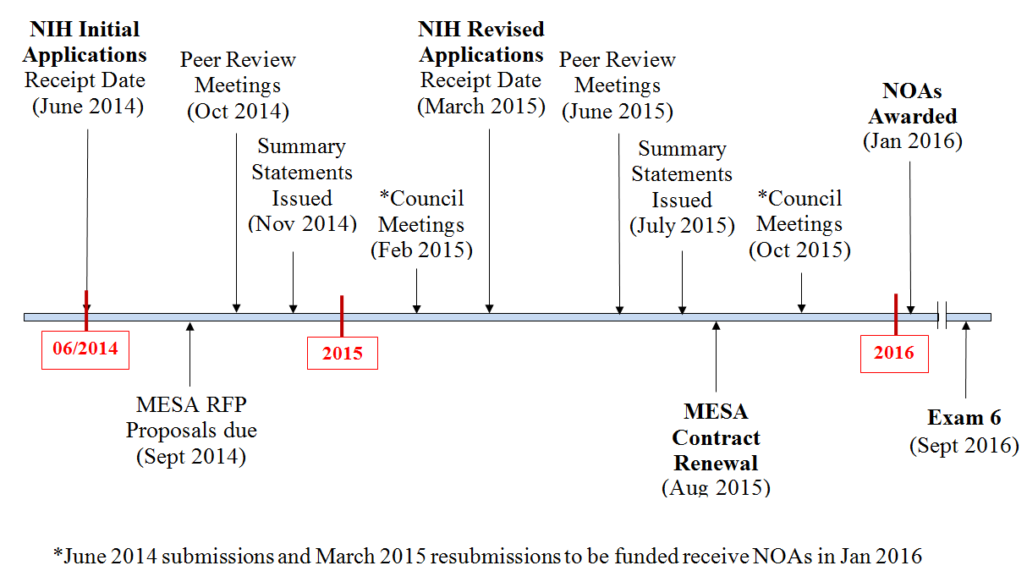
Exam 6 Timeline

Slide 13
Exam 6 Core Exam
#Participants | ~ 4000 PPTs.
Time Burden | Average duration: 125 minutes
Exam components | Consent/Check-in Seated blood pressure Anthropometry Phlebotomy Medical history Personal history/demographics Medication Inventory

Slide 14
Exam 6 Ancillary Studies (<13th %)
PI | Title
Bertoni, Alain | Transition from risk factors to early HF: prevalence, pathogenesis,and phenomics
Heckbert, Susan | Atrial fibrillation burden, vascular disease of the brain MRI in MESA
Barr, Graham | Pulmonary microvascular perfusion in the Multi-Ethnic Study of Atherosclerosis
Liu, Yongmei | Obesity-related epigenetic changes and type-2 diabetes

Slide 15
Exam 6 Ancillary Studies
Bertoni, Alain | Transition from risk factors to early HF: prevalence, pathogenesis,and phenomics
#Participants | All participants at Exam 6 (~4000) 300 for exercise testing at 1 site
Time Burden | 90 Minutes for all 2 hours for exercise testing subset
Exam components | Echocardiography, six minute walk test, physical activity questionnaire, heart failure symptoms survey Three sites: Arterial tonometry One site: CPET

Slide 16
Exam 6 Ancillary Studies
Heckbert, Susan | Atrial fibrillation burden, vascular disease of the brain MRI in MESA
#Participants | 1500 ppts at all sites (~250/site) 1/3 afib, 1/3 high risk, 1/3 controls
Time Burden | Exam 6: 50 minutes F/U Exam (1-2 years later): 65 minutes
Exam components | Exam 6: Cognitive function testing, application of ECG patch monitor, physical functioning questionnaire, 5 ml blood. (wear one ECG monitor for 14 days, return it, self-apply a second ECG monitor for 14 days). F/U Exam: Brain MRI and second physical functioning test on 1350 (of above 1500 ppts)

Slide 17
Exam 6 Ancillary Studies
Barr, Graham | Pulmonary microvascular perfusion in the Multi-Ethnic Study of Atherosclerosis
#Participants | 2000 participants selected from MESA Lung II
Time Burden | Consent, Spirometry, pulse oximetry, full lung CT scan +/- CTA (65 minutes)
Exam components | Dual source CTA for pulmonary perfusion (1000) or Full lung CT scan (1000) Spirometry, pulse oximetry, 250 uL blood, creatinine

Slide 18
Exam 6 Ancillary Studies
Liu, Yongmei | Obesity-related epigenetic changes and type-2 diabetes
#Participants | N=2800 participants with isolated monocytes from MESA Epigenomics ancillary study
Time Burden | 15 minutes
Exam 6 components | Blood and urine for eGFR, fasting glucose, lipids profiles, and albuminuria assessment.

Slide 19
Thank You!!!

