Slide 1
MESA Project Officer Report
Jean Olson, MD, MPH
MESA Project Officer
Lorraine Silsbee, MHS
MESA Deputy Project Officer
Prevention and Population Sciences Program
Division of Cardiovascular Sciences
National Heart, Lung, and Blood Institute
MESA Steering Committee
February 25, 2015

Slide 2
Topics
NIH/NHLBI Research Funding Update
Precision Medicine Initiative
Other NHLBI News
MESA Renewal Update

Slide 3
NIH Request for Information: Emeritus Award (NOT-OD-15-064)
Intended purpose of award: succession planning
  Transfer line of research to younger investigators in an efficient, cost-effective way
Comments are sought on
  Community interest
  Ideas for uses and characteristics
  Ways NIH could incentivize use
  Impediments to participation
  Other
Comments due by March 6
For more info, see Rock Talk blog of Feb 3 (http://nexus.od.nih.gov/all/2015/02/03/emeritus-rfi/)
http://grants.nih.gov/grants/guide/notice-files/NOT-OD-15-064.html

Slide 4
NIH Funding Opportunities
NHLBI FOA: Secondary Dataset Analyses in Heart, Lung, and Blood Diseases and Sleep Disorders (R21),
  PAR-13-009; Receipt date: Oct 21, 2015
  http://grants.nih.gov/grants/guide/pa-files/PAR-13-009.html
NIDDK FOA: Small Grants for New Investigators to Promote Diversity in Health-Related Research (R03)
  PAR-13-074; Receipt date: June 16, 2015
  http://grants.nih.gov/grants/guide/pa-files/PAR-13-074.html
NIA FOA: Secondary Analyses of Existing Data Sets and Stored Biospecimens to Address Clinical Aging Research Questions (R01)
  PA-13-168; Standard receipt dates; expires May 8, 2016
  http://grants.nih.gov/grants/guide/pa-files/PA-13-168.html

Slide 5
NIH Funding Opportunities (cont’d)
NIA FOA: Diabetes and Cardiovascular Disease in Older Adults (R01)
  PA-15-037; Standard receipt dates; expires January 8, 2018
  http://grants.nih.gov/grants/guide/pa-files/PA-15-037.html
NINR/NIA FOAs: Prevention Research in Mid-Life Adults (R21 and R01)
  R21: PA-15-097 http://grants.nih.gov/grants/guide/pa-files/PAR-15-097.html
  R01: PA-15-098 http://grants.nih.gov/grants/guide/pa-files/PA-15-098.html
  Standard receipt dates; expire May 8, 2018

Slide 6
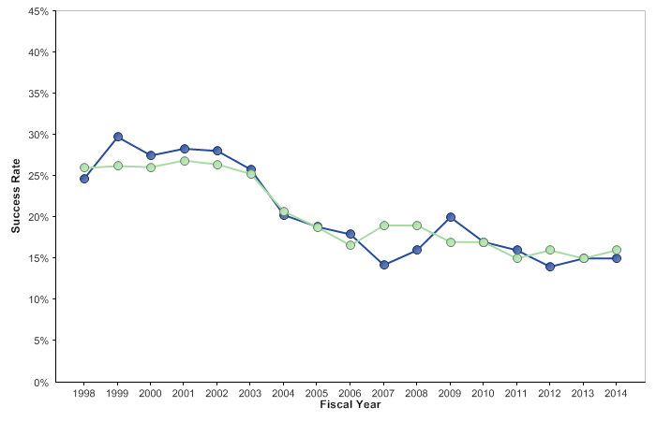
Success Rates of New (Type 1) Research Project Grant Applications
http://report.nih.gov/NIHDatabook/Charts/Default.aspx?showm=Y&chartId=157&catId=2
Notes:
6
Data and chart description for this slide can be located at http://report.nih.gov/NIHDatabook/Charts/Default.aspx?showm=Y&chartId=157&catId=2

Slide 7
Bending the Curve on New NHLBI R01 Awards
R01s Funded: 2008-2013
Number of R01 grants
Data from NIH Reporter: http://report.nih.gov/success_rates/Success_ByActivity.cfm
Slide courtesy of Gary Gibbons, presented to NHLBI Advisory Council 2/10/15
Notes:
Reference: NIH Reporter
Link: http://report.nih.gov/success_rates/Success_ByActivity.cfm
(Research Project Grants: Success Rates by type, activity, and IC) Only include New R01 Awards

Slide 8
Current NHLBI Funding Paylines FY 2015
Grant Program | Percentile | Priority Score | Description
R01 | 13 |  | Research Project Grant
ESI | 23* |  | Early Stage Investigators
AIDS | 23 |  | HIV/AIDS Grants
K awards |  | 30 | Career Dev’t Awards
T32/35 |  | 25 | Institutional NRSA Training
*Summary Statement issues must be satisfactorily resolved on applications >18th percentile.
http://www.nhlbi.nih.gov/research/funding/general/current-operating-guidelines

Slide 9
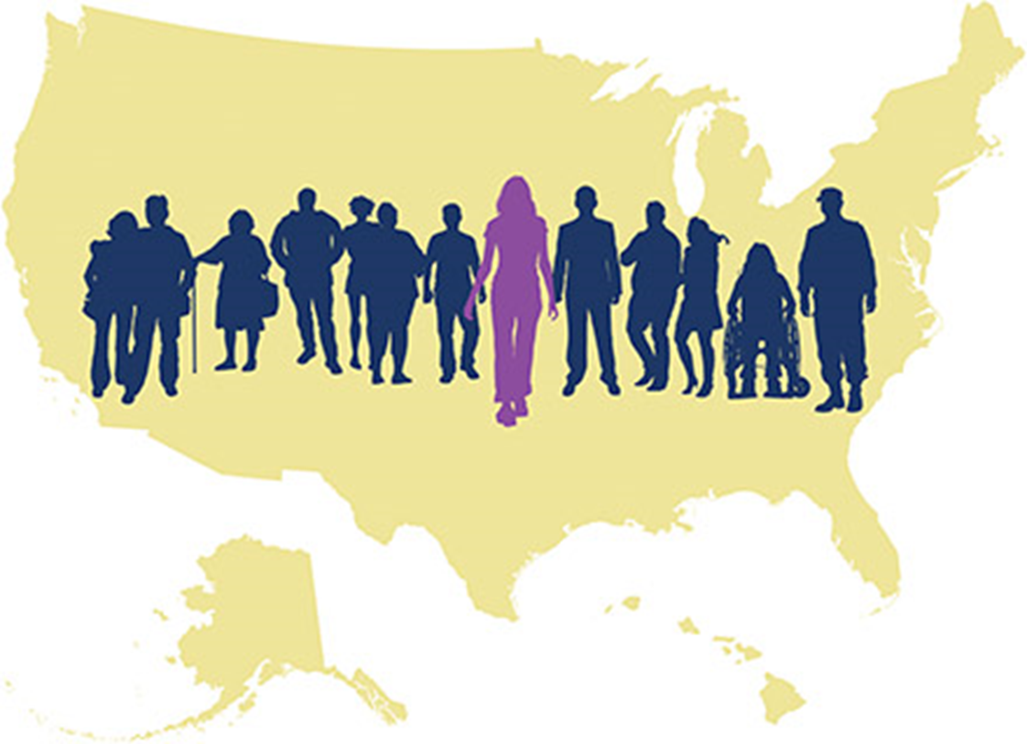

Precision Medicine Initiative
An “innovative approach to disease prevention and treatment that takes into account individual differences in people’s genes, environments, and lifestyles.”
- White House Fact Sheet 1/30/15
Proposed $215B in FY16
(NIH, FDA, ONCHIT)
Two major goals, focus on genomics
  Near-term: cancer prevention and treatment
  Long-term: expansion to all areas of health

Slide 10
Precision Medicine Long-Term Goal
Support a national network of researchers
Recruit national cohort of 1 million volunteers
  Genomic data and biospecimens
  Clinical data from EHRs
  Lifestyle data using mobile devices
NIH Workshop Feb. 11-12 topics
  Building a consortium of cohorts
  Participant engagement and privacy
  Data collection; mobile technologies
  Informatics and EHRs
  Data access and sharing
http://www.nih.gov/precisionmedicine/workshop.htm

Slide 11
NHLBI Trans-Omics for Precision Medicine
Goals
  Evaluate use of systems medicine approaches for large scale biological discovery
  Provide a resource to the scientific community (“data commons”)
First Step: WGS program
  Jump-started in late FY14
  Data set to include ~20K participants from nine NHLBI studies
  Clinical phenotypes and other –omics data to be added
  May expand to other cohorts in the future

Slide 12
NHLBI Advisory Council/BEE Epidemiology Working Group
Charge: to make recommendations to NHLBI on taking advantage of new scientific opportunities and delineating future directions for epidemiology and population sciences research in HLBS diseases
Draft recommendations on line
  https://nhlbiepi.files.wordpress.com/2014/10/council-bee-epi-wg-presentation10-22-14-_pptx.pdf
Final report accepted for publication by AJE
NHLBI Institute-wide committee assembled to consider strategies for implementation

Slide 13
NHLBI Strategic Visioning Process
Aim: help guide NHLBI’s future research directions over next 5-10 years
  Compelling questions and critical challenges to be identified in multi-stage process
  NIH staff have submitted hundreds of questions and challenges
  Public online crowdsourcing platform to be unveiled in Spring 2015

Slide 14
MESA Contract Renewal
Five-year duration
  Anticipated start 8/15/2015
  Anticipated end 8/14/2020
Single contract
Exam-related tasks, if done, span 28 months
  Exam preparation 1/01/16 - 8/31/16
  Exam and closeout 9/01/16-4/30/18

Slide 15
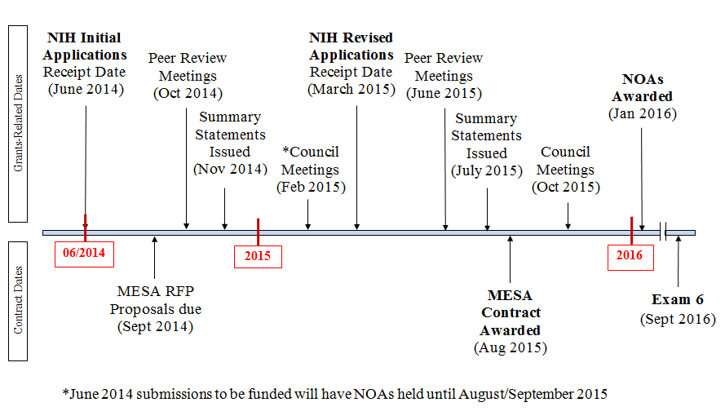
Renewal Timeline for MESA Grants and Contracts

Slide 16

MESA Publications
Number
of
manuscripts
published or
in press
(n=814)*
* From the MESA public website, accessed 2/22/2015

Slide 18









Genomics & Medicine Workshop 2014:
Emerging Ideas
Integration of data types for open access DATA COMMONS
  Integrate phenotype & Omics data
Need for greater diversity in study populations
Whole Genome Sequencing as the next stage
  Pilot data management
  Matrix strategy with Whole Exome; Chips
Investment in ‘layers’ of “omic” measures in well phenotyped and genotyped populations (epigenome; RNA)
Need to facilitate studies of common and rare variants to show function/causality
Notes:
Think about how to capture visially

Slide 19
NHLBI WGS and Data Commons
NHLBI Precision Medicine
Data Commons
Clinical Phenotype
Genomics
Transcriptome
Proteome
Microbiome
Jump start with previous down payment
Start-up Seed Estimate in FY14 ~ $57M
Launched WGS program and developing Data Commons

Slide 20








NHLBI Data Commons for Precision Medicine:
Toward an NHLBI Synthetic Meta-Cohort
Meta-Cohort
NHLBI Core Cohorts
CVD in Family Cohorts:
Mexican American
Old Order Amish
Diverse HLBS
Clinical Cohorts:
Asthma and COPD

